Slide 1

10519 Pilot Program for the promotion of Biomedical Engineering (CE) in public health services in the State of Sonora
Elliot Vernet
Regional Council of Biomedical Engineering for Latin America –SOMIB/310MED

Slide 2
The Team / Workgroup
Mariana Tarín León, Sociedad Mexicana de Ingeniería Biomédica
Fátima Carolina Solís Nájera, Instituto Tecnológico de Hermosillo
Raúl Armando Andrade Arvizu, Sociedad Mexicana de Ingeniería Biomédica
Elliot Alejandro Vernet Saavedra, 310MED/SOMIB

Slide 3
Background
In the State of Sonora there are three univeristies that offer a degree in Biomedical Engineering with an avergage admission of 260 students per year. [1]
On the other hand, the public health services in the State of Sonora are divided into five Jurisdictions whose purpose is to plan, coordinate, supervise and evaluate the provision of medical care services to the population (2.5 m) of responsibility and public health to the entire State population. [2] The project was delimited by selecting only one Jurisdiction on the city of Hermosillo.

Slide 4
Justification
This work is motivated in order to be a promoter with the state government authorities so that graduates of biomedical engineering from the state of Sonora might join to the public health services.
The purpuse oh this work is to exhib to the personnel the role played by a biomedical engineer in the clinical-hospital environment, showing the importance of the management of medical technology, its impact on the quality of health care.

Slide 5
Description
Before defining the strategy for the promotion of Biomedical Engineering in the Public Institution, a survey was carried out and applied to the chiefs administative departments , as well as other personnel involved with medical technology, (administrative, medical, nurse and paramedical positions).
The data obtained through the survey gave a general overview of the knowledge that the staff of the institution has regarding about Biomedical Engineering issues, this results defined a first topics for lectures or training.
TOPICS
1. Electrical Safety
2. Metrology
3. Technovigilance
4. Clinical engineering and its importance within the hospital environment
5. Functional Inventory
6. The importance of preventive maintenance
7. Use, handling, preservation of Vital Signs Monitor
8. Use, preservation management of dental unit

Slide 6
Description
After defined the topics, it was develovep a scheduled of talks (program) to the personnel assigned to the public institution considering only administrative, medical and paramedical positions.
The SOMIB Sonora Professional Chapter and 310MED company personnel participated in this work, They were developers of the topics and the oral presentations.

Slide 7
Goals of the project and final users that will benefit
In order to spread the activities of Biomedical Engineering, a series of lectures was carried out for health personnel from Health Jurisdiction No.1.
The lectures were given by professionals belonging to the Mexican Society of Biomedical Engineering (SOMIB).
The development of this work is motivated in order to be a promoter with state government authorities so that the graduates of the career Biomedical Engineering in the state of Sonora can be incorporated into public health services.

Slide 8
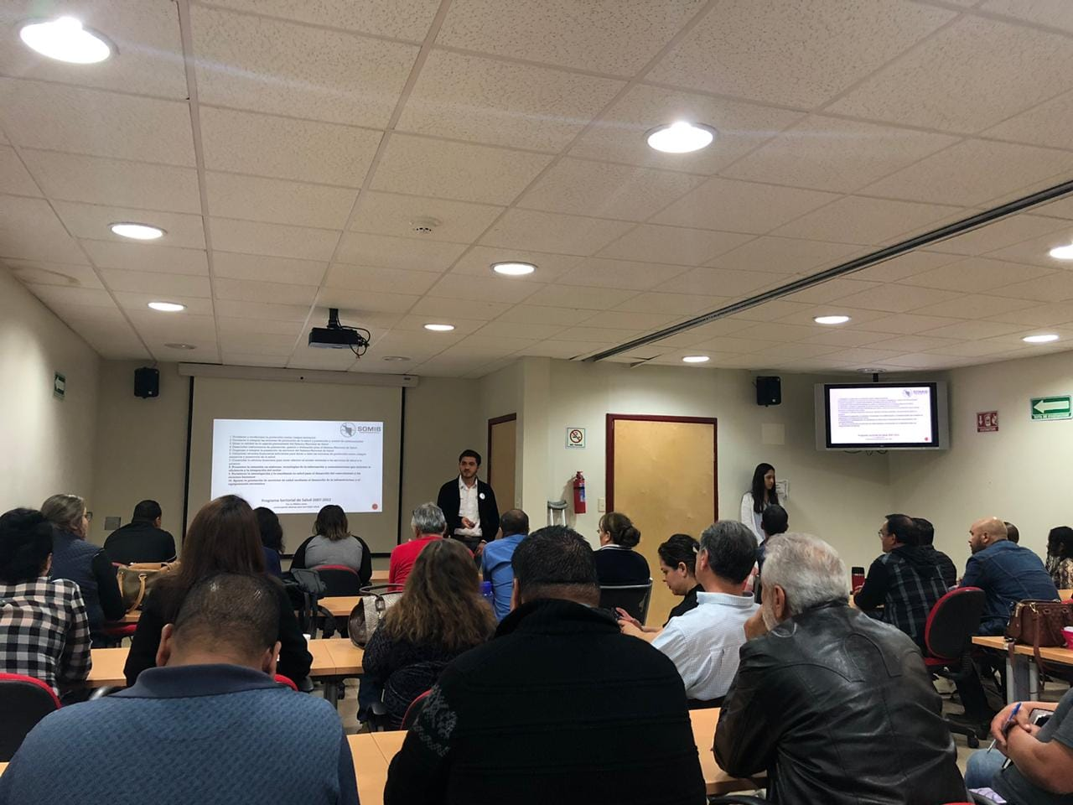
Results
Eight lectures on biomedical engineering were designed for decision makers and medical staff (doctors, nurses and administrative staff).
Five talks were given with an average attendance of 40 people.
The importance of the role of the clinical Biomedical Engineer in the hospital environment is recognized with the incorporation of two students practicing Biomedical Engineers.
Future perspective: Consolidate a program to promote Biomedical (clinical) Engineering in health services that can be replicated in other health care centers at the state or national level.
Elliot Vernet
vernetelliot@gmail.com

