Slide 1
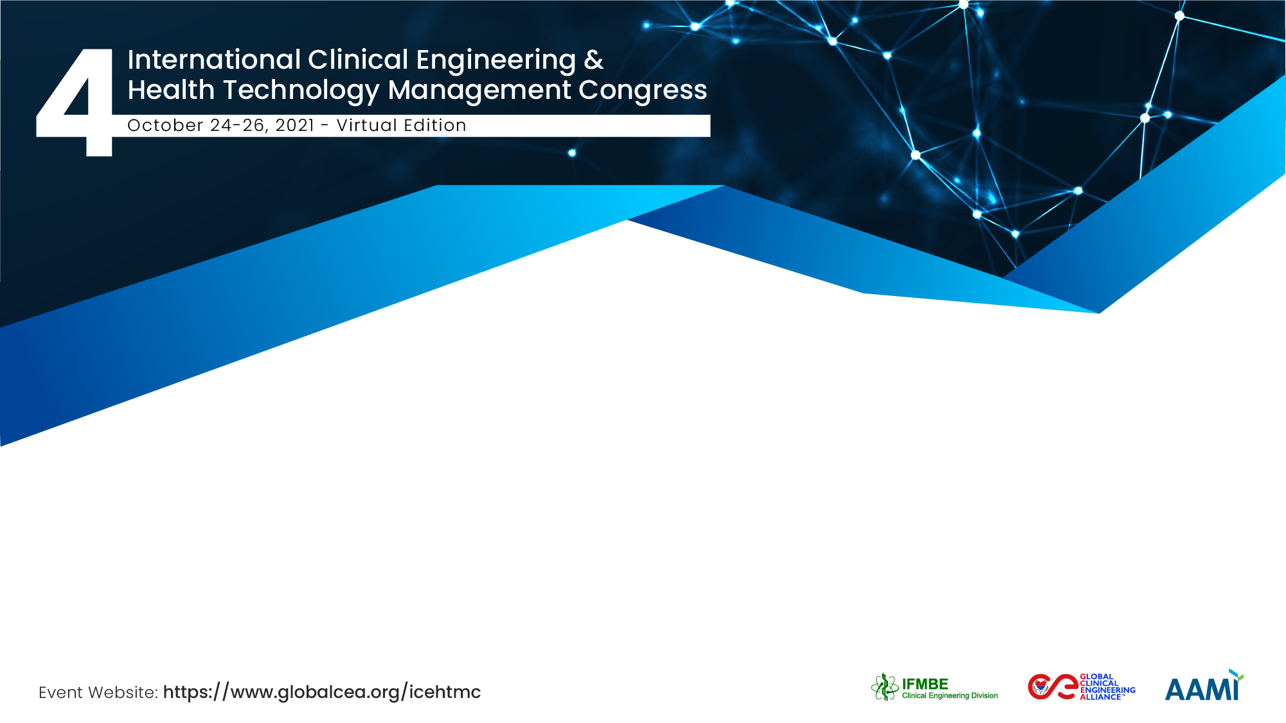
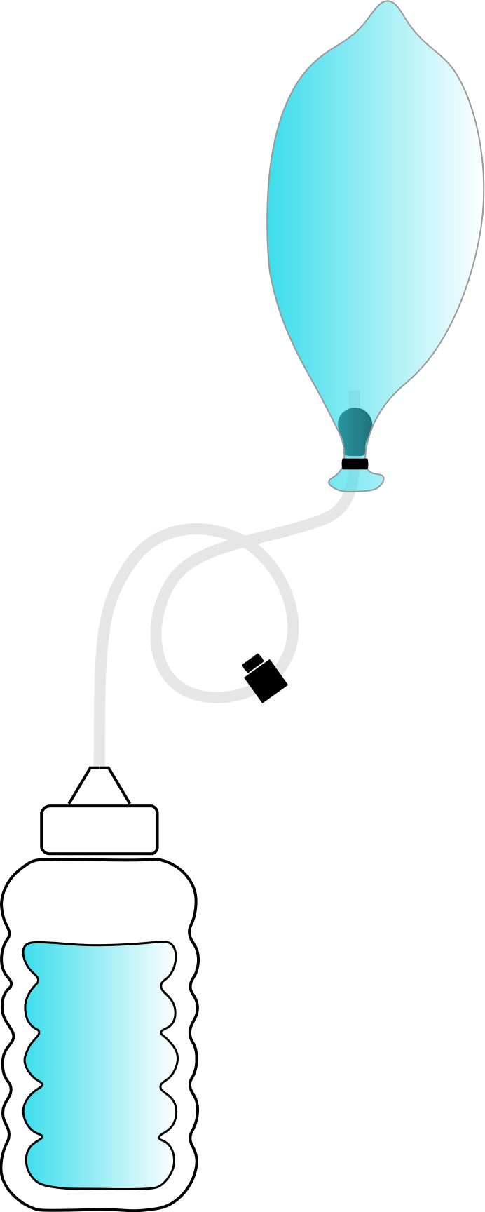


A 3D-printed condom intrauterine balloon tamponade for low-resource settings
Davide Piaggio (Research Assistant, PhD student)
Prof Leandro Pecchia
Applied Biomedical Signal Processing Intelligent eHealth Lab, University of Warwick, UK

Slide 2











The Team / Workgroup
Davide Piaggio (Research Assistant, PhD student)
Alessia Maccaro
[Bioethicist] (Research Fellow)
Prof Daton Medenou
Dr Roland C. Houessouvo
Coventry
University Abomay-Calavi, Benin
Scott Hyland
[mechanical eng] (MSc)
Katy Stokes
[Biologist]
(PhD student)
Abomey-Calavi
Prof Leandro Pecchia

Slide 3

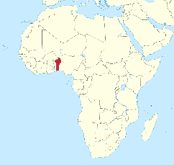


Description
5 field studies in Sub-Saharan Africa in 18 months fed a SWOT (Strengths, Weaknesses, Opportunities and Threats) analysis, which informed the definition of a framework for the contextualized & user-driven design of medical devices for LMICs
This SWOT informed the contextual design of the 3D-printed intrauterine balloon tamponade, aiming to be a first-line treatment of postpartum haemorrhage (PPH) in low-resource settings (LRS).
Strengths
Diffusion of condoms
Easy-learners
Centralised leadership
Resilient workers
Peaceful and growing country
Weaknesses
Limited-resource country
Lack of specialised personnel
Poor supply chain
Poor infrastructures
Gender biases
Uneven distribution of resources
Leverage on circular economy (using 3D printers and protocyclers) and capacity building;
Recycling old parts of the same device;
Local manufacturing
Use of water bottles;
Use of condoms;
Affordable (free) design/deployment
Target (potential) lay-users
Easy deployment
No maintenance
Opportunities
Flexible workers
Little/No-inertia to changes
Threats
Shortcuts become chronic solutions
Empowered operators will never be medical doctors

Slide 4









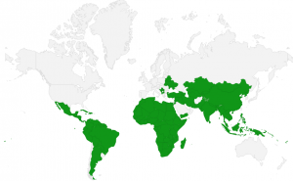
Goals of the project and final users that will benefit
One of the 17 Goals is:
«...ensuring Good Health & Wellbeing (3)»
  In particular, Goal 3 target number 1 aims to: «reduce the global maternal mortality ratio to less than 70 per 100,000 live births by 2030»
25% of maternal mortalities worldwide are due to PPH
The Goals of this projects were:
Design and prototype a 3D-printed condom-based intrauterine balloon tamponade, based on circular economy principles, for empowering lay-users in treating PPH
Preclinically validate device measuring the water leak and the pressure drop over time in two conditions (i.e., open air and in a 3D-printed uterus model)
Run clinical trials
Chance of death during childbirth and pregnancy in LRSs
A device for LRS
Final Users: given the scarcity of specialised doctors and of devices (and spare parts) for this health condition, there is a clear need for a simple but effective device to treat PPH
PPH:
>500 mL blood loss
Chance of death during childbirth and pregnacy in higher resource settings

Slide 5
Methods – Design and prototyping
Material - PLA
Layer height - 0.16 mm
Infill - 15%
Nozzle temperature - 200°C
Bed temperature - 40°C
For threaded valves:
M11x0.75 (finer),
M11x1.5 (coarser)
The device was designed using Autodesk Fusion 360, sliced on Cura, and printed on a Creality Ender 3 3D printer

Slide 6
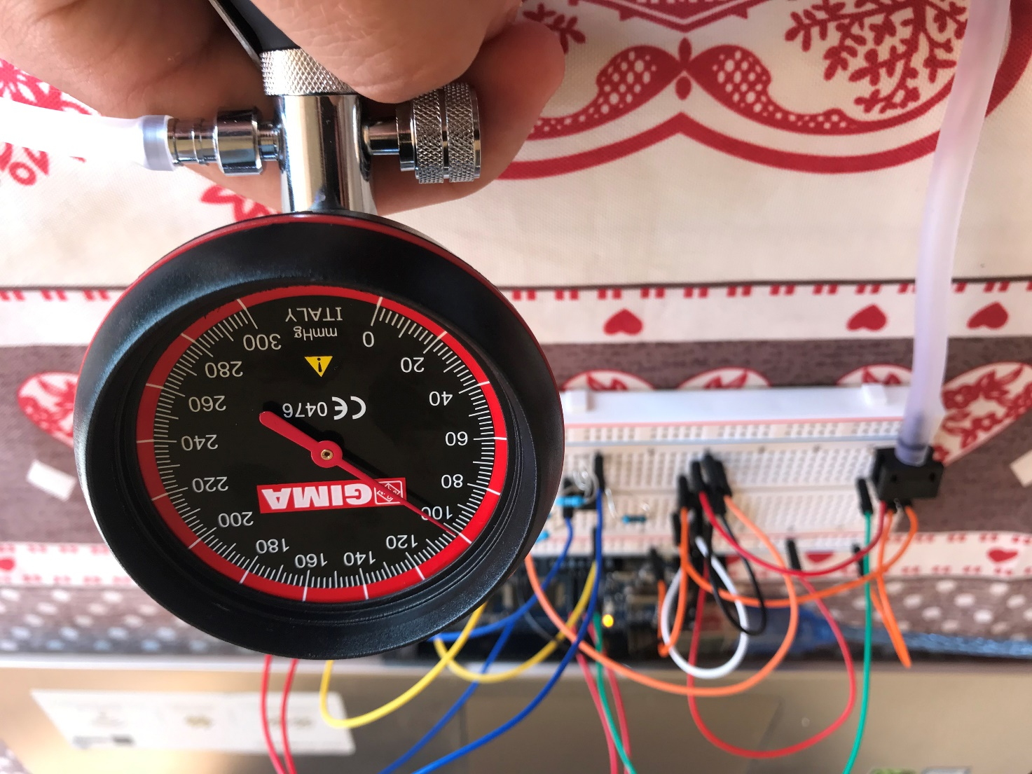
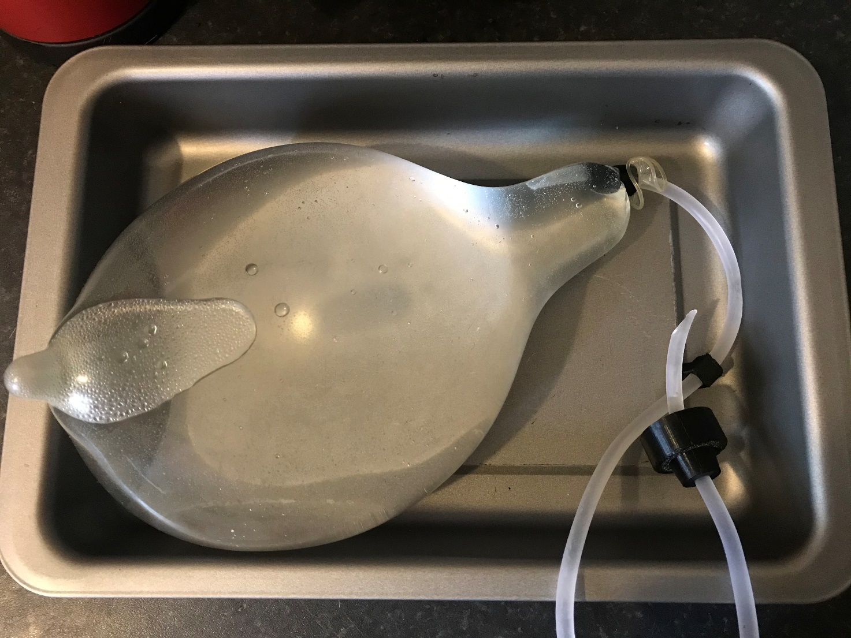
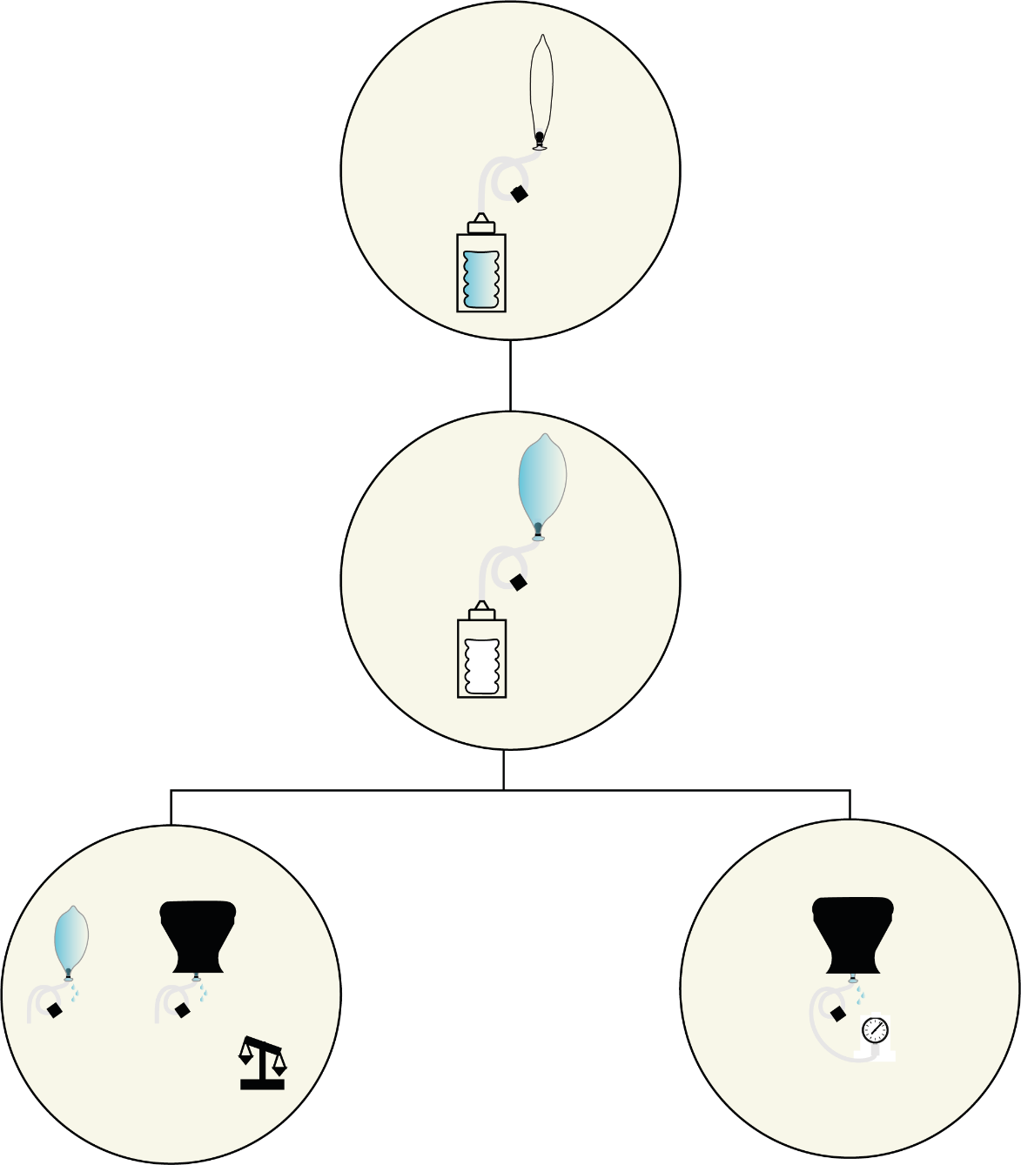
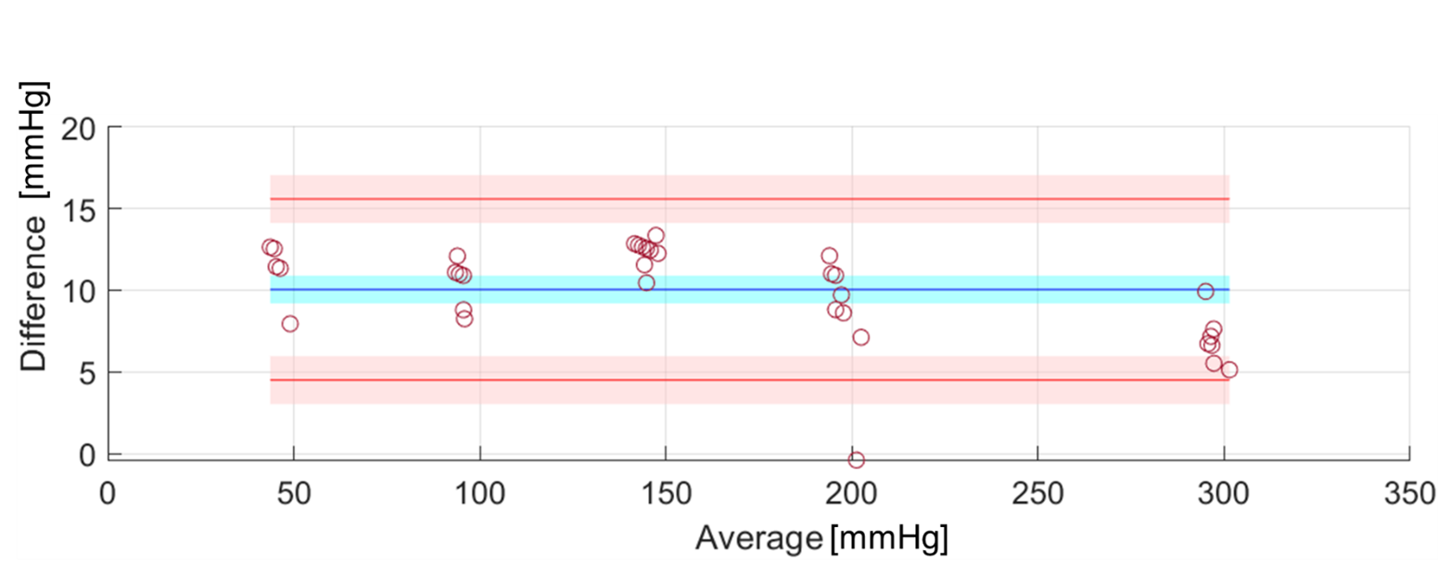
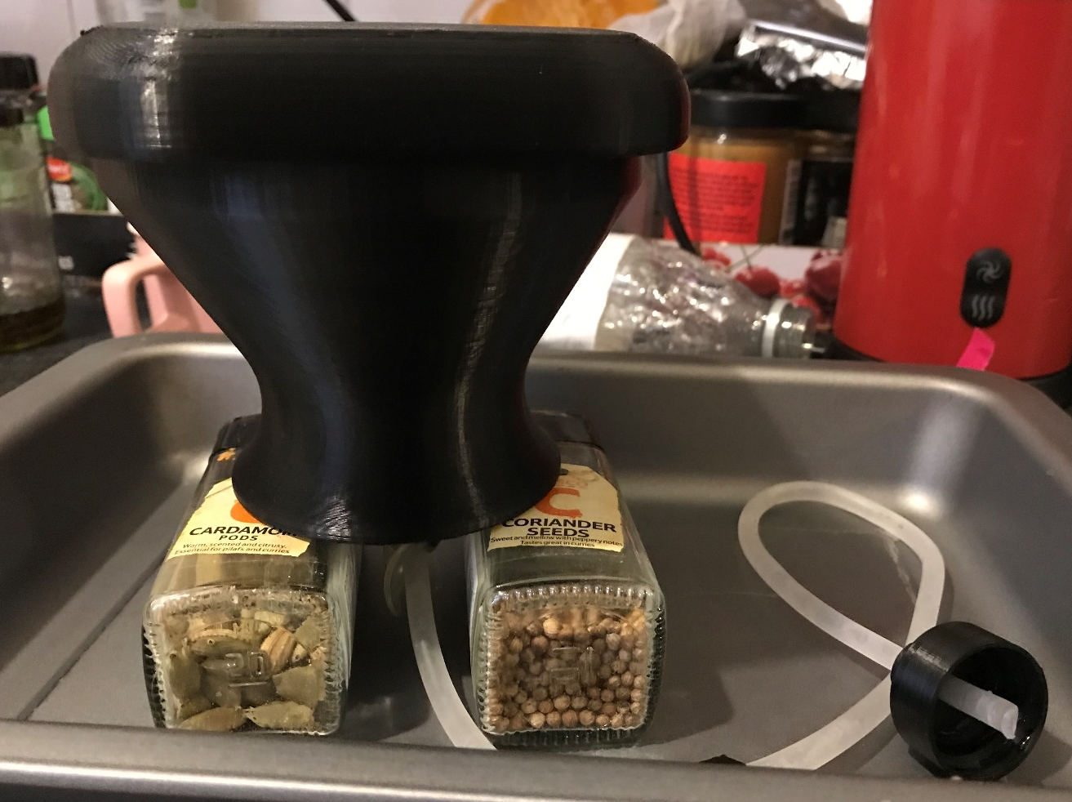
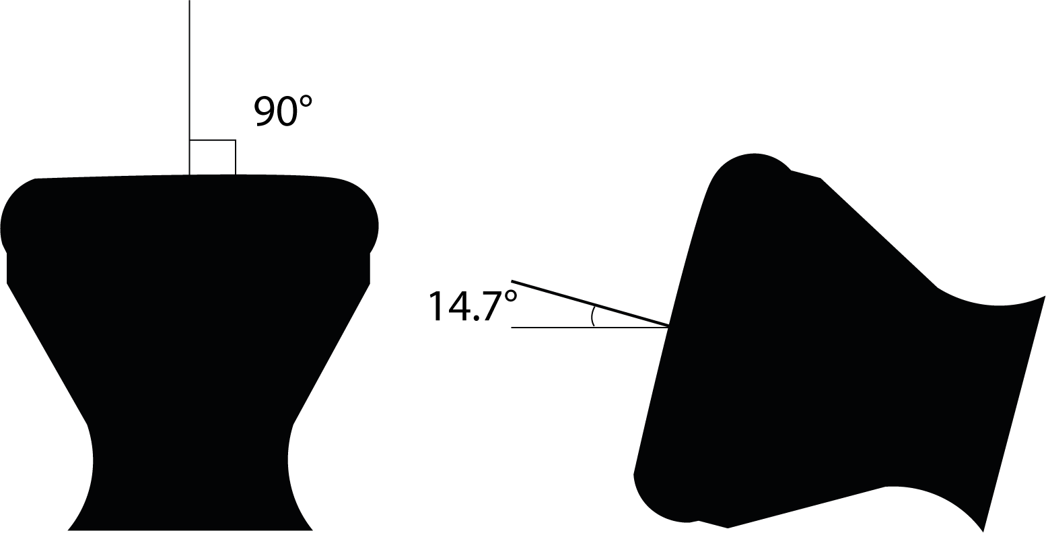
Methods – Validation and testing
The device was validated measuring the volume of leaked water and of lost pressure over time, in two conditions (i.e., open air and in a 3D-printed uterus model***). For measuring the loss of pressure an ad-hoc circuit was created on Arduino, using a pressure sensor (a manometer was used as a benchmark).
*** Uterus model adapted from: Mollazadeh-Moghaddam K, Dundek M, Bellare A, Borovac-Pinheiro A, Won A, Burke TF. Mechanical Properties of the Every Second Matters for Mothers-Uterine Balloon Tamponade (ESM-UBT) Device: In Vitro Tests. AJP reports. 2019 Oct;9(4):e376.

Slide 7

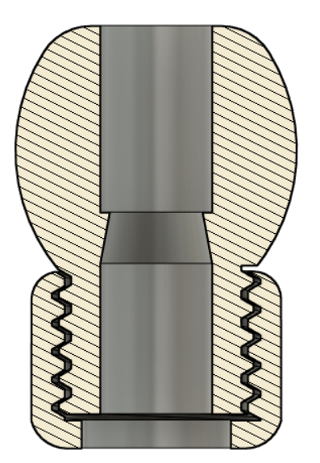
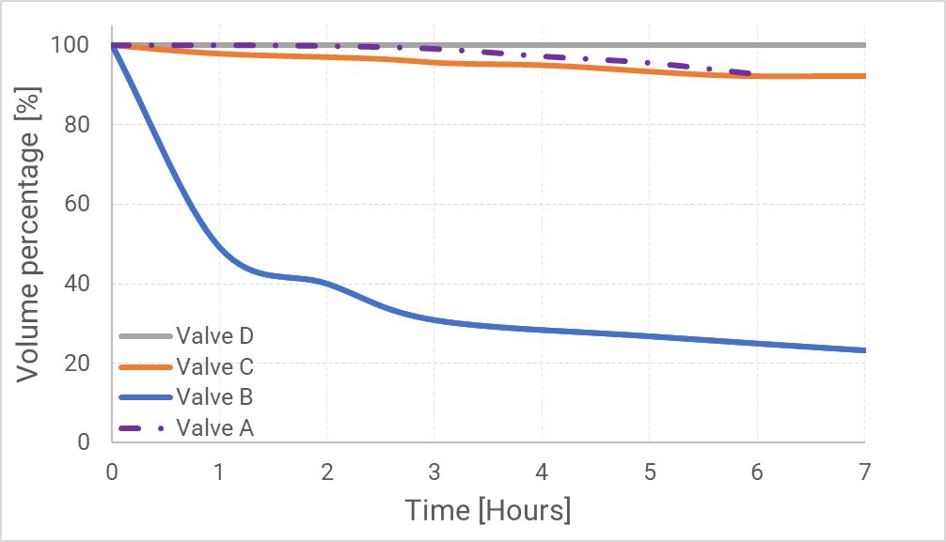
Results
Valve performance comparison
D
Variable | Open Air | In Uterus model***
Average Water Leak (mL/h) | 0 | 2.47
Total Water leak (mL)* | 0 | 14
Average Pressure loss (mmHg/h) | ---- | 0.93
Total Pressure loss (mmHg)** | ---- | 2.75
*over 5+ hours
** over 3 hours

Slide 8

Leandro Pecchia
l.pecchia@warwick.ac.uk, davide.piaggio@warwick.ac.uk
Applied Biomedical Signal Processing Intelligent eHealth Lab, University of Warwick, UK
Piaggio D., Hyland S., Stokes K., Orfeo A., Maccaro A., Pecchia L. A 3D-printed condom intrauterine balloon tamponade (currently submitted).

