Slide 1

Affordable and open-source emergency ventilator for COVID-19 patient and ambulances settings
Joseph Habiyaremye
IPRC Kigali/Rwanda Polytechnic

Slide 2
The Team / Workgroup
Eng.Costica Uwitonze: Biomedical Engineer
Eng.Jean Claude Udahemuka : Biomedical/Electrical Engineer
Prof.Stefen Rulisa: Reproductive and maternal health
Prof.Paulin Banguti: Cardiac anesthesiologist

Slide 3
Description
This presentation provides details about the design and development of an affordable and open-source mechanical ventilator that can be used for COVID-19 patients. Apart from this, this ventilator has been designed to fit in an ambulance. The design and the development of this machine have been motivated by the outbreak of the novel COVID-19 by the end of the year 2019 which made the shortage of ventilators even in developed countries. The development of these affordable machines points to attenuate the impact caused by this shortage especially in Rwanda and other developing countries. The method which was used is to electronically drive an Ambu bag so that the user can set and maintain some clinical parameters such as the tidal volume, breath rate, and inspiration, and expiration rate. The user will also be able to monitor the pressure in the patient’s pulmonary channels. The developed machine can be either supplied directly from 220V /50Hz Ac source, by a power adaptor, or by DC power jack from the ambulance and this machine has an in-built battery which can go up to 7 hours and 20 min.

Slide 4
Goals of the project and final users that will benefit
The goal of the project is to design and develop an open-source ventilator that can fit into an ambulance so that it can be used for ventilating a patient during the time when an ambulance takes him/her from a remote location especially in developing countries. Apart from that, the device can be used for covid patients.

Slide 5
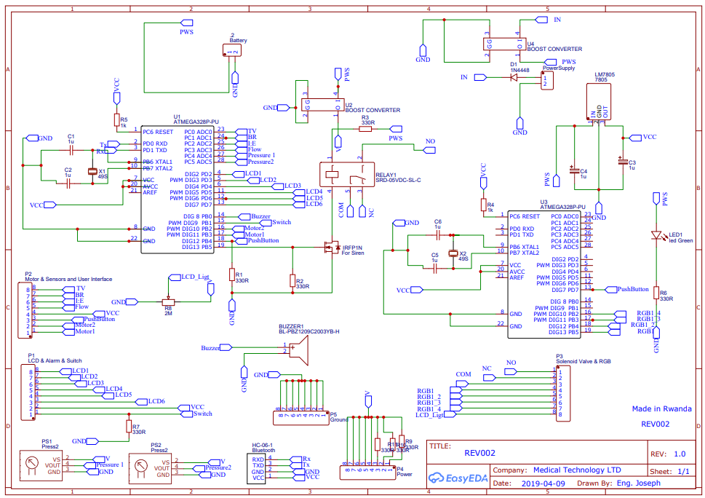
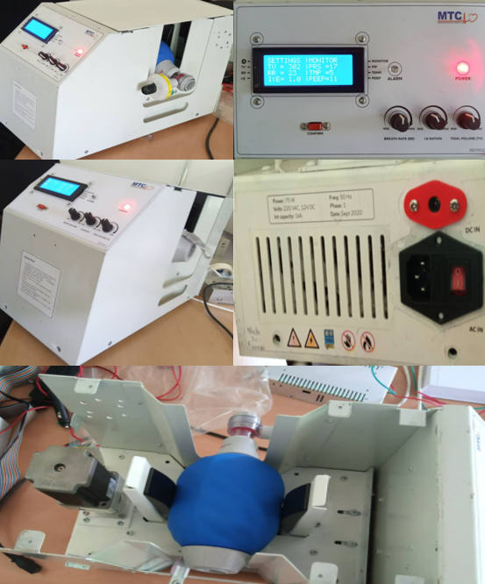
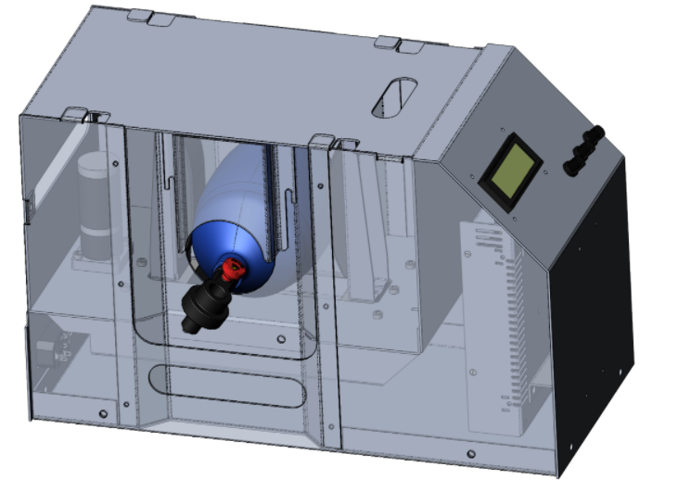
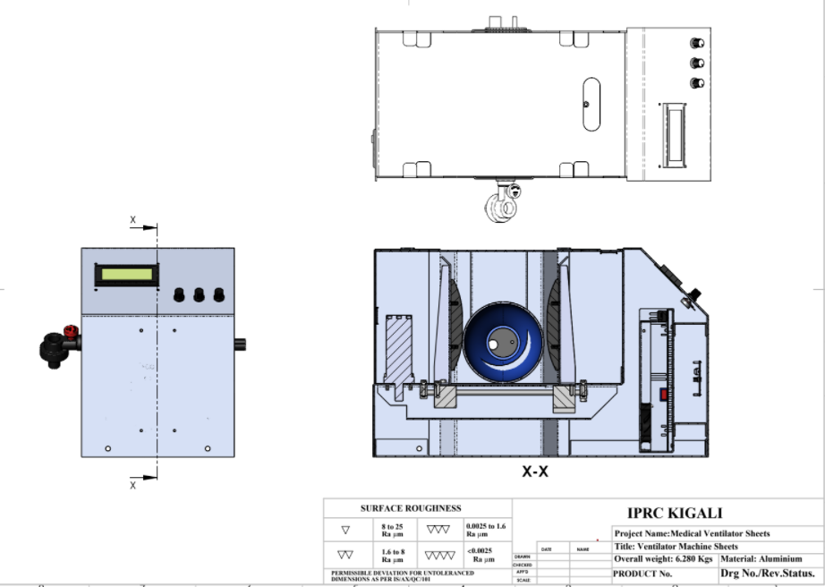
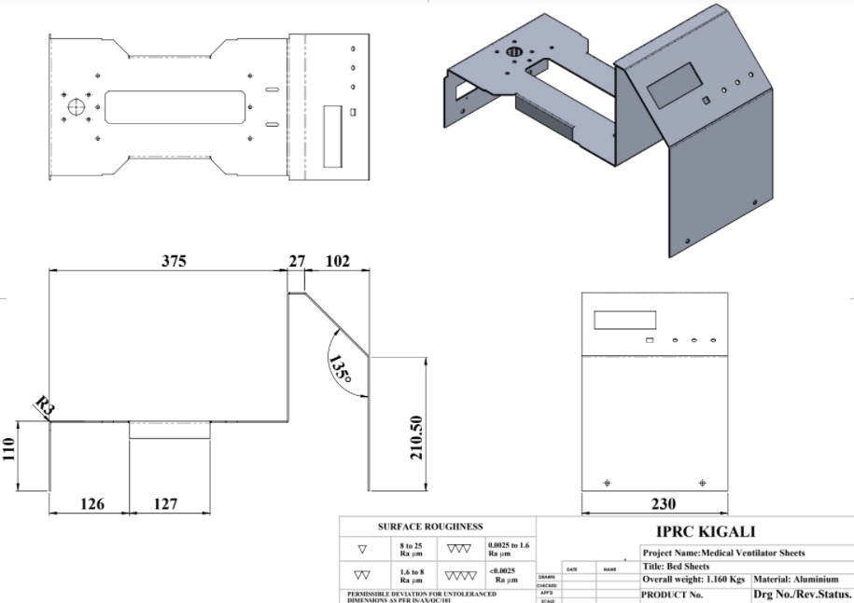
Results
The design resulted in an emergency ventilator with the following specification:
Tidal volumen: 100-700Ml
BR: 20-40BPM
I/E: 1-3
Power backup: 7hours and 20 mins
Power supply : AC/DC [220/50-60Hz~/12V--]
Weight: 11Kgs

Slide 6
Joseph Habiyaremye
josephu2020@ieee.org
IPRC_Kigali_Rwanda Polytechnic, Rwanda

