Slide 1
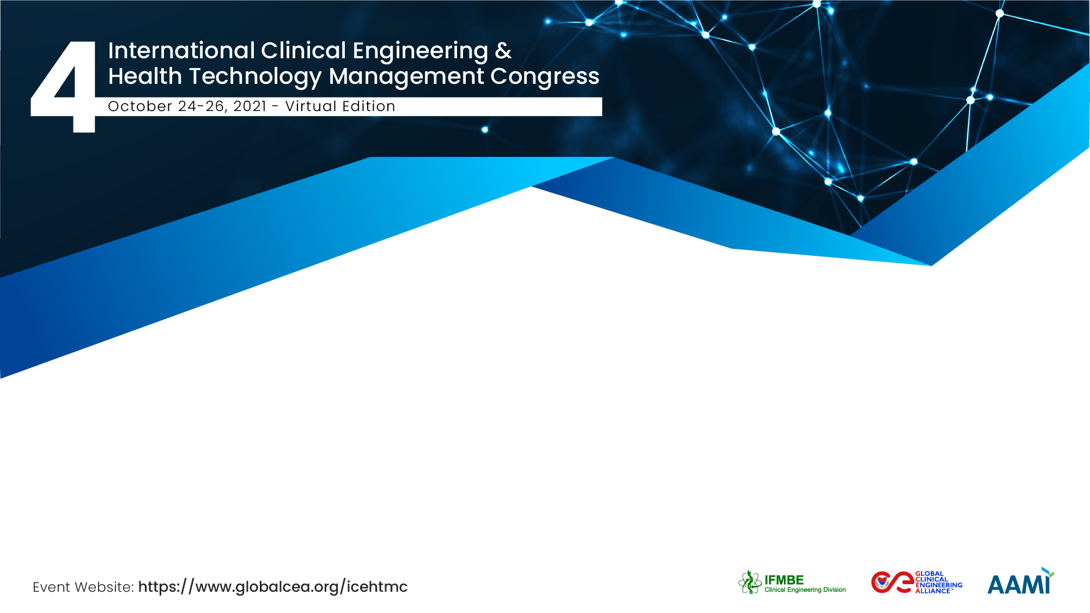
Alarm management with Physiologic Monitor in Medical Intensive Care Unit
Yi-Chieh Lin
China Medical University Hospital, Taiwan

Slide 2

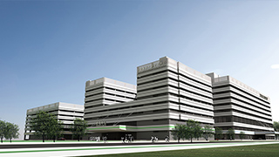
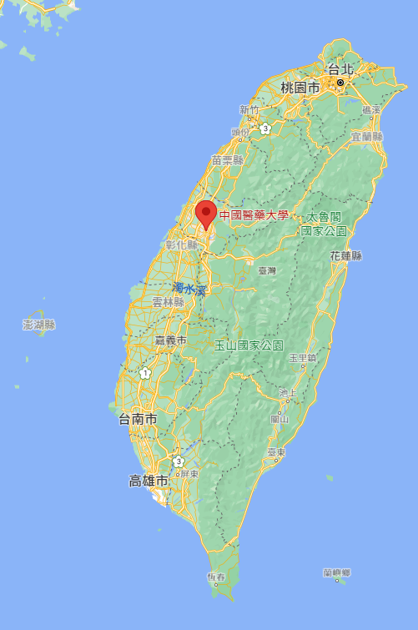

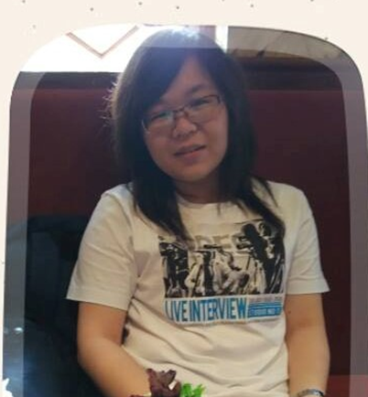
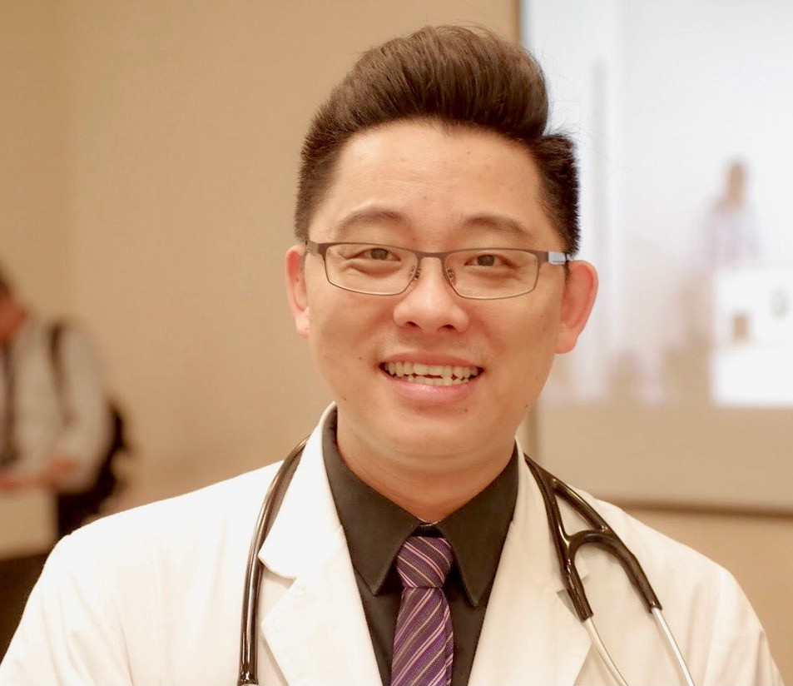
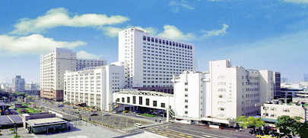
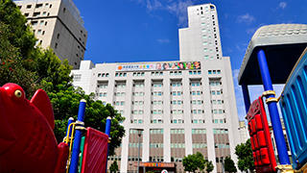
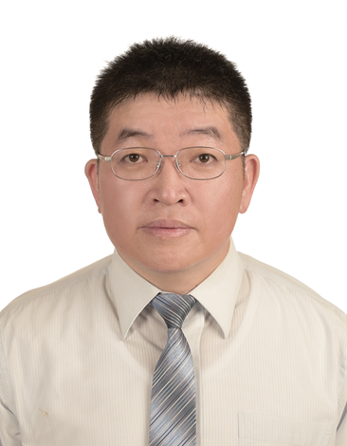
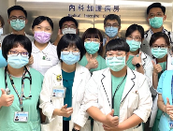
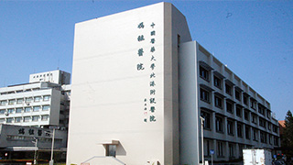
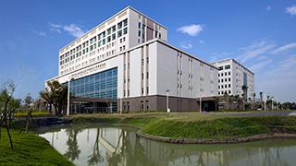
The Team / Workgroup
CMUHH(Hsinchu)
CMUH(Taichung)
Wei-Cheng Chen
Director of Respiratory Intensive Care Unit , CMUH
Yi-Chieh Lin
Clinical engineer ,CMUH
CMUCH (Taichung)
China Medical University Hospital(CMUH) since 1980.
There are 2,200 beds.
6000 employees
(884 Physician &2,615Nurses)
CMUBH(Yunlin)
Hsin-Tai Chen
Director of Medical engineering Office,CMUH
MICU team
ANH(Tainan)

Slide 3
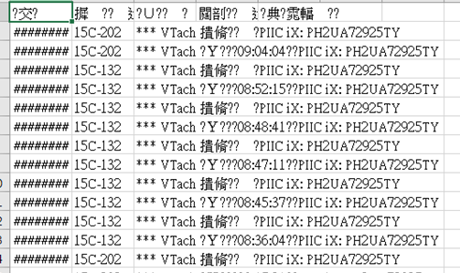
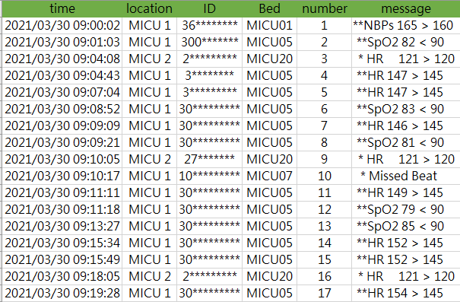
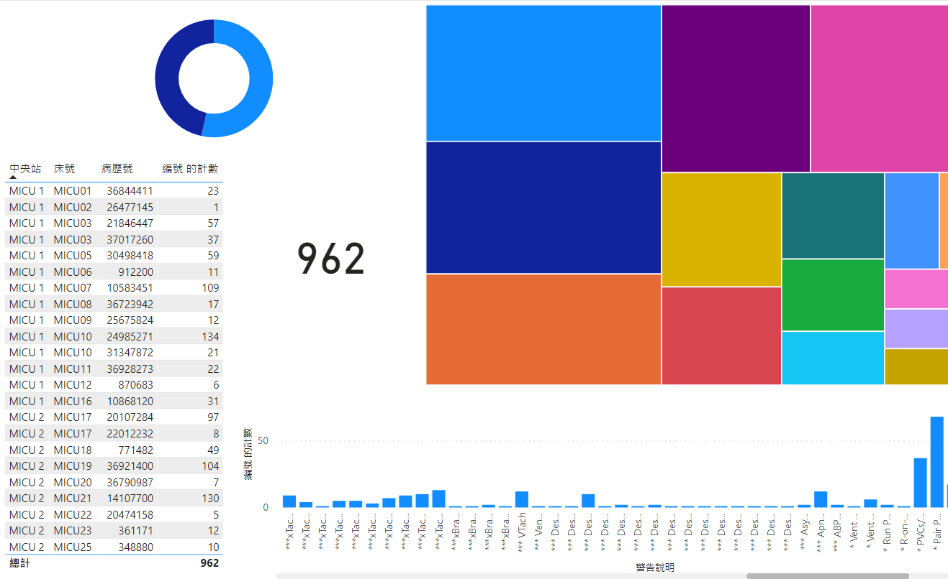
Description
Clinical engineer collects data & analysis
1. Export raw data
2. data partitioning
3. parameter selection
4. Make a dashboard
１
２
３
４

Slide 4
Clinician analysis data & treatment plan
58(19.5%)
102(34.2%)
18(0.9%)
57(54.8%)
Antibiotics and arrhythmia medications

Slide 5
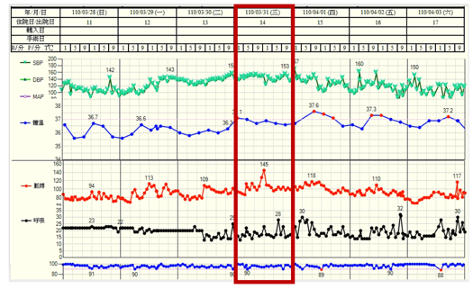
Results
Detected undetected condition on the general vital signs.
missing beat
79(32.5%)
88(40.9%)
Tachycardia

Slide 6



The Boy who Cried Wolf
False alarm
Alarm fatigue
Team

Slide 7
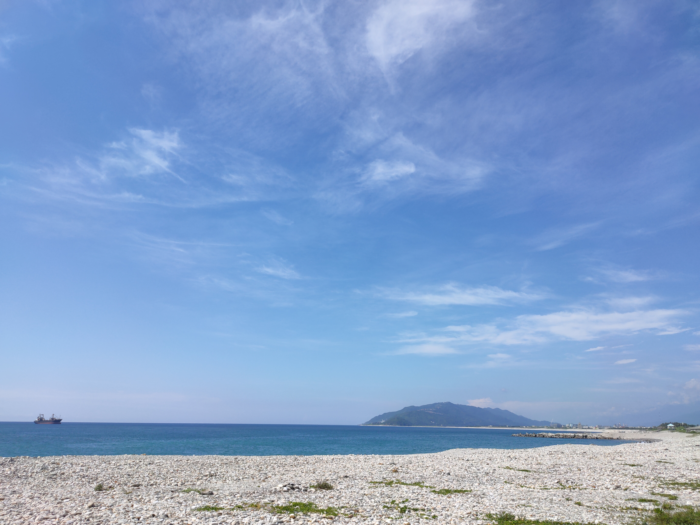

Yi-Chieh Lin
Thank you for listening.
A34029@mail.cmuh.org.tw
ej9917@gmail.com
China Medical University Hospital, Taiwan

