Slide 1

Application of ROC curve in timing evaluation of preventive maintenance of medical equipment
lin Zhongkuan., Zheng Kun., Shen Yunming., Zhang Mangmang
Tthe Children’s Hospital, Zhejiang University School of Medicine, National Clinical Research Center for Child Health, China

Slide 2
The Team / Workgroup
Author: SHEN Yunming, Master
Institute: Children’s Hospital of Zhejiang University School of Medicine
Street: No.3333 Binsheng Road
City: Hangzhou
Country: China
Author: Zhang Mangmang Master
Institute: Children’s Hospital of Zhejiang University School of Medicine
Street: No.3333 Binsheng Road
City: Hangzhou
Country: China
Author: Lin Zhongkuan, Master,
Institute: Children’s Hospital of Zhejiang University School of Medicine
Street: No.3333 Binsheng Road
City: Hangzhou
Country: China
Author: ZHENG Kun, Master, Member of CSCE
Institute: Children’s Hospital of Zhejiang University School of Medicine
Street: No.3333 Binsheng Road
City: Hangzhou
Country: China

Slide 3
Description
Preventive maintenance of medical equipment is an important part of the whole life cycle management of medical equipment. It is a key measure to ensure the safety of clinical use, reduce failures and maintenance costs. Medical equipment will cause instability of its own parameters due to wear or failure. However, if the quality control plan is unreasonable, it will cause non-standard and low-quality maintenance effects, and many patients will die due to medical equipment failure.Although the maintenance strategies recommended by some manufacturers may be beneficial to clinical use, they are too conservative.This project takes the neonatal jaundice treatment box as a case, and uses the ROC method to find the best time for its preventive maintenance.
First, the effective surface irradiance of the measuring device and its corresponding clinical treatment effect evaluation.
Secondly, draw the ROC curve of group A data, and obtain the sensitivity, specificity and Youden index value of each Irradiance threshold, and find the best threshold.
Finally, bring the critical point of the threshold into the group B for test.

Slide 4
Goals of the project and final users that will benefit
Goals of the project :Improving the preventive maintenance strategy of medical equipment, especially to evaluate the timing of preventive maintenance is crucial to monitoring the risk of medical equipment use.
Final users that will benefit: It can not only ensure the normal use of the equipment in the clinic, but also achieve precise management and reduce maintenance costs.

Slide 5
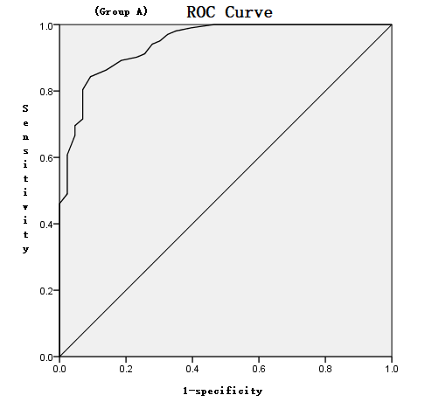
Results
This experiment takes the irradiation intensity of the neonatal jaundice treatment box as an example. data from 2017 to 2019 is regarded as group A,the data from 2020 is regarded as group B. A total of 264 clinical data were obtained in this experiment. Draw ROC curve of group A,and find the threshold critical point back to group B of the test experiment.
2017~2020 experimental data
Group | Time | Positive | Negative
A | 2017 ~ 2019 | 181 | 27
B | 2020 | 47 | 9

Slide 6
Results
Gruop B return inspection results
The results show that the prediction accuracy of the threshold is 82%, which has high clinical application value. It can not only reflect the personalized preventive maintenance of a single device, but also achieve precise preventive management and reduce maintenance costs.The clinical response is good. Facts have proved that it is feasible and effective to evaluate the preventive maintenance timing of medical equipment based on the ROC curve, and this experimental method is suitable for promotion in the quality management of medical equipment.
 | Positive | Negative
Total | 47 | 9
Greater than the threshold critical point | 39 | 1
Percentage | 83.0% | 11.1%
Accuracy | 82%

Slide 7
Thanks for listening
Submitting Author Name: Lin Zhongkuan
Submitting Author Email: lzk@zju.edu.cn
Submitting Author Organization, Country: the Children’s Hospital, Zhejiang University School of Medicine, China

