Slide 1

Applying the MERS System to Capital Planning in a Remote Northern Canadian Context
Cherryl Li*, MHSc
Government of the Northwest Territories
*Now with Island Health
Notes:
Good morning, my name is Cherryl Li and I am a clinical engineer working for Island Health here on the western coast of Canada. However, today I’ll be talking about my work with applying the MERS system to capital planning during my time (as a clinical engineer) with the Government of the Northwest Territories in remote northern Canada.`

Slide 2
Authors
Cherryl Li, MHSc
  Biomedical Engineer
  Island Health
Shauna Mullally, MASc
  Health Technology Planning Manager
  Department of Health and Social Services
  Government of the Northwest Territories
Kevin Taylor, MScEng, PEng
  Territorial Manager, Biomedical Engineering
  Northwest Territories Health and Social Services
  Government of the Northwest Territories
Notes:
I just want to highlight that I could not have accomplished this without the generous support from my team, which includes Shauna Mullally, lead of health technology planning in the NWT, and Kevin Taylor, director of biomedical engineering. Kevin is also one of the two authors of the original MERS system paper, published in the Journal of Clinical Engineering in early 2005.

Slide 3
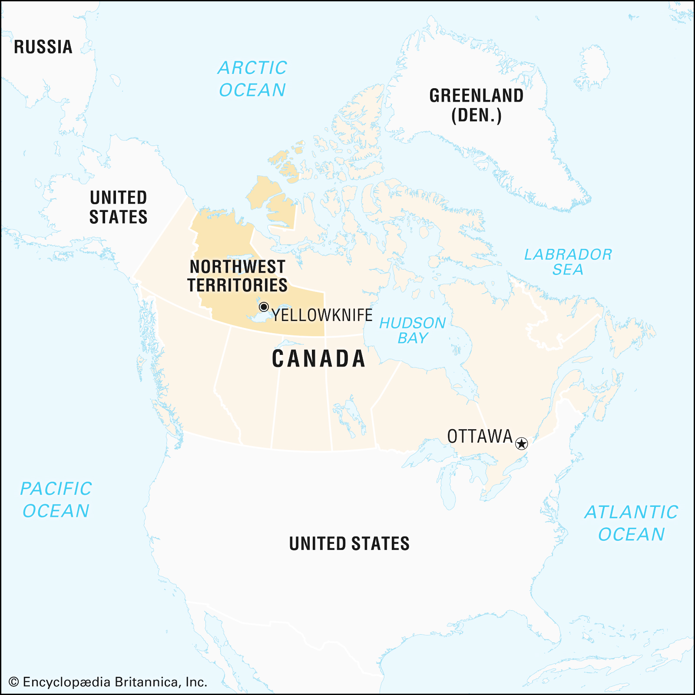
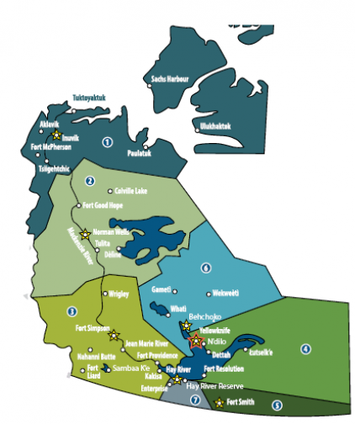
Context
Northwest Territories (NWT)
Geographic region of 1,346 km²
Population of 41,790*
Hospitals in Yellowknife (capital city), Inuvik and Hay River
20+ health centres
Approximately 6400 health technology assets valued at $61 million
*2016 census
Notes:
To start, I want to provide some geographical context of Northern Canada.
The Northwest Territories, shown in box here, is an indigenous territory located in northern Canada and extends for more than 1300 square kilometers. It is the most populous region of the three Northern territories of Canada with a population of 42,000. Half of the population lives in Yellowknife, the capital city, shown here, which also houses the largest hospital in the region. Not pictured are hospitals in Inuvik and Hay River, as well as the many health centres distributed throughout the territory.
The health technology planning team works alongside biomedical engineering to manage, service and replace medical equipment in the NWT. In early 2021, there were approximately 6400 assets valued at approximately $61 million dollars. Perhaps to some of you, these numbers may not seem like a lot especially when compared to larger jurisdictions throughout Canada or the rest of the world, but keep in mind these devices are sporadically distributed throughout the territory, and there are logistical challenges to ensuring the timely maintenance and replacement of these health technologies. Furthermore, the number of health technology assets in a jurisdiction is not directly correlated to its impact on service; for example, should a defibrillator fail in a small remote health centre, there will be significant impacts on programming to ensure this patient receives the care they need.

Slide 4
Challenges & Outcomes
Equipment procurement challenges in Northern Canada
  Sparse population over large geographical area
  Extreme temperature fluctuations throughout year
  Limited staff knowledge and constantly changing clinical workforce
  Rural communities accessed by plane or by ice road
  Limited to no internet in certain locations
Medical Equipment Replacement Score (MERS) system designed for:
  Health technology/equipment planners
  Biomedical engineering
  Clinical leadership
Notes:
On top of logistical challenges with our sparse population and large geographic area, there are other northern-specific challenges with equipment planning in the North. For example, temperature extremes are common with a large climate variant from north to south. Summer highs reach 36 degrees Celsius, while Winters regularly approach below 40 degrees Celsius. Limited staff knowledge with our constantly changing clinical workforce is another ongoing challenge in the north. And as previously mentioned, certain communities are available only by plane or ice road, and limited internet access can lead to challenges with data collection or data validity.
Given the criticality of health technology management in the remote NWT, our team indicated a need to prioritize replacement of medical technologies using a robust, evidence-based approach. Ultimately, this system will benefit health technology planners, biomedical engineers and clinical leadership to better plan for and manage the future of medical equipment in the NWT such that patients can receive more effective and more safe health care.
--
Want clinical leadership to be engaged with medical equipment mgmt. process; very useful for leadership and their own planning

Slide 5
Medical Equipment Replacement Score (MERS)
A higher score indicates a
higher priority for replacement
$$MERS=technical+device safety+mission critical$$
Physical Condition
  e.g., 1 for new condition, 5 for unsafe condition
Age vs. Lifespan
  e.g., 1 if new device, 5 if device is older than its expected lifespan
Discontinuation Multiplier
  e.g., score increases if no vendor support exists
Mission Criticality
  e.g., 1 for zero-impact technology, 5 for priority service-related technology
Backup Multiplier
  e.g., score increases if no facility or regional backup exists
Physical Risk
  e.g., 1 if limited to no risk, 5 if death
  is possible to user if device fails
Technology-Related Incident Multiplier
  e.g., score increases if documented incident or hazard alert exists
Notes:
That brings us to today’s topic – the Medical Equipment Replacement Score (MERS) system. Based upon the original study, Kevin and I collaborated to refine the MERS system to our current needs. As you can see here, MERS is an equation designed to allow us to quantify the qualitative factors behind the medical equipment replacement process.
The scoring system consists of three main components (technical, device safety, and mission critical scores) into several subcomponents that sum up to a singular MERS score. Assets with high MERS scores receive higher priority for replacement.
The technical component is made up of the physical condition, the age, and the discontinuation multiplier of the device, which indicates where vendor support is available or not.
The device safety component consists of the physical risk subcomponent, which evaluates the risk to patient or user should the device fail or malfunction, and the technology-related incident subcomponent, which allows us to indicate whether an incident or hazard alert exists with the device.
The mission-critical component allows us to define the value of a technology depending on the services of a facility or health system. The mission criticality subcomponent defines the impact to service, while the backup multiplier is exactly as it sounds – it indicates whether a facility or regional backup exists.
Again, all of these components are aggregated into the MERS score to asses the replacement of any medical device.

Slide 6
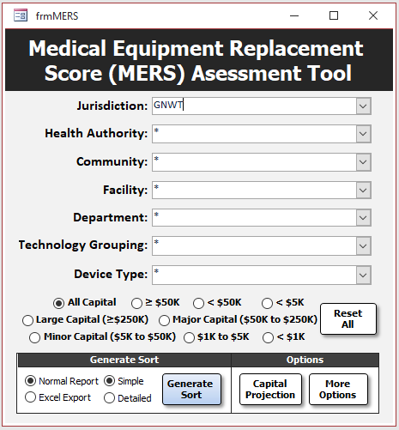
MERS Assessment Tool
Location
Sorting options allow for detailed view
Technology Grouping
Sort by device category (UMDNS)
Capital Projection
Assess future long-term capital projects to establish funding requirements
Capital Grouping
Sort by cost of equipment
More Options
Used for data validation purposes
Export Options
Allow users to chose amount of detail shown when exported to excel or PDF format
Notes:
This refined MERS scoring system was then programmed into the appropriately titled “MERS Assessment Tool” using Microsoft Access and Excel. The existing biomedical equipment database uses proprietary software, so data is extracted from this software to Microsoft Access so that each medical device can be assigned a prioritized MERS score.
Users from biomed or health technology planning have the ability to see devices from a holistic level, such as by health authority or community, and down to the granular level such as by each facility or device type. Users can then chose to export the results directly to a PDF document or to an excel format for further manipulation.
Users may also sort results based on the cost grouping for budgetary purposes. Rather than looking for MERS scores, there is a specific option here to view a capital projection, so future capital requirements can be assessed in more detail.

Slide 7
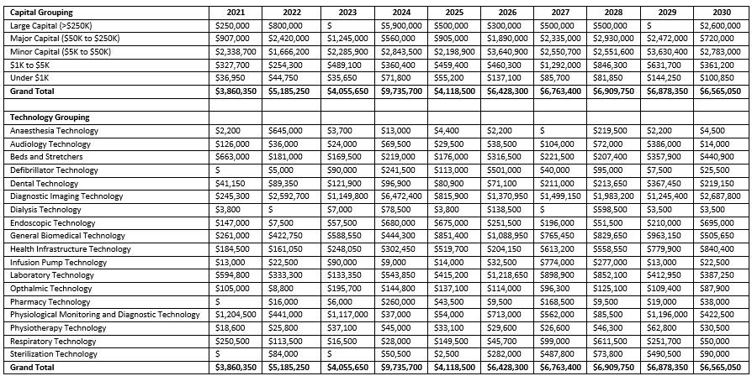
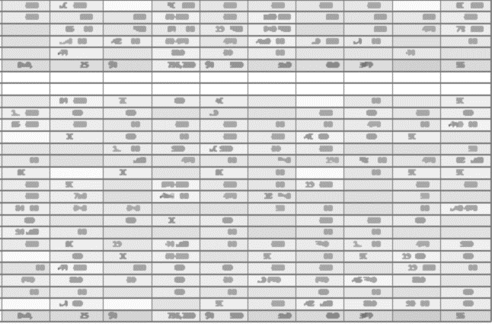
Capital Projection
Projected costs required each year for the next 10 years*
Capital Grouping
Sorted from highest budget group to lowest
Technology Grouping
Sorted by type of medical equipment/technology in alphabetical order
*Projection for 2031 – 2040 not shown
Notes:
When users select the Capital Projection option, they will be presented with an excel sheet shown here. On the left-hand column, you’ll see that devices have been grouped by capital budget or by technology grouping (procurement bundle). The right hand columns depict the funding needed to replace equipment at the end of its risk-adjusted lifespan. For example, certain pieces of large capital equipment must be replaced in 2021 and 2022, but no equipment needs to be replaced in 2023, therefore no funding is required for that subcategory. Additionally, while this sheet captures the next 10 years, there is a second page that indicates funding required for an additional 10 years from 2031 up until 2040.
Note that the data presented here has factored in risk-adjusted lifespan, so that a balance between budgetary constraints and clinical program requirements is achieved to support the governmental capital planning process. Earlier this year, this capital projection tool was used to form the basis of our next five-year capital funding projection for health technology management, and these projections are in the process of being reviewed by our territorial government.
Overall, the MERS system was refined and programmed into a tool that allows users to outline medical equipment replacement priorities over the next 20 years. This facilitates an organized approach to health technology management given limited capital funding and our northern-specific challenges and allows users to better address medical technology needs and future system development.

Slide 8
Cherryl Li
cherryl.li@islandhealth.ca
Island Health, Canada
Notes:
Thank you all for listening. If you have any questions or comments, please feel free to reach out to me at my email shown here.

