Slide 1
CE DAY
BEFORE AND AFTER CHECKLIST IN THE OPERATING ROOM
CLINICAL ENGINEERING – Biomedical instrumentation
HOSPITAL ALBERT EINSTEIN
Authors:Berthone Soares, Everton Galvão, Filipe Simionato.

Slide 2
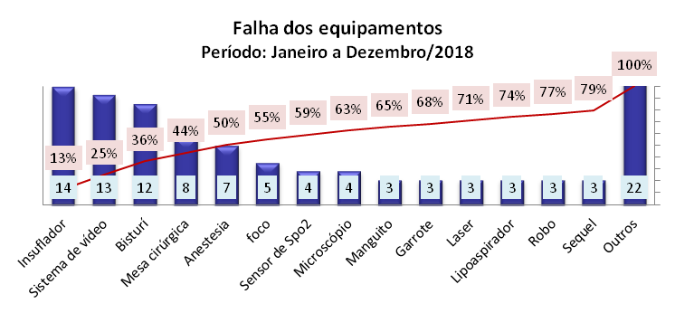
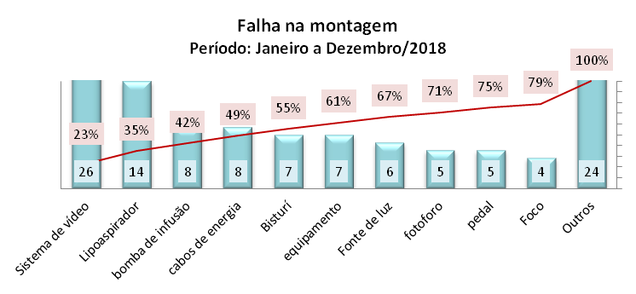
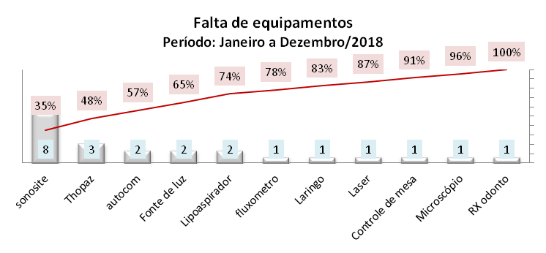

BEFORE AND AFTER CHECKLIST IN THE OPERATING ROOM
Analysis of the occurrences of Clinical Engineering
In the period from January to December 2018, of the 322 occurrences, only 250 had the causes described, with 43% of cases (107) referring to equipment failure, 46% of cases (114) referring to assembly failure and 23% (9 cases) are due to lack of equipment.
Equipment failure
Period: January to December/2018
Assembly failure
Period: January to December/2018
Through the occurrences mentioned above, an analysis was carried out to identify the main causes of Clinical Engineering occurrences. It was observed that for equipment failure, 50% of the causes were related to: insufflator, video system, scalpels, surgical table and anesthesia. For assembly failure, 55% of the causes were related to the video system, liposuction machine, infusion pump, power cables and scalpel. For lack of equipment, 57% of the causes were related to Sonosite, Thopaz and Autocom.
Lack of equipment
Period: January to December/2018
O nível de serviço da Engenharia Clínica é medido através de uma pesquisa de satisfação aplicada no final das cirurgias e nela são avaliados se houve alguma falta de equipamento, atraso de equipamento ou falha de equipamento. Avaliando todas as 428 ocorrência de 2018 percebeu-se que nem todas elas pertenciam a Engenharia Clínica, fazendo uma reclassificação identificou-se que 106 ocorrência não pertenciam a Engenharia Clínica, assim melhorando a média do nível de serviço de 96% para 97%.

Slide 3
Review of the operational model of Clinical Engineering in the Operating Room
Root cause analysis for assembly failure and equipment failure
For the analysis, the information from the service level monitor and the service orders generated in the period from January to December 2018 were considered
Assembly failure
Equipment failure
assembly failure | root cause
Video System | Lack of color configuration on screens Lack of image routing
Liposuction | Provision of equipment with missing connector nozzles, leaks or noise.
Infusion pumps | Lack of standard pumps in the room, Lack of charge in the batteries. Failures during the start of the procedure
Power Cables | Equipment found in a room without cables or with cables of inadequate length.
Equipment Failure | Root Cause
Inflator | Flow obstruction failures Lack of heating accessory Lack of equipment compatible with the heating accessory
Video System | Interference in images caused by scalpels Head cable failures Poor video cabling contact Lack of proper configuration and many damaged optics
Electric scalpel | Control pedal failure
Operating Table | Magnus Table: Movement failure Hydraulic problems Remote control failure Sensor failures. Betastar Table: Remote control failure Damage to the fairing Collisions of the table with other objects
Anaesthesia | Falhas relacionadas a display e misturadores de gases (GE) Falhas no sistema de medição de gases (Drager) Falha do sensor Spirolog (Drager) falha de motor (Drager)
The analysis of failures in the surgical room assembly process points mainly to failures in the assembly of video systems, liposuction machines, infusion pumps and lack of power cables.
Analysis of data related to “equipment failure” showed that 50% of cases were concentrated in technologies: Insufflator, Video system, Scalpels, Surgical Tables and Anesthesia.

Slide 4

Review of the operational model of Clinical Engineering in the Operating Room
Creation of Check list
Main steps to be developed with the implementation of the checklist
2
3
1
List the essential points to be checked during each surgical assembly process
Establish uniform room check process
Start process of recording and traceability of the assembly process
Proposed actions: Preparation of a checklist

Slide 5
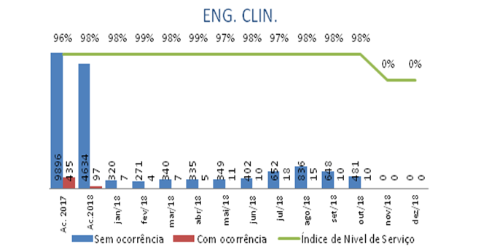
Review of the operational model of Clinical Engineering in the Operating Room
DEFINITION PHASE
General Data
Indicators
Problem Description
1. Amount of critical equipment tested per surgery.
1.1 Number of surgeries with minimal follow-up.
1.2 Number of surgeries evaluated through a form.
2. Department of Clinical Engineering restructured, according to the operational capacity study.
3. Percentage of Productivity.
Clinical Engineering is responsible for managing the Institution's medical equipment park, performing activities from management, maintenance, operation and final destination of technologies, mainly promoting safety for patients and users.
The department is composed of 1 Manager, 2 Coordinators, 2 Supervisors, 1 Medical Physics, 5 Engineers, 1 Technologist, 32 technicians, 4 Gas Therapy Technicians, 11 Assistants and 4 Interns, who take care of approximately 20,000 pieces of equipment, performing an average of 2,696 surgical preparations per month, 2,623 equipment inspection routes, 1,318 preventive maintenance, 1,078 maintenance (corrective, installation and deactivation), 62 calibrations and tests of Medical Physics, 1,199 calibrations in flowmeters and gas valves.
In view of the SLA of 100% for meeting requests with the Surgical Center, on average 10 serious occurrences/month are recorded in the operating rooms (due to lack, delays or failures in equipment) the equivalent of 2% of the total surgical procedures/month, which compromises the service level of the Surgical Center (Service level of Clinical Engineering at the Surgical Center: 98% - period: January to October/2018), generating risks to the process and complaints from surgeons.
The objective of this project is to study a restructuring of Clinical Engineering to improve the level of service in the Surgical Center, identifying opportunities for professional adaptation to the activities.
Goals
1. Improve the level of Clinical Engineering service in the Operating Room by 1.5 P.P. (from 97% to 98.5%, i.e. reduce 158 occurrences in operating rooms out of a total of 316).
2. Improve the satisfaction of the Clinical Engineering Team in the Surgical Center from 75 to 77 (satisfaction of HIAE in 2018).
3. Review of the operational capacity of Clinical Engineering with the objective of achieving 92% productivity
Scope
Includes:
1. Service level study of the CE team of the Surgical Center.
2. Study of positions, functions and operational capacity of the INSBIO and IMAGEM teams.
Deletes:
1. Study of the activities of the groups: Gas Therapy, External Units and PCEC.
Notes:
Metas:
1. Oportunidade de melhorias no método de apropriação dos custos e redução dos custos.
2. Oportunidades de aumento de receita e doações.

Slide 6
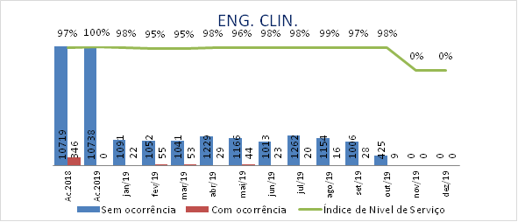
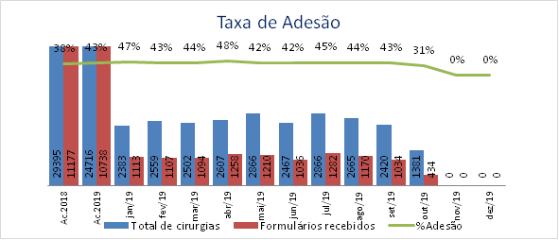
Review of the operational model of Clinical Engineering in the Operating Room
Improved staff satisfaction
Improvement: The operating room checklist was implemented in April 2019 in the two operating rooms, but we are only managing to perform 30% of the procedures.
The results are already perceived through the percentage of favorable evaluations according to the number of respondents.
The 2019 adherence rate is much higher than the 2018 work measurement period.
LEGEND
NO OCCURRENCE
WITH OCCURRENCE
SERVICE LEVEL INDEX
After
CLINICAL ENGINEERING
MEMBERSHIP FEE
Pré projeto
Pós projeto

