Slide 1
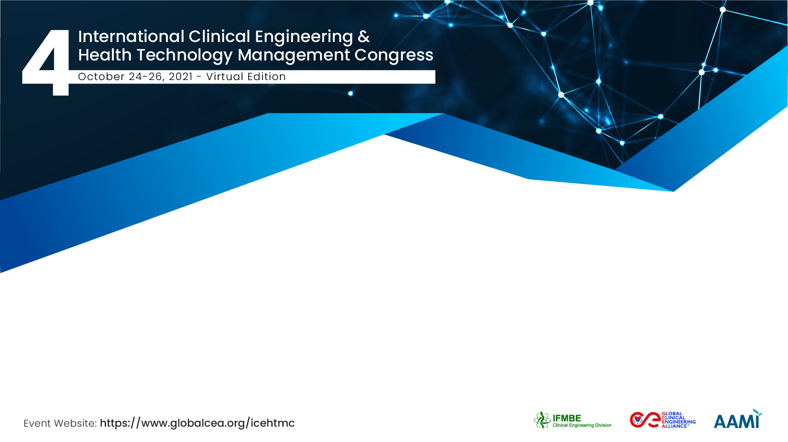
Asset management evaluation in the Peruvian Social Health Insurance System
Eduardo Toledo Ponce
Deputy Manager of Maintenance of the Social Health Insurance
Gonzalo Romero Ramón
Maintenance Supervisor at Social Health Insurance

Slide 2


The Working Group
Maintenance Deputy Management
Central body regulating and supervising hospital maintenance management in the Peruvian Social Health Insurance
389 healthcare facilities
56,464 hospital equipment

Slide 3
Equipment Management
Type
Operability
Warranty
Useful Life

Slide 4
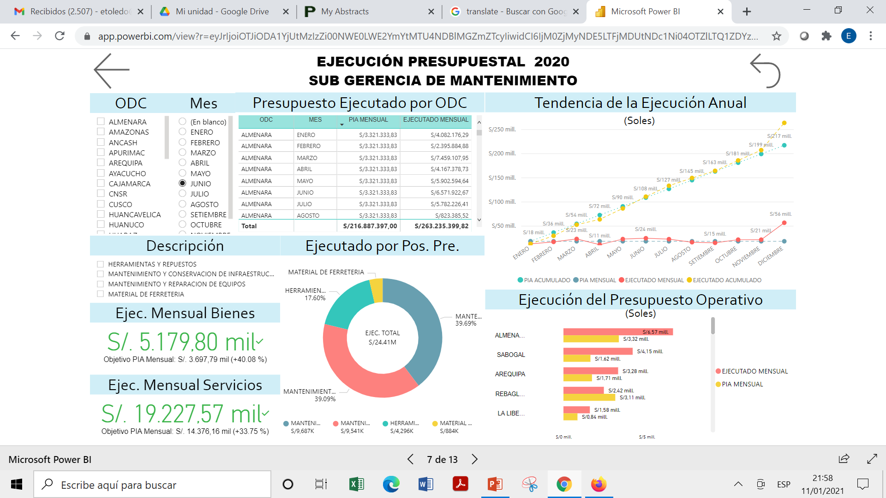
Description of the Proposal
5 indicators have been determined:
Equipment Operability (OE)
Budget Execution (BE)
Preventive Maintenance Compliance (PMC)
Percentage of Unplanned Maintenance (PUM)
Cost of Service Ratio (CSR)
Indicators Targets
OE | BE | PMC | PUM | CSR
≥ 90% | ≥ 100% | ≥ 80% | ≤ 10% | ≤ 5%

Slide 5
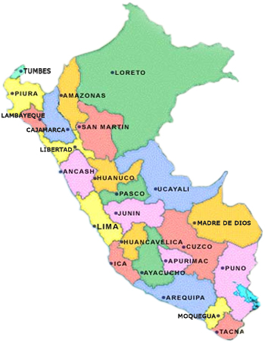
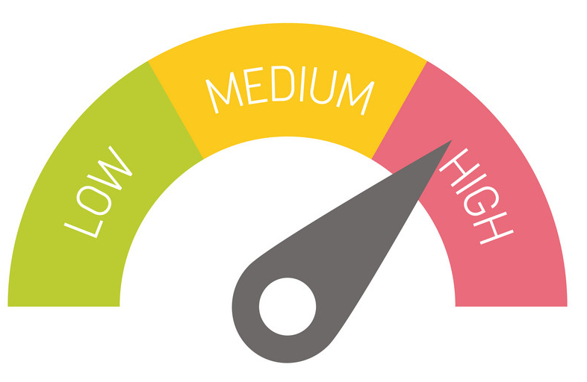
Program Objectives
Evaluate the results obtained by the 32 Autonomous Decentralized Bodies (ADB) in 2020, through maintenance management indicators
To identify ADB with management deficits and those that performed adequately
Carry out differentiated strategic activities for each ADB, which will allow improving and optimizing their management

Slide 6
Results
Based on the evaluation carried out at the 32 ADB in 2020 the following results have been determined for each indicator:
Indicator | Goal | Best | Worst | Avg. | St. Dev.
OE | ≥ 90% | 99.0% | 78% | 91.1% | 4.7%
BE | ≥ 100% | 150.0% | 44% | 99.4% | 24.8%
PMC | ≥ 80% | 97.7% | 50% | 84.1% | 12.6%
PUM | ≤ 10% | 1.2% | 11.4% | 3.2% | 2.9%
CSR | ≤ 5% | 0.2% | 21.3% | 4.5% | 4.3%

Slide 7
Strategy
A strategy of selective and unannounced supervision was determined for the group with the best results
A strategy of reinforcement and accompaniment was determined for the group with the poorest results
Autonomous Decentralized Bodies
Strategic Activity
Cajamarca, Huancavelica, Huaraz, Juliaca, Moyobamba, Pasco, Puno, Ucayali
Maintenance management supervision
Ancash, Cusco, Ica, Junin, Loreto, Rebagliati, Sabogal, Tacna
Strengthening of management capacities

Slide 8
Eduardo Toledo Ponce
Eduardo.toledo@essalud.gob.pe
Deputy Manager of Maintenance of the Social Health Insurance, Perú
Gonzalo Romero Ramón
Externo.gromero@essalud.gob.pe
Maintenance Supervisor at Social Health Insurance, Perú

