Slide 1
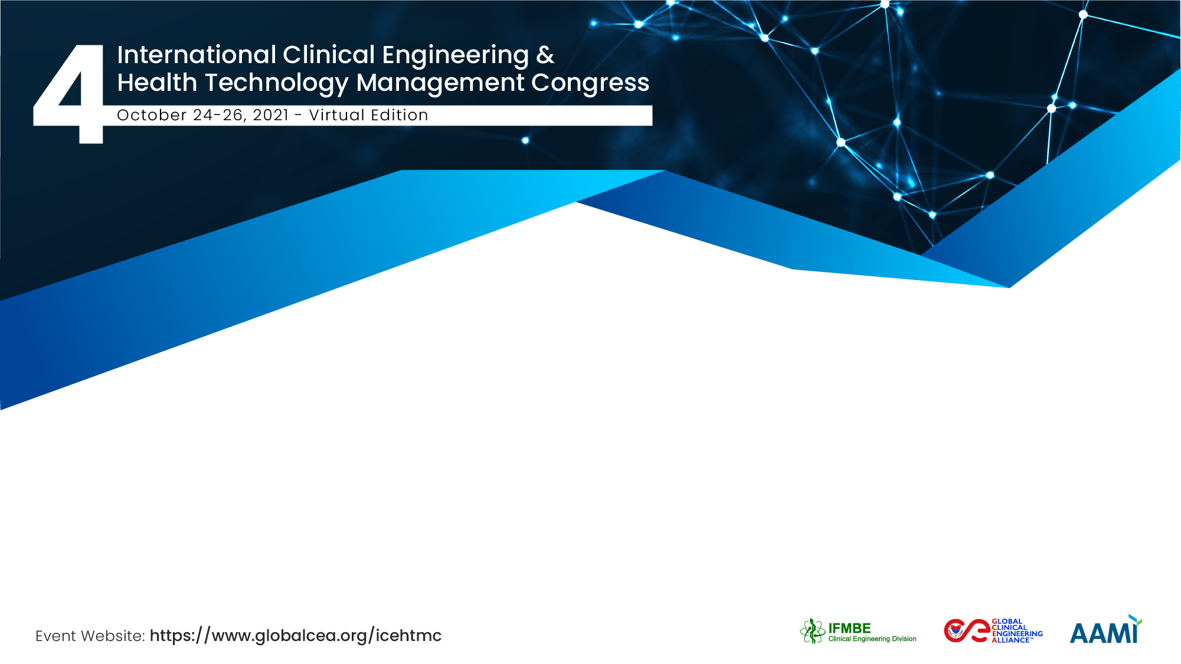

SABI
Bioengineering Argentine Society
Clinical Engineering Chapter
Marcelo Lencina – National Technological University – Regional San Nicolás- Argentina
Germán Giles – Schiller Americas - USA

Slide 2
The Team / Workgroup
Marcelo Lencina – National Technological University – Regional San Nicolás- Argentina
Rubén Acevedo – Entre Ríos National University – Argentina
Eduardo Fernández Sardá – “Garraham Pediatrics Hospital” – Argentina
Germán Giles – Schiller Americas – Argentina-USA

Slide 3
Description
SABI is the Biomedical National Society founded in 1979, where professionals that work in the biomedical engineering field promote the development of the Exact Sciences application to the Biological and Medical Sciences problems.
Dr. Biong. Rubén Acevedo is the actual President and has four Divisions (Clinical Engineering, Students, Rehabilitation and Professional,) and the Universities Medical Devices Laboratory Network. The CE Chapter is presided by Eduardo Fernández Sardá.
The Society is affiliated to CORAL and IFMBE and has agreements with many National Medical Societies (SATI, SANE, SAMFYR, etc.) and Regional Societies (ACCE, SOMIB, IEEE, ABClin, etc.).
Every two years has the National Congress, the next will take place in San Juan province in September 2022.
Since 2017, National Clinical Engineers have a WhatsApp group, where the professionals share and exchange their knowledge and experiences.

Slide 4
Goals of the project and final users that will benefit
Promote the development and training of Biomedical Engineering and Bioengineering through publications, documents, journals, webinars and congresses.
Advise on the development and use of medical devices.
Strengthen the relationship with the Professional Associations of the provinces.
Improve communication between colleagues from different regions of the country, with the aim of knowledge exchange and experiences in order to facilitate the daily work.

Slide 5
Results
Two training webinars per week since April to August 2020, before the first COVID 19 wave. Training on use and maintenance of ventilators, anesthesia machines, pulse oximeters and monitors. Exchange of COVID 19 experiences with Mexican, Spanish and Italian colleagues.
One webinar per week since September to December 2020 called “Contributions of Clinical Engineering in the fight against COVID 19, from Ushuaia to La Quiaca”, where every province presented their works done during the first wave (air conditioning systems, ICU extension, PPE, UV sterilization, PSA, oxygen concentrators, liquid oxygen use, etc.).
Law No. 10915 of the Province of Entre Ríos creates Engineering Services in public and private health establishments. Also, three hospitals has a BME as a Director.
Advice to the National MoH on oxygen consumption, so that it could establish regulations for the provision of production companies.

Slide 6
Results
Through the SABI Laboratories Network, the national ventilators manufacturers coordinated the calibration and commissioning of old equipment that was unused.
Statement on the quality and safety required for the manufacture of ventilators, endorsed by the Argentine Society of Intensive Care and the Council of Engineers of Buenos Aires City.
The HTM leader of Tucumán MoH (Luis Rocha) was nominated as Engineer of the year by the Tucumán Engineers Association by his work in the COVID 19 pandemic fight and the lives saved.
Advice to Companies and Universities in the reconversion and development of new medical devices to face the pandemic.

Slide 7
Marcelo Lencina & Germán Giles
mhlencina@gmail.com ; germangiles@gmail.com
SABI (Bioengineering Argentine Society), Argentina

