Slide 1
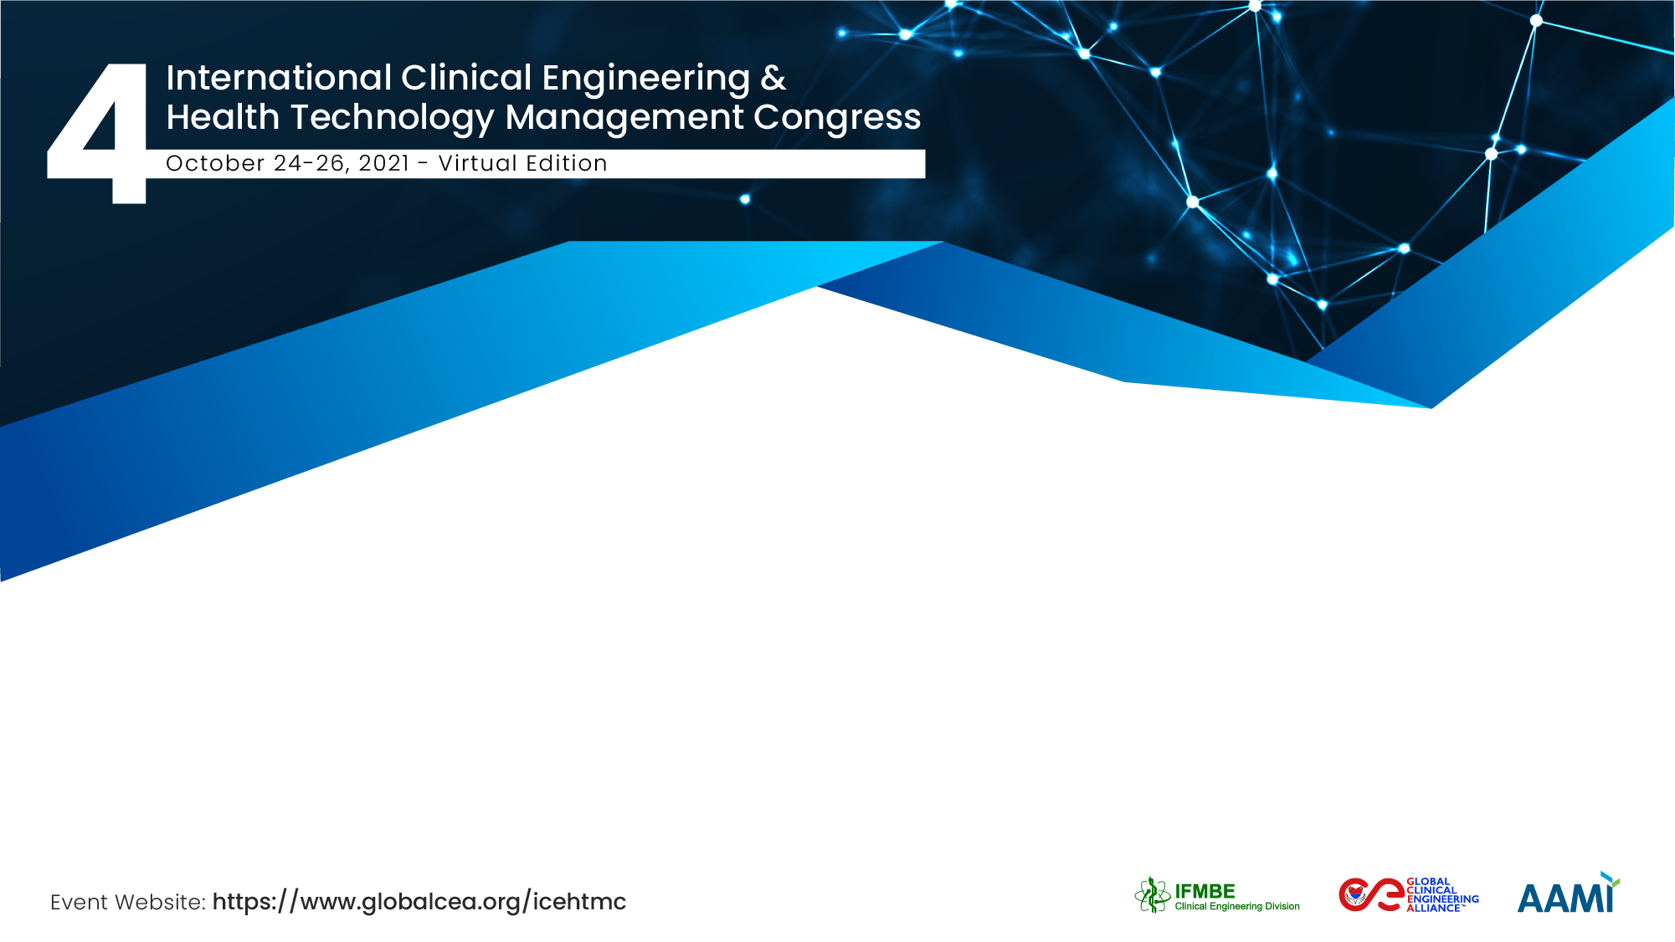
Biomechanical Compatibility of 3D Printed Upper Limb Assistive Technology
Nuhu Abdulhaqq Isa
Near East University, Nicosia
NeuroTime medikal cihazlar, Istanbul

Slide 2
The Team / Workgroup
Nuhu Abdulhaqq Isa
Assoc. Prof. Dr Dilber Uzun
Hani Hamdan

Slide 3
Description
There is growing number of persons who lost one or more body parts and require prosthetics to assist their lives. Despite recent developments in prosthesis, traditional methods of fabrication are usually associated with unnecessary waste of raw materials, long-time, lower biocompatibility, non-customization, and high-cost.
3D printing has the capacity of fabricating customized prosthesis with excellent clinical improvement as indicated by studies.
However, what are the biomechanical compatibility competence of these prosthetics fabricated by 3d printing technology?

Slide 4
Goals of the project and final users that will benefit
The goal is to evaluate biomechanical compatibility performance of 3D Printed prosthesis using fuzzy-PROMETHEE.
The topic is significant because it investigates the nearly neglected vital question of biomechanical compatibility in e-NABLE community- an ever-growing field with an estimated 20,000 e-NABLE volunteers in over 100 countries allows the sharing of useful designs but possibility of harm to patients cannot be out ruled.
This study adds to the growing literature investigating quality and biocompatibility performance of 3D printing applications in medicine.

Slide 5
Materials and Methods
For this study, a total of 10 3D prosthesis were selected from e-NABLE community including phoenix hand v3, osprey hand, motogripper terminal device, cyborg beast, flexy-hand 2, raptor reloaded, k1 hand, ody hand, forefinger gripper, and unlimbited arm v2.1.
The parameters used to analysis the prostheses include, the weight, adaptive grip, actuation, control, cost, pros, adult size, aesthetic, difficulty, and star review from users (*). These parameters can be helpful in analyzing biomechanical compatibility of prosthesis limbs (Kate et al., 2017; Cuellar et al., 2018; Kang et al 2018).
We define importance/weight of each criterion. Fuzzification by triangular fuzzy linguistic scale and defuzzification by Yager index, lastly data is simulated.
Details of methodology are provided in article and dataset can be accessed from

Slide 6
Results
The table show positive, net, and negative outranking values. Positive outranking values indicate cumulative strengths of biomechanical compatibility, while negative signify cumulative weakness.
Simply, the positive outranking flow value should be as high as possible while the negative should be as low as possible.
The net flow is the distance between positive and negative flow which provides the full ranking result.
The prosthesis with the highest net flow value is the most biomechanically compatible and vice versa.

Slide 7
Results
Rank | 3D prosthesis | Phi (net) | Phi (+) | Phi (-)
1 | Raptor Reloaded | 0,1582 | 0,2346 | 0,0764
2 | Phoenix Hand v3 | 0,1302 | 0,2262 | 0,0960
3 | MotoGripper Terminal Device | 0,0930 | 0,1758 | 0,0828
4 | Forefinger Gripper | 0,0599 | 0,1651 | 0,1053
5 | Cyborg Beast | 0,0225 | 0,1856 | 0,1631
6 | Ody Hand | -0,0144 | 0,1258 | 0,1403
7 | Osprey Hand | -0,0350 | 0,1289 | 0,1638
8 | Unlimbited Arm v2.1 | -0,1174 | 0,0777 | 0,1951
9 | K1 Hand | -0,1404 | 0,0854 | 0,2258
10 | Flexy-Hand 2 | -0,1566 | 0,0744 | 0,2309

Slide 8
Nuhu Abdulhaqq Isa
Annuur55@gmail.com
Near East University, Cyprus
NeuroTime medikal cihazlar, Turkey

