Slide 1

COVID-19: implementing an effective information system to manage SARS-CoV-2 RT-PCR testing
Valentina Manso, Eng.
Quality Control and Clinical Risk Management Unit
Local Health Services Authority “Lanciano Vasto Chieti"

Slide 2
The Team / Workgroup
Thomas Schael – Eng, General Manager
Maria Bernadette Di Sciascio – MD, Quality and Safety Manager
Valentina Manso – Eng., Biomedical Engineer
Giuseppe Torzi – Vet, Public Health Service Department
Arturo Di Girolamo – MD, Public Health Service Department

Slide 3
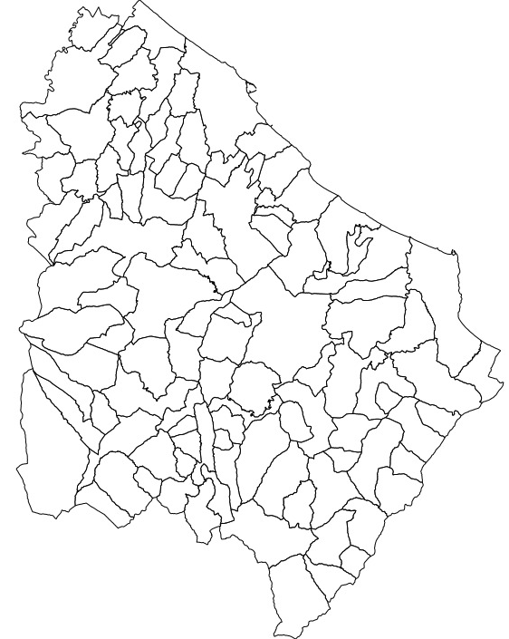
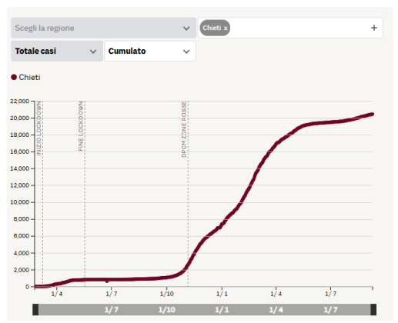

The Health Local Service “Lanciano Vasto Chieti”organization and the local impact of Covid-19 pandemic
Chieti
Ortona
Area: 2.600 m²
104 municipalities
Total population: 376.397
(updated January 2021)
Hospital facilities: 5
Healthcare Workers: 4500
20.461
Vasto
Lanciano
Atessa
SARS-CoV-2 cases
(September 11th2021 update)

Slide 4
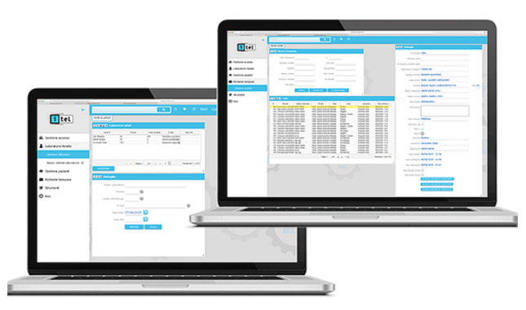
SARS-CoV-2 diagnosis: RT-PCR test
Pediatricians and general practitioners
Public Health Service staff – contact tracing
Patients
Hospital workers
School
Nursing homes and residential care centers
Drive-through testing station
To contain and mitigate the COVID-19 emergency and to manage the request, execution and report of SARS-CoV-2 RT-PCR test, both at the territorial and hospital level, we implemented an information system named “Smarttest®” that was provided to all the healthcare professionals involved in the request and management of SARS-CoV-2 RT-PCR test.
Models of use
Smarttest® Informtic system

Slide 5
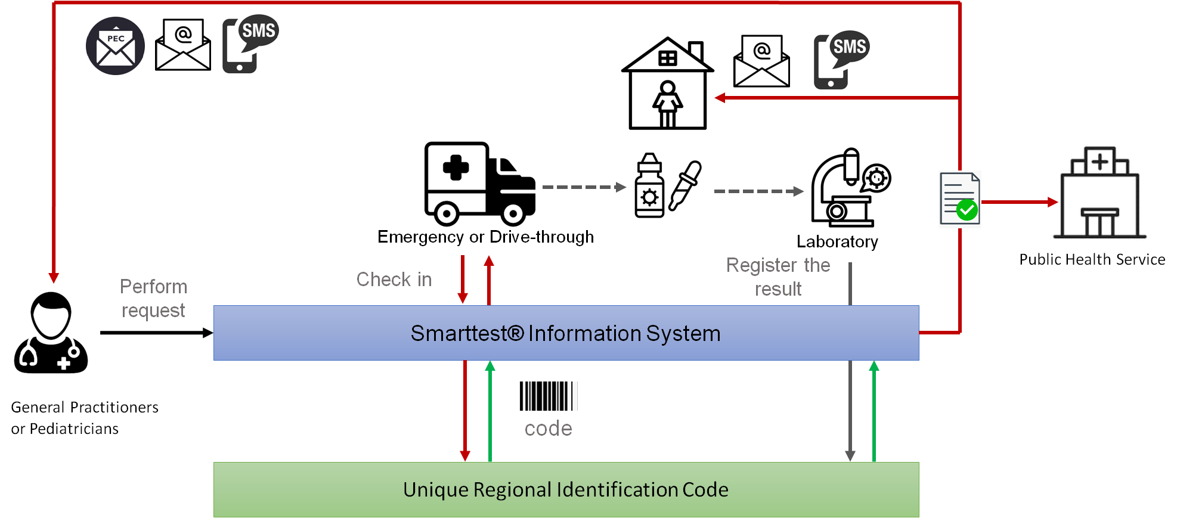
Fig. 1 – Care setting A “At home patients Management”

Slide 6
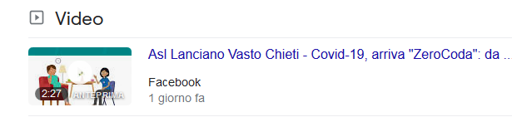
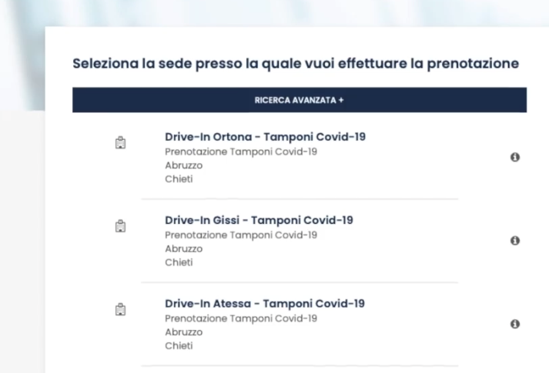
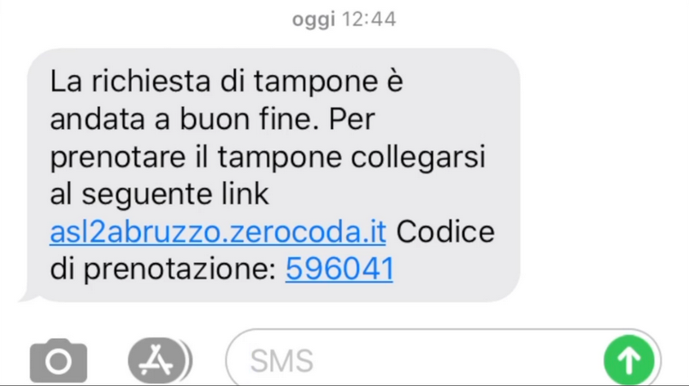
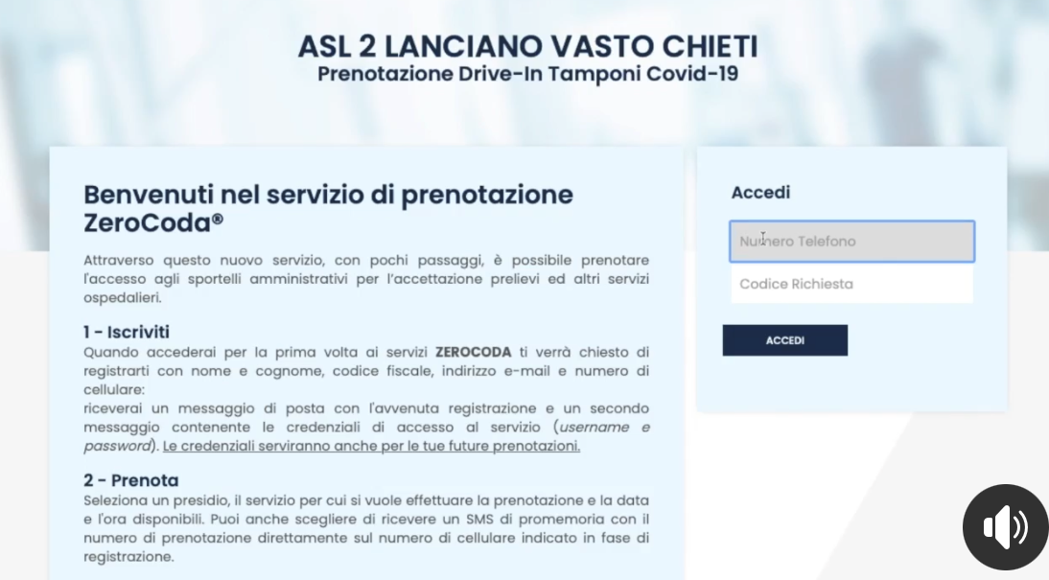
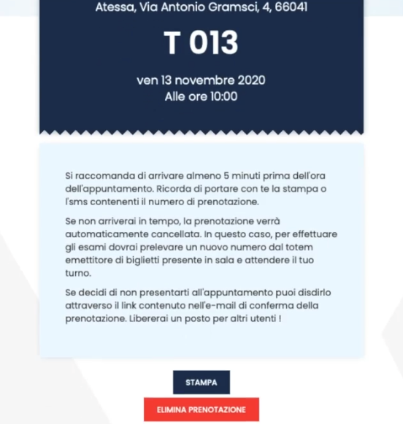
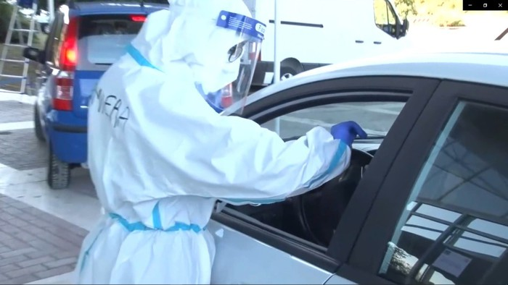
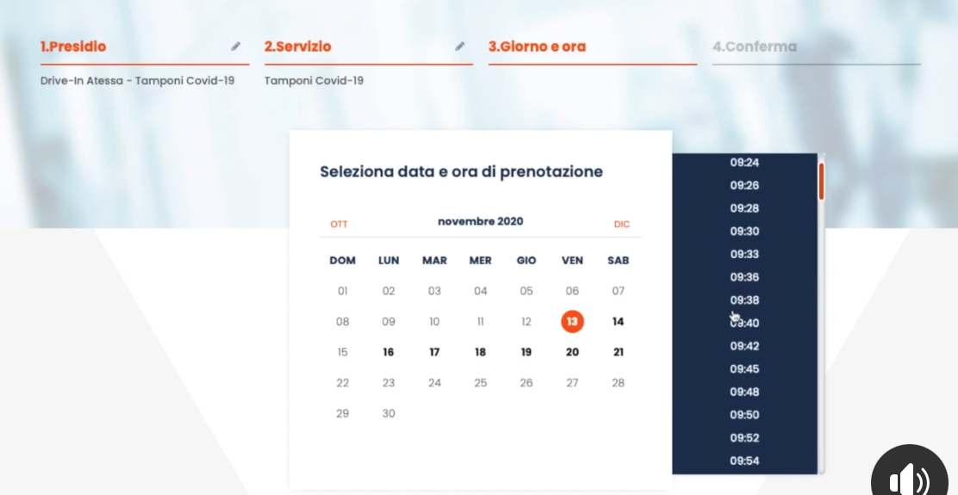
Drive-through sampling strategy
https://www.youtube.com/watch?v=Frh_t1l1GXQ
1. Message with the link to the service
2. Booking service homepage
3. Select drive-through station
5. tiket
4. Choose the date and the excat time

Slide 7
Goals of the project and final users that will benefit
The aim of this work is to improve the management of SARS-CoV-2 RT-PCR test, from the request of the test to the return of the results to the patients.
In this way, the Local Health Service Lanciano Vasto Chieti managed to facilitate all the subjects involved in this workflow, and in particular:
Pediatricians and general practitioners;
Public Health Service staff;
Workers and patients of Nursing homes and residential care centers;
Emergency staff;
Laboratory staff;
Drive-through operators;
Patients.

Slide 8
Results
686 Healthcare Operators are currently using this information system (General Practitioners , Pediatricians, Doctors, hospitals general manager)
367.436SARS-CoV-2 RT-PCR test were requested and performed:
  82204 at home
  124259 patients and healthcare personnel
  160973 drive-through
24-48 hours is the current waiting time for the communication of diagnosis

Slide 9

Valentina Manso, Eng.
valentina.manso@asl2abruzzo.it
Local Health Services Authority Lanciano Vasto Chieti, Italy

