Slide 1
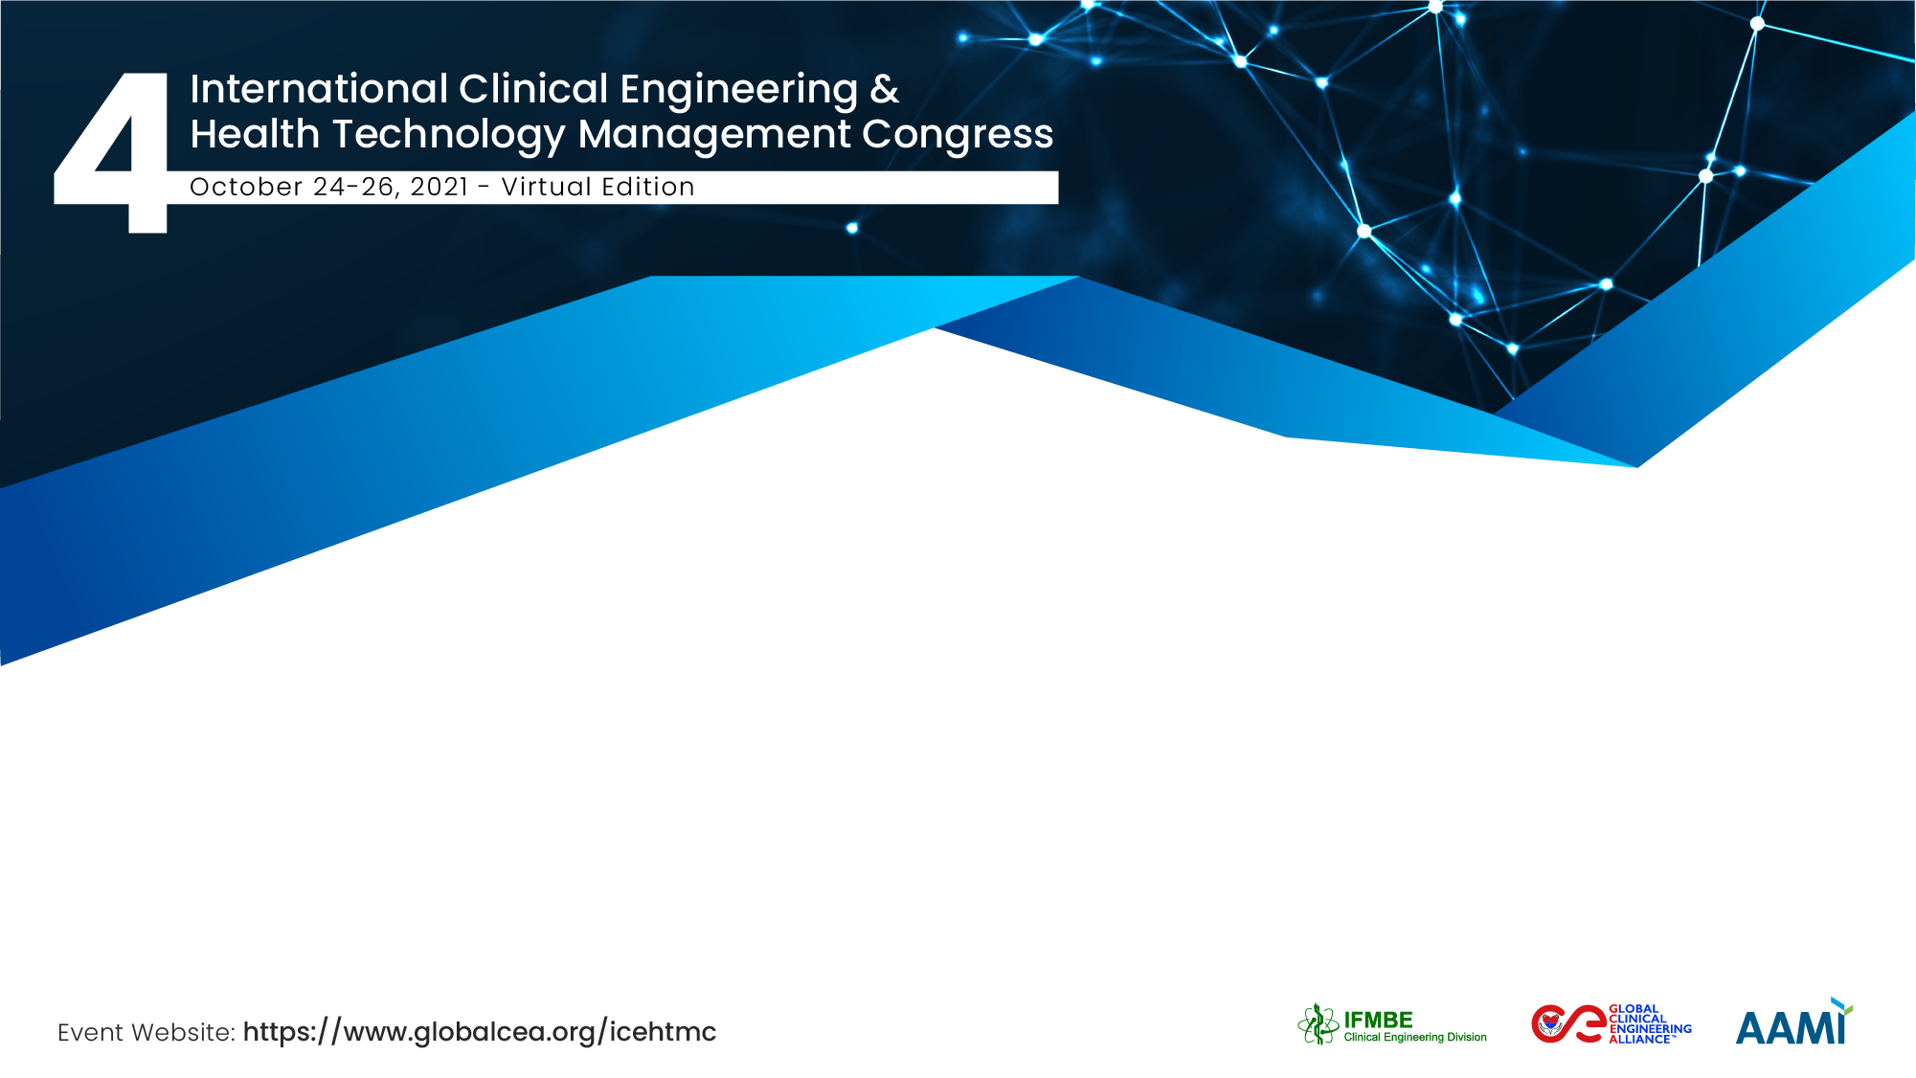
Caregiving safety during management of infectious outbreaks. The need for contactless patient monitoring.
Mar Elena and Alejandro Barriga-Rivera
University of Seville

Slide 2


The Team / Workgroup
Mar Elena, Ph.D.
Assistant Professor
Electronic Engineering Department
University of Sevilla
Sevilla, Spain
Alejandro Barriga-Rivera, Ph.D.
Research Associate
Physics Department
University of Sevilla
Sevilla, Spain

Slide 3
Description
During infectious disease outbreaks that endanger human lives, caregivers are severely exposed, as they need to approach patients to deliver treatment and perform vital monitoring.
Elimination of some of these risks is no possible, but engineering measures are used to mitigate the magnitude of the epidemic; that has been the case of the recent COVID-19 or EBOLA outbreaks.

Slide 4
Goals of the project
The development of non-contact monitoring systems could provide the following advantages:
Enhance caregivers’ safety during surveillance of patients.
Reducing costs and time deployment of the hospital infrastructures and the lack of individual medical equipment or human resources.
Giving special attention to the target patients, who are those who present pathologies or health problems that require continuous monitoring.

Slide 5
Final users that will benefit
Catastrophes such as terrorist attacks or earthquakes, among others
Patients with predictable pathologies with sudden deterioration such as cardiovascular, respiratory and neurological diseases
Pediatric care in order to avoid invasive methods in children
Populations exposed to highly infectious diseases
Waiting rooms, transfer ambulances and helicopters

Slide 6
Contactless patient monitoring (I)
Consists of a camera to monitor people and their biosignals, through the simultaneous use of three technologies:
  Artificial vision (AV)
  Artificial intelligence (AI)
  Augmented reality (AR)
These technologies must be evaluated in different scenarios, such as waiting rooms or ambulances

Slide 7
Contactless patient monitoring (II)
To monitor the overall health status of symptomatic patients with the minimum human intervention, we must surveil changes in biosignals:
  Heart rate
  Oxygen saturation
  Body temperature
  Detection of people
  Identification and tracking of trajectory and pose

Slide 8
Results
In a global crisis context in which substantial portions of the nations are seeking medical assistance within a brief time windows, the deployment of solutions based on artificial intelligent methods, virtual reality and customized adaptive treatment, can allow prevention in patients’ complications ensuring that they receive care at the right time.

Slide 9
Mar Elena
marelen@us.es
University of Seville, Spain

