Slide 1

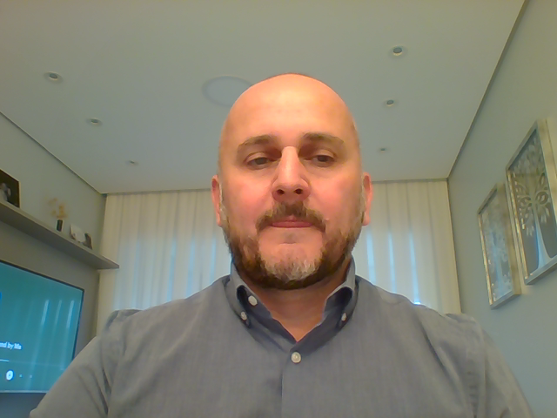
Clinical Engineering Academy: New Approaches for Participation and Continuous Education in the Healthcare System
Murilo Contó
IFMBE, Brazil

Slide 2

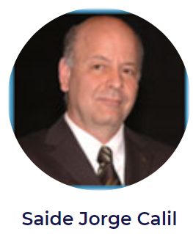

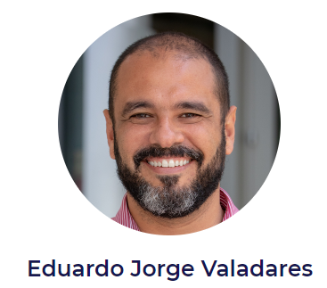
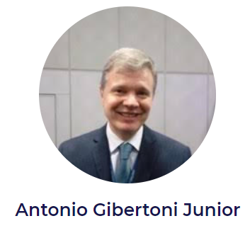


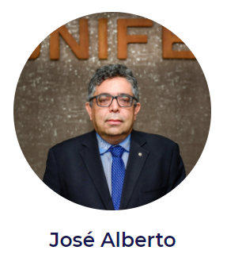

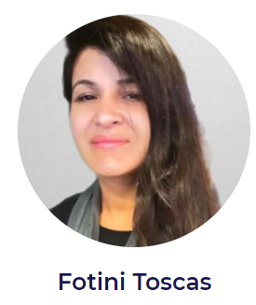
The Team / Clinical Engineering Academy
Experts in the Clinical Engineering field working in the Academy, Ministry of Health, Hospitals and in MedTech companies → Brazilian healthcare ecosystem

Slide 3
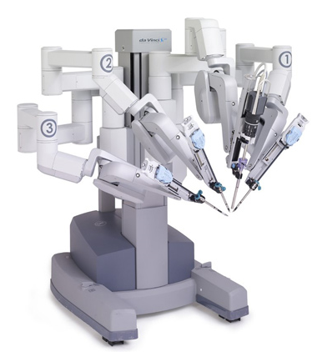
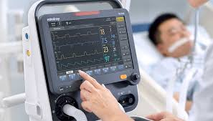
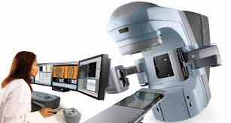

Description
Technological innovations in healthcare is increasingly accelerating
To promote the correct management of medical equipment, the clinical engineering must keep a process of continuous education
Advocacy actions regarding aspects about: regulation, certification and profession recognition
Recognition of the Clinical Engineer as a part of the healthcare staff - relevant role became more evident with the Covid-19 Pandemic

Slide 4

Goals of the project and final users that will benefit
1- Promotion of new teaching approaches complementary to those regularly included in academic clinical engineering courses
2- Awareness and direct action with national authorities, healthcare professionals and managers to recognize the Clinical Engineering field
3- Production of digital content, bibliographic material and evaluation of regulation and standards within the healthcare system

Slide 5
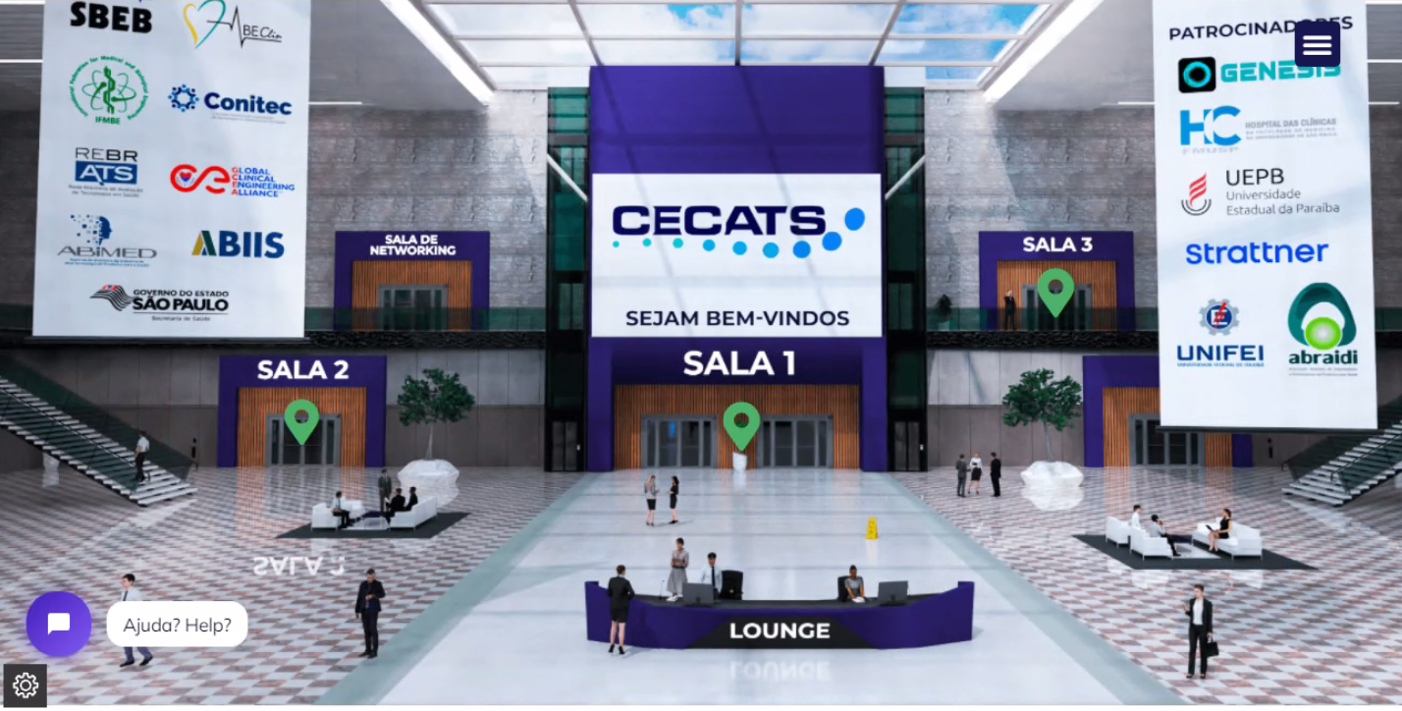
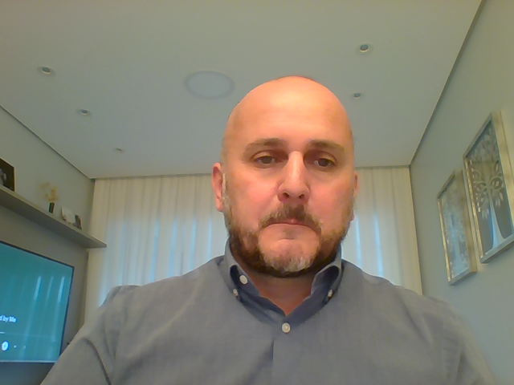
Results
The WG called as “Academia de Engenharia Clínica” was structured in subgroups: Regulation & Standards, CE Certification, Capacity Building, Publications and Webinars.
Channel on YouTube → has already more than 1000 subscribers and more than 6000 viewers for the 12 webinars (only organic dissemination )
Recognition of the profession in Brazil: two important Bills presented to the Brazilian Congress: 1- Recognition of the Clinical Engineer as professional; 2-Management Program for every healthcare facility
1º CECATS - Congress on Clinical Engineering & HTA 20-22 October 2021

Slide 6
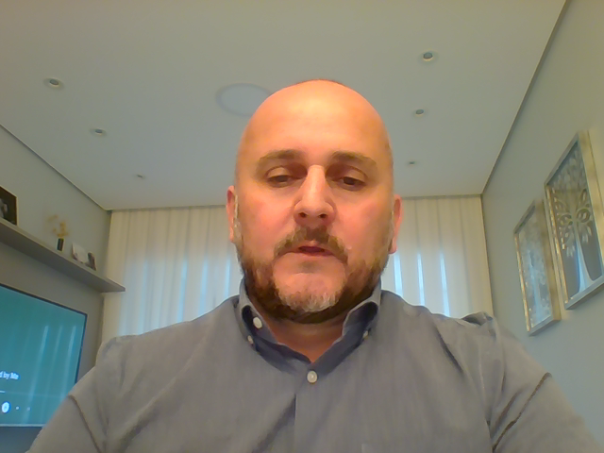
Murilo Contó
Murilo.conto@terra.com.br
IFMBE, Brazil

