Slide 1
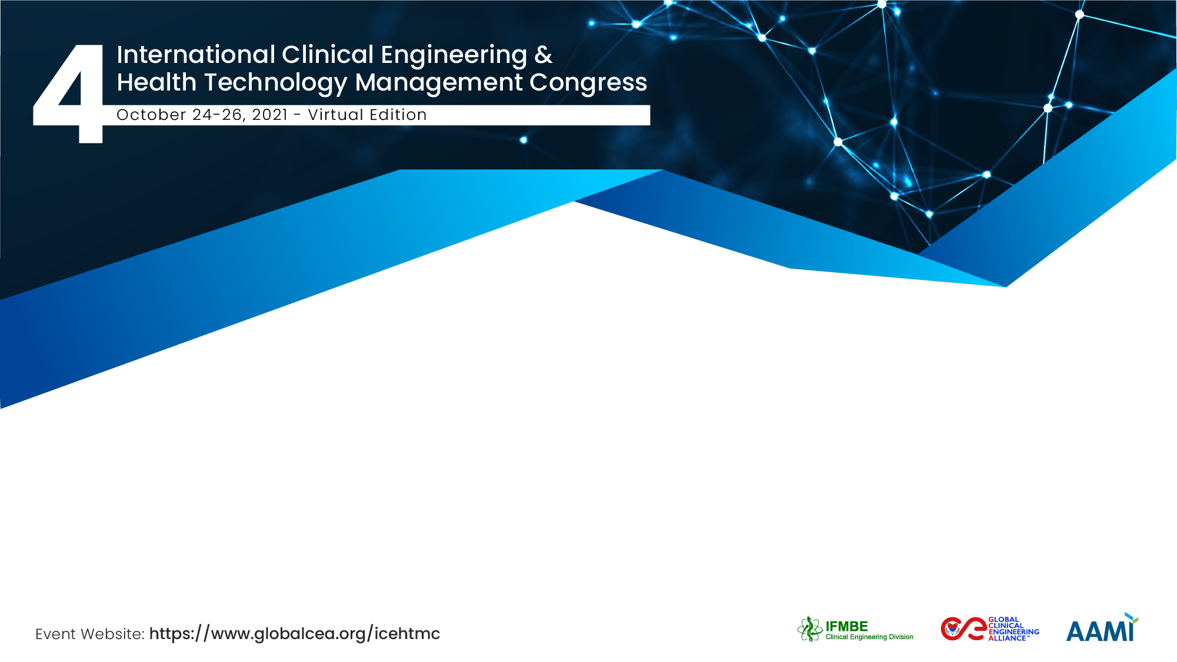
Clinical Engineering Education at the Graduate Level
Frank R. Painter, MS, CCE
University of Connecticut

Slide 2
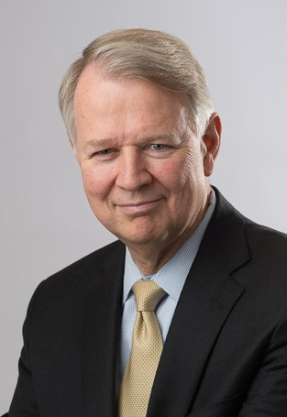
Frank R. Painter, MS, CCE, FACCE
over forty years of clinical engineering and biomedical equipment service management experience.
directed in-house programs at three large metropolitan teaching hospitals and managed two successful regional independent medical equipment service organizations.
faculty member and past Clinical Engineering Program Director in the Biomedical Engineering Graduate Program at the University of Connecticut.
actively involved in the American College of Clinical Engineering and the New England Society of Clinical Engineering.

Slide 3
Clinical Engineer
ACCE definition
A professional who supports and advances patient care by applying engineering and managerial skills to healthcare.
Notes:
So this is applied engineering.
For the program’s purposes, this is the definition we are going with.
There are many definitions out there, which professors and others are creating.
Some have said CE programs focus on design, which I feel is not the primary definition.

Slide 4
UCONN CE Educational Program
MS BME Program
Ten distance-learning courses focusing on CE related subjects
Two-year program with a paid two-year CE internship in a major teaching hospital
In-hospital mentoring and guided learning
12-15 funded internship positions available
Notes:
Assumes a quality undergraduate education

Slide 5
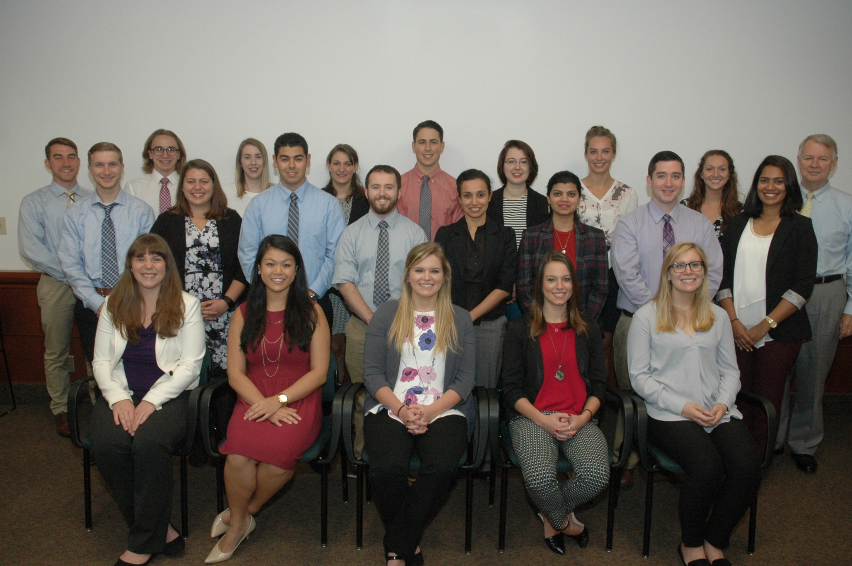
Notes:
Recently (in the past 10 years) there have been more women than men in the program.

Slide 6
CE Internship
Working under the guidance of a clinical engineer
Requirement to work at most major CE activities
  Planning
  Projects
  Installation management
  Committee assignments
  Technology management
Some defined time is spent just observing clinicians using technology on patients (we call this “clinical rotations”)
Notes:
First major component of the program (& one that sets it apart).

Slide 7






C E Internship Hospitals
Hartford Hospital
Baystate Health Systems
Los Angeles VA Medical Center
UMASS Medical Center
Rhode Island Hospital
Massachusetts General Hospital
Geisinger Medical Center, Pennsylvania
Yale New Haven Hospital
Dallas VA Medical Center
Middlesex Hospital
Stanford Children’s Hosp, California

Slide 8
CE Curriculum Design
Guided by
ACCE “CE Body of Knowledge Survey” conducted every 2-3 years
the 10-12 CE internship hospital CE directors
the program director (a CE)
the CCE exam (which is based on the BOK survey)
Designed to yield fully functional and experienced CEs
Notes:
Second major component

Slide 9
Clinical Engineering Courses
Clinical Engineering Fundamentals
Engineering Problems in Hospitals
Human Error and Medical Device Accidents
Medical Instrumentation in the Hospital
Clinical Systems Engineering
Medical Device Cybersecurity
Project Management
Clinical Rotations

Slide 10
Clinical Engineering Fundamentals
Technology Management
Equipment Management
Information Management
Maintenance Management
Quality Management
Safety Management
Risk Management
Financial Management

Slide 11
Human Error and Medical Device Accidents
Human Error
Human Factors Engineering
FDA & Medical Devices
Root Cause Analysis
HFMEA
Patient Safety
Accident Investigation Techniques
Medical Device Accidents & the Legal System
Surgical Fires, Electrosurgery,

Slide 12

Clinical Systems Engineering
Medical device networks
Interconnectivity
Interoperability
Passing data to the electronic medical record
Networking
Data transfer formats

Slide 13
Summary
Clinical Engineering Courses
Mentoring and guidance by experienced CEs
Two years of Internship Experience

Slide 14
Results (175 graduates in past 20 years)
Most work in CE departments in healthcare systems
Some advance to hospital administration or technology management positions elsewhere in the healthcare system
Some work for third parties managing CE and HTM activities
Some work for medical equipment manufacturing companies - in technology support in the clinical environment, product development, human factors, manufacturing support, even sales.
Three have become nurses and one an engineering professor.

Slide 15
Frank R. Painter, MS, CCE, FACCE
frpainter@engr.uconn.edu
University of Connecticut, United States

