Slide 1
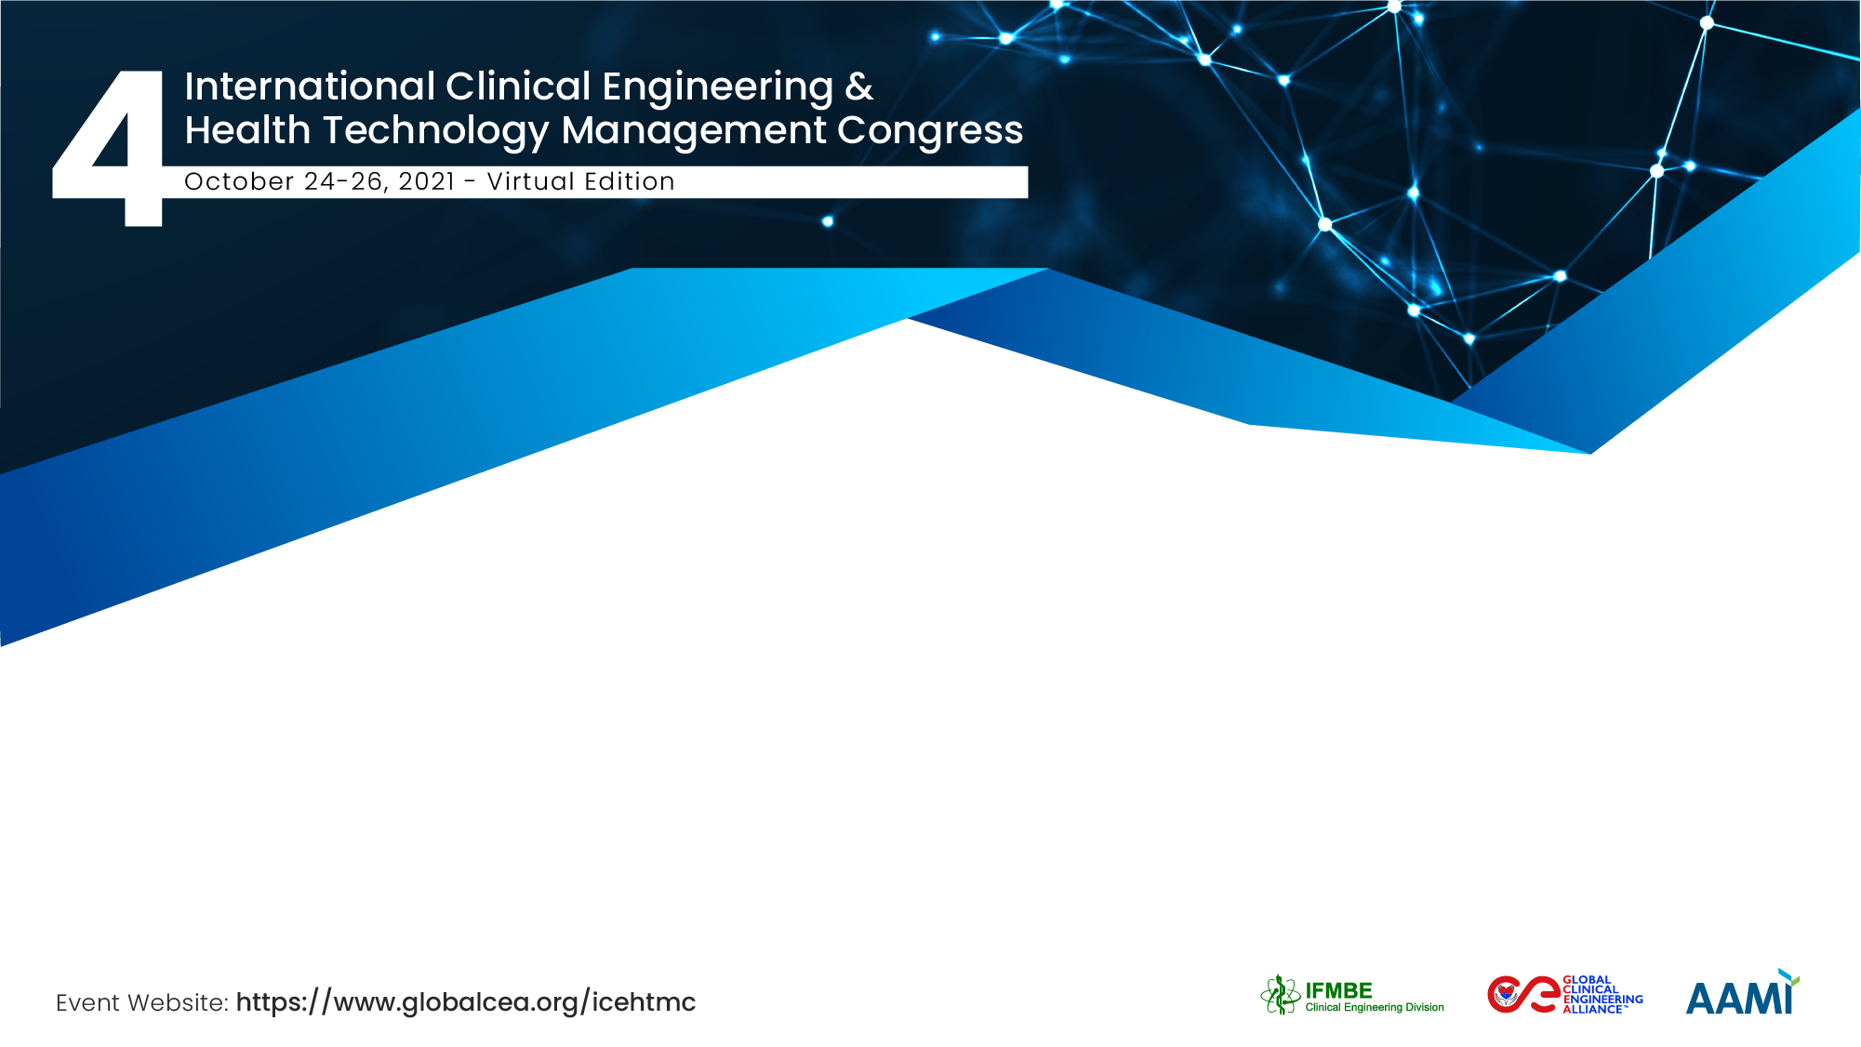
Clinical Engineering acting as consulting department in hospitals around Brazil
Marcello Dias Bonfim
Hospital Sírio-Libanês

Slide 2
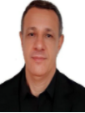
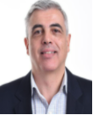

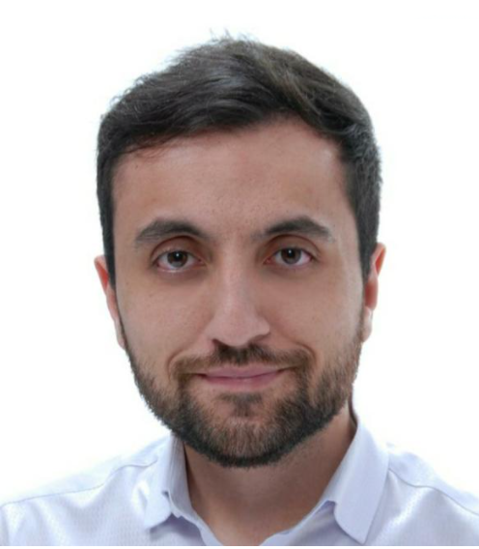
The Team / Workgroup
Valmir Donizeti Tunis
Supervisor of Clinical Engineering
Maxwell Allan Gonzaga da Silva
Supervisor of Clinical Engineering
Marcello Dias Bonfim - Presenting Author
Manager of Clinical Engineering
Fabio Alcarpe Coda
Clinical Engineer

Slide 3

Description
The Clinical Engineering department actively participates with the consulting team of Hospital Sírio-Libanês, helping in the situational diagnosis and management model of public and private health institutions, at the request of the Ministry of Health, Health Secretaries or the board of directors in charge.
Clinical Engineering
Consulting
Diagnosis Problems
Propose improvements

Slide 4


Goals of the project and final users that will benefit
Disseminate knowledge and apply experienced analysis:
Share our experience to public and private hospitals in order to help then to improve processes and policies.
To know different realities of many Brazil´s area and propose a standard methodology

Slide 5
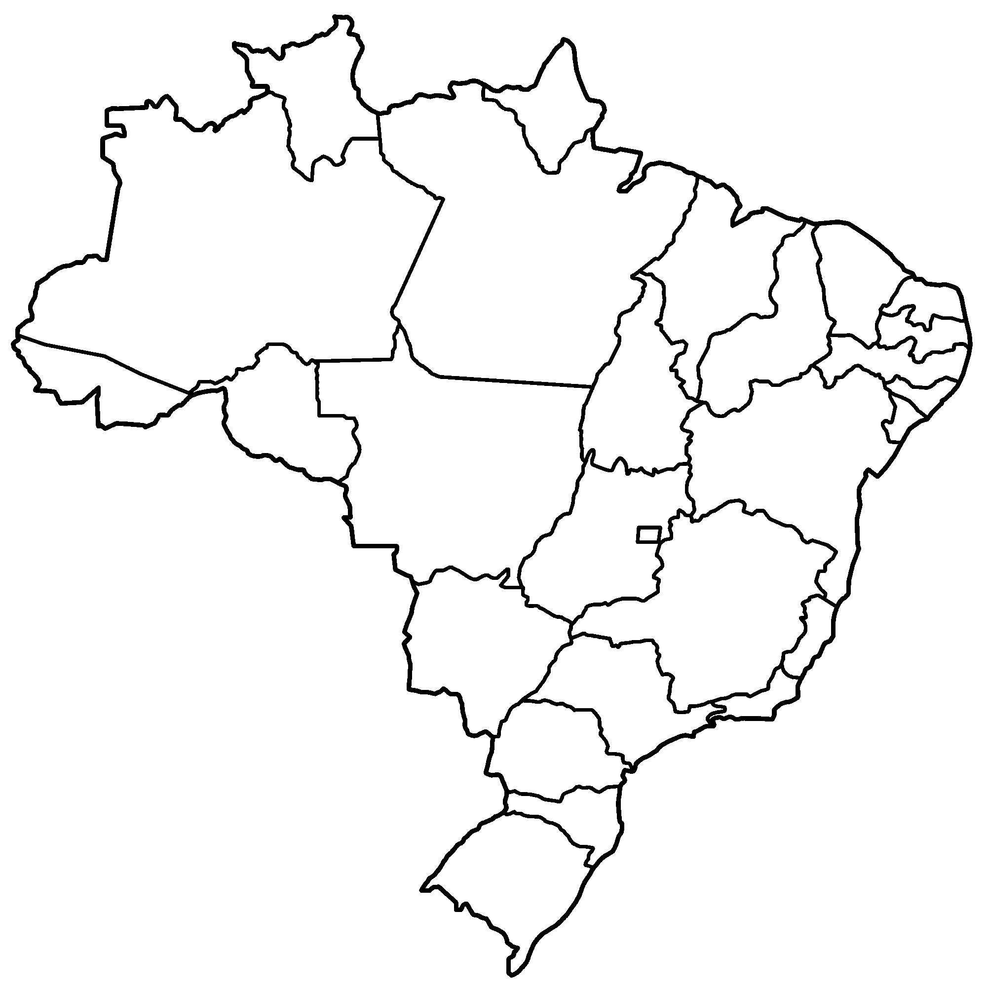

Results
AP
AM
PA
MA
MA
RN
Hospital de Base – Ary Pinheiro
Hospital 28 de Agosto
Hospital Municipal São Benedito
Hospital Psiquiátrico São Pedro
Hospital Tramandaí
Hospital Nova Iguaçu
Hospital Beneficência Portuguesa Porto Alegre
Hospital Geral Roberto Santos
PB
PI
AC
TO
PE
RO
AL
SE
MT
BA
Restructuring of management models
Resource and contract optimization
Raising awareness of the need for infrastructure changes
Reinforce the importance of the role of Clinical Engineering
GO
MS
MG
SP
PR
SC
RS
8 Hospitals Visited
25,600 km Traveled
36h Travel
96h Consulting

Slide 6
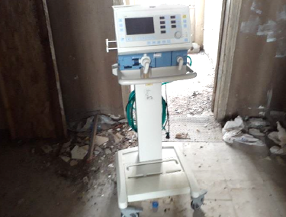
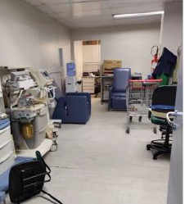
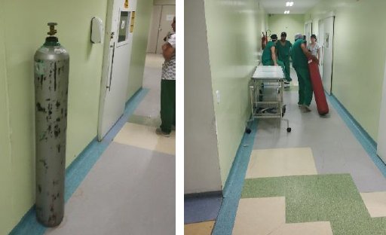
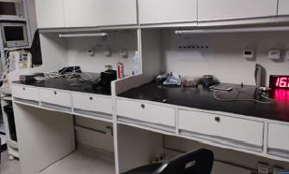
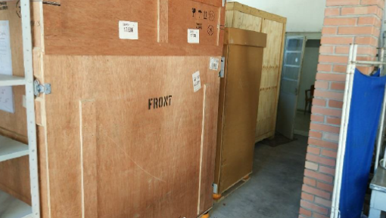
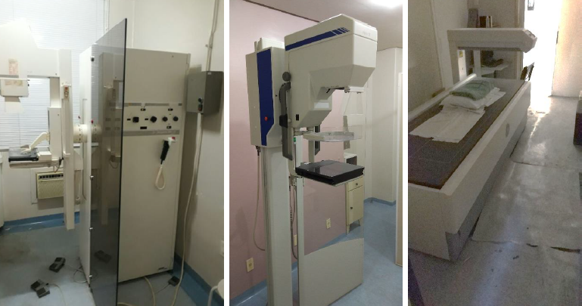
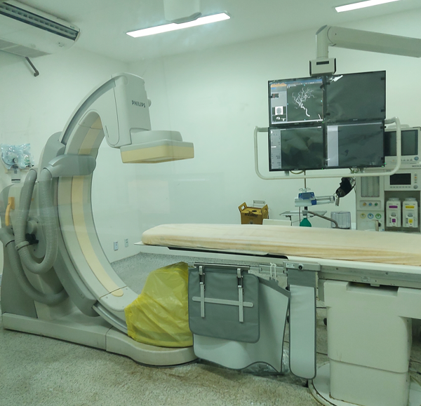
Photos
Assessment of clinical engineering areas of hospitals
Employee carrying oxygen cylinder without cart
New equipment dumped in poor storage conditions
Poor storage, roof leak
Evaluate the condition of use - imaging equipment

Slide 7
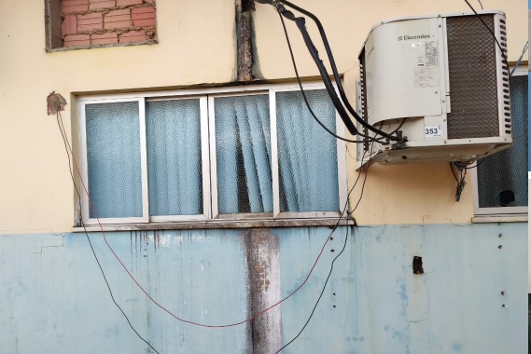
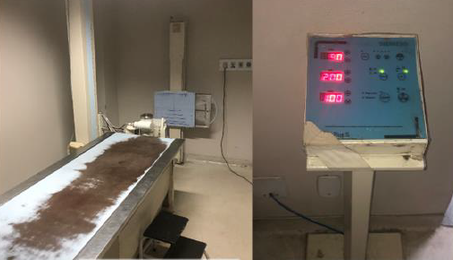
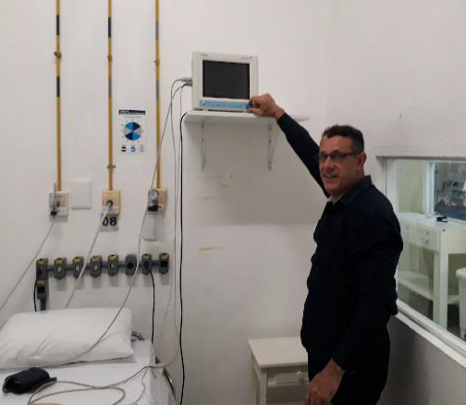
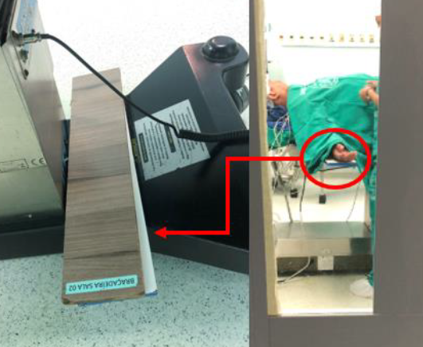
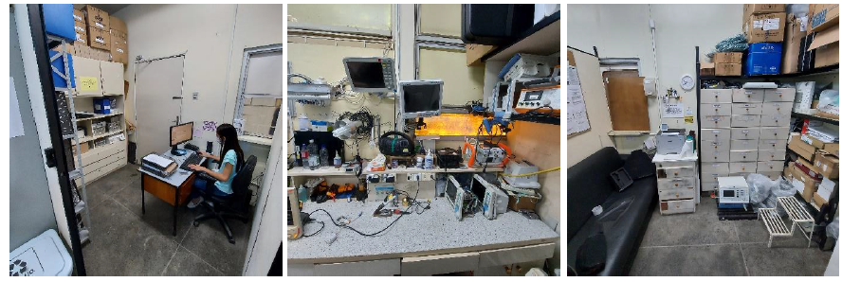
Photos
Poor electrical installations
Old X-Ray, poor conditions of table
Our BMET during inspection
Clinical Engineering Room
inappropriate accessories, patient risk safety

Slide 8

Final report

Slide 9






Curiosity findings during the visits
Clinical engineering without management software;
Reduced teams;
Apprehensive teams with consulting;
Difficulties in eating, distance between cities, hospital, center, transport;
Poor infrastructure conditions in some places
Bureaucracy and delay to repair equipments

Slide 10
Final Words / Learnings
See different realities
Propose management improvements
Strengthen the partnership of private hospitals by supporting public hospitals in opportunities to improve their processes and infrastructure.
Equity,
Access, Efficiency and Universality

Slide 11

“No company is better than your administrator allows.”
Peter Drucker

Slide 12
Marcello Dias Bonfim
marcello.bonfim@hsl.org.br
Hospital Sírio-Libanês, Brazil
Thank You !

