Slide 1

Clinical needs and technical requirements for ventilators for COVID-19 treatment critical patients: an evidence-based comparison for adult and pediatric age
Martina Andellini
martina.andellini@warwick.ac.uk, University of Warwick, Coventry, UK
martina.andellini@opbg.net , Bambino Gesù Children’s Hospital, Rome, Italy

Slide 2
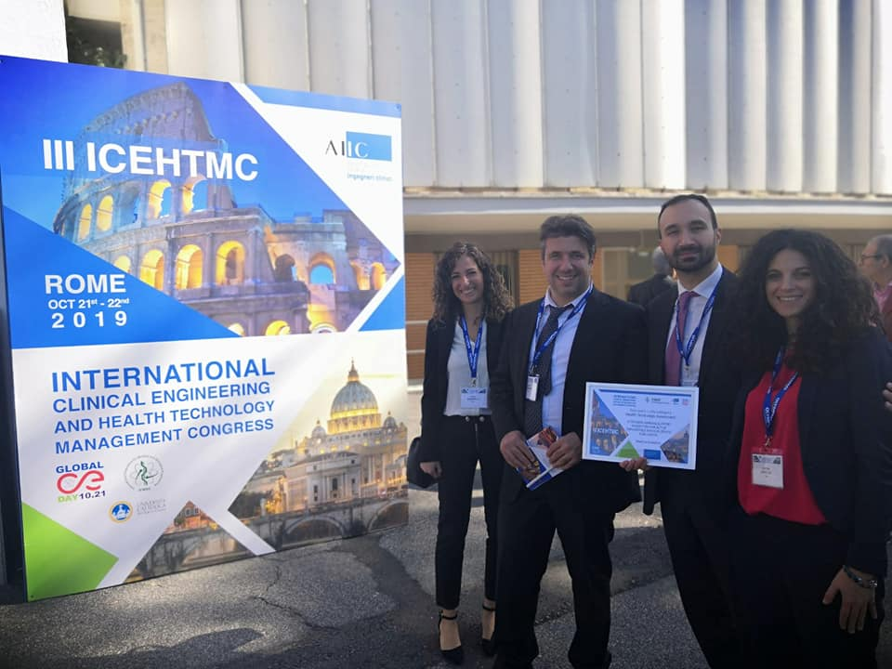



The Team
Leandro Pecchia
Francesco Faggiano
Matteo Ritrovato
Martina Andellini
Elena Bassanelli
School of Engineering, University of Warwick
HTA UNIT Bambino Gesù Children’s Hospital, Italy

Slide 3


Introduction
Last update: 05/10/2021
March 2020
July 2020
5090 ICU beds
Sudden and unexpected increase of ICU beds demand
Growth of ICU length of stay (30 days) compared to the normal ICU stay of 14 days
Drastic increase of the number of ICU beds
Drastic increase of ICU staff
Drastic increase of life-saving ventilators and other related supplies

Slide 4

Two sides of the same coin
Problems with ICU ventilators supply.
Problems in rapidly increase the manufacture of ICU ventilators to deal with the demand.
Some companies converted their production to ICU ventilators.
The selection of the type of the ICU vetilator that best fits with specific health and social context needs was based on TIME and AVAILABLE RESOURCES instead of QUALITY, APPROPRIATENESS and EFFECTIVENESS.

Slide 5
Main issues
Countries were racing against time in arranging new ICUs
Problem of ventilators’ supply:
- complicated variety of ICU ventilators designs
- limitations in time and resources during the emergency
Stakeholders necessitate affordable solutions to rapidly understand the real needs of a specific health context.
Learning how to correctly evaluate the coherent amount of ventilators really needed in a specific context as well as the essential technical requirements that ventilators should have to ensure effective treatment for COVID-19 critical patients.

Slide 6
Objectives
Offering an overview of how the application of a structured and reliable evidence-based approach for technologies evaluation might provide support during COVID-19 pandemic in ICUs management and critical equipment supply.
Defining the essential (minimum) technical requirements that an intensive care ventilator should have in order to treat COVID-19 critical patients

Slide 7



Methods
Defining the clinical indications and guidelines for the management of suspected and confirmed COVID-19 patients
Detailed description of the clinical syndromes’ profiles associated with COVID-19 for mild, severe and critical illnesses
Guidelines and strategies to manage severe acute respiratory infections in suspected and confirmed COVID-19 patients.

Slide 8


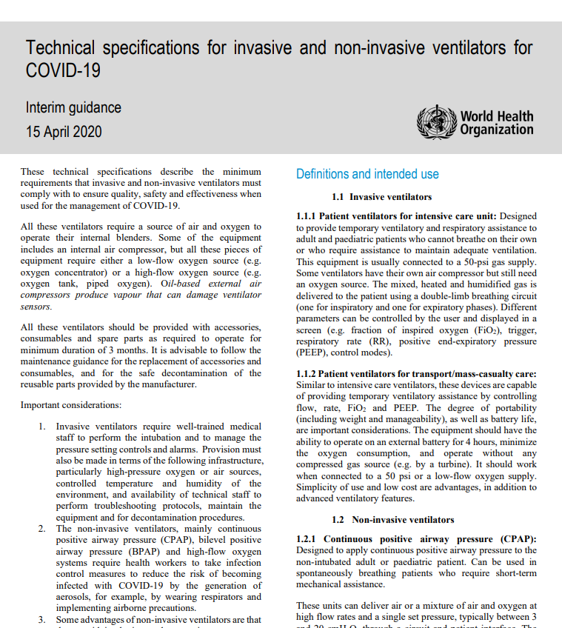
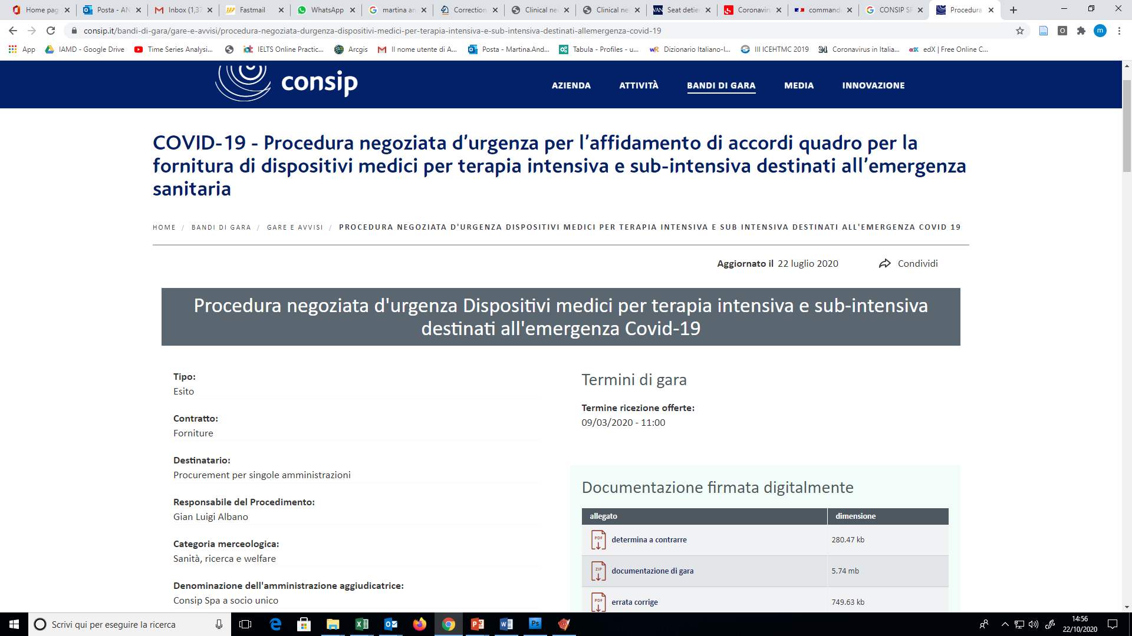
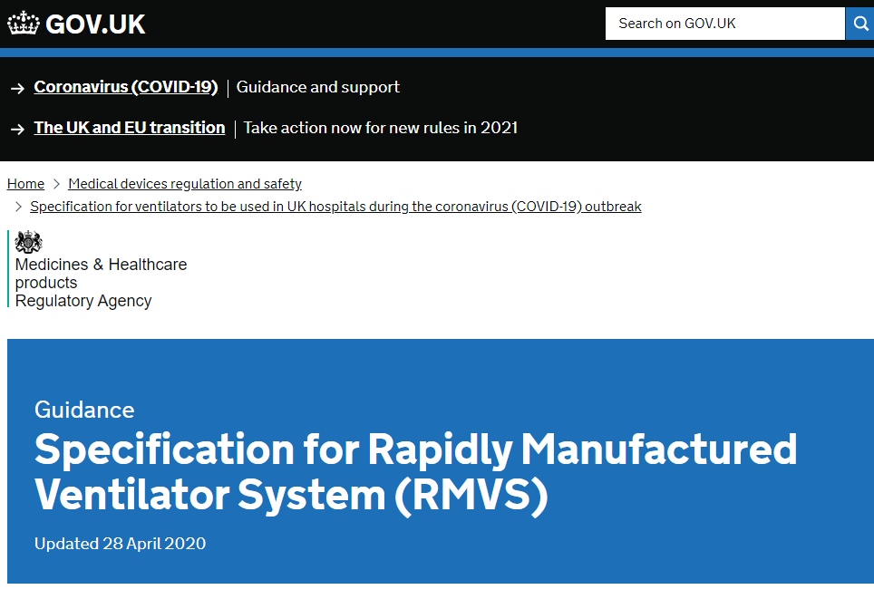
Methods

Slide 9
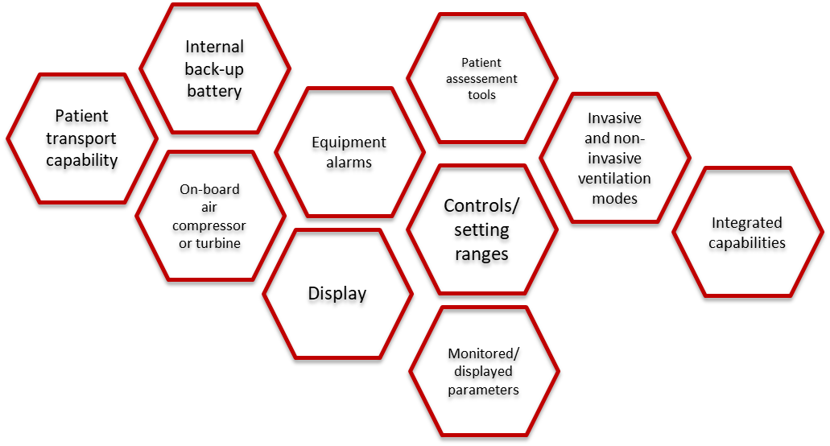
Methods

Slide 10
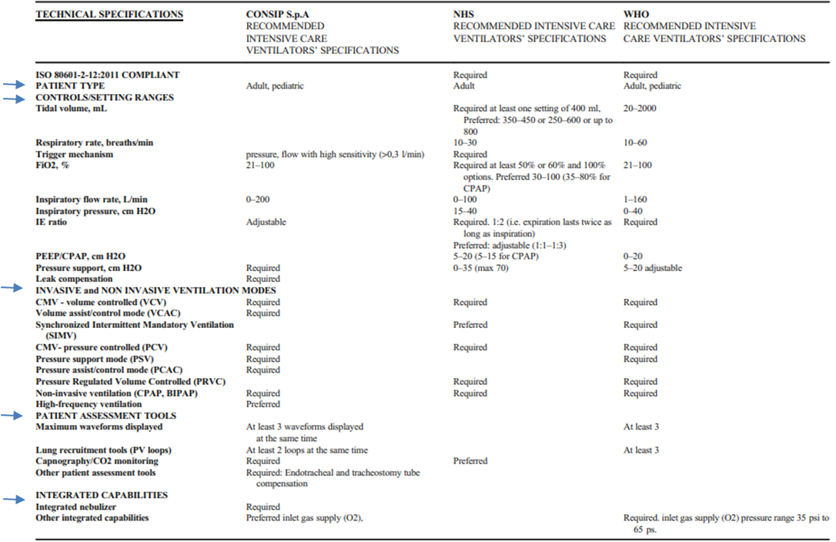
Results
MHRA

Slide 11
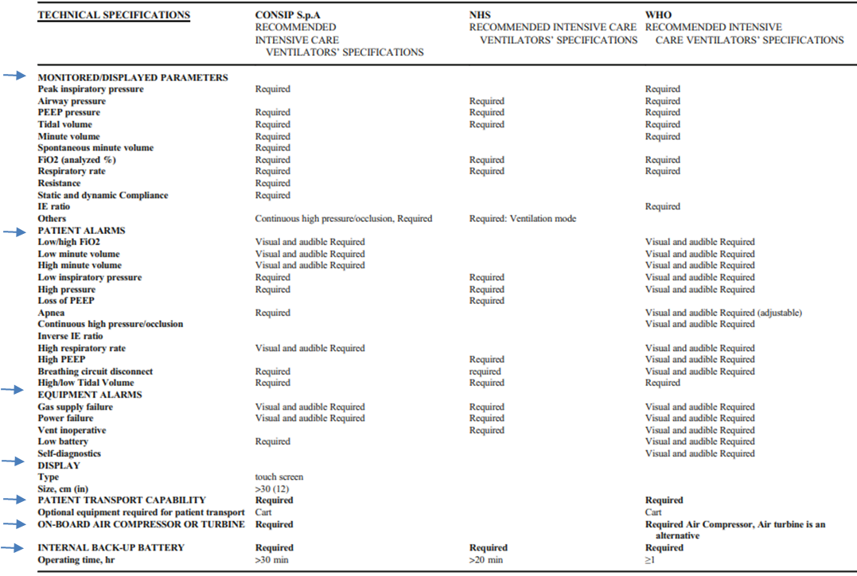
Results
MHRA

Slide 12
Conclusions
Incentivizing cost-effectiveness analysis and the use of evidence-based HTA could lead to a reduction of unnecessary expenses, keeping the real health needs and time as driver indicators
Priorization of health needs is pivotal during emergency
Structured decision-making processes based on evidence, are able to optimize time and resources allocation
In this context, the comparison among different countries points of view might be crucial.

Slide 13
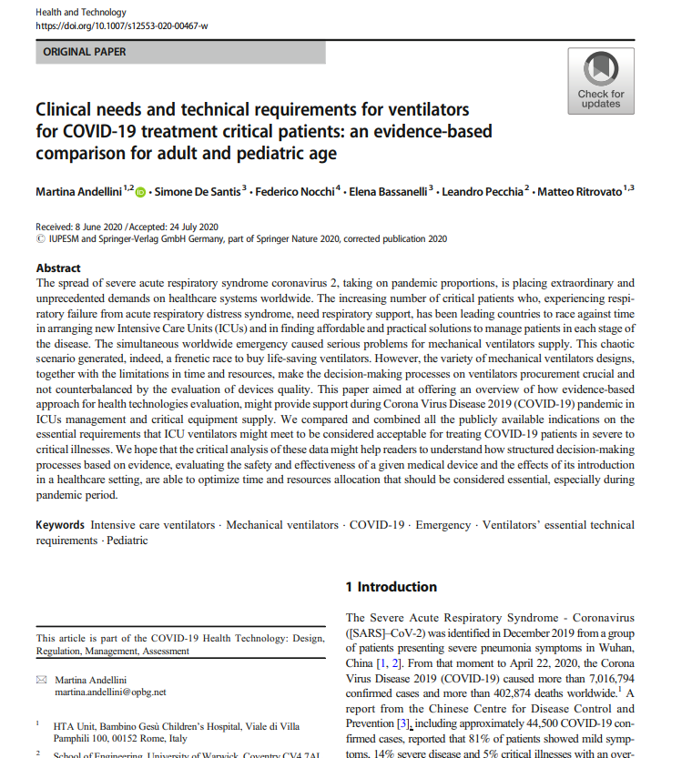
Andellini, M., De Santis, S., Nocchi, F. et al.
Clinical needs and technical requirements for ventilators for COVID-19 treatment critical patients: an evidence-based comparison for adult and pediatric age.
Health Technol. 10, 1403–1411 (2020). https://doi.org/10.1007/s12553-020-00467-w
Thank you for your attention
Martina Andellini
martina.andellini@warwick.ac.uk, University of Warwick, Coventry, UK
martina.andellini@opbg.net , Bambino Gesù Children’s Hospital, Rome, Italy

