Slide 1
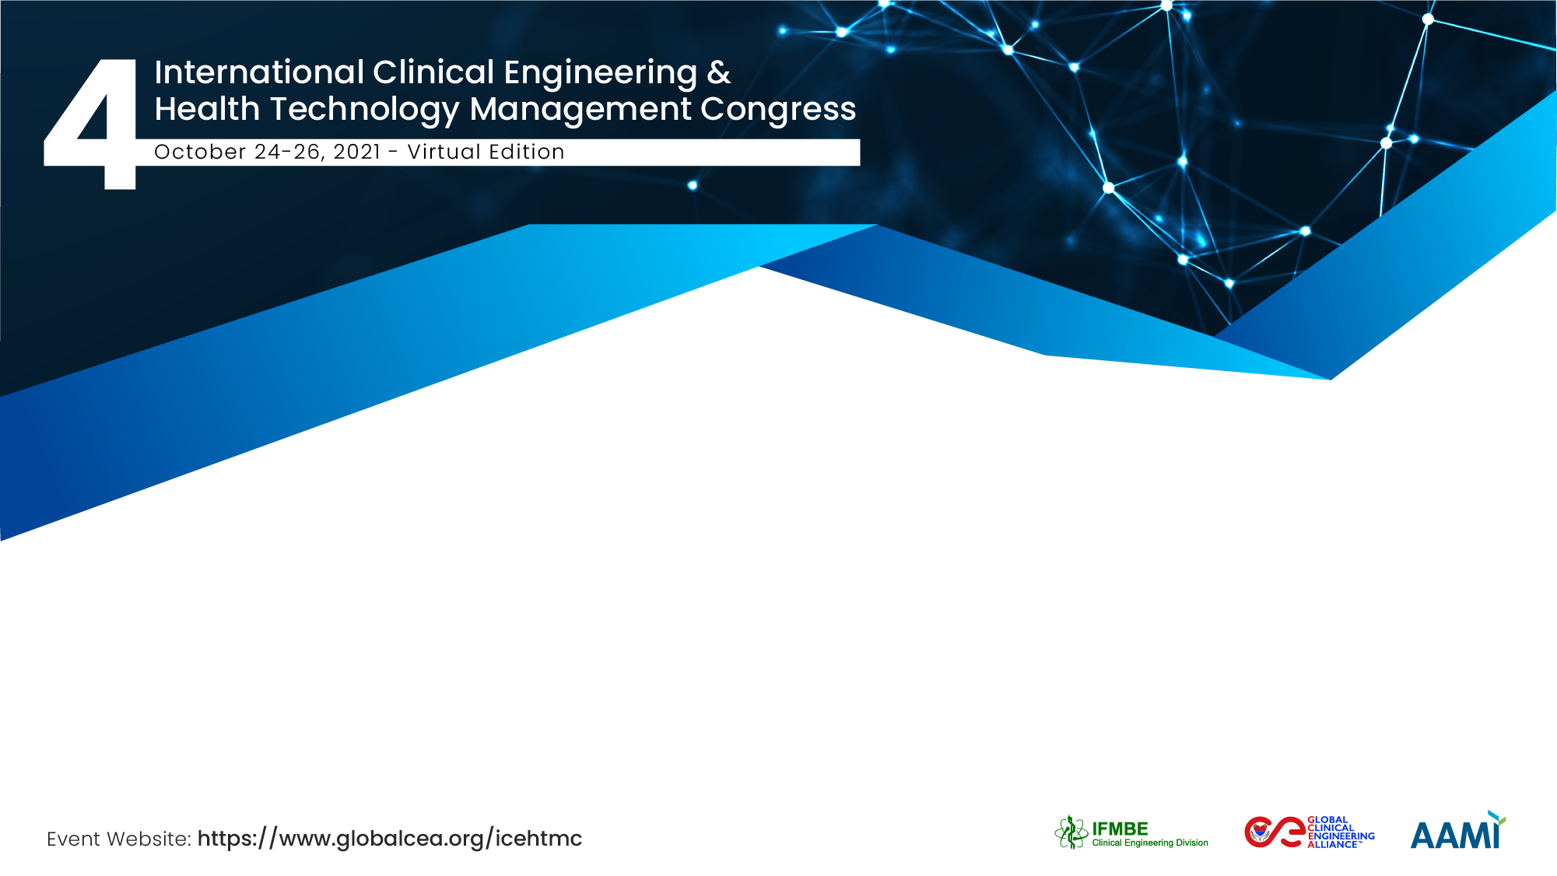
Decisional model for wards reconfiguration in Covid19 emergency
Alice Selva
Operations Management Team
ASST dei Sette Laghi (Italy)

Slide 2
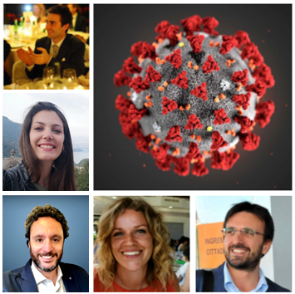
The Team / Workgroup
Operations Management – ASST Sette Laghi
Presenting author
Alice Selva | Operations Specialist Inpatient
Co-authors
Anna Squara | Operations Specialist Outpatient
Luca Ferri | Operations Specialist Operating Rooms
Piergiorgio Salerno | Operations Specialist Technology
Giovanni Poggialini | COO

Slide 3
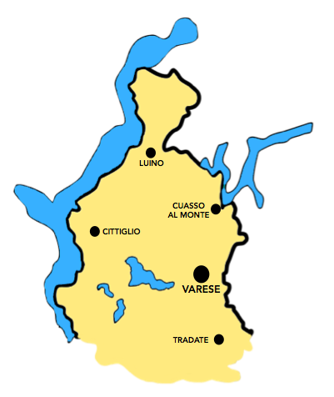

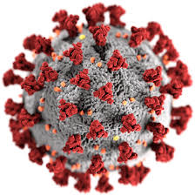
Description
The case of Varese at a glace
3° COVID Hospital
Area of VARESE: 40.OOO inhabitatnts affected by Covid-19
5°COVID Hospital
Covid HUBS distribution in the ASST Sette Laghi area
Maternal&child
COVID Hospital
PONTE
ASST dei Sette Laghi: 6 out of 7 poles as Covid HUBS
2° COVID Hospital
ANGERA
Main COVID Hospital
4°COVID Hospital
ASST dei Sette Laghi: 1800 Covid-19 patients

Slide 4
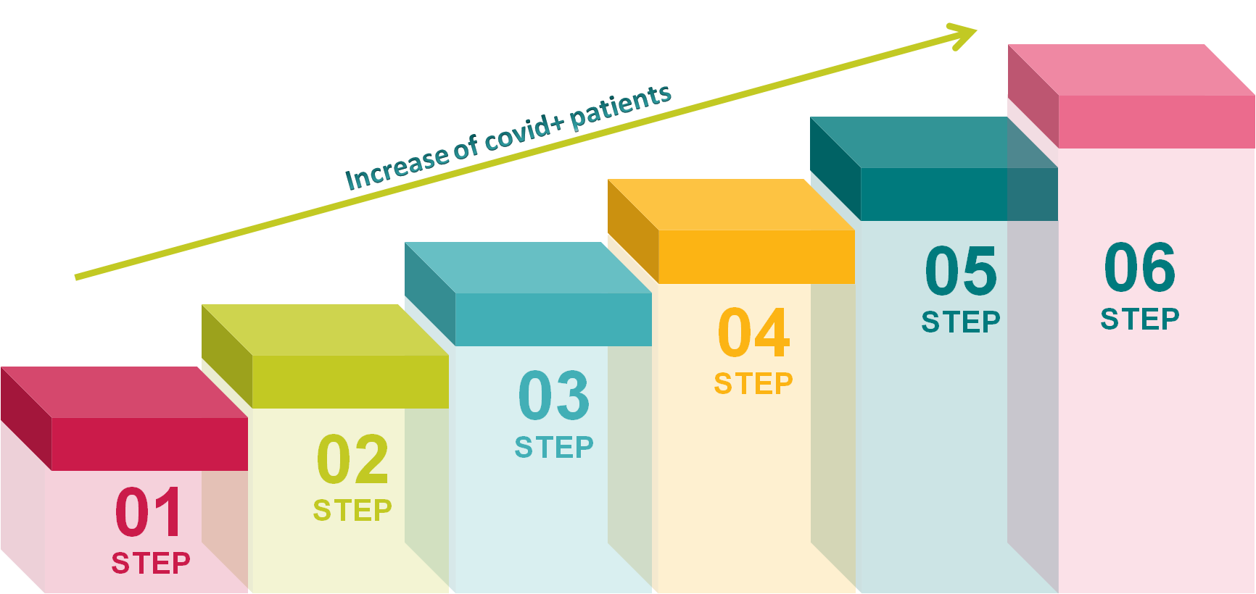
Description
WHO: the Operations Management team
WHAT: developed a decisional step-based-model (VI steps)
WHY: to be promptly reactive in the conversion of wards of each pole from Covid- to Covid+
HOW: the activation of a new step depended on the achievement of a threshold value of Covid+ acute patients

Slide 5
Goals of the project and final users that will benefit
Goal
Balance the demand for different care settings for Covid+ patients and the need of continuing the Covid- activities for urgent and non-procrastinable cases.
Execution
The exceedance of a specific threshold of acute Covid+ patients determines the activation of the related rearrangement step, thus incrementally converting wards from Covid- to Covid+ according to the different care setting.
Beneficiaries
Patients affected by Covid+, that receive the most appropriate cure setting according to their health status.
Patients affected by urgent not-covid-related disease who have had the necessary treatment guaranteed.

Slide 6
Goals of the project and final users that will benefit
Threshold point
Number of acute covid+ patients
Th 5: 450
Th 6: 480
Th 1: 100
Th 2: 175
Th 3: 250
Th 4: 350
Number of beds availablility through the activation of each step
STEP 5:
562
STEP 6: 684
STEP 4: 448
STEP 3: 340
STEP 1: 150
STEP 2: 210
Overall beds activated for each thereshold

Slide 7
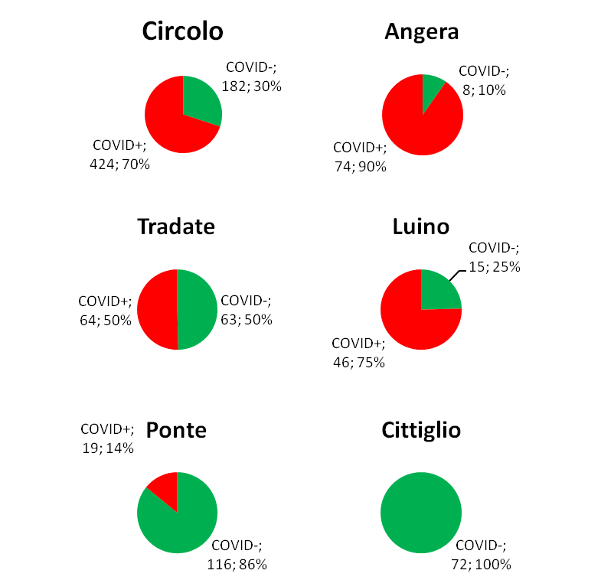
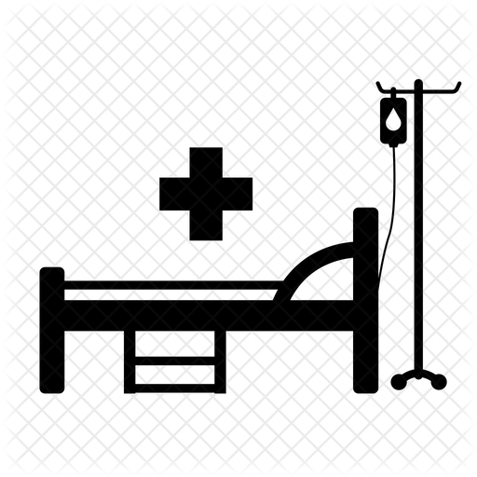


Results
06
Covid-and Covid + distribution
05
01
645 covid+ patients cure simultaneously (150 with respiratory support)
350 new Covid+ patients within a week (50 admission/day).
02
Balance the workload among acute, subacute and intensive care
departments and the operating rooms.
03
Beneficiaries
03
225 surgery operations per week guaranteed for emergencies and urgent
surgical operations

Slide 8
Alice Selva
Alice.selva@asst-settelaghi.it
ASST dei Sette Laghi, Varese (Italy)

