Slide 1
Design Implementation of a Sustainable Accurate Malaria Diagnostic at Primary Care Facilities for Developing Countries
Eustache Muteba
- International Medical Informatics Association (IMIA), Correspondent in DR Congo
- Department of Electronics and Informatics (ETRO), Vrije Universiteit Brussel (VUB), Belgium

Slide 2

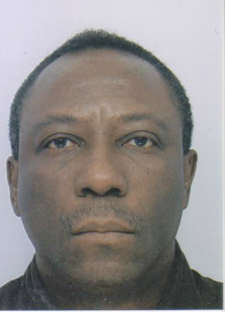
The Team / Workgroup
Eustache Muteba
Researcher-Lecturer
https://orcid.org/0000-0002-2133-5710

Slide 3
Description
In developing countries multiple challenges still run over despite their realistic strategies to fight against malaria disease. Among these challenges, there are: Acquisition of a low-cost digital microscope; Adequate infrastructures and facilities (Internet, power supply, maintenance); Integration of the digital microscope in hospital activities; Lab technician competences; Waiting time of lab results.
Too many people worldwide suffer unnecessarily because they lack access to
affordable health technology and to low-cost medical solutions. Efficacious
Interventions are needed to fill this gap.
Our study presents a design of implementation strategies for a sustainable accurate
malaria diagnostic at primary care facilities, national level, of developing countries.

Slide 4
Goals of the project and final users that will benefit
The goal of the project is the development of implementation strategies:
- to allow acquisition of a low-cost digital microscope of medical institutions,
to assure sustainable accurate malaria diagnostic at primary care facilities, National level, of developing countries.
Principals beneficiaries are:
1° Decision makers: to decide the reduction and subvention of medical materials; to control and eliminate malaria;
2° Healthcare givers/Lab technicians: to effectively use the materials and to improve the quality of care;
3° Patients: to cure.

Slide 5
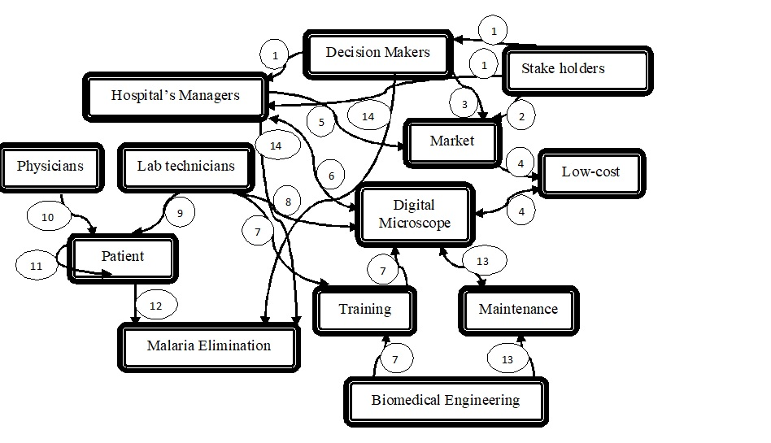
Results
We suggest a strategic plan that specifies events and activities to achieve.
A conceptual diagram shows how the strategic plan could be operational.
Furthermore, a list of addressed outcomes and its measures is presented.
Events and Activities
Event 1: Meeting to establish the conciliation procedure with decision maker, stake holders and hospital’s managers
Event 2: Prospecting and marketing a low-cost digital microscope obtained from material vendors and donors
Event 3: Implications of decision makers to subsidized material acquisition
Event 4: Provide a low-cost digital microscope
Event 5: Acquired a low-cost digital microscope
Event 6: Hospital’s equipment
Event 7: Training
Event 8: Using digital microscope for laboratory test
Event 9: Laboratory result
Event 10: Diagnosis and treatment
Event 11: Following treatment
Event 12: Cure and eliminate malaria
Event 13: Maintenance and Evolution (new acquisition)
Event 14: National goals to control and eliminate malaria is achieved

Slide 6
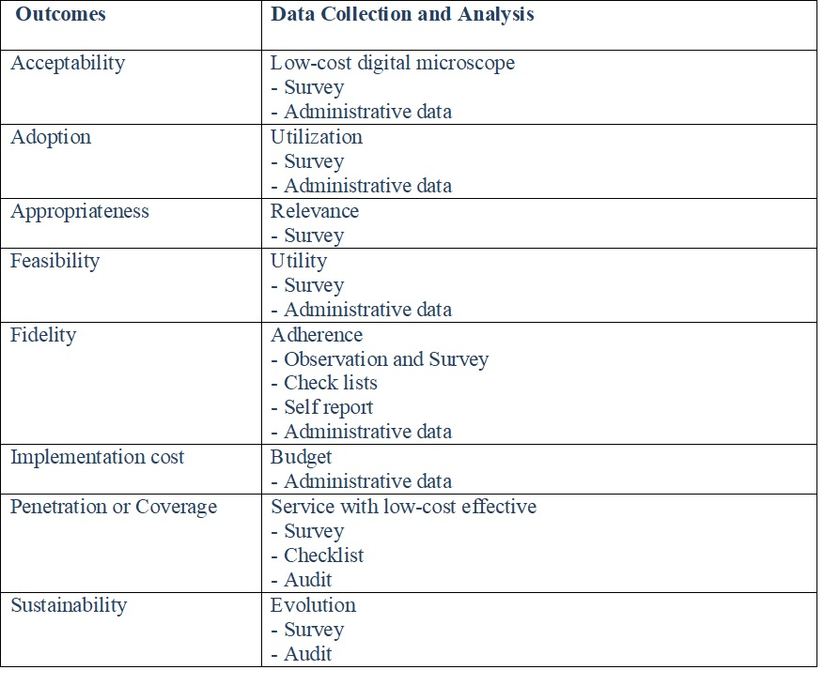
Results
Addressed Outcomes

Slide 7
Eustache MUTEBA
emuteba@etrovub.be;
emuteba@hotmail.fr
International Medical Informatics Association (IMIA), Correspondent in DR Congo

