Slide 1
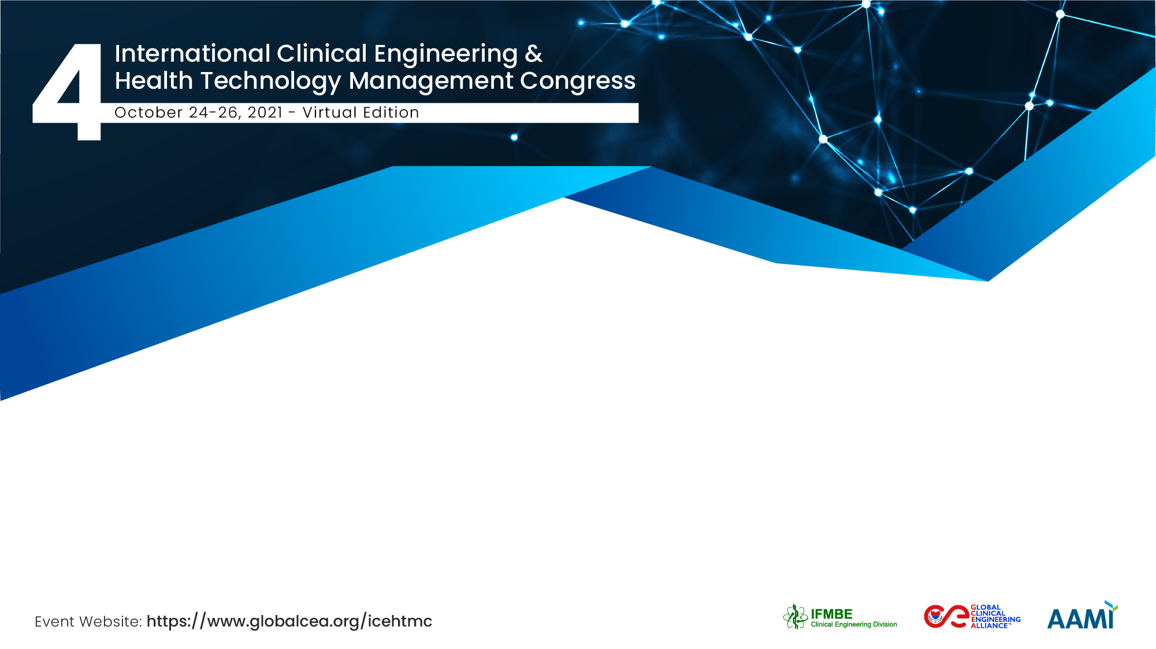
Developer Driven Framework for
Security and Privacy of Data in Flow in the Internet of Medical Things
Ceara Treacy
Dundalk Institute of Technology

Slide 2

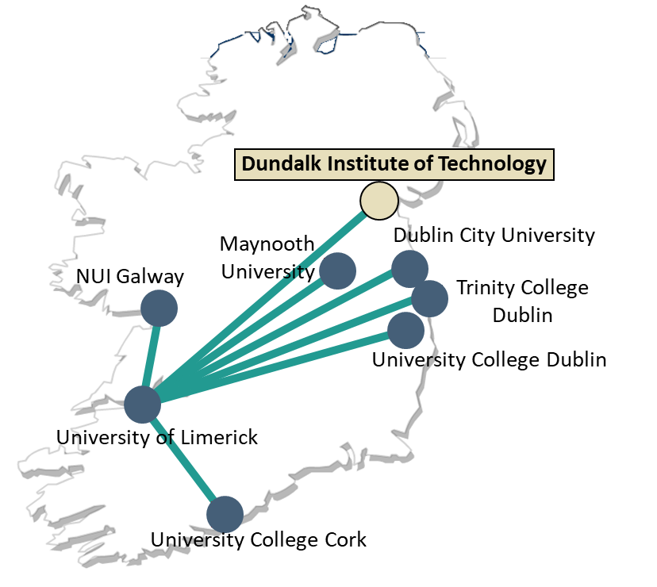


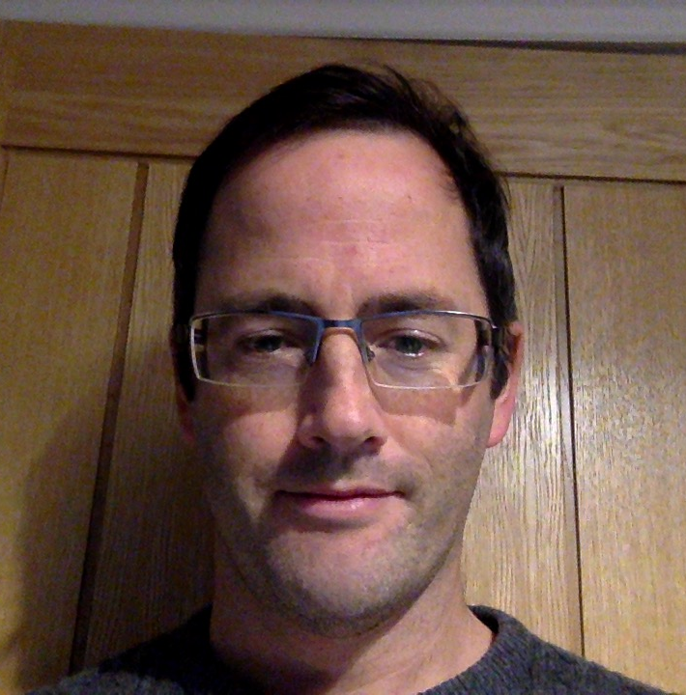
Regulated Software Research Centre (RSRC) and Lero, the Science Foundation Ireland Research Centre for Software
Ceara Treacy
Professor Fergal McCaffery
Dr John Loane
Notes:
Education
Courses
Training Modules
HDip Healthcare Software
MSc Medical Device Software
MSc Healthcare Software
Basic Research
Medical Device Software Engineering / Processes
Embedded Software
Traceability
Medical device Security
Medical IT Networks
Medical Software Defects
Medical Software Testing
Applied Research
Increasing Efficiency
Medical Device Software Roadmaps
Targeted Research
Standards
IEC 62304 (IEC 80002-3)
IEC 82304-1
IEC 80001-2-7
IEC 80001-2-8,
IEC 80001-2-9
MDevSPICE
AAMI SW91

Slide 3
Developer Driven Framework for Security and Privacy of Data in Flow in the Internet of Medical Things (IoMT)
AAMI TIR57 Recommended Security Risk Process
Security and Privacy risk management plan
Step 1
Contextual Knowledge
Step 2
System Decomposition
Security and privacy risk analysis
Threat Modeling
Step 3
Threat Identification
Security and privacy risk evaluation
Step 4
Analyse the Threats and Prioritisation
Security and privacy risk assessment
Security and privacy risk control
Data Flow Security and Privacy Controls
Step 5
Determine Framework Properties against Identified Threats
Security and privacy risk management
Evaluation of overall residual security and privacy risk acceptability
Step 6
Selection of Controls to Mitigate Threats
Security and privacy risk management report
Data Protection Impact Assessment
(DPIA) to assist in compliance with Data Protection Principles of the General Data Protection Regulation (GDPR)
Production and postproduction information
Notes:
Align with the requirement of Art. 25 of the GDPR, which is Data protection by design and by default
The controller shall implement appropriate technical and organisational measures for ensuring that, by default, only personal data which are necessary for each specific purpose of the processing are processed.
European Union Agency for Cybersecurity (ENISA) policy makers and regulators promote the use of DPIAs as a means of threat modeling and building data protection by design and by default into their products and systems

Slide 4
Provide evidence for adherence to the 7 Key GDPR Data Protection Principles
Data Protection Principles
Framework
Properties
Security Properties
Framework Properties
Privacy Properties
Framework
Threat Modeling
STRIDE
ISO/IEC 27033-3 Information technology -- Security techniques -- Network security
LINDDUN
Data Flow Security and Privacy Controls
(DFSPCs)
Corresponding Threat Types
Identify and mitigate the threats
Notes:
The framework is built out of the data protection principles of the GDPR, which include both consideration for data security and privacy
Read from the slide
INTRO - These key principles are set out right at the beginning of the GDPR and they both directly and indirectly influence the other rules and obligations found throughout the legislation. Therefore, compliance with these fundamental principles of data protection is the first step for controllers in ensuring that they fulfil their obligations under the GDPR. The following is a brief overview of the Principles of Data Protection found in article 5 GDPR:
1. Lawfulness, fairness and transparency - Any processing of personal data should be lawful and fair. It should be transparent to individuals that personal data concerning them are collected, used, consulted, or otherwise processed and to what extent the personal data are or will be processed. The principle of transparency requires that any information and communication relating to the
2. Purpose Limitation - Personal data should only be collected for specified, explicit, and legitimate purposes and not further processed in a manner that is incompatible with those purposes. In particular, the specific purposes for which personal data are processed should be explicit and legitimate and determined at the time of the collection of the personal data. However, further processing for archiving purposes in the public interest, scientific, or historical research purposes or statistical purposes (in accordance with Article 89(1) GDPR) is not considered to be incompatible with the initial purposes.
processing of those personal data be easily accessible and easy to understand, and that clear and plain language be used.
3. Data Minimisation - Processing of personal data must be adequate, relevant, and limited to what is necessary in relation to the purposes for which they are processed. Personal data should be processed only if the purpose of the processing could not reasonably be fulfilled by other means. This requires, in particular, ensuring that the period for which the personal data are stored is limited to a strict minimum (see also the principle of ‘Storage Limitation’ below).
4. Accuracy - Controllers must ensure that personal data are accurate and, where necessary, kept up to date; taking every reasonable step to ensure that personal data that are inaccurate, having regard to the purposes for which they are processed, are erased or rectified without delay. In particular, controllers should accurately record information they collect or receive and the source of that information.
5. Storage Limitation: Personal data should only be kept in a form which permits identification of data subjects for as long as is necessary for the purposes for which the personal data are processed. In order to ensure that the personal data are not kept longer than necessary, time limits should be established by the controller for erasure or for a periodic review.
6. Integrity and Confidentiality: Personal data should be processed in a manner that ensures appropriate security and confidentiality of the personal data, including protection against unauthorised or unlawful access to or use of personal data and the equipment used for the processing and against accidental loss, destruction or damage, using appropriate technical or organisational measures.
7. Accountability: Finally, the controller is responsible for, and must be able to demonstrate, their compliance with all of the above-named Principles of Data Protection. Controllers must take responsibility for their processing of personal data and how they comply with the GDPR, and be able to demonstrate (through appropriate records and measures) their compliance, in particular to the DPC.

Slide 5
Step 1
Contextual Knowledge
Step 2
System Decomposition
Step 3
Threat Identification
Step 4
Analyse the Threats and Prioritization
Step 5
Determine Framework Properties against Identified Threats
Step 6
Selection of Controls to Mitigate Threats
Identify Need for a DPIA
Identify Lawful Legal Requirements and Categorise PII
Understand Framework Properties
Administrate Two LINDDUN Properties and Threat Categories
Identify the Assets
DFDs -Decomposition Levels 0 – 2/3
  - Annotations
STRIDE & LINDDUN Threat Categories
Threat Modeling
Security
and Privacy
Library Threats/Attacks
CWE Top 25
OWASP Top 10 (API)
Threat Identification
Per-Interaction
Threat Types
NIST 800-30 Risk = Likelihood x Impact
Prioritising (PII) Highest ranked in Libraries
Ranking according to PII categorisation/harm
Mapped Framework Properties to Threats
Select Data Flow Security and Privacy Controls (DFSPCs) to mitigate threats

Slide 6
Goals of the project and final users that will benefit
To assist SMEs and inexperienced developers in the IoMT assure the security and privacy of data in flow in the IoMT in line with data security and privacy regulations.
In SMEs, developers and designers are the key groups responsible for bringing functional activities for compliance with GDPR in systems and products
The framework’s goals is to assist SMEs and developers:
Negotiate the GDPR data protection requirements. The GDPR does not provide clear guidelines for designers and developers on how to build GDPR compliant products. The regulation is complicated and the details on the different aspects of the are disseminated throughout the regulation.
Lack of concise guidance and disseminated standards for security and privacy generally and in the security and privacy domain if difficult to navigate.
This is further complicated due to the lack of skilled security and privacy developers and available software. SMEs struggle to maintain and attract talent.
Assist with the assuring

Slide 7
Results
The Developer Driven Framework has been extensively scientifically validated by experts in security and privacy standards
It was then successfully piloted in the development teams of multiple medical device organisations
  The organisations are now using the framework for new development projects
  The framework is being used as a starting position for a software bill of materials (SBOM) led by the development team.
A comment from one CTO
“We had no idea what was needed, and the framework completely took the guess work away”

Slide 8
Ceara Treacy
Ceara.treacy@dkit.ie
Dundalk Institute of Technology, Regulated Software Research
Centre, Ireland
“This work was supported with the financial support of the Science Foundation Ireland grant 13/RC/2094 and co-funded
under the European Regional Development Fund through the Southern & Eastern Regional Operational Programme to
Lero - the Science Foundation Ireland Research Centre for Software (www.lero.ie)”.

