Slide 1
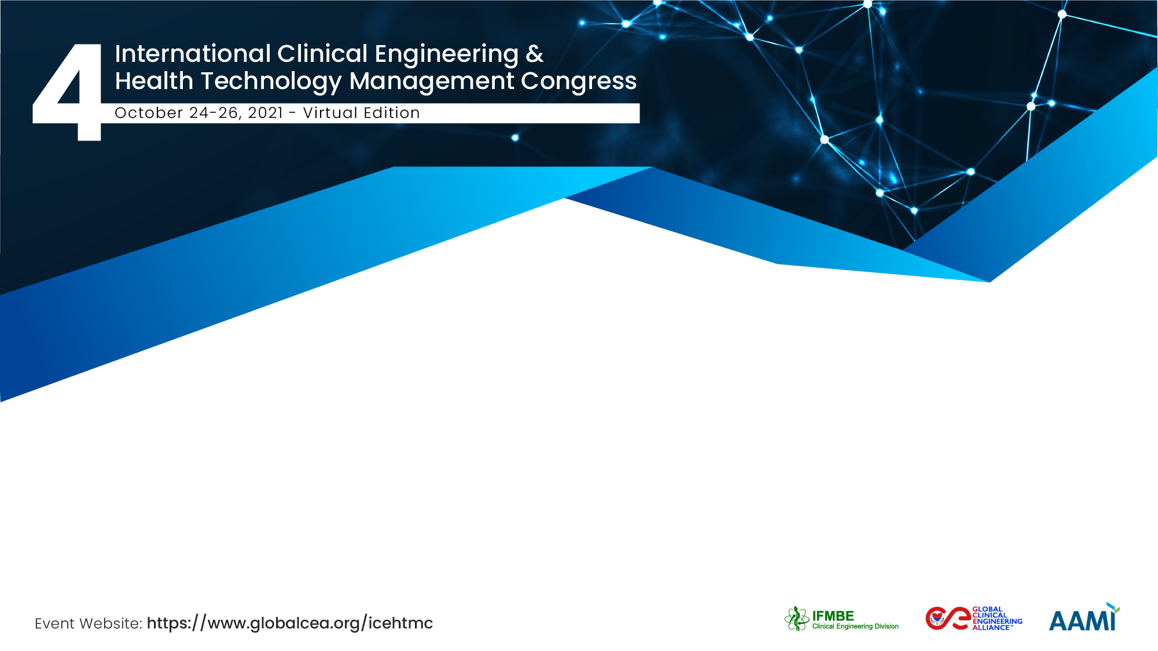
Development of A Set of Minimum Requirements for Remote Patient Monitoring Solutions
Meabh Smith
Medical Physics & Clinical Engineering, Beaumont Hospital, Dublin, Ireland

Slide 2
The Team
Meabh Smith,
Medical Physics & Clinical Eng, Beaumont Hospital, Dublin, Ireland
Loretto Grogan,
Chief Nursing Information Officer, Health Services Executive, Ireland
Michael Duane,
Medical Physics & Clinical Eng, University College Hospital, Galway, Ireland
Heather Cronin,
Health & Social Care Electronic Healthcare Record Lead, National Rehab Hospital, Dublin, Ireland
High-level, Multi-disciplinary, Multi-organisational

Slide 3
Protect investment: clinical, technical, workflow – How?
Context:
  Changing models of care – Covid;
  Rapid deployment of new digital tech;
  Many start-ups in Ireland.
HTA
Rapid
Localised
Digital
Kotters 8 Steps to Change
  Urgency
  Powerful coalition
  Vision for change
  Communicate the vision
  Remove obstacles
  Short-term wins
  Build on change
  Anchor the changes in corporate structure.

Slide 4
Goal
Beneficiaries
Tool for Rapid Assessment of Digital Technology
Easy to use
Standardised
Relevant
Effective
Sensitive to different organisational structures
People, Process, Tech
Funders - value
Clinicians – care of patients
Patients – home-based care
Clinical Engineers
  – ensuring appropriate investment of effort
International Community?

Slide 5
Method
 | Objective/ Subjective | Assessment Standard | Process/ Work Flow Impact | Technology Impact | Effective/ Relevant | Safety | Cost | Data Security | Data Protection | Usability | Value
Company information
Product information
Data:
Usability Summary:
Technical Support for patient:
Costs:
Anticipated Benefits (outline to support business case):
Interoperabilty
Ethics and Legal Issues
Break-it Assessment?
Is there an opportunity for Dis-investment?

Slide 6
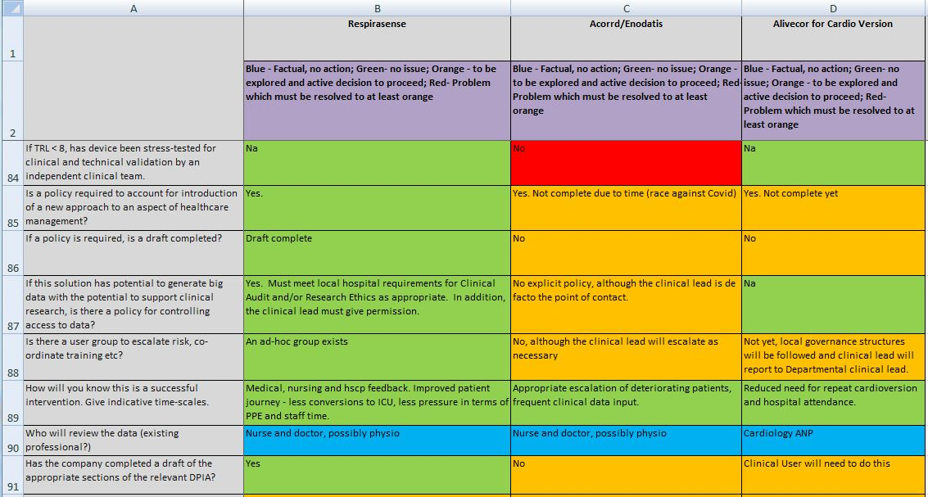
Results

Slide 7
Conclusion
Necessary to ensure valid, cost-effective and safe use of tech;
Supports:
  Innovation (transparency)
  Business Case and development of specifications
  Risk Assessment (required)
Value can only be achieved with buy-in from senior decision-makers and practitioners - > must be embedded within well-developed Governance structures.

Slide 8
Meabh Smith
meabhsmith@beaumont.ie
BEAI, Biomedical Engineering Association of Ireland
Dept of Medical Physics & Clinical Engineering
Beaumont Hospital
Dublin
Ireland

