Slide 1

Digital Bridges: Bringing Hope and Healing to those Hurting the Most
Manish Kohli, MD, MPH,MBA, FHIMSS, FAAFP and Bret Heinrich, CFRE, MFA
Senior Advisor, Albright Stonebridge Group CEO
Board Member and Global Programs Committee Chair, Wings of Hope Wings of Hope
Past Chairman of Board, HIMSS

Slide 2


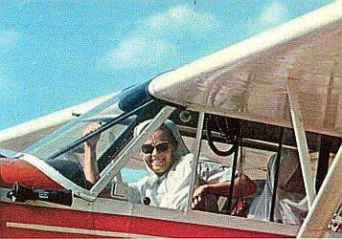

MISSION
Changes and save lives through the power of aviation.
VISION
We envision a world in which all people have access to the resources they need to create a better life.
50+
Years serving humanity worldwide
160
Operations served since founding
48
Countries served since founding
2
Nobel Peace Prize Nominations
Notes:
Description
This presentation will present the team’s experiences building and deploying this novel ecosytem that is designed to serve communities globally- long before planes and teams arrive with humanitarian assistance and long after they ﬂy out. In a sense, the Wings of Hope Global Humanitarian Network serves to ensure that hope, health and healing will always be accessible to the vulnerable, whether or not we are physically present with a plane on the ground in a community.
Wings of Hope and its Colombian-based NGO partner, Patrulla Aérea Civil Colombiana have been providing humanitarian assistance in El Charco and eleven other similarly remote communities using airplanes and physical runways to deliver life-saving health care through surgery and clinical consultations. While this help is indeed saving and changing lives, Wings of Hope recognizes gaps in access to critical healthcare when the planes are not on the ground
Goals of the project and final users
that will benefit
In an era where more people have access to mobile phones than to clean water, electricity or toothbrushes, there is a clear and compelling opportunity to leverage technology to help directly address critical needs. Founded in 1963, Wings of Hope provides lifesaving and life-changing humanitarian assistance and public beneﬁt ﬂights to thousands of Americans and to indigenous people in developing countries around the world.
The organization is a two-time Nobel Peace Prize nominee and is consistently recognized as a leader in safety and patient care. Building on its proven successes in saving and changing lives through the power of aviation and, in an increasingly digitally connected world, Wings of Hope envisions a realm of opportunities to deepen and broaden the impact of its humanitarian endeavors.

Slide 3


Slide 4
Program Values
Empowerment
Scalability
Stewardship
Sustainability
Notes:
Manish

Slide 5

Working towards Sustainable practices
GHN Partner
Capacity-Building
Community
Participatory Methods
Empowerment
Knowledge Exchange
Best Practices
Training Programs
Utilizing local resources
Data Driven

Slide 6
Together we go farther:
Partnership Model
Patrulla, Colombia
Service Partners
Wings of Hope
Communities
Samaritan Aviation, Papua New Guinea
Donors
Volunteers
Vendors
Fly Spec, Zambia
Flying Medical Service, Tanzania
Communities
Communities
Communities
Communities
Notes:
MANISH
Common value: we will share and support each others success

Slide 7
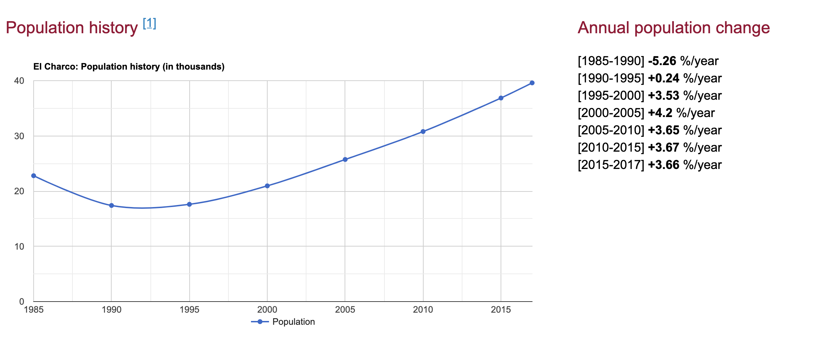
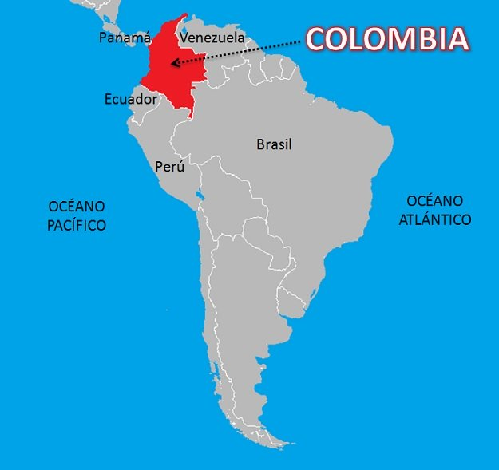
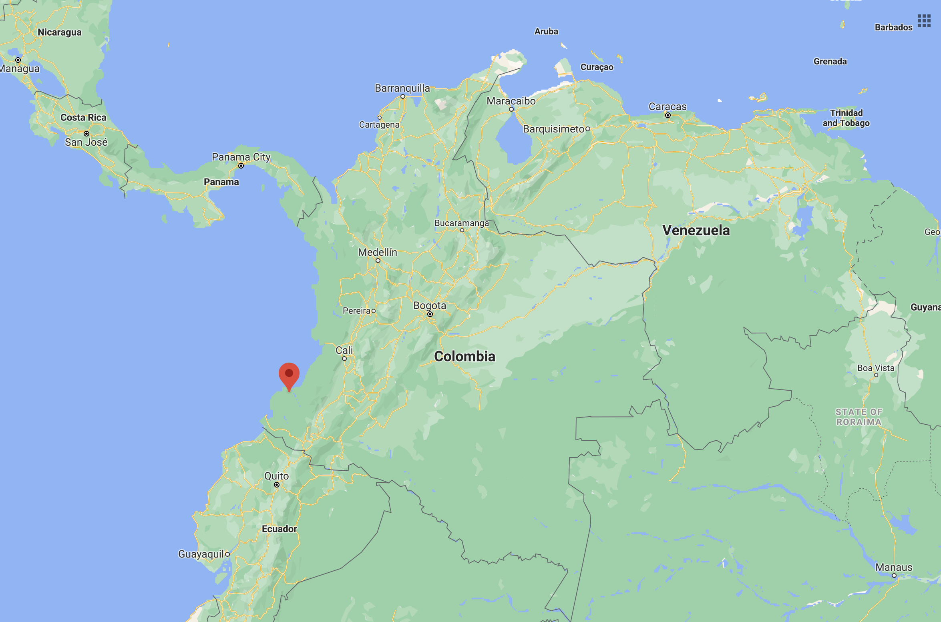
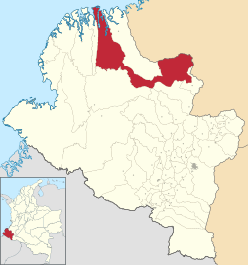
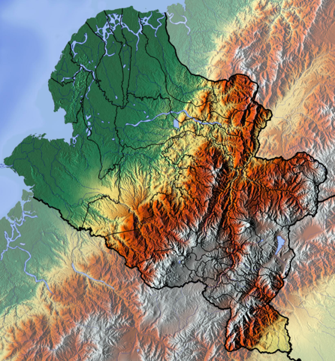
EL CHARCO, Nariño, Colombia
67% Urban
33% Rural
67.3% of the population in Nariño and 99% in El Charco lives below the poverty line

Slide 8
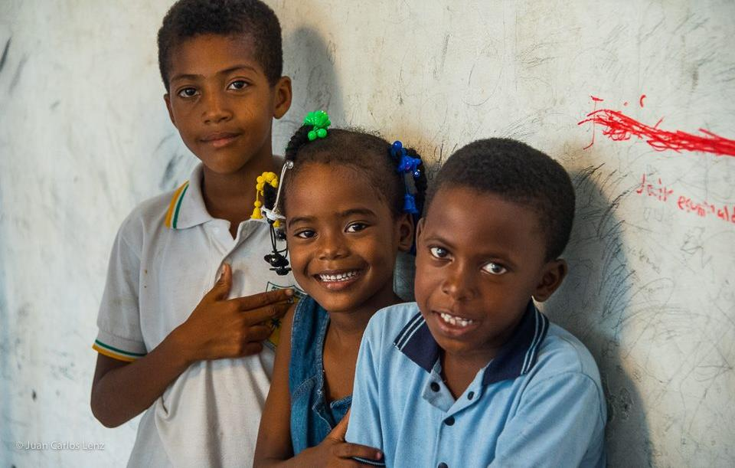
We want to go even further…
Telehealth
Remote Patient Monitoring
Drone Program
Data and Analytics
Supply Chain and Logistics
Funding
Program development
Access to vendors and international domain knowledge partners
  Digital runway to help PAC develop a secure and stable connectivity to stay in touch with the communities.
  Tools for telehealth, diagnosis and digital clinical record.
  Data management expertise
Dedicated airplane/ Drone technology

Slide 9
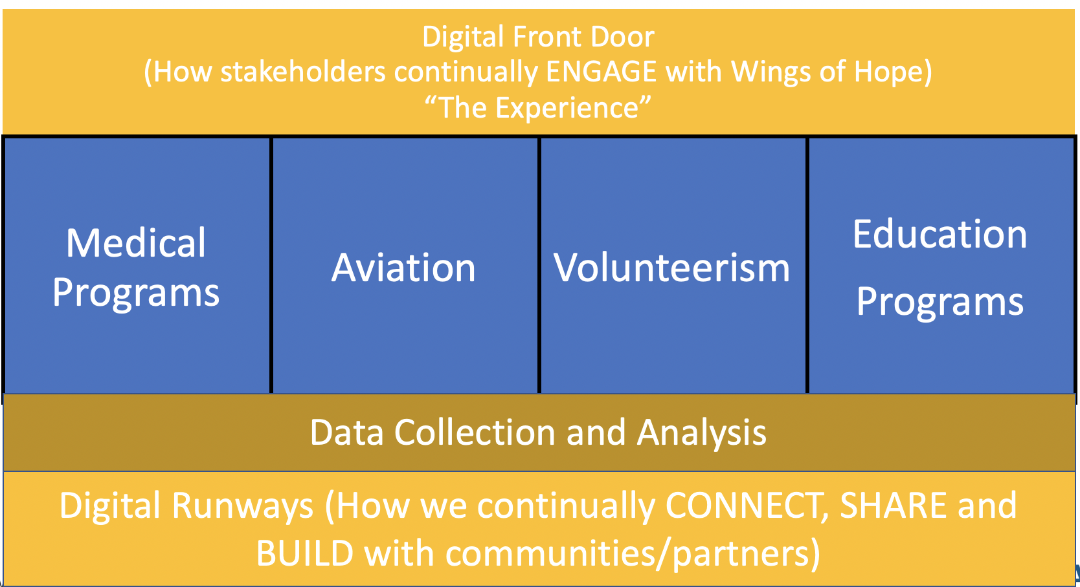
Global Humanitarian Network
Notes:
MANISH

Slide 10
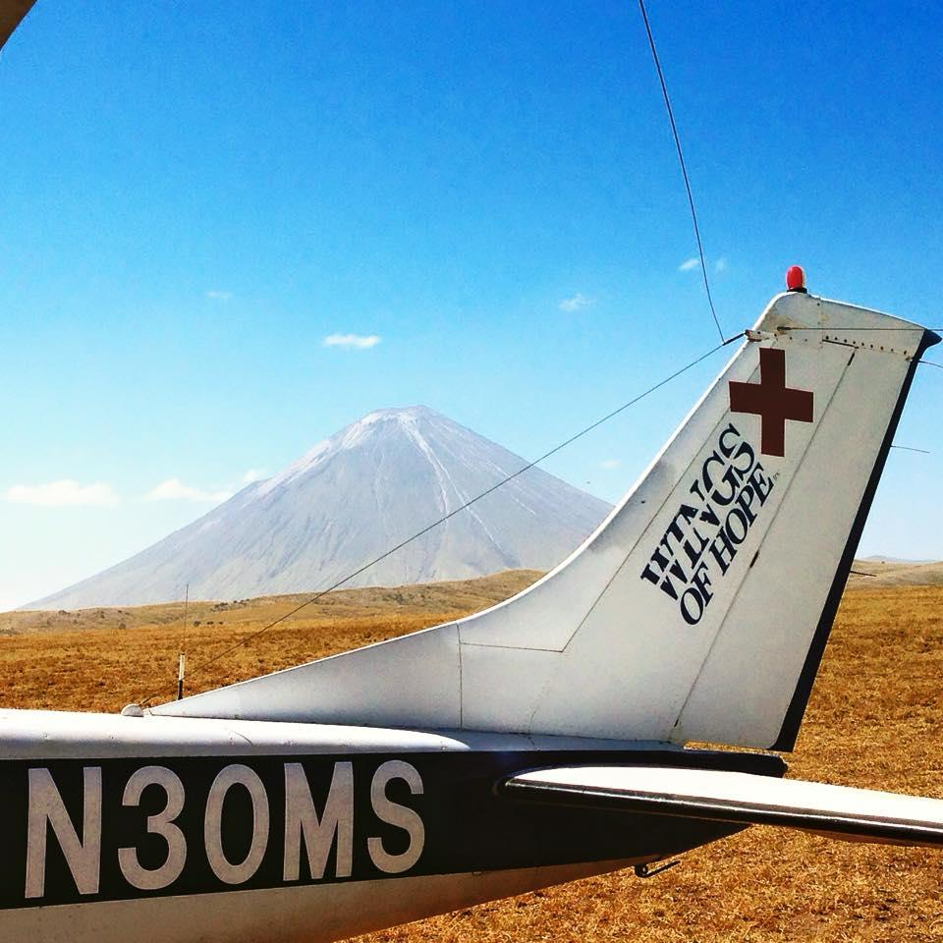
Bringing Hope and Healing to those who are hurting the most
Where there are wings, there is Hope
Notes:
Leveraging the promise of a digital runway to augment the power of its ﬁxed wing and volunteer programs, the organization embarked on an ambitious, transformative journey to create a digitally distributed ecosytem, powered by emerging and established technologies such as unmanned aerial systems (UAS, aka drones), virtual care and education platforms, remote patient monitoring tools, analytics and artiﬁcial intelligence, to bridge disparities in care at scale, sustainably.

Slide 11

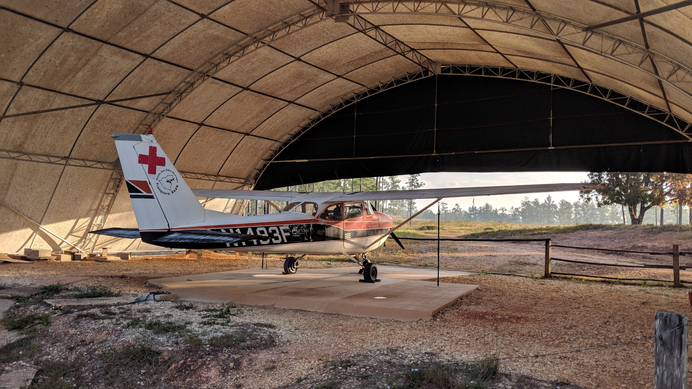
Manish Kohli, MD, MPH,MBA, FHIMSS, FAAFP
manish.kohli@wingsofhope.ngo
Bret Heinrich
bret.heinrich@wingsofhope.ngo

