Slide 1

2024 Global Clinical Engineering Day/Week
International Program for Open-Source Medical Device Design:
A contribution to development cooperation
Ramon Farré, Ph.D.
Professor of Physiology
Unit of Biophysics & Bioengineering
School of Medicine & Health Sciences
rfarre@ub.edu

Slide 2

Next slides present a short description of the Program
Full details can be found at:
www.open-source-medical-devices.com

Slide 3

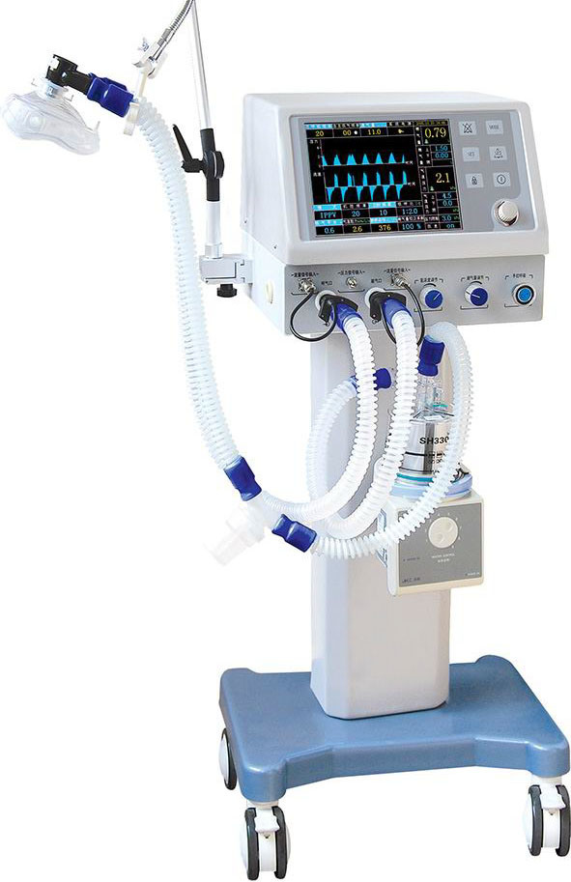
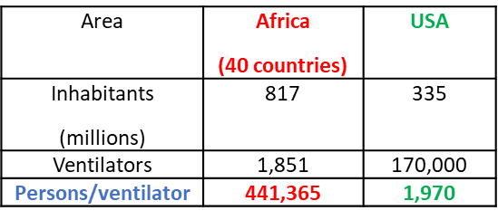
International Program for Open-Source Medical Device Design: A contribution to development cooperation
The problem
Most medical devices are produced by companies in developed countries, with high product prices thus unaffordable to most patients in LMICs.
Example:
Mechanical ventilators
Only a small wealthy minority in LMICs have access to commercialized medical devices. Billions of inhabitants in low-resource regions have scarce or no access to life-saving medical equipment.
Inequity in global health:
How to reduce this access inequality besides passively waiting under the wishful thinking that economic differences among countries will soon disappear?

Slide 4
International Program for Open-Source Medical Device Design: A contribution to development cooperation
Possible solutions?
1) Philanthropic donations of commercially available medical devices: helpful for specific cases, but not a universal solution (high cost, maintenance problems).
2) Building devices in LMICs could reduce production and distribution costs while enabling improved servicing and repairs but is challenging and slow. It requires:
- capital funding,
- trained professionals,
- management of intellectual property,
- reduction of costs to ensure that the devices are affordable.
3) Alternatively, an open-source approach provides an opportunity for the provision of medical technology in low-resource regions.

Slide 5
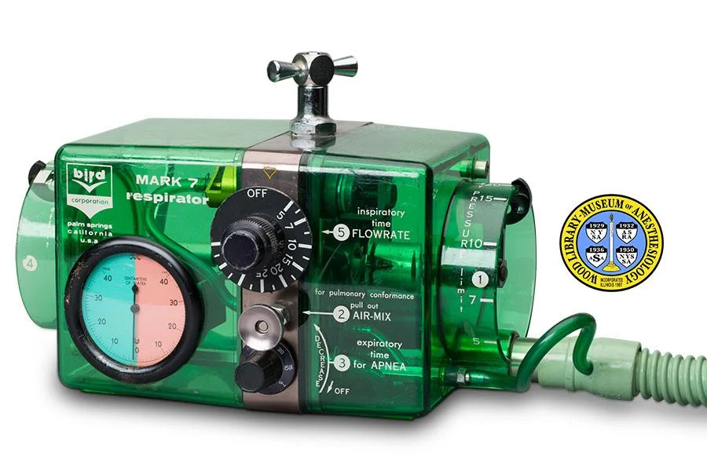
International Program for Open-Source Medical Device Design: A contribution to development cooperation
Open-source techology development
Is based on the sharing of detailed technical descriptions open to be freely replicated or adapted without any patent restrictions or limitations.
It can be applied following the concept of frugal engineering, i.e. the design is focused on the core functions, avoiding non-essential functionalities.
Commercial industrial strategies are typically based on competition, usually by offering complementary (vanity) features may provide a competitive advantage.
Most commonly used medical devices are based on often simple technological principles that originated decades ago and are no longer restricted by patents.
1950-60

Slide 6
International Program for Open-Source Medical Device Design: A contribution to development cooperation
Open-source, high-performance, low-cost medical devices
Currently facilitated by:
3D printers, cheap and widely available
Simple inexpensive electronic platforms (e.g., Arduino)
Affordable sensors, actuators and electronic components
Components availability by E-commerce (e.g., Amazon, Alibaba)
Individuals or small professional groups can fabricate complex devices in a way that was not possible a few years ago.
The technical complexity required to assemble the low-cost open-source devices is at the level of an academic exercise for engineering/electronics students.
Useful that clinicians in LMICs contact engineer teams in their environment to collaborate.

Slide 7
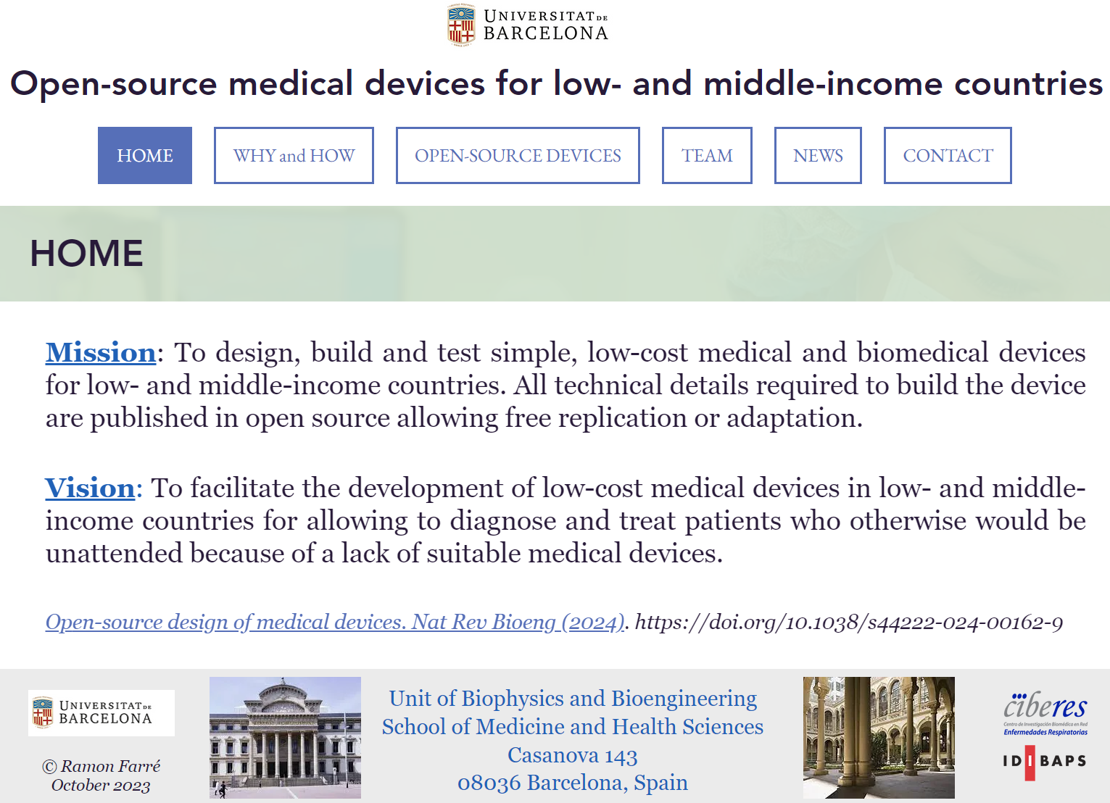
International Program for Open-Source Medical Device Design: A contribution to development cooperation
Low-cost, highly performant medical devices are possible by global cooperation.
For instance: www.open-source-medical-devices.com

Slide 8
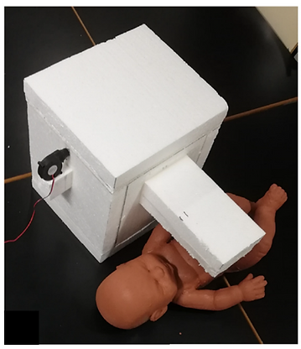
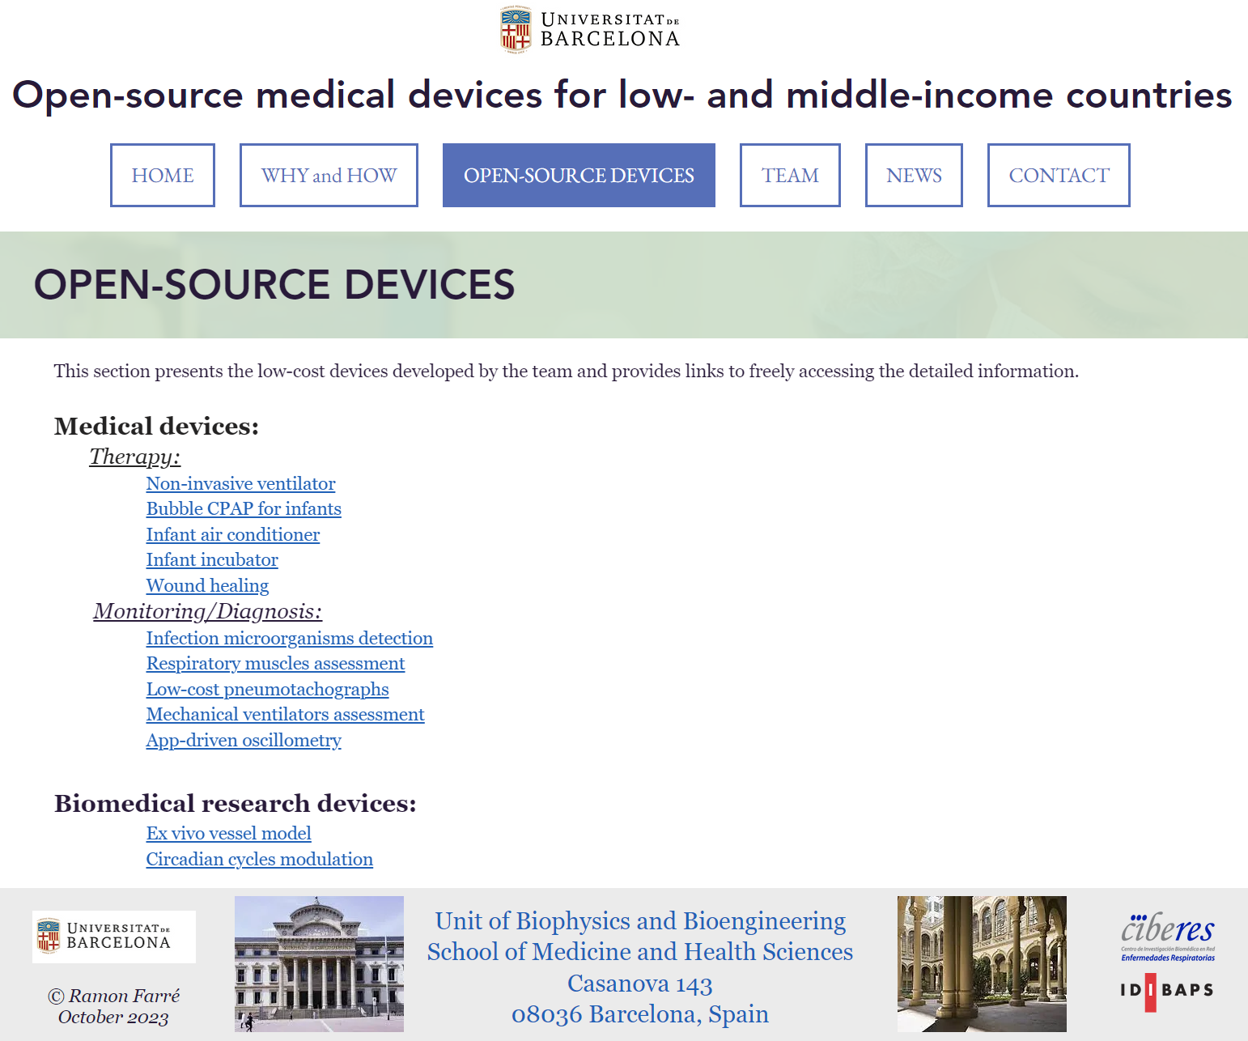
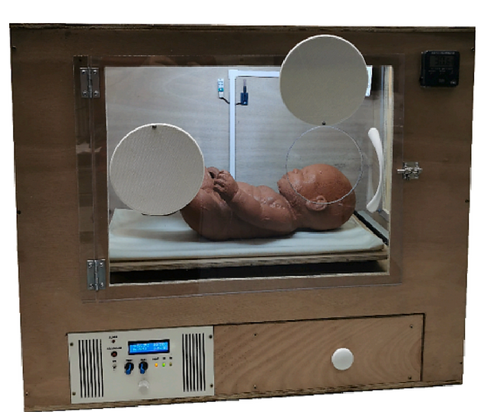
International Program for Open-Source Medical Device Design: A contribution to development cooperation
www.open-source-medical-devices.com
Infant air conditioner
Examples
Infant incubator

Slide 9
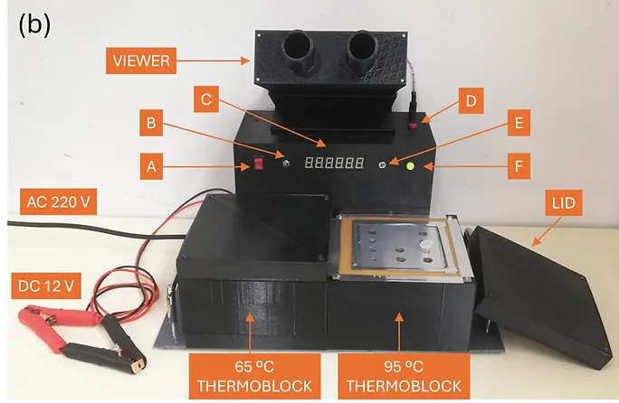
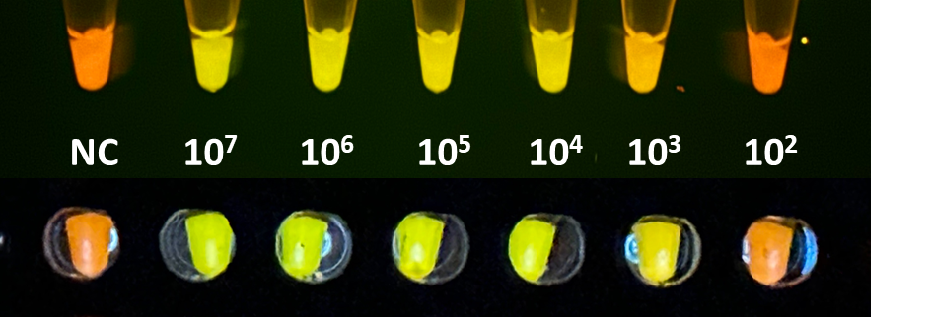
International Program for Open-Source Medical Device Design: A contribution to development cooperation
www.open-source-medical-devices.com
Infection microorganisms detection
Loop-Mediated Isothermal Amplification (LAMP)
Examples

Slide 10
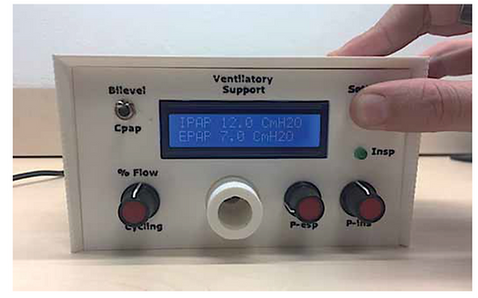
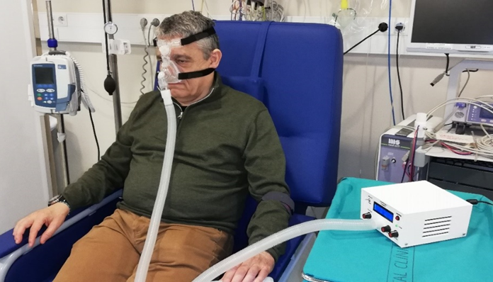
International Program for Open-Source Medical Device Design: A contribution to development cooperation
www.open-source-medical-devices.com
Non-invasive ventilator
<75 $
Examples
Sierra Leone, Vietnam

Slide 11
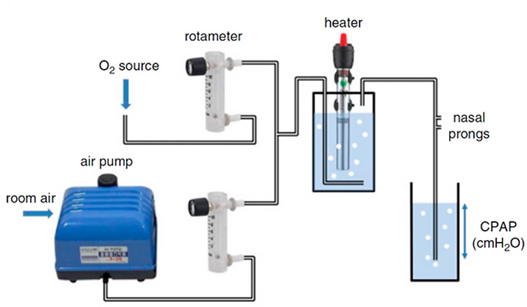
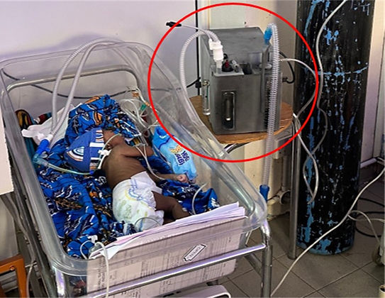
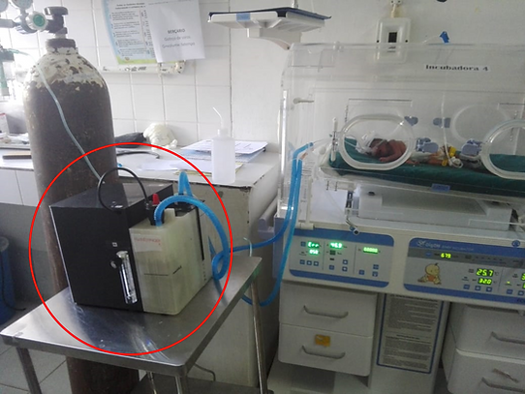
International Program for Open-Source Medical Device Design: A contribution to development cooperation
www.open-source-medical-devices.com
<100 $
Bubble CPAP for infants
Examples
Bangla-Desh, Gambia, Mozambique

Slide 12
International Program for Open-Source Medical Device Design: A contribution to development cooperation
Safety and patient protection
FDA, CE approval is conventional in developed countries: very complex and expensive.
Accepting that, to be used in LMICs, medical devices must have an FDA or CE mark is in practice equivalent to prohibiting most inhabitants from having access to potentially life-saving treatments.
Simple and effective alternative:
Decades ago in developed countries, when most medical devices were developed by building them locally before being industrialized, patient safety was ensured by inspection and approval by hospital ethical boards, which is the way for currently approving clinical trials.
This local regulation model was and is useful for protecting patient safety. Therefore, this process could be equally applied to approving medical devices built locally.

Slide 13

International Program for Open-Source Medical Device Design: A contribution to development cooperation
CONCLUSIONS
The open-source approach may be a tool for facilitating affordable medical devices for patients in LMICs who otherwise would not have access to devices that, in some cases, enable life-saving treatment.
Addressing the global gap in healthcare is thus not facing a scientific or technological barrier, but instead is facing a social responsibility challenge.
www.open-source-medical-devices.com

