Slide 1
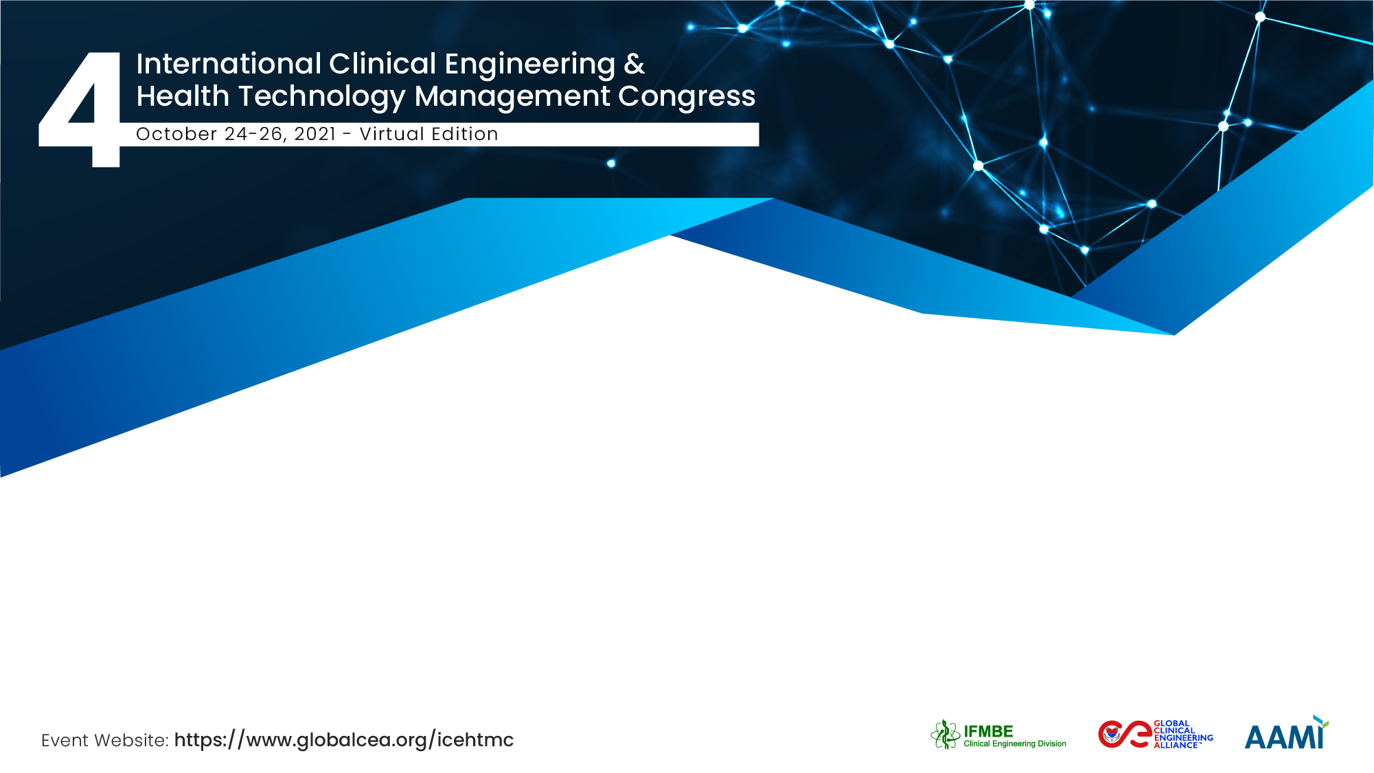
From the Basement to the C- Suite Clinical Engineers: Technology managers that add value to Healthcare Organizations
Mery Vidal Vidal
Regional Manager of CE and Medical Devices – AUNA´ s Group
President of Peruvian Association of Clinical Engineers (ASPIC)
Collaborator Member CED- IFMBE

Slide 2

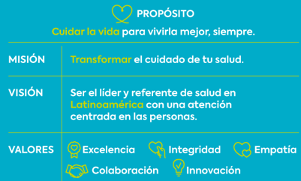
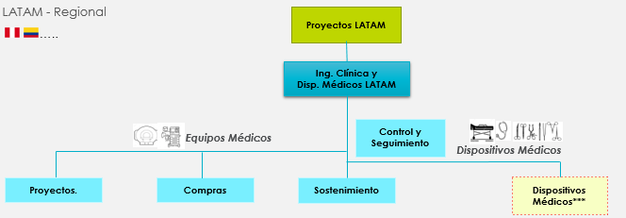

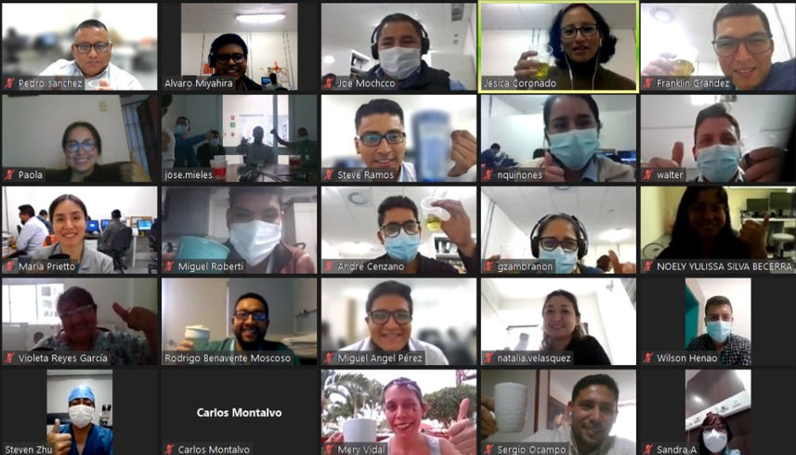
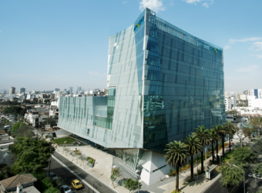



CE in AUNA
Peruvian group of medical centers and private hospitals in Peru and Colombia founded in 2008 by Oncosalud and Enfoca.
Mission: To manage the Medical Equipment Technology and Medical Devices in order to guarantee patient safety, user satisfaction and profitability of AUNA's Operations and Projects.
Structure:
Team Work
16 private hospitals and medical centers
US$ 417M in revenues
+739 Beds
+ 6.5k employees
39 people in the team
16 medical centers
S/ +US$ 71M in medical assests (+7.8k med eq.)
+ US$ 2M in savings annually
Centralized Management Model
Colombia
Clínica Delgado - Lima
Copyright © 2021 por Mery Vidal Vidal – Todos los derechos reservados
Notes:
To transform healthcare in the countries in which we operate by providing excellent patient outcomes and a positive and streamlined patient experience, all at an affordable cost

Slide 3


CE AUNA Achievements
Evolución
"Creation of an area from scratch that adds value to AUNA"
Being an AUNA's Strategic Support area (part of decision-making table C-Suite).
To have a structure, processes and people that meet and understand AUNA´s needs (patient safety, user satisfaction, profitability and future).
Implement the 100% of AUNA Projects with satisfactory results in time, scope and cost (transfer of know-how).
To raise the service level of medical equipment suppliers in Peru.
Raise the CE profession: to promote the creation of other Clinical Engineering areas in Peru.
Design a Leading management model and being referent in Peru and internationally.
•Budgeting, initial purchasing
• Control 100% the Life Cycle of the medical equipment
•Management Reports
•Leader of the purchase and negotiation process
•Plans for continuity of the operation
•Capture “know how” transforms them into AUNA Clinic Model
•“Glocal” model
•Project future of technology that promotes technological leadership
•Basic maintenance activities
Strategic/ Leads
2021
2019 / 2020
…..
“We are technology managers that add value to organizations and whose focus is the patient, user satisfaction and the profitability of the Business”
2014
2012
2010
Operational / Support
Notes:
Área de soporte estratégico
Rol Protagónico en proyectos

Slide 4
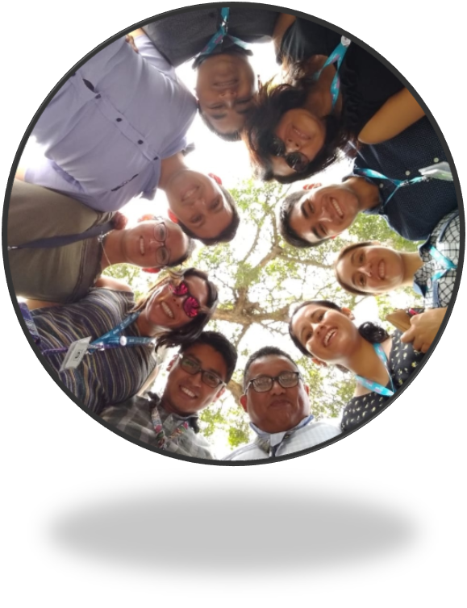
Tips
In presentations / meetings with C-Suite:
And don´t forget
Have someone to follow, admire, guide you and promote you - Mentorship and Sponsorship
Shine for what you are capable of, believe in yourself and makes C-Suite knows and trusts you
Have passion, self-motivation and inspiration - 200% Attitude + “Be good at”
Show your knowledge about tha value generation model and that your activities add to it – Key information
Read and invest in Updating, Experiences and Networking
It is not enough to be but to appear so + Soft Skills
Work Hard and Persist - Practice Makes Perfect - Let Nothing Stop You
Be a master in communication, present your ideas as executive proposals. Talk in their language
CE: Key Actor in Healthcare
Develop Talent and Empower the team - the team must shine
Technology managers that add value to organizations and whose focus is the patient, user satisfaction and the profitability of the Business
Copyright © 2021 por Mery Vidal Vidal – Todos los derechos reservados

Slide 5


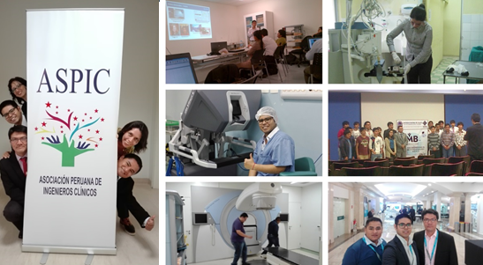

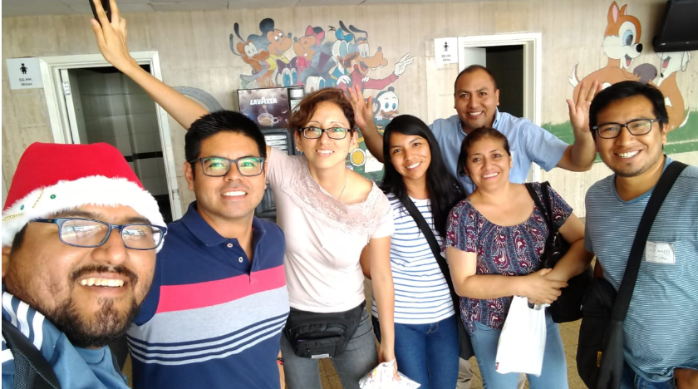
Peruvian Association of Clinical Engineers
Achievementss:
We are now 84 Associates :)
ACCE (USA) Collaboration agreement.
Participation in the “Global Session / Summit” AAMI 2019 (USA) and III ICEHTMC (Italy).
IFMBE CED Global Collaborating members
Exchange of knowledge and experiences – A. WhatsApp
Social Responsibility events.
Members have participated in the initiatives carried out by MINSA, ESSALUD, Private Sector, Universities - COVID19
Non profit association. Founded on December 2017
Misión: to promote activities for the continuous development of Clinical Engineering in Peru, in this way, to contribute with the patient safety and humanization of the healthcare system.
Position: President and Founder
For more information visit: www.aspicperu.org
Copyright © 2021 por Mery Vidal Vidal – Todos los derechos reservados

Slide 6


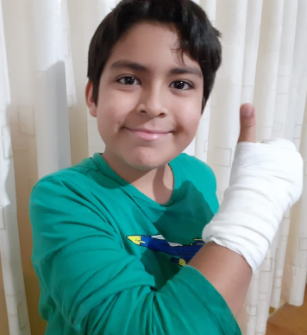
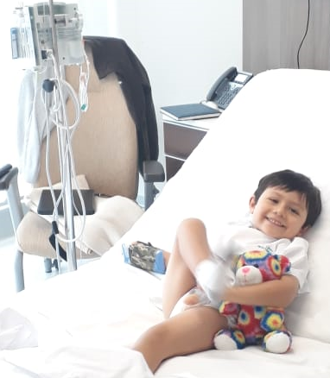
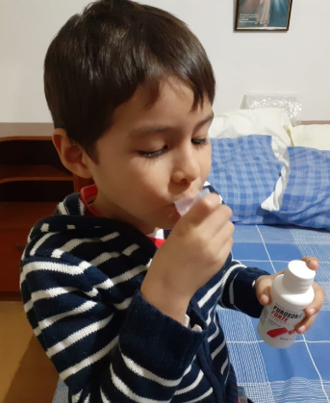
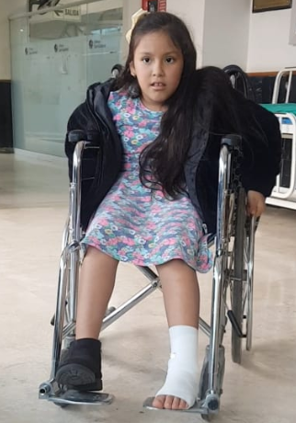
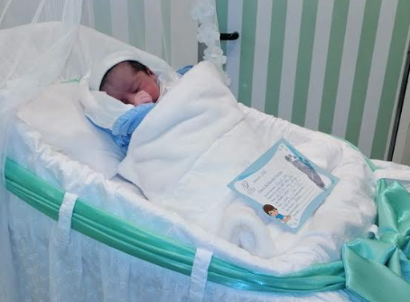
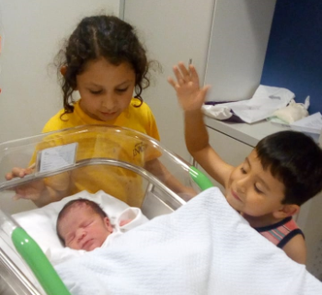
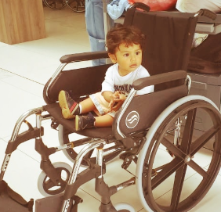


What inspires us to work
in Clinical Engineering?
“We do it for the patient ... it is worthless to have the best technology or the best management system if our patients do not receive a humane and dignified treatment”
Humanization in HEALTH!

Slide 7
Mery Vidal Vidal
Mery.vidalv@pucp.pe
Regional Manager of CE and Medical Devices – AUNA´ s Group
President of Peruvian Association of Clinical Engineers (ASPIC)
Collaborator Member CED- IFMBE
PERU

