Slide 1
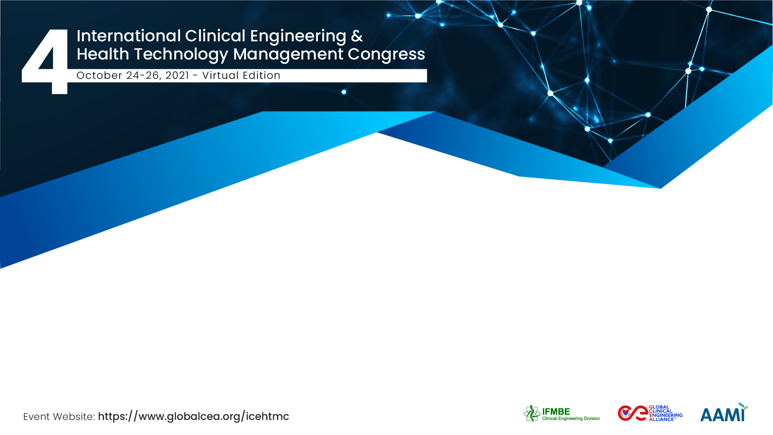

Generating additional innovation and research opportunities during COVID 19 in device and technology development through a Clinical Engineering Innovation and Research Team
Professor Chris Hopkins CEng, FAHCS
Hywel Dda University Health Board
TriTech Institute
Wales, United Kingdom

Slide 2
Description
One positive development from the trials supported during the COVID 19 period has been a strengthened relationship between the Research / Development and Clinical Engineering departments.
Companies seeking to develop new technologies needed to get rapid regulatory approval from the Medicine’s & Healthcare Products Regulatory Agency (MHRA).
Achieving such approval required the expert technical input of clinical scientists and engineers within the Clinical Engineering department, alongside the input of experienced researchers, adept at designing studies and gaining ethical approval.
Simply put, we found our local supply chain could not interface with the NHS without Clinical Engineering and R&D support.

Slide 3
The Team / Workgroup
Professor Chris Hopkins, Head of Clinical Engineering, Hywel Dda University Health Board. Fellow of the Academy for Healthcare Science, Consultant Clinical Scientist & Honorary Professor, Wales Institute for Science & Art (WISA).
Professor Keir Lewis, Professor of Respiratory Medicine at Swansea University & Consultant & Respiratory Lead at Hywel Dda University Health Board.
Dr Rachel Gemine, Senior Researcher & Grant Manager at Hywel Dda University Health Board.
Dr Leighton Philips, Director of Research & Development & Innovation, Hywel Dda University Health Board.
Dr Sean Jenkins, Associate Professor, Assistive Technologies Innovation Centre, University of Wales Trinity Saint David.
Dr Naomi Joyce, Senior Lecturer and Project Lead, Healthcare Technology Centre, Swansea University Medical School.

Slide 4
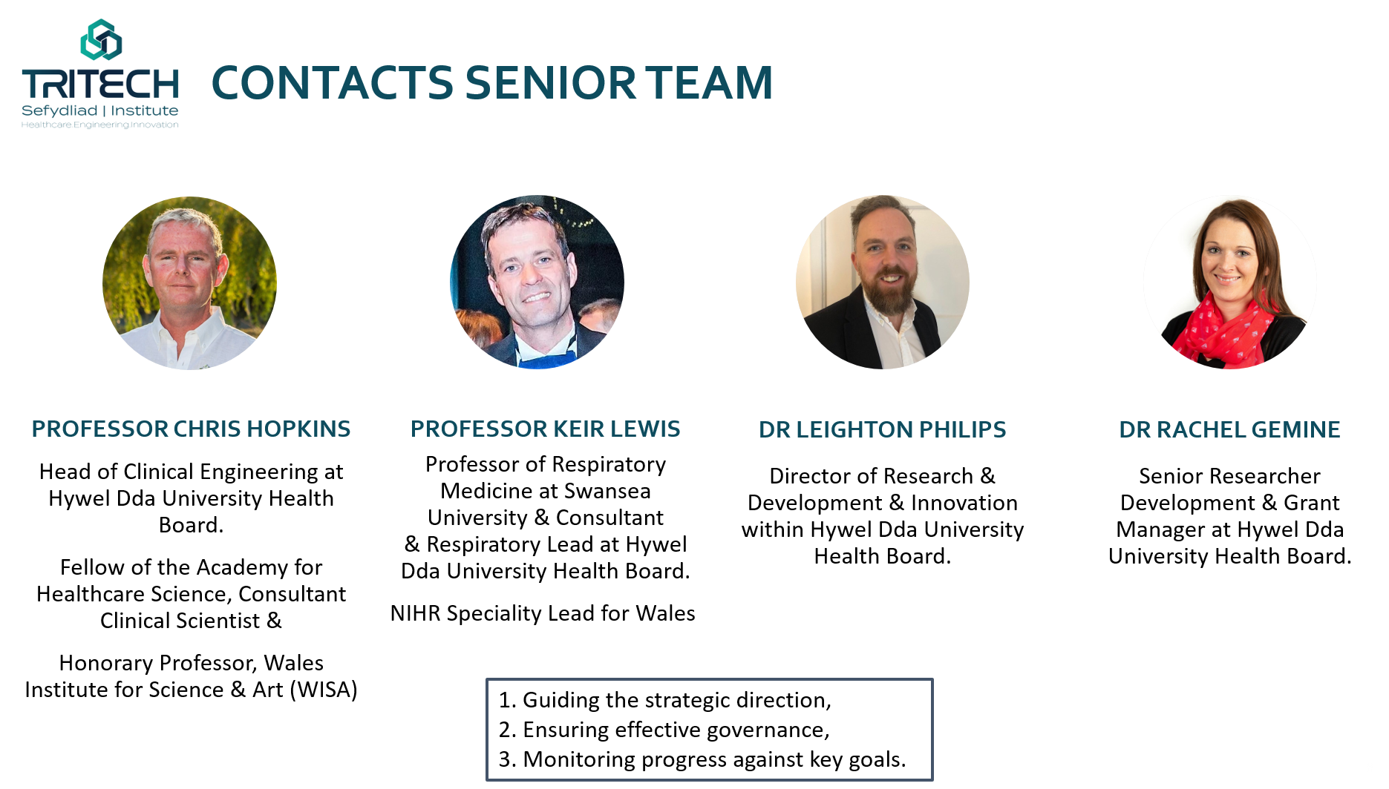




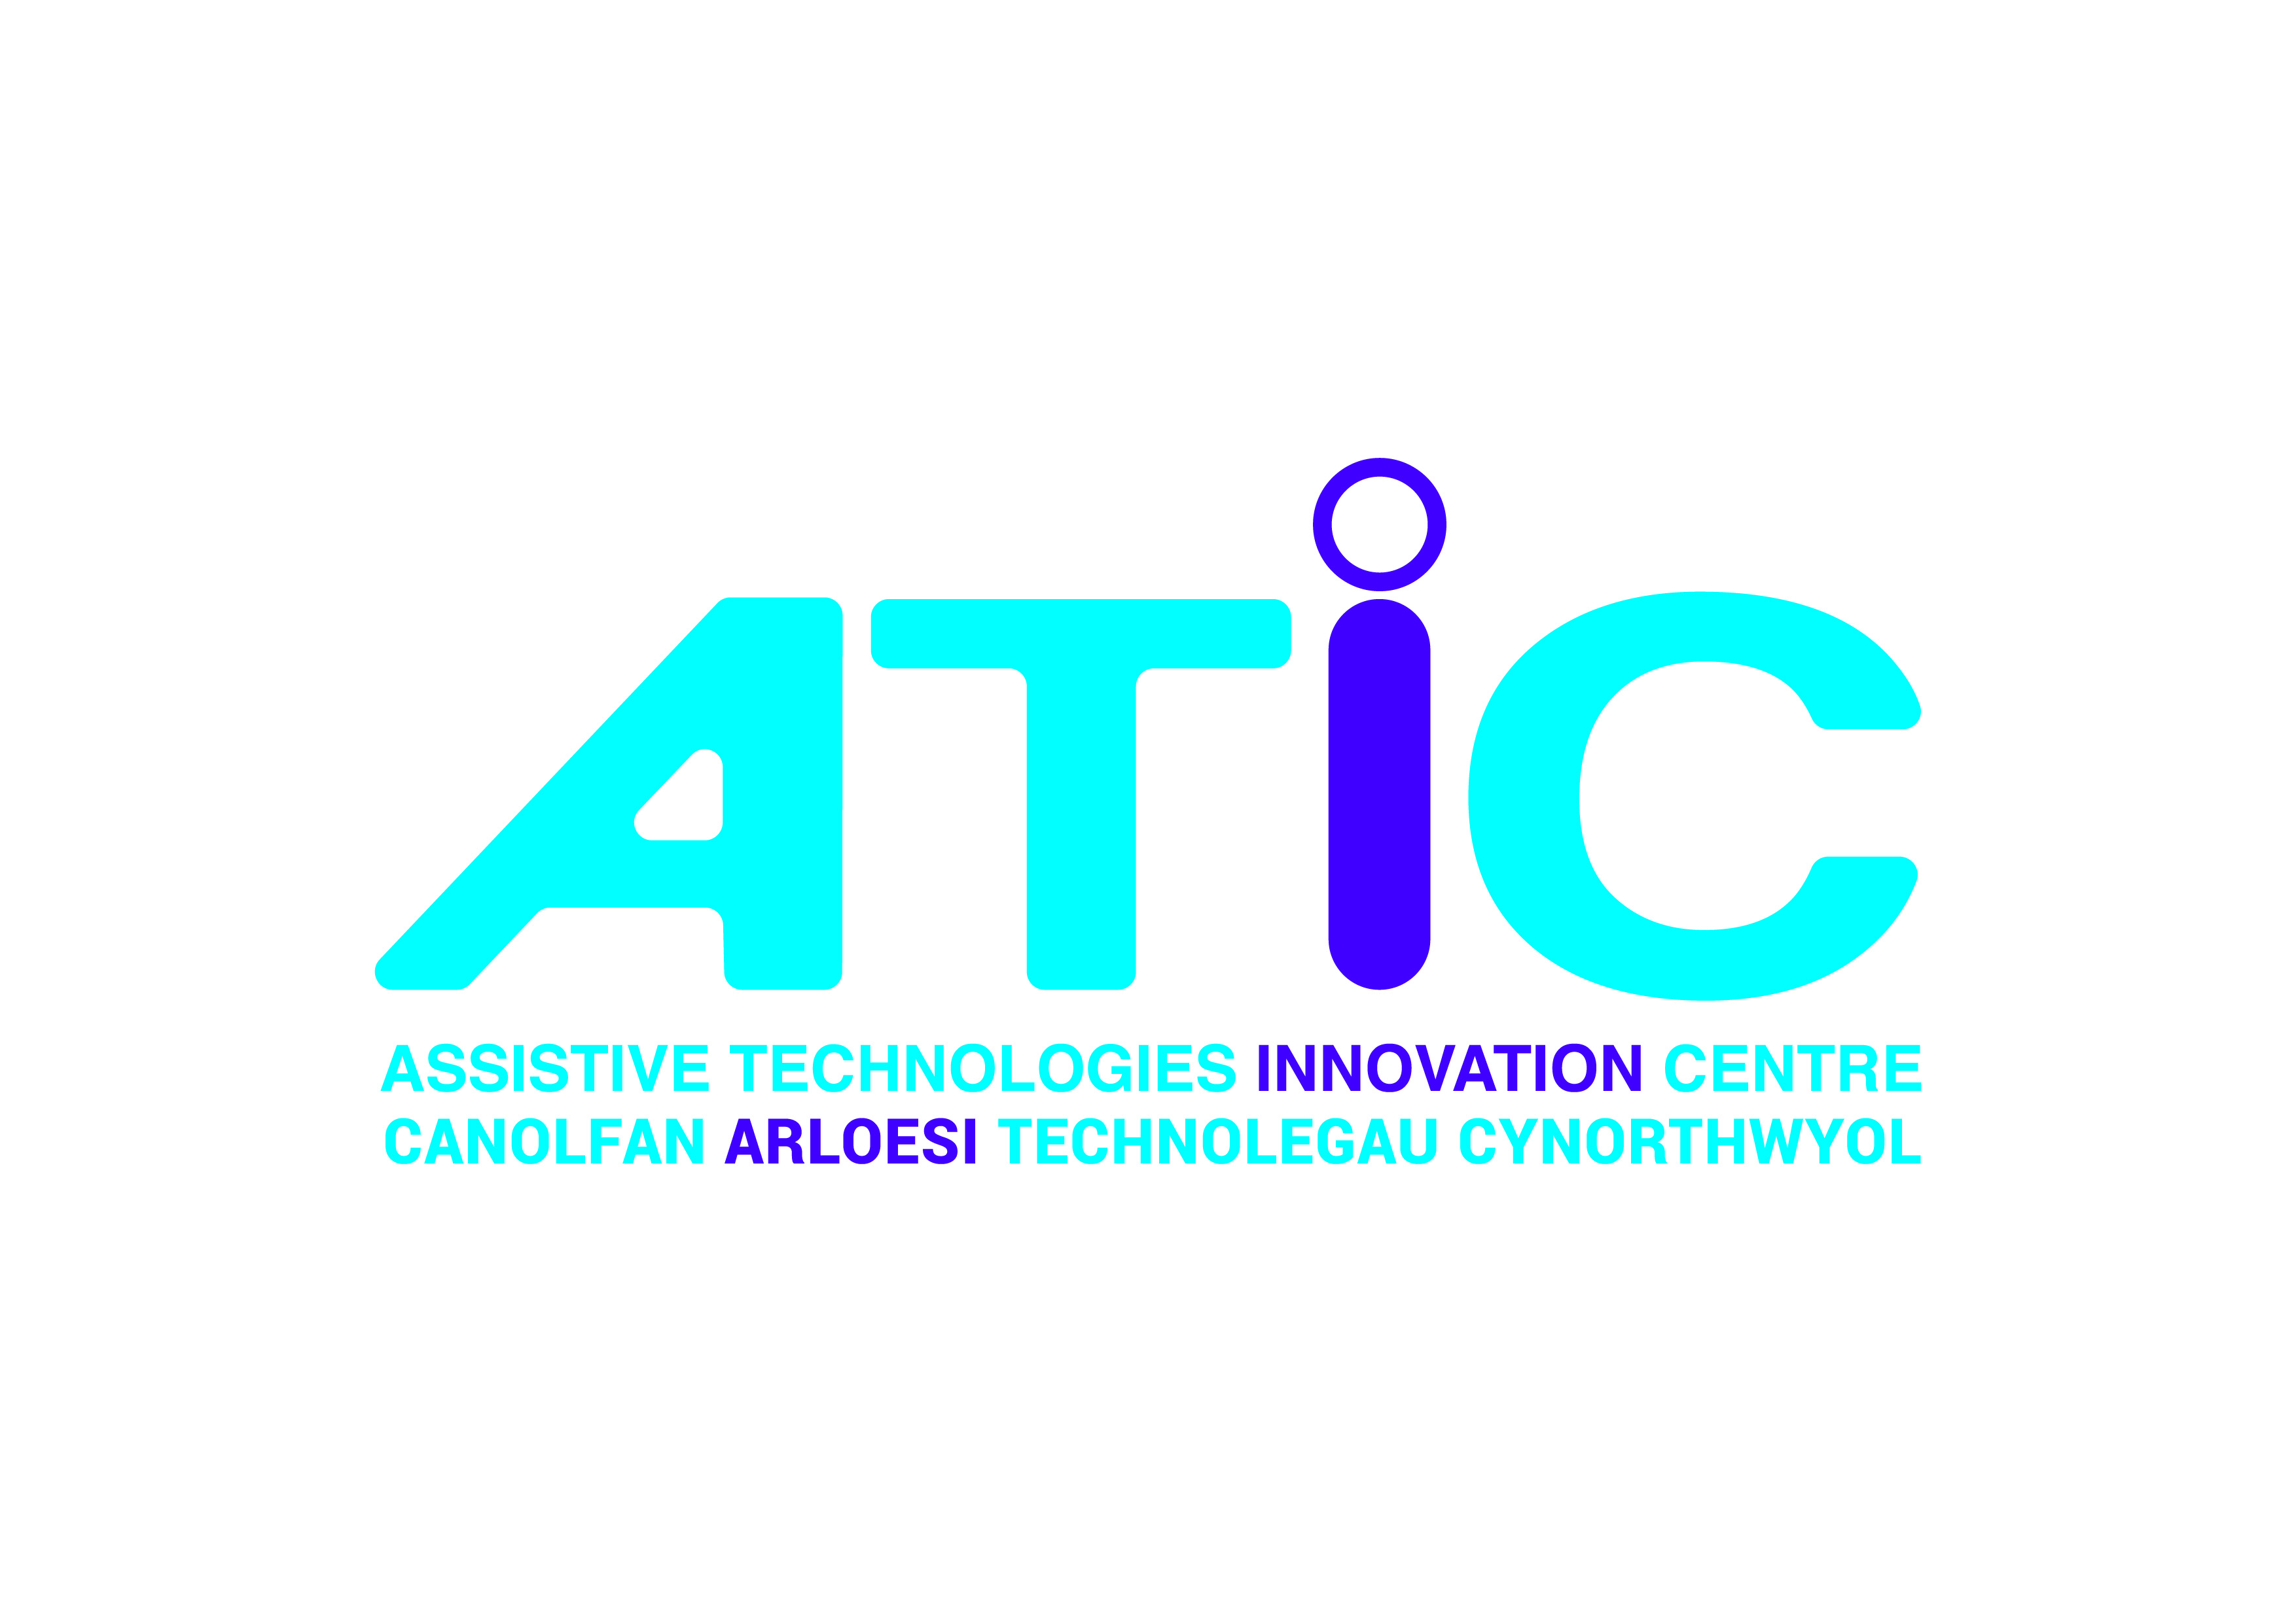
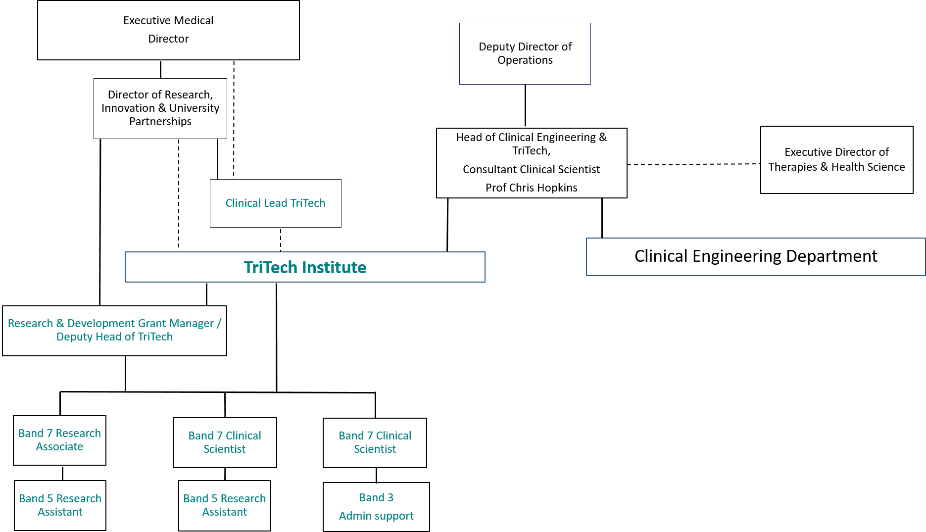





Results

Slide 5
Goals of the project and final users that will benefit
Medical device design and manufacture
Additive manufacturing and 3D printing.
Biomechanical evaluation
Human-centric design and evaluation.
  Working with the University and local manufacturers.
Regulatory and compliance advice.
Digital health
Mobile phone apps and games for patient support
Digital devices for clinician support
Wearable monitoring devices
Sensing and imaging
Biomedical sensing and imaging.
Computer modelling and Artificial intelligence.
Modelling, analysis and decision support
Data analysis for diagnosis and decision support
Healthcare systems modelling
A.I Image analysis for diagnosis
Mathematical modelling of diseases and treatment
Modelling human decision making
Softer but important…
Research active staff
Patients accessing new technologies…first
Research – develop devices or apps or commission clinical investigations to ensure the effectiveness and safety of technologies.
Real world evaluation – commission projects to understand the wider impact of technologies, post regulatory approval, as part of routine care services using VBHC.
Consultancy –specific advice from the TriTech team which might relate to the process for securing regulatory approval of a new technology or initial basic clinical testing of a technology.

Slide 6



Prof. Chris Hopkins CEng, FAHCS
Tritech.HDD@wales.nhs.uk
UK
TriTech Institute @tritech_hd https://tritech.nhs.wales

