Slide 1

Hospital laboratory assessment of High Frequency Oscillatory neonatal ventilators performances
Daniele Pietrobon
Ospedale Pediatrico Bambino Gesù, Italy

Slide 2

The Team / Workgroup
CLINICAL ENGINEERING UNIT
  Simone De Santis
  Federico Nocchi
  Daniele Pietrobon
  Carlo Capussotto
NEONATAL INTENSIVE CARE UNIT
      Andrea Dotta
HTA UNIT
  Matteo Ritrovato

Slide 3
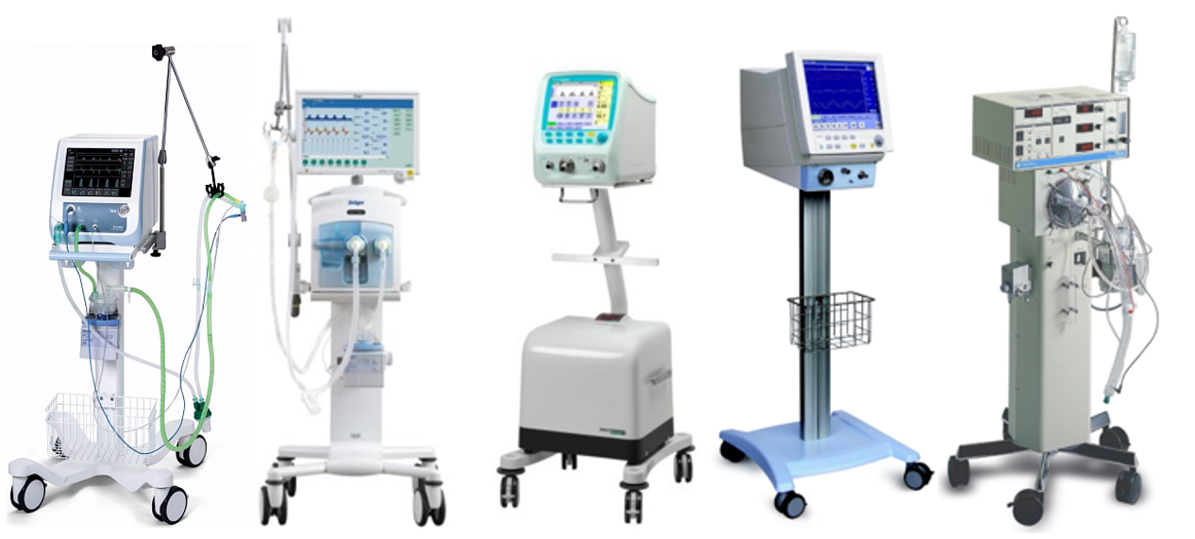
Description
High Frequency Oscillatory Ventilation - HFOV
Sinusoidal pressure wave (~5 to15 Hz), produced by an oscillating membrane or other system (piston, diaphragm, …)
Bias Flow that provides fresh gas and allows the control of temperature and humidity
Various models of ventilator available
Patient circuits with low distention (minimize LP effect)

Slide 4
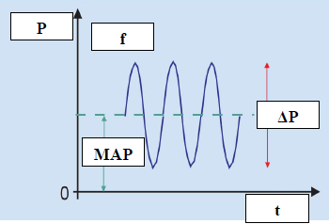
Description
High Frequency Oscillatory Ventilation - HFOV
Widespread as lung-protective ventilation mode for reduced risk of ventilation-induced injuries
Patient’s respiratory system and breathing circuit (endotracheal tube) dissipate a large amount of energy, and reduce the pressure oscillations due to resistance and viscous friction
Relevant differences between set and delivered ventilation parameters

Slide 5
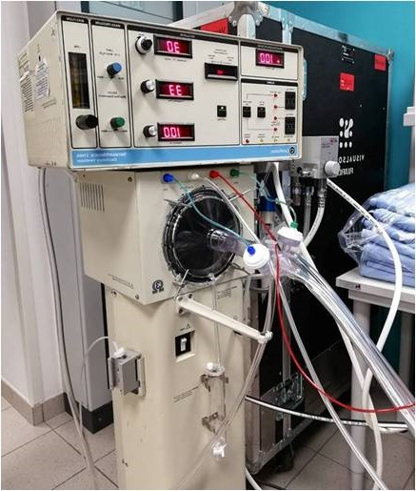

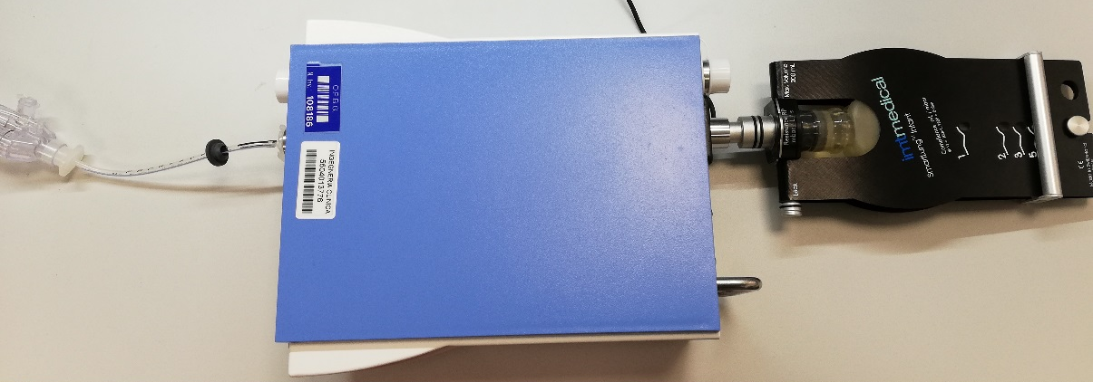
Goals of the project and final users that will benefit
Simulate, with a laboratory measurement protocol, the HFO ventilation setup used in NICU clinical practice
Evaluate and compare the performances of different HFO ventilator models
Analyse effects of endotracheal tube and different breathing circuits, on gas pressure and flow delivered to different kinds of patients
Share results with OPBG’s NICU and other groups for better choice of ventilator, circuit and therapy settings

Slide 6
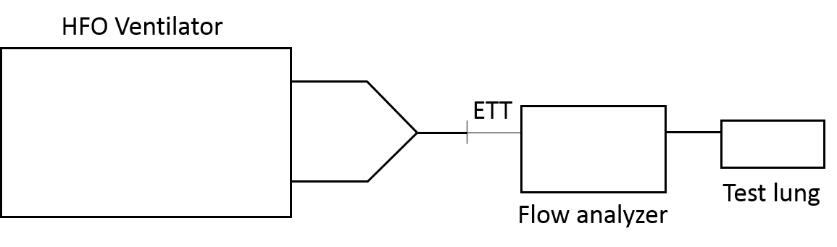
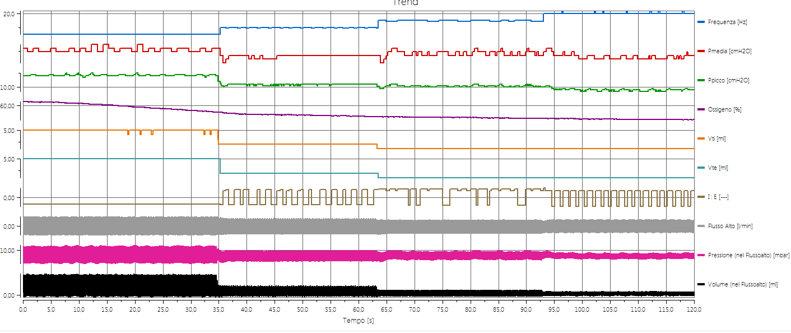
Methods
We defined a technical protocol for laboratory assessment of HFO ventilators’ performances, then applied it to different models of HFO ventilators
SETUP
Response to ETT
Observed:
f, ΔP, MAP
After variation of: ETT (∅ 2-4 mm,
no ETT)
Response to lung condition
Observed:
ΔP
After variation of: Resistance, Compliance
Impact of circuit
Observed:
Tidal Volume
After variation of:
Circuit + F, MAP, ΔP
PARAMETERS
OF INTEREST

Slide 7
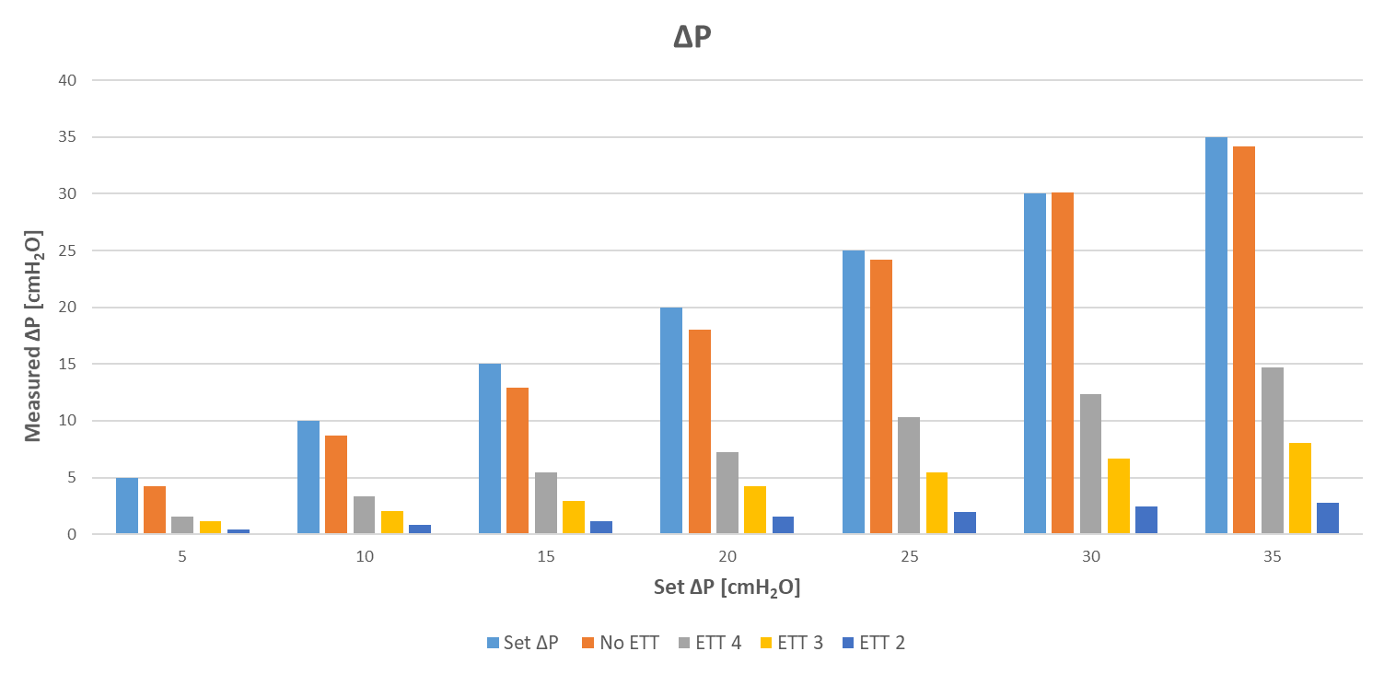
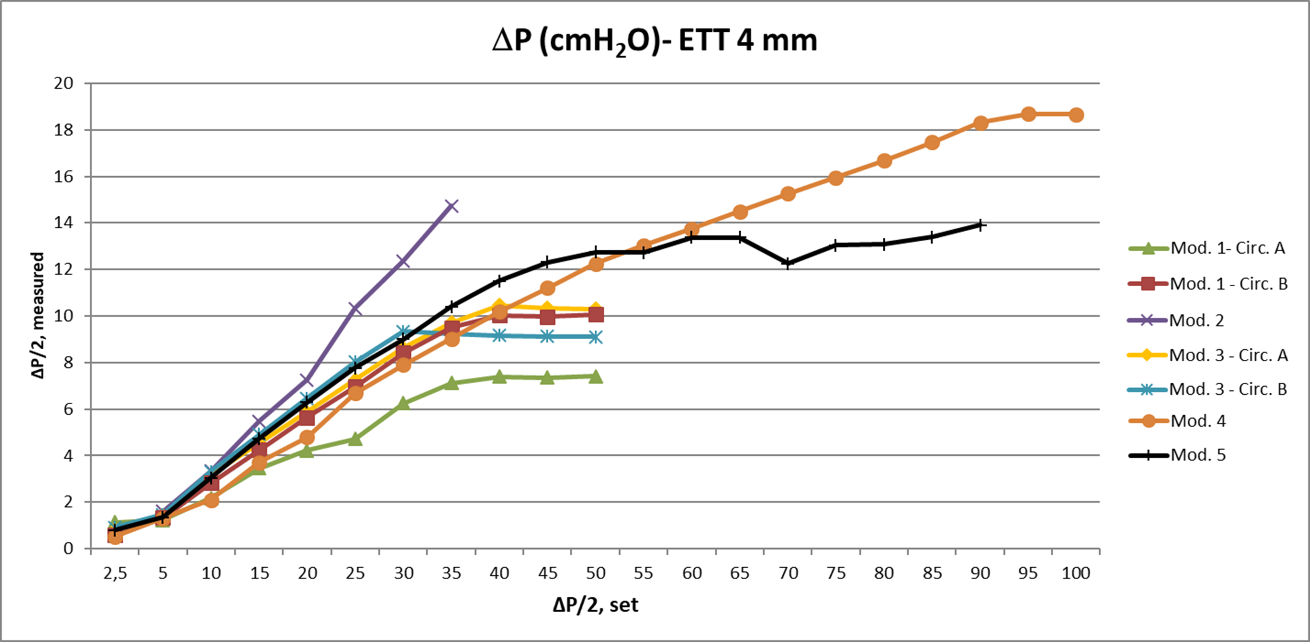
Results
Results show relevant differences in effective pressure and flow obtainable with the different configurations of ventilator, breathing circuit and set of parameters
Data can support the clinical activity and the technology acquisition and management processes.
An extension of the study with a clinical protocol could validate laboratory results and add further domains for HFOV performance evaluation

Slide 8
Daniele Pietrobon
daniele.pietrobon@opbg.net
Clinical Engineering Department – HTA & Safety Research Unit
Ospedale Pediatrico Bambino Gesù, Roma, Italy

