Slide 1


How Much Medical Device Security Is Enough?
Seth Carmody, PhD
VP Regulatory Strategy
Mike Kijewski
CEO

Slide 2


Slide 3
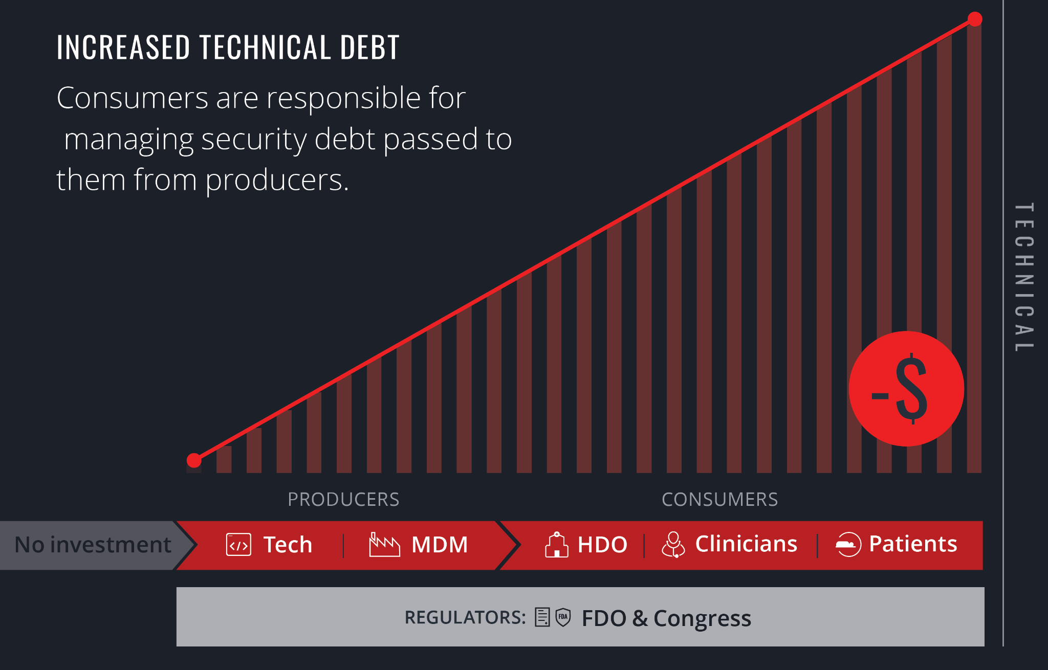

Slide 4
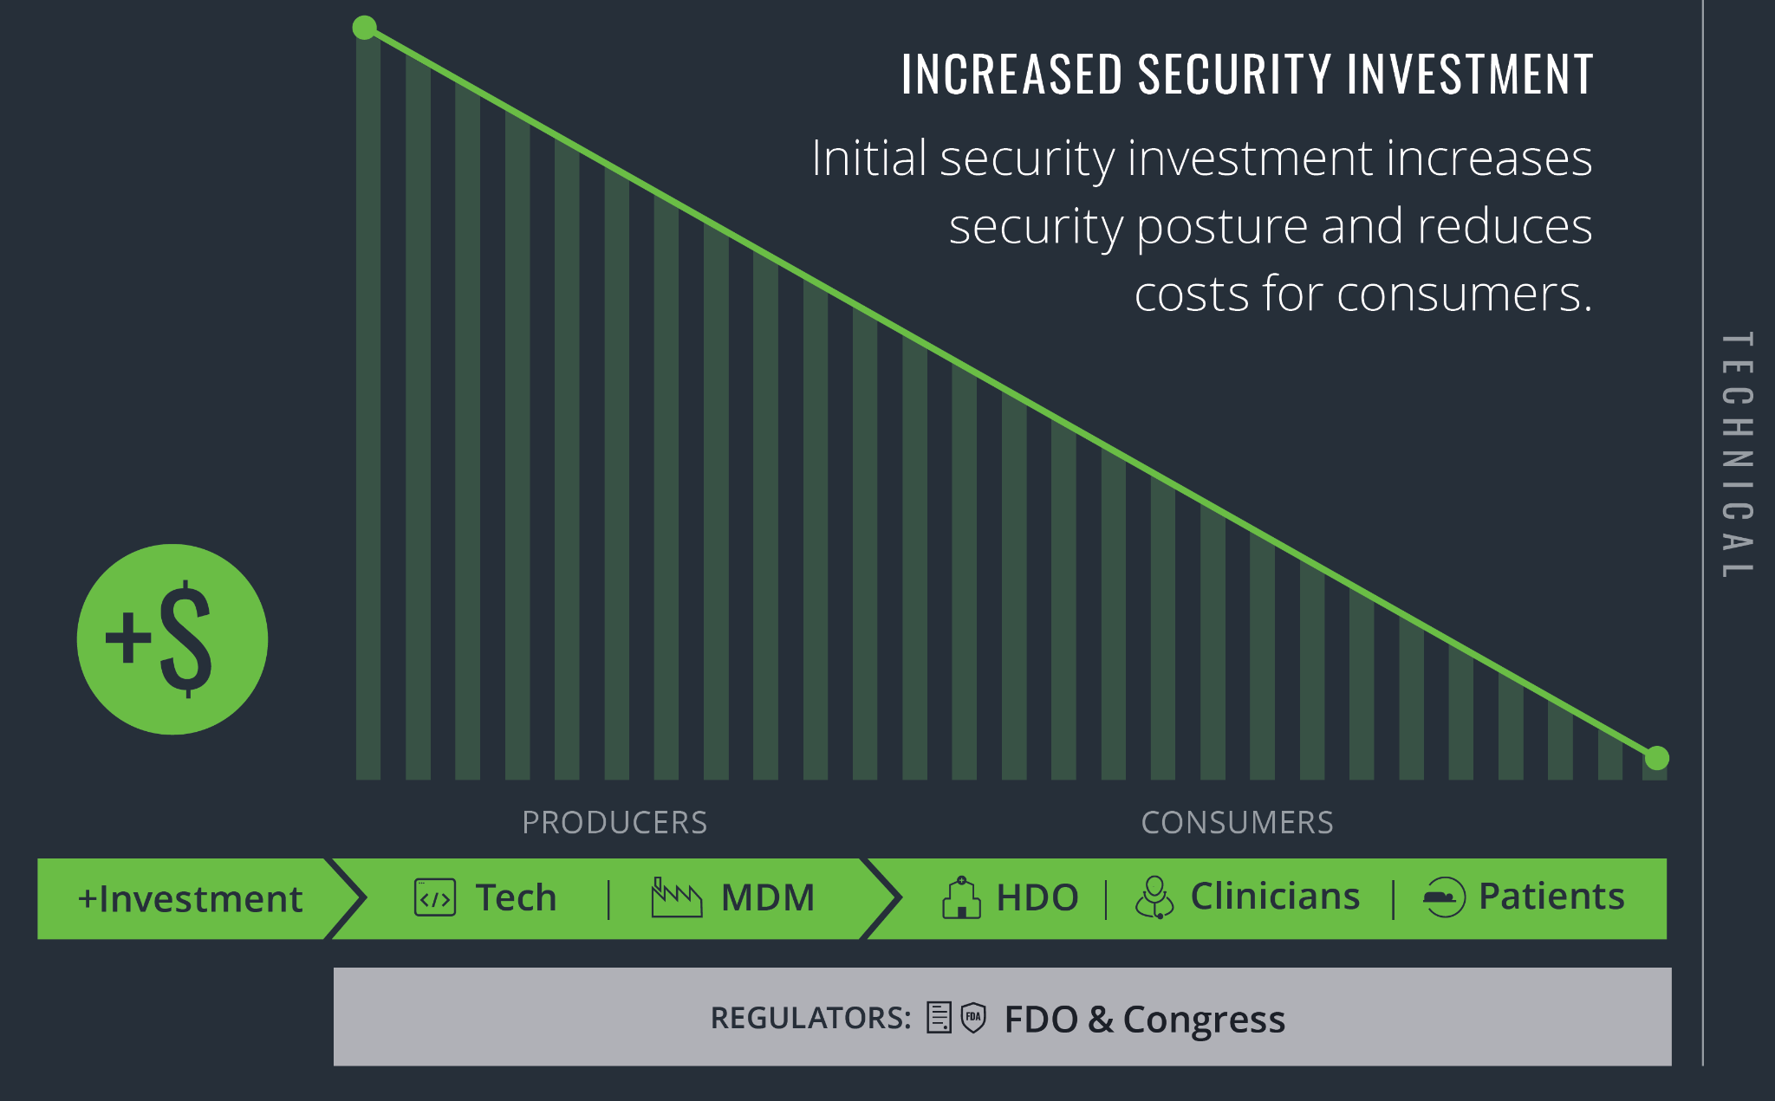

Slide 5
Benchmarking the Security Spend Equation
Total Security Spend = 1 / Total Security Debt
Total Security Debt ～ P($Market Delay) + P($Liability)
Total Security Spend = Total R+D Spend * 0.5%
$ 500,000.00 | $ 100,000,000.00 | 0.005
$ 12,500,000.00 | $ 2,500,000,000.00* | 0.005
Assumptions: security spend is a cost center, organization’s security efficiency or core competency is sub-optimal
*https://www.medtronic.com/us-en/our-company/key-facts.html

Slide 6
The Cost of Security Debt
Total Security Debt = Incident Cost * Latent Flaws * Discovery probability
$ 12,000,000.00 | $ 1,000,000.00 | 12 | 1
$ 100,000,000.00 | $ 20,000,000.00 | 5 | 1

Slide 7
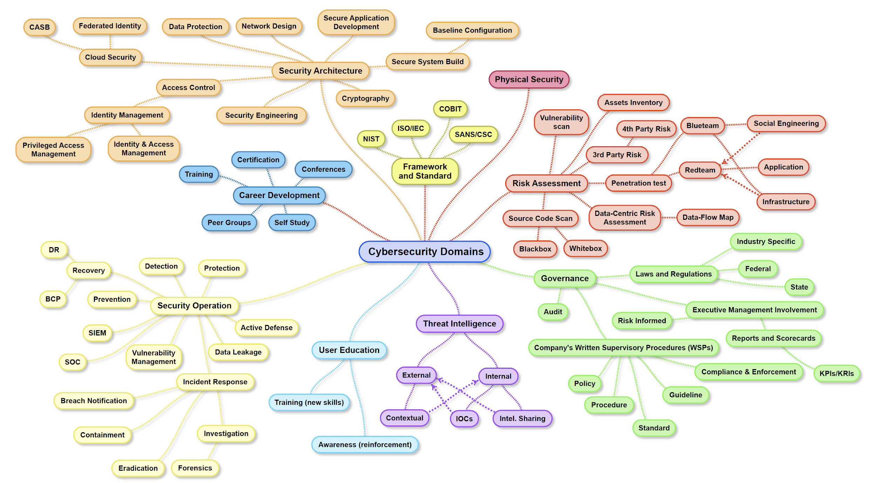
Security Spend needs to cover many Security Domains
Credit - Henry Jiang

Slide 8
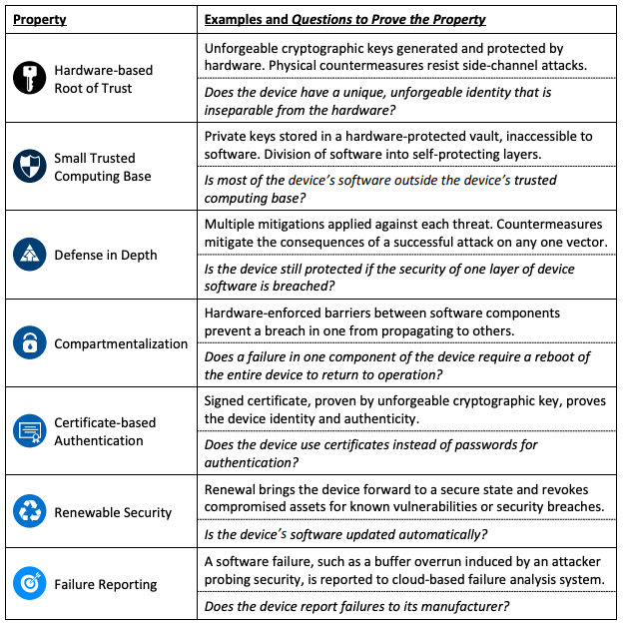
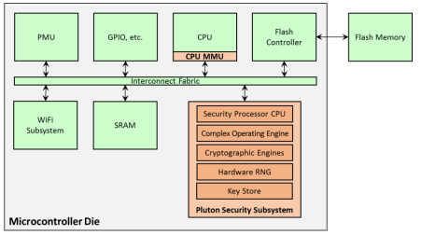
Security Spend needs to cover Technology
The Seven Properties of Highly Secure (IoT) Devices
https://www.microsoft.com/en-us/research/wp-content/uploads/2017/03/SevenPropertiesofHighlySecureDevices.pdf

Slide 9


© PhonlamaiPhoto | istockphoto.com

Slide 10
Questions?
https://medcrypt.com/whitepapers-medical-device-thoughtleadership.html
seth@medcrypt.co
mike@medcrypt.co

