Slide 1
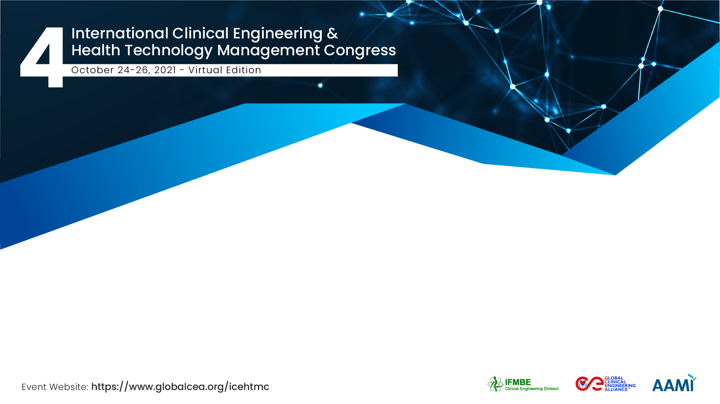



Improvident Growth of CE in SEARO and other Global Regions:
First-rated Footmark by CED, IFMBE to ensure better Healthcare
ID: 10848
Md. Ashrafuzzaman, Jitendar Sharma, Rossana Rivas Tarazona, Tobey Clark, Tom Judd
Military Institute of Science and Technology (MIST),
Saudi Bangladesh Institute of Biomedical Engineering & Technology (SBIBMET)
Andra Med Tech Zone (AMTZ)
WHO CC for HTM, Universidad Peruana Cayetano Heredia-UPCH
WHO CC for HTM, University of Vermont
Clinical Engineering Division, IFMBE

Slide 2
The Team / Workgroup
Major Md. Ashrafuzzaman, Ph.D, EME
Founder, Saudi Bangladesh Institute of Biomedical Engineering & Technology (SBIBMET)
Associate Professor, Biomedical Engineering Department, Military Institute of Science and Technology (MIST)
Dr. Jitendar Sharma
MD & CEO, Andra Med Tech Zone (AMTZ)
Rossana Rivas Tarazona
Head-Clinical Engineering Specialty, Faculty of Public Health, Universidad Peruana Cayetano Heredia-UPCH
J. Tobey Clark
Engineering Supervisor & Director, WHO Collaborating Center for HTM / University of Vermont
Tom Judd
Chair, Clinical Engineering Division, International Federation of Medical & Biological Engineering (IFMBE)

Slide 3
Description
For example, just after attending the 3rd WHO Global Forum on Medical Devices and II ICEHTMC in 2017 the Bangladeshi CED, IFMBE collaborator have been engaged himself for the successive development Biomedical Engineering in Bangladesh and now government has established Biomedical Engineering Institute to run BE programs nationwide which is implementing in the college/university/institute and the healthcare facilities. All countries of SEARO region has adopted CE/BE accreditation program for credentialing BE/BMET/CE/CET to enhance their capacities and hands on skills for operation and maintenance of medical devices and equipment effectively. India has been certifying their local CE/BE graduates through Indian Biomedical Skill Consortium (IBSC). Nevertheless, country collaborators from different regions of the world are now aligning to upsurge their clinical skills and fit the competencies with other healthcare professionals work role/responsibilities. All the experts of CE in these countries have planned clinical engineering practice experiences that enable the students and professionals to attain new knowledge and demonstrate achievement of the final learning outcomes of the CE program.
CE stakeholders should consult with their state board of healthcare authority/ministries to ensure clinical engineering requirement and medical device regulations would be met with this opportunity and experiences. CED programs are responsible for informing CE practitioners and specialists of the risks and responsibilities associated with working in a health care facility at this COVID-19 situation and all related movements showed progressive effects on CE/BE reached more than 150 countries. Additionally, CED, IFMBE programs are responsible for communicating with CE students, trainees and all level experts about their rights to be protected from infection and their options for completing the clinical engineering practice requirements of the CE programs effectively.
Healthcare Technology Management (HTM) and Clinical Engineering Programs i.e congresses, conferences, webinars, workshops, townhalls etc. of Clinical Engineering Division (CED), International Federation of Medical and Biological Engineering (IFMBE) are encouraged to promulgate plans to take advantage of this opportunity and make every effort to reach out to eligible Clinical Engineers (CE), Clinical Engineering Technicians (CET), CE students, Biomedical Engineering (BE) students, professionals at hospitals and inform them of the opportunity can be availed from CED, IFMBE. CED, IFMBE programs and initiatives are encouraged to collaborate to identify ways to accomplish appropriate CE experts and educators for supervising of the CE and BE student-employee to achieve the final learning outcomes of the CE program.

Slide 4
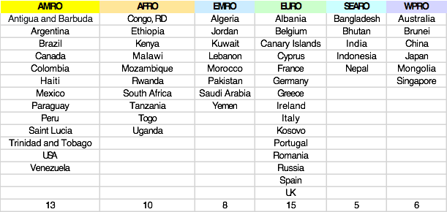
CED, IFMBE Growth
360
150
250
110
100
CED Board & Collaborator (B&C) growth
CED B&C Countries Represented
70
40
20
2nd
year
2015
2017
2020
2021
4th
year

Slide 5
Global Network
Combat against
COVID-19
1
Global CE Training / Webinars
Global CE Weekday COVID19 e-Newsletter
Global CE WhatsApp
Global CE Blogs
CED, IFMBE
Bangladesh
Global CE Partnership with WHO
WHO-GCEA-CED 2020-2021 Innovation Project
Global CE Alliance (since 2020)
Global CE Internships
2
3
Global CE Summits (2015, 2017, 2019, 2021)
Global CE Congresses-ICEHTMC (2015, 2017, 2019) 1000 participants (70 countries) *Expect 1500 (120 countries)
Global CE Day (since 2015)
Global CE Journal (since 2018)

Slide 6
Goals of the project and final users that will benefit
To prepare the countries of SEARO region for developing certified CE/CET to minimize the gaps between the other countries.
To develop and practice effective training modules to train new graduates of CE/BE and EMT following success stories and seek cooperation from the global CE experts.
To adopt and practice Clinical Engineering Certification, Training, and Examination Process for improving and implementing CE-HTM efficiently in assistance with WHO, IFMBE, ACCE, ECRI, PAHO, AAMI, IMDRF, IHF, AHWP, IBSC and other regulatory authorities.
To apply the collaborative mechanism for implementation CE-HTM Accreditation and Certification in Bangladesh, SEARO and other region with the assistance from CED, IFMBE.

Slide 7
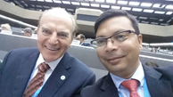
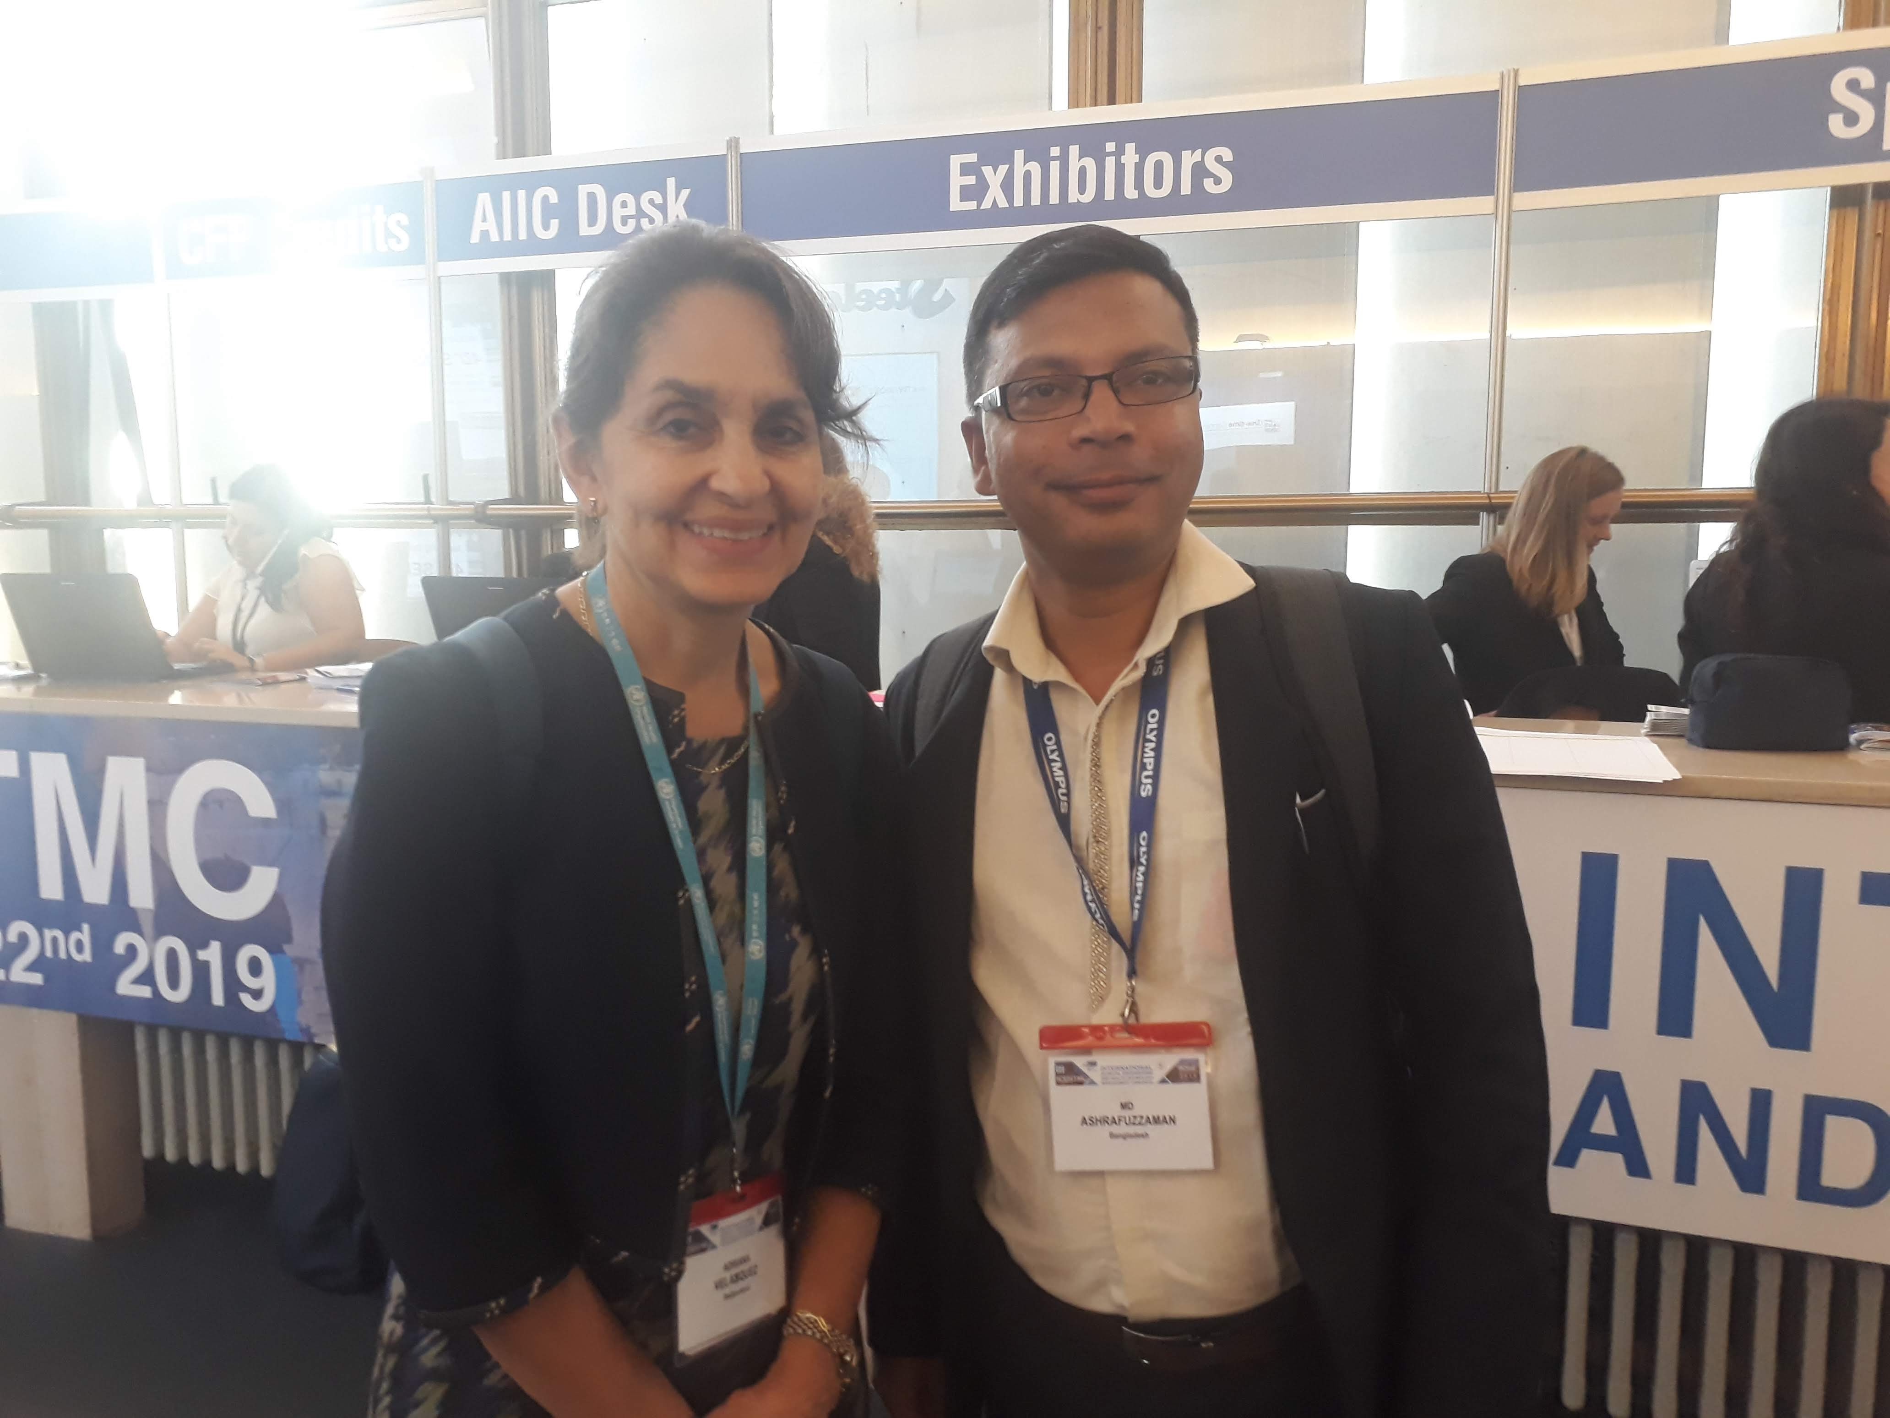
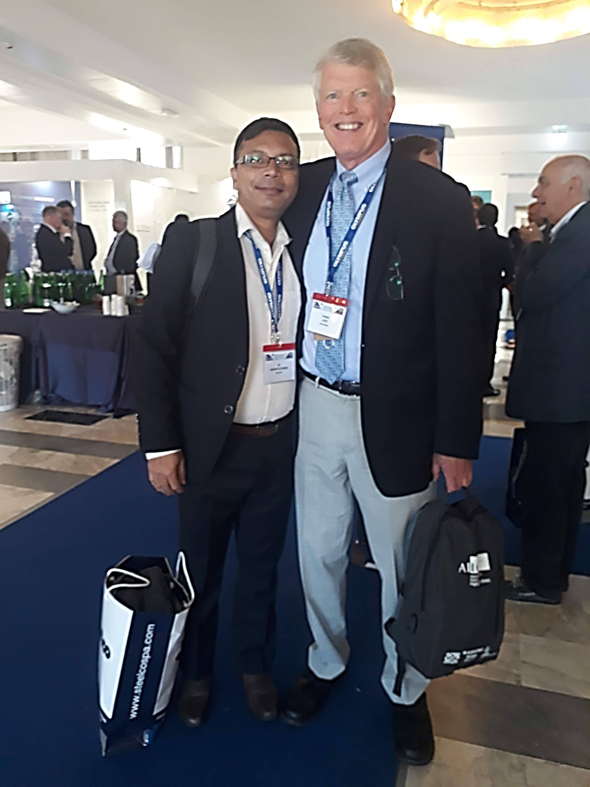
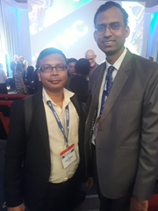
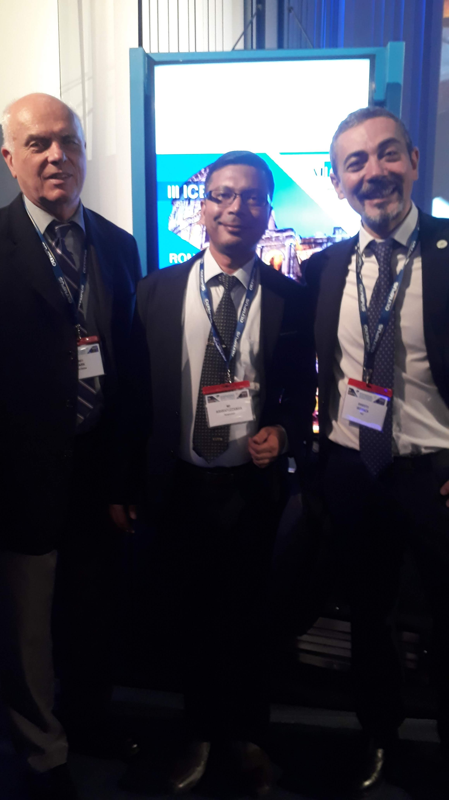
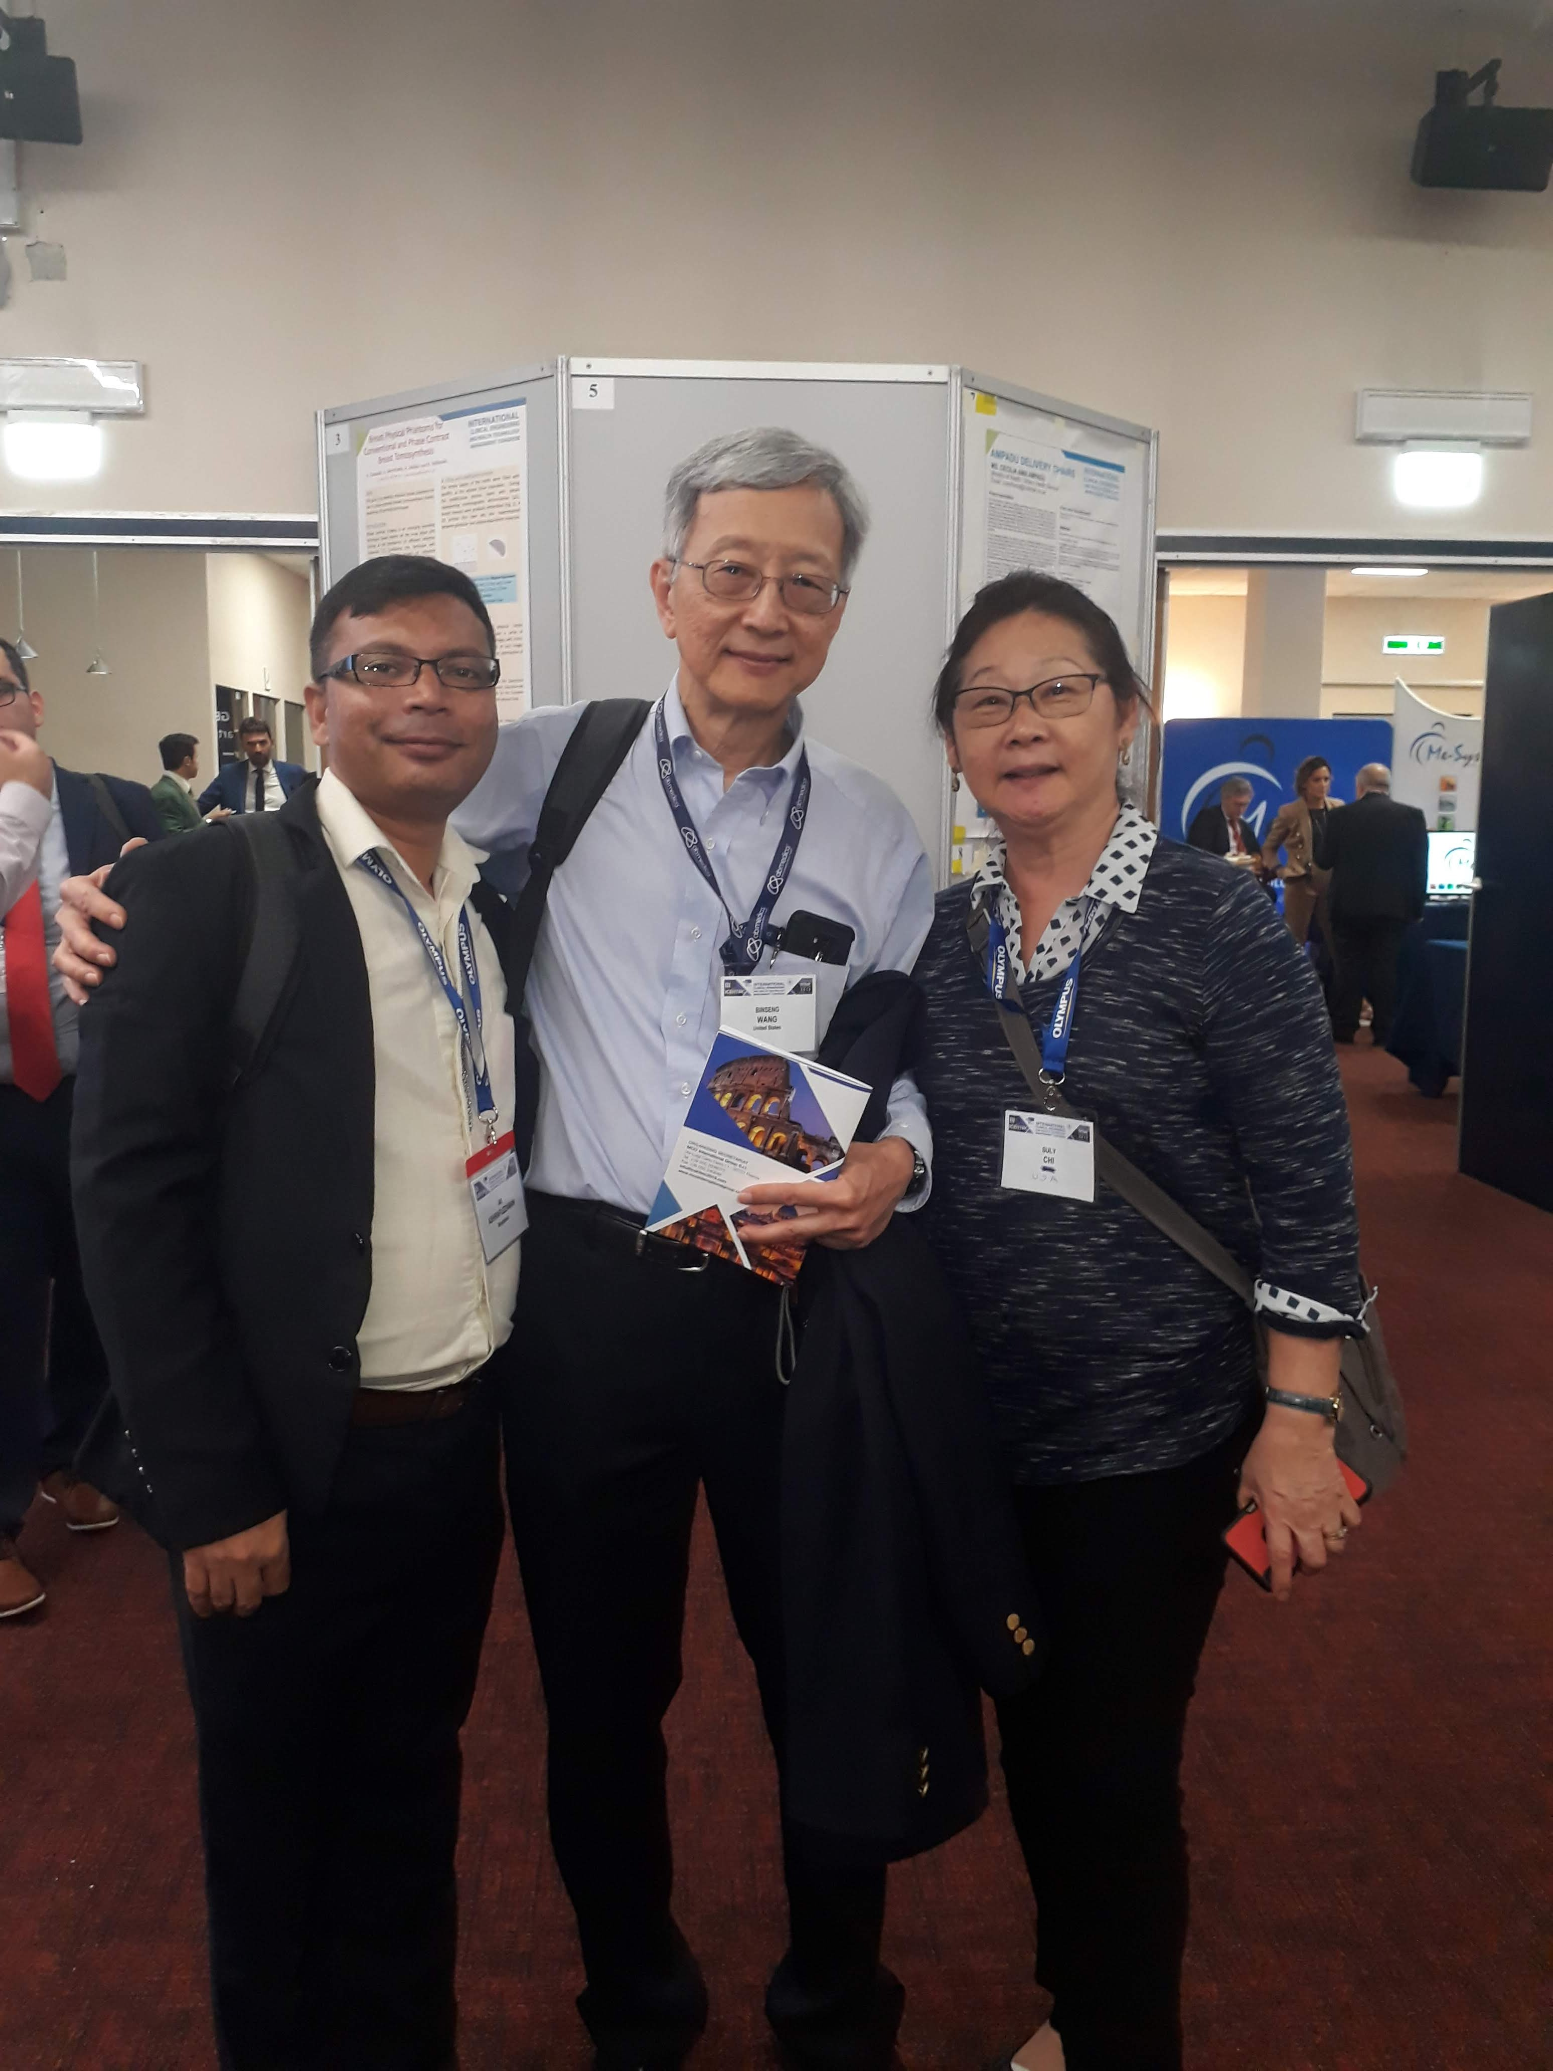
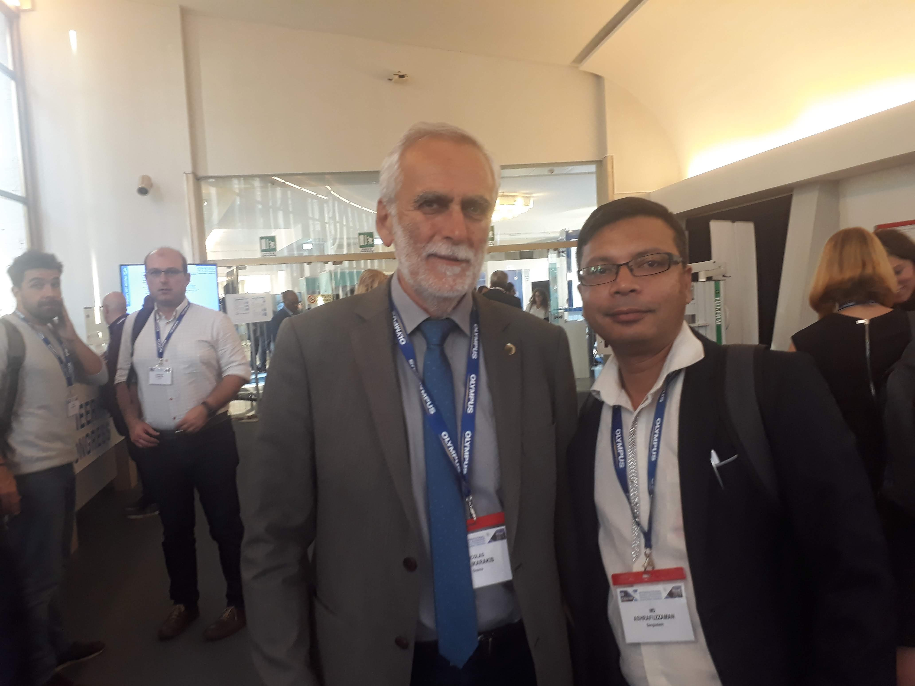
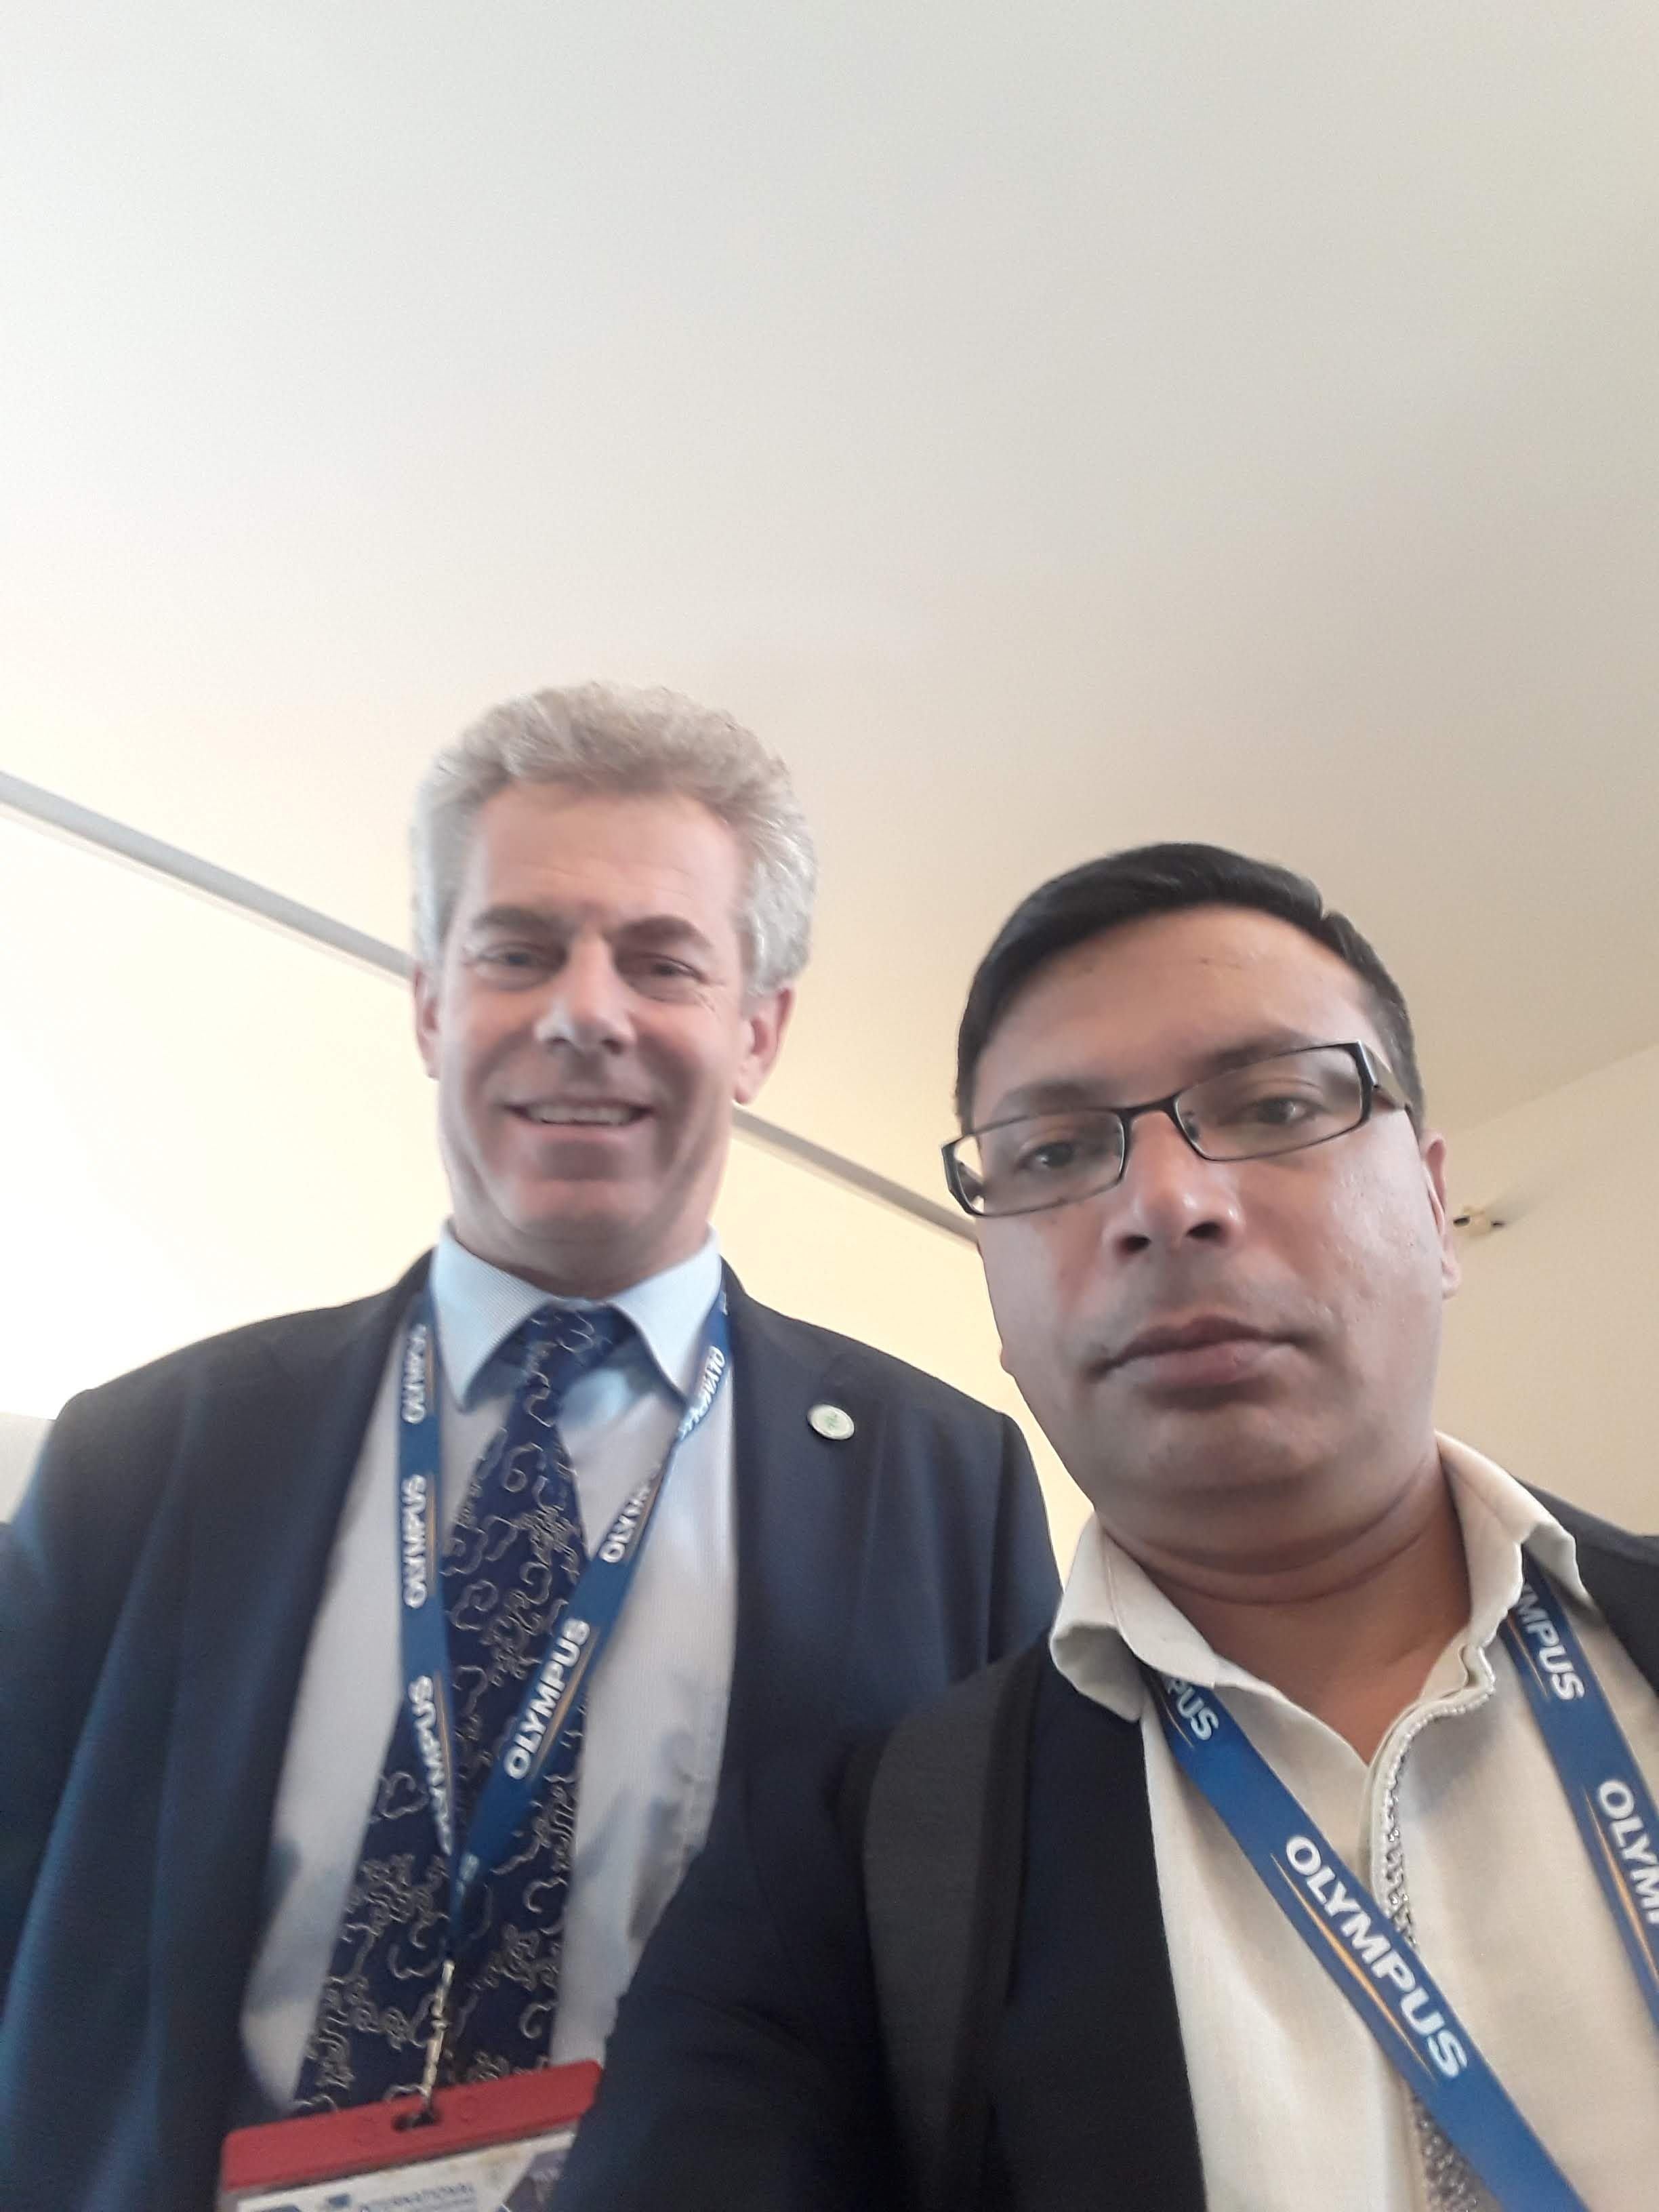
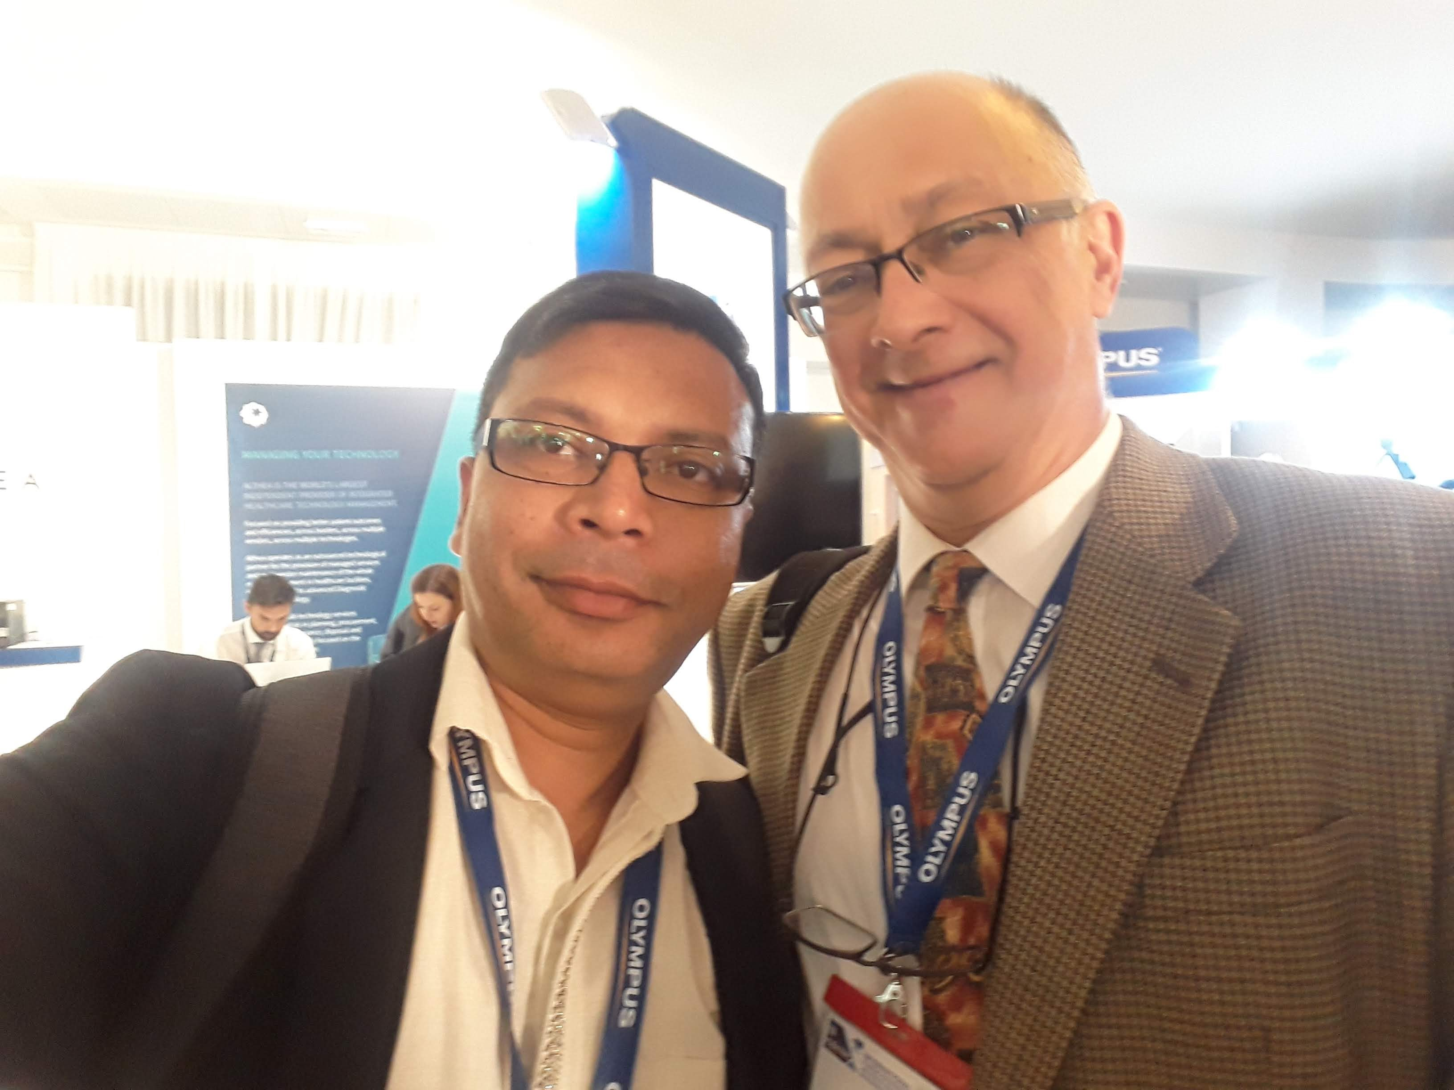
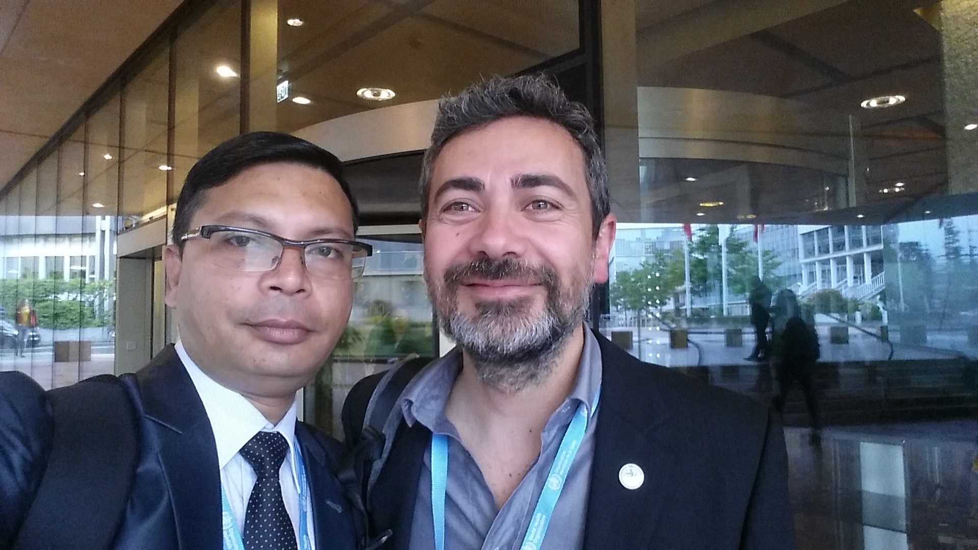
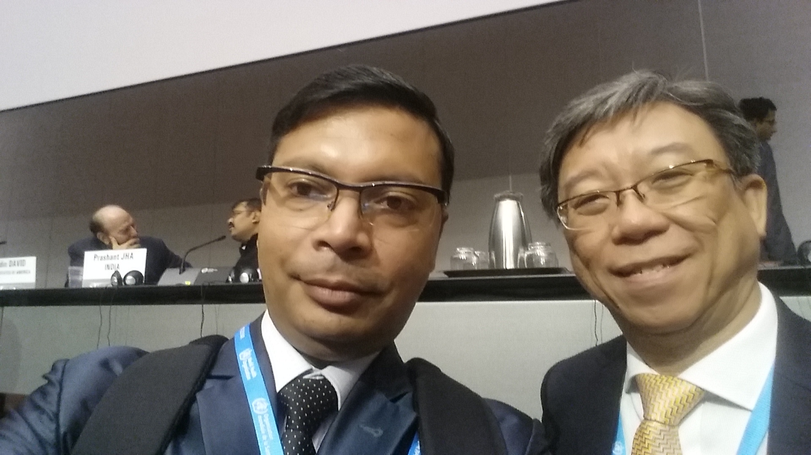
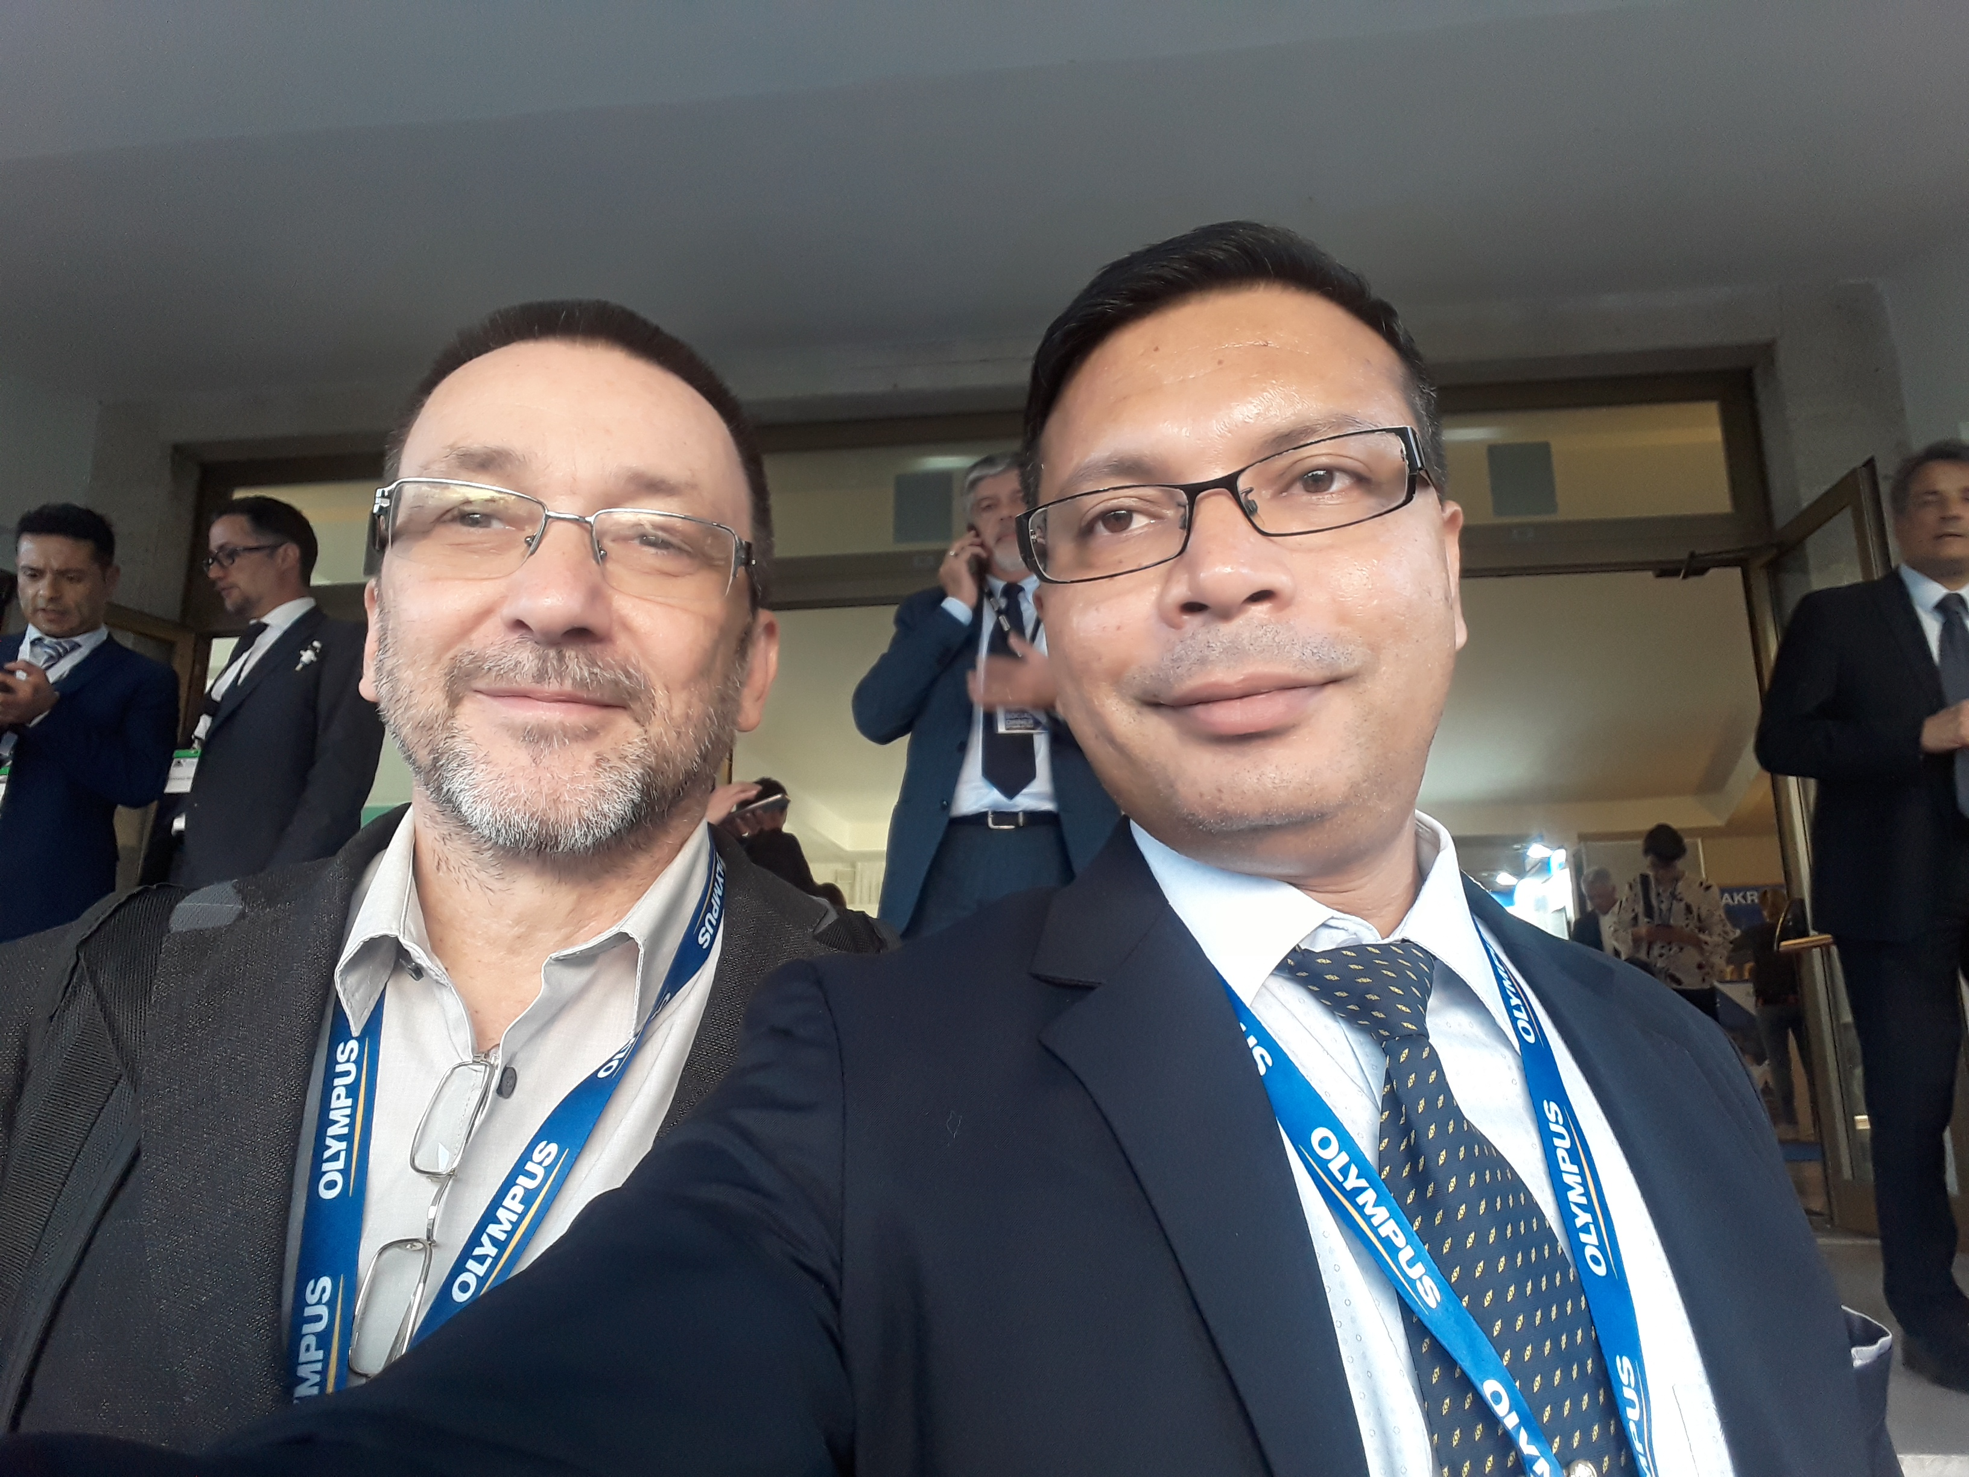
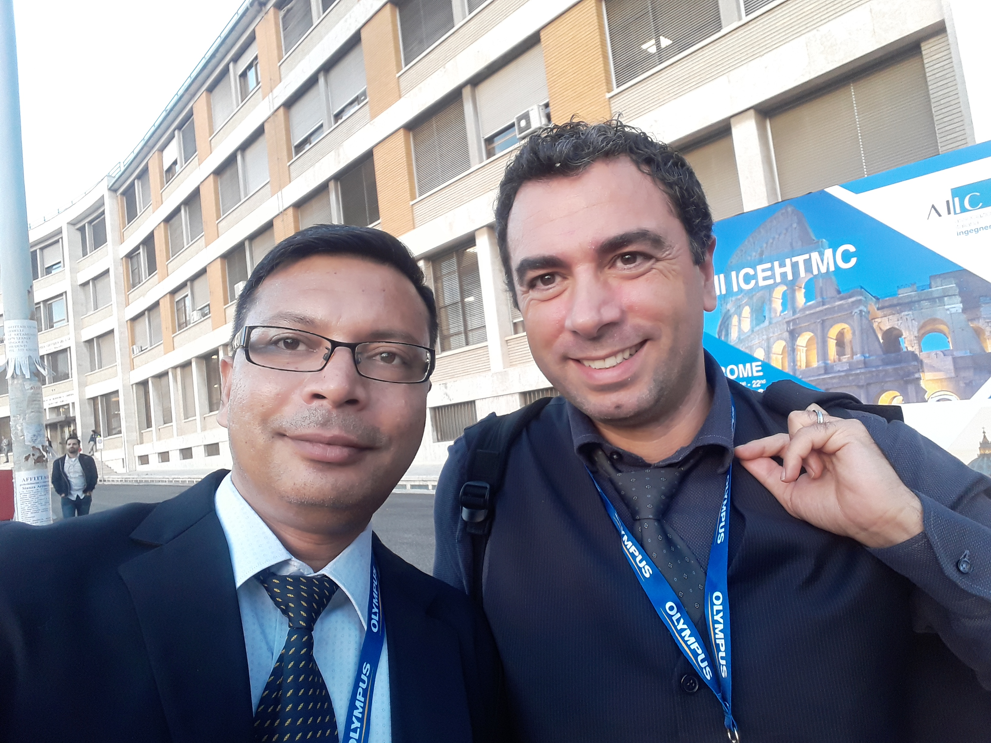
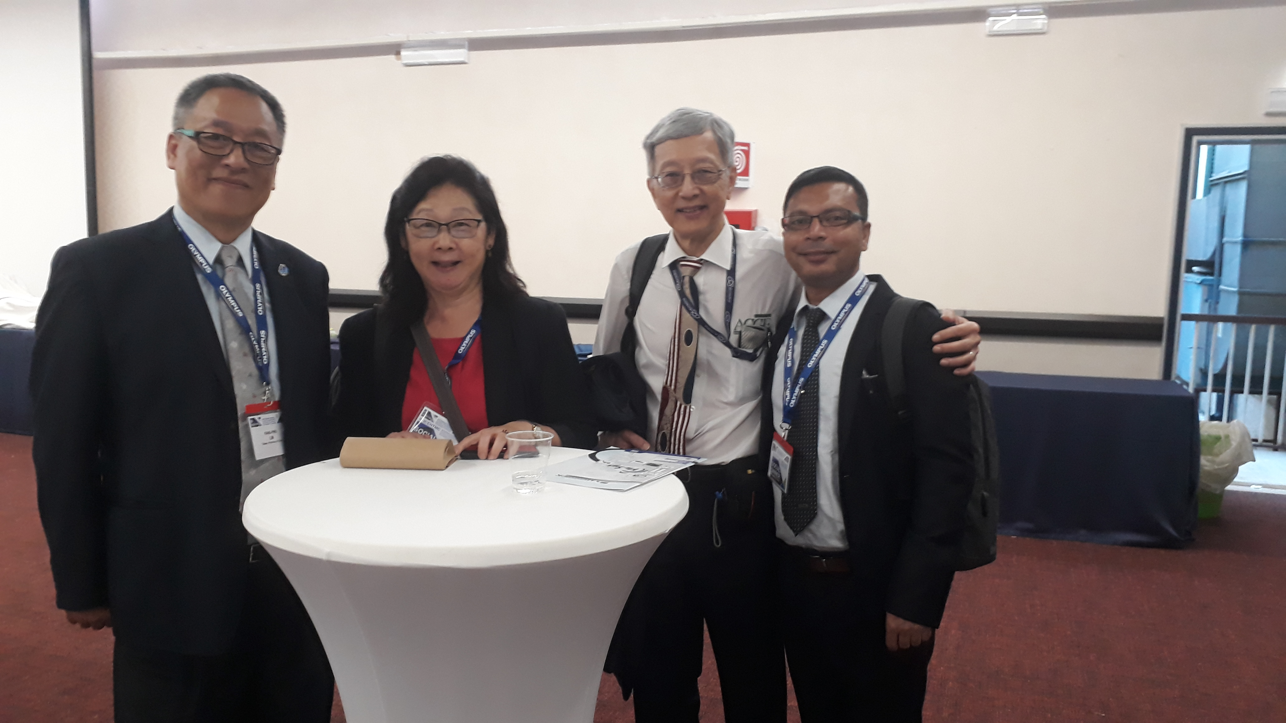
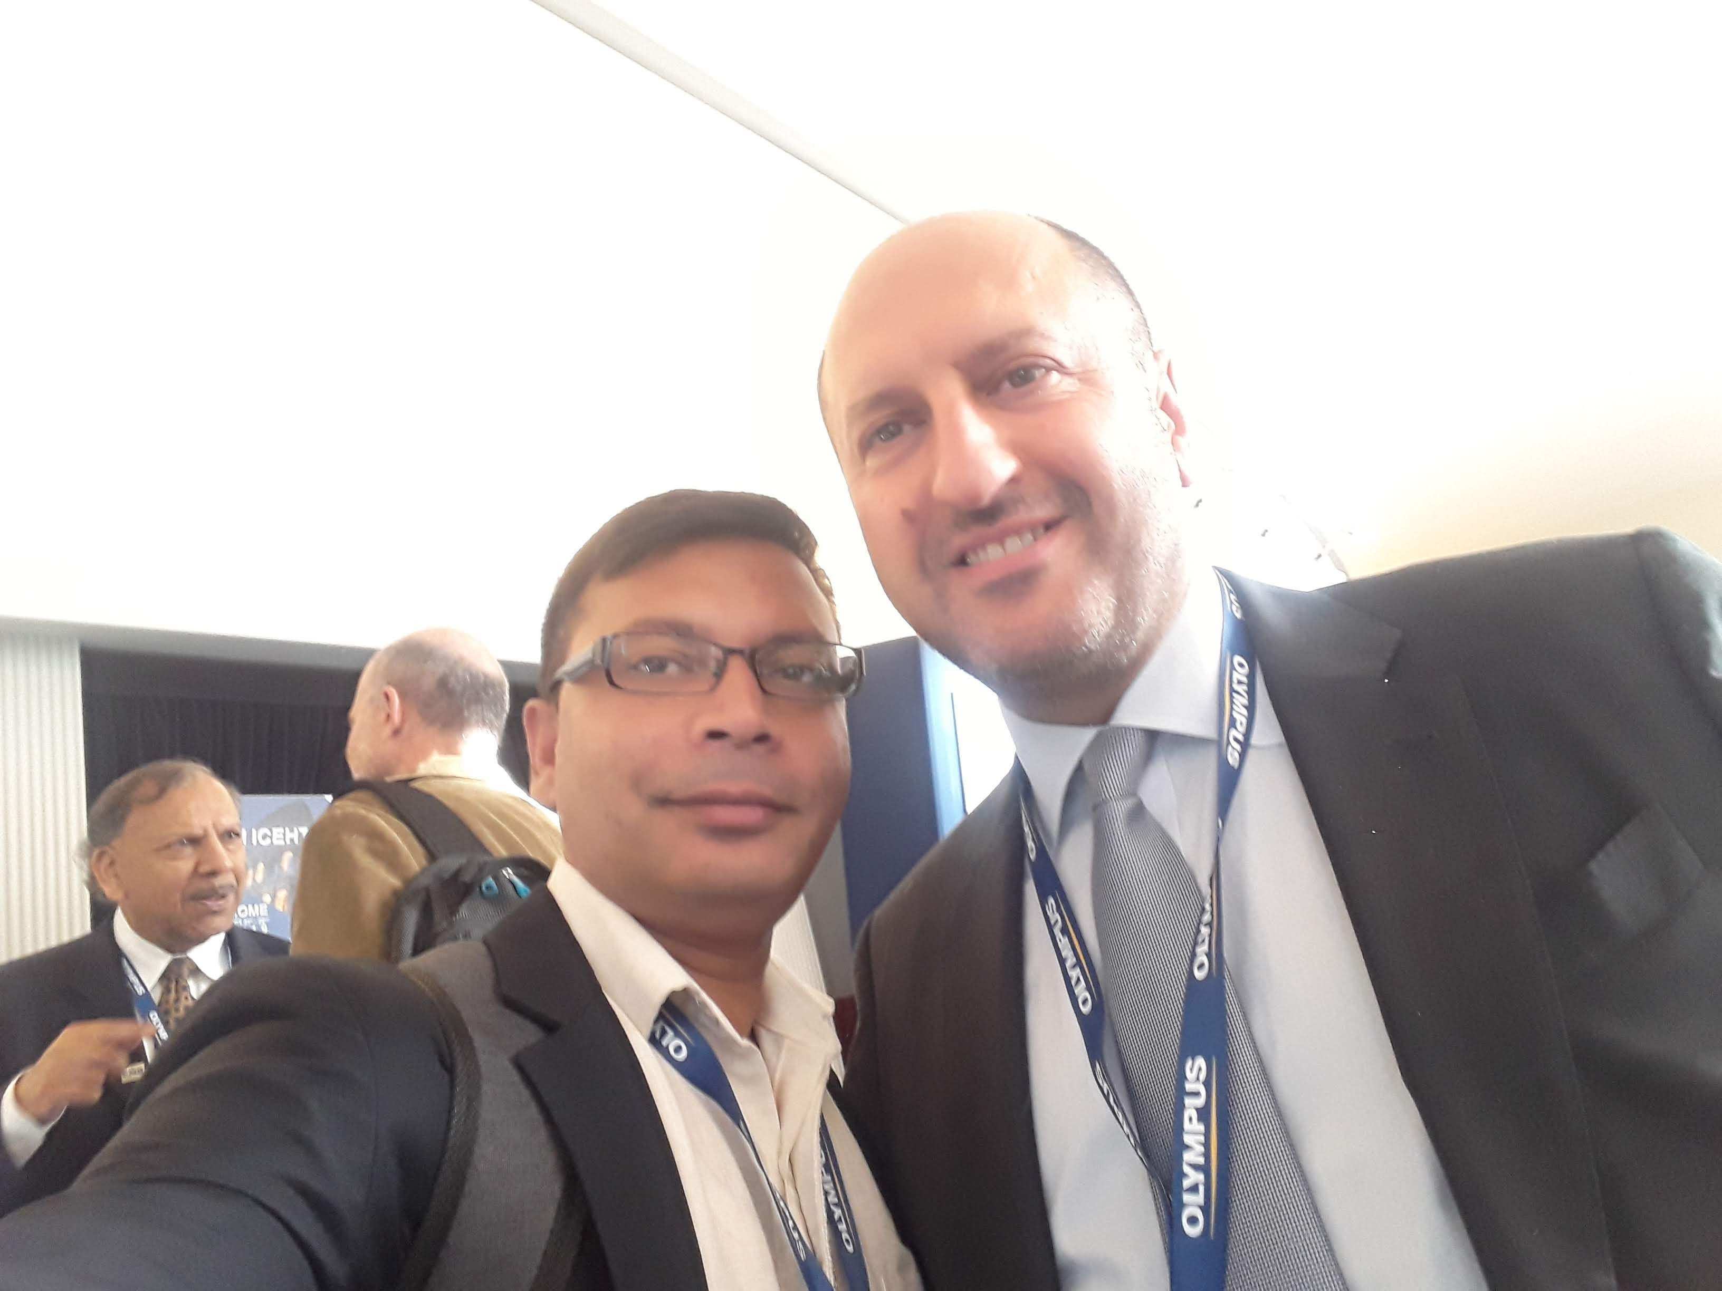
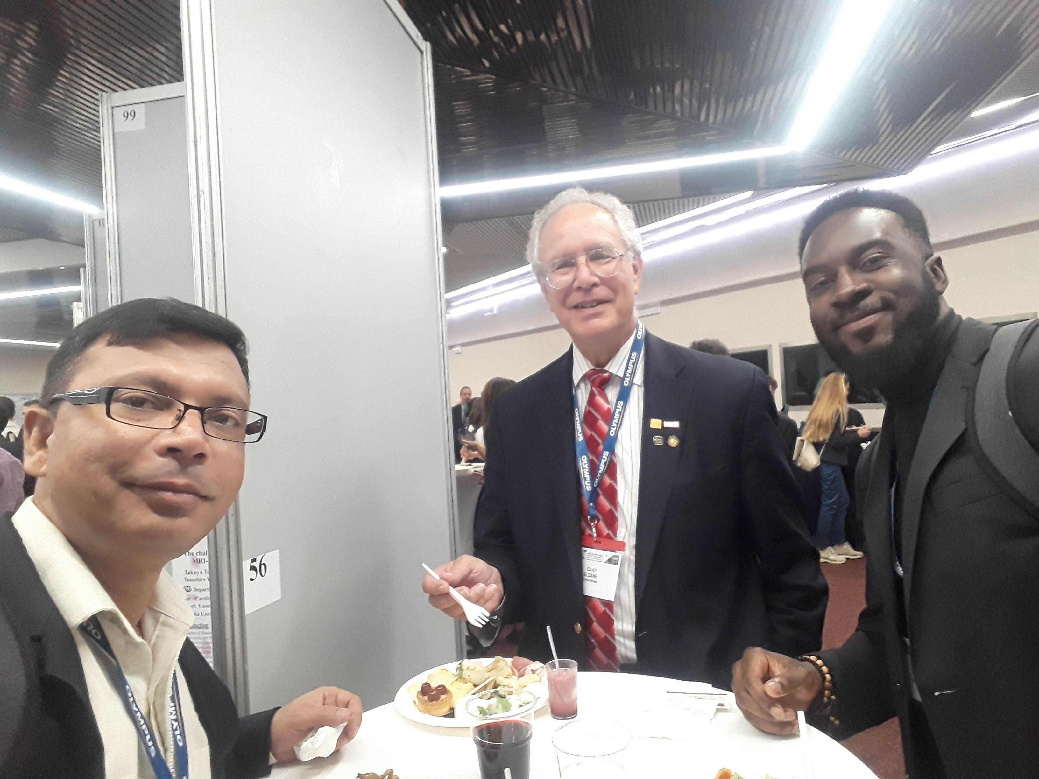
Results
Through the CE Marketing approaches the possible outcomes shall be achieved;
High-Level Decision Makers of the Government and Private sectors can be made conscious about the CE-HTM necessity & its importance at hospitals for quality services.
National CE Action Plan can be formulated easily for producing more number of CE professionals nationally and get benefits in Hospitals & related Facilities.
Regional cooperation will be enhanced and potential outcomes shall be achieved through mutual relationship with all the Clinical Engineering Association worldwide with good practice and regular reporting systems.
Newly established GCEA shall pave the way of delivering CE-HTM magnificently to its global
partners and together we all can make it better in coming days.

Slide 8


Major Md. Ashrafuzzaman, Ph.D, EME
ashezaman@gmail.com
+8801798366108
Military Institute of Science & Technology (MIST)
Saudi Bangladesh Institute of Biomedical Engineering & Technology (SBIBMET)
Bangladesh
Thank you!!!!

