Slide 1
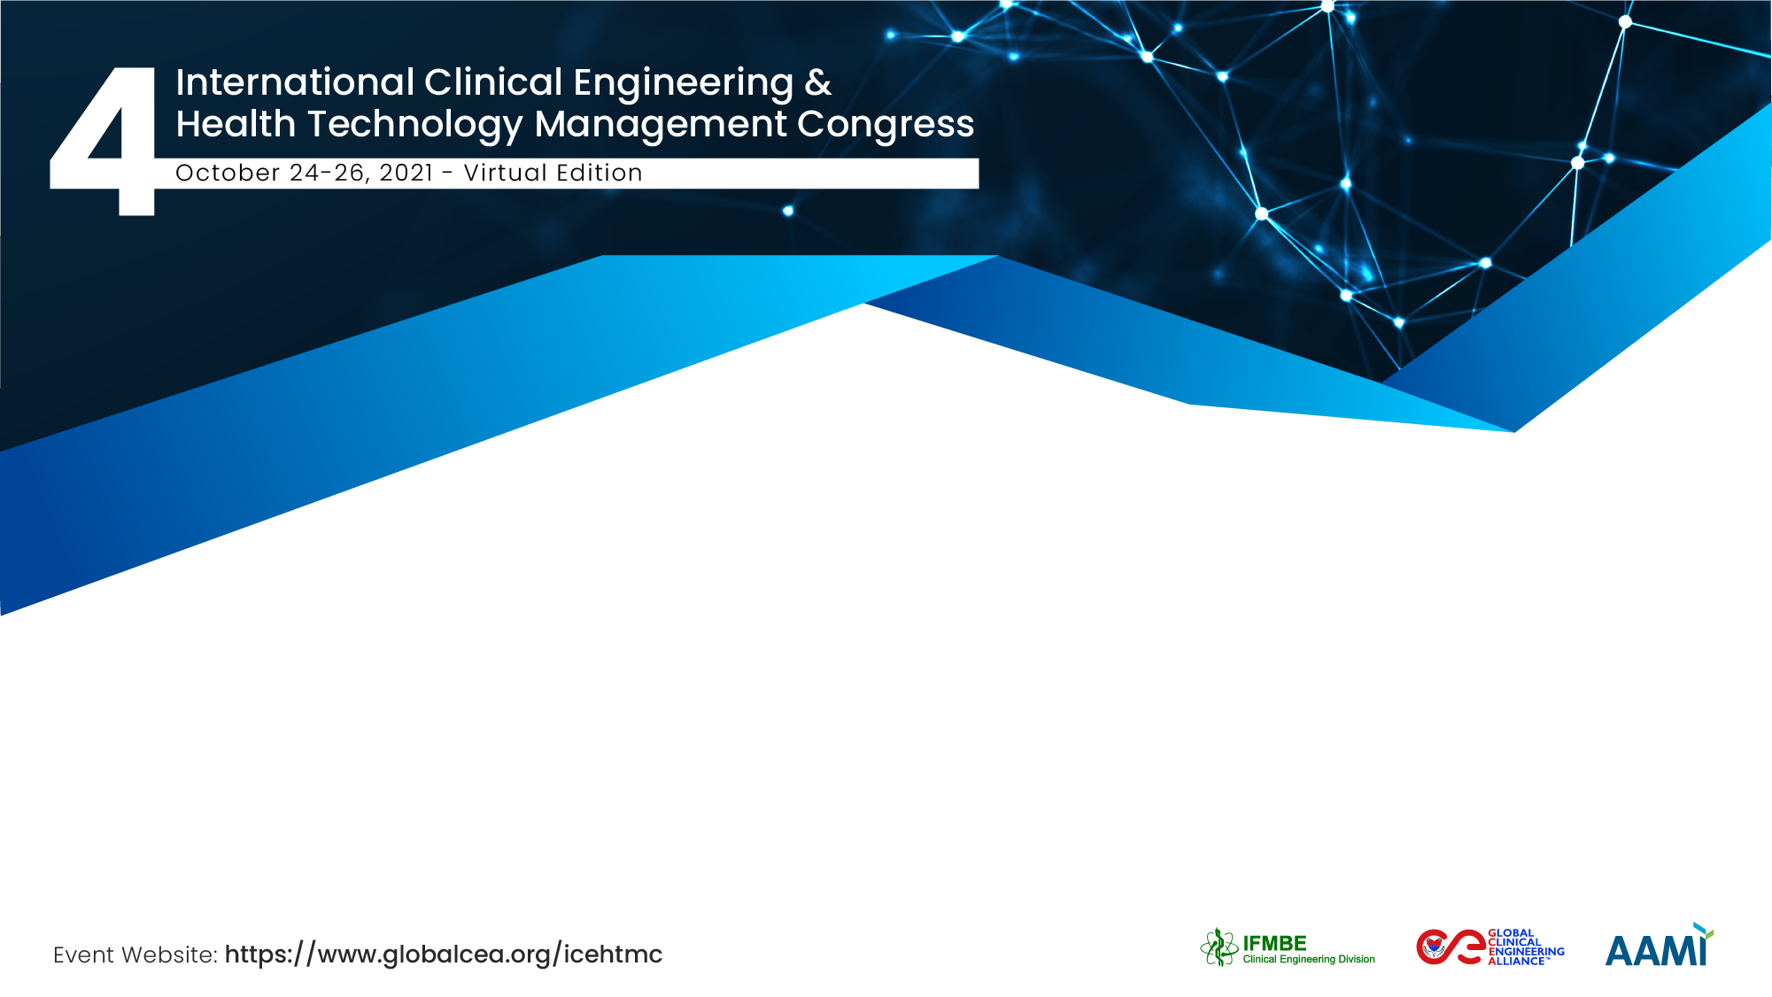
Improving the quality of biomedical equipment and maintenance for the quality and safety of care
OUSSEY Sadikou
Head of Technical and Biomedical Service at Campus University Hospital, MSHPAUS/CHUC

Slide 2
The Team / Workgroup
The inventories described in the abstract are conducted by
OUSSEY Sadikou, Head of Technical and Biomedical Service at CHU Campus
Individuals that will conduct this Abstract study are:
MOUSSA Mikaïla Bamba , Director of Health Infrastructure, Equipment and Maintenance
OUSSEY Sadikou, Head of Technical and Biomedical Service at Campus University Hospital

Slide 3
Description 1/4
Biomedical equipment, the main support for the quality and safety of care, is the subject of special attention in all health facilities. In sub-Saharan Africa in general and Togo in particular, deficiencies are noted in the quality of biomedical equipment being used in hospitals . This usually has a bad repercussion on the quality and safety of care. The findings on the inadequacies in the quality of biomedical equipment and maintenance are based on two reviews, the results of which are presented below.
The first inventory concerned laboratory equipments in 2016-2017 through the project RESAOLAB + Togo. This inventory took into account the 30 most important medical biology laboratories in the country (reference laboratories, CHUs, CHRs and district hospitals). In 1234 equipment, 95 are unbranded , 186 are without model , 285 do not have a serial number , 489 have no marquage and the rate of equipment failures is 26%.
The second inventory was done in the north, the région named Kara in 2018-2019 as part of the project on Reproductive Health and Sexual Rights.

Slide 4
Description 2/4
This inventory took into account the 10 most important hospitals in this region . Out of a total of 2728 pieces of equipment , 1704 are unbranded , 1723 are without a model , 1978 have no serial number , 1796 have no marking and the immobilization rate is 32 %.
The results of these inventories revealed the non-compliance of the supplies with the qualification criteria for biomedical equipment before being use in health facilities. The same remarks are made in health facilities in other regions of the country. It is a necessity to improve the quality of biomedical equipment and maintenance for the quality and safety of care.
The development of this project will see the involvement of various stakeholders and will take into account WHO guidelines for acquiring quality medical equipments. Its implementation will constitute support for quality care in accordance with the 5 axes of the national health development plan.
In the past, my principal work is technical support to the Ministry of Health departments in projects. But in July, there were disruptions in the course of activities.
Following my appointment as Head of Technical and Biomedical Service (STB), I am called upon to take charge of all engineering activities in addition to my previous responsibilities. My schedule is now divided between five (05) main responsabilities namely :

Slide 5
Description 3/4
The activities of Head of Technical and Biomedical Service
Maintenance of COVID-19 test laboratory equipment at GNASSINGBE Eyadema international airport
Technical support to the Ministry of Health, Public Hygiene and Universal Access to Health Care (MSHPAUS) in the project to strengthen the health system in reproductive health and sexual rights. I am in charge of equipment and maintenance in the project
Biomedical maintenance course at the Higher School of Biological and Food Techniques (ESTBA) at the University of Lomé (UL)
Launch of my firm called Cabinet Conseil Technologies et Santé (CCT & S)
With my new role as biomedical manager, the work initially planned on the quality of equipment and maintenance has been revised to adapt to the new context. The project to improve the quality of biomedical equipment and maintenance will follow the steps below :

Slide 6
Description 4/4
pilot phase in my hospital, Campus University Hospital : inventory of existing equipment and improvement of specifications to qualitatively acquire future equipment. These quality acquisitions should start with coming projects and the equipments to be planned for 2022. Take into account the resource documents of AFIB, IFMBE and WHO
Form a think tank on biomedical maintenance, including the heads of biomedical departments of CHUs and CHRs
Join together in an association : creation of the ATIBM (Togolese Association for Biological and Medical Engineering) open to all stakeholders
Extend the project to improve the quality of biomedical equipment and maintenance to other health facilities.
All these activities will begin in 2022. A consensual schedule will be drawn up in december. The process will be conducted with the support of the Director of Sanitary Infrastructures, Equipment and Maintenance, co-author of this document. At the end of these stages, proposals will be made to the Ministry of Health for the implementation of regulations on medical devices.

Slide 7
Goals of the project and final users that will benefit
Goals Noted
Improve regulations on the supply of biomedical equipment
Develop acceptance criteria for donation equipment
Improve the management of biomedical equipment
Make biomedical staff more operational
who will benefit from this work
Clinical Engineers and Technicians
Biomedical equipment users
Patients

Slide 8
Expected Results
biomedical equipment in health facilities that meet WHO criteria;
Better management of biomedical maintenance
Equipment failure rate less than or equal to 5%
have a more efficient biomedical staff

Slide 9
OUSSEY Sadikou
ousseysdk@gmail.com
Head of Technical and Biomedical Service at Campus University Hospital (CHUC)
Togo

