Slide 1


Information battle against Covid19: Public
Engagement Through Biomedical Technology Webinars
Aris Dermitzakis
Hellenic Society of Biomedical Technology (ELEVIT),

Slide 2

The Team / Workgroup
Panagiotis D. Bamidis ^{1,2}
Alkinoos Athanasiou ^{1,2}
Aris Dermitzakis ^{1,3}
Vasiliki Zilidou ^{1,2}
Nicolas Pallikarakis ^{1,3}
¹ Hellenic Society of Biomedical Technology (ELEBIT), Athens, Greece
² Lab of Medical Physics, School of Medicine, Aristotle University of Thessaloniki, Greece
³ Institute of Biomedical Technology (INBIT), Patras, Greece

Slide 3





Hellenic Society of Biomedical Technology
Thessaloniki
100 Members
Founded in the ‘70s
International Presence
MEMBER OF
International Federation of Medical
and Biological Engineering
European Alliance of Medical and Biological Engineering & Science
FIRST MEMBER TO JOIN
Global Clinical Engineering Alliance
Athens

Slide 4
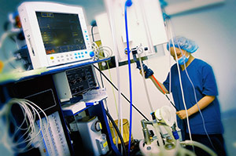
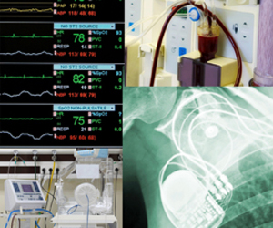
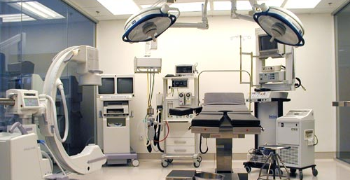
Covid Challenges
Clinical engineers were in the front line of fight with Covid 19
Extraordinary mobilization of CEs worldwide leaded by CED/IFMBE, WHO and GCEA initiatives, followed by numerous national/regional CE societies.

Slide 5




Covid Challenges
Biomedical technology products are at the frontline of efforts to contain the spread (masks) or wipe out the disease (vaccines).
Management of Medical Devices and Donations
Meanwhile the healthcare crisis has affected public and private sector operations and equipment critical to the management of the pandemic has been put at risk.

Slide 6


Covid Challenges
Disinformation regarding the Covid19 pandemic can magnify serious public health issues, put pressure on health systems and undermine efforts to effectively control the pandemic.
Received many questions from members i.e. about how to treat MD with the fear of contamination.

Slide 7



congresses
Goals
webinars
We aimed to engage the biomedical and healthcare technology stakeholders and practitioners in Greece through a series of webinars, congresses and measure their response.
Procurement experts, policy designers, healthcare workers (doctors, nursing staff), biomedical technology departments staff, clinical and biomedical engineers are among key target audience.
key target audience

Slide 8

Actions
Technical Seminars from MD manufactures on correct maintenance and use of Critical MD
Support of INBIT’s series of Webinars on: “Health Technology Assessment of Medical Devices”
Participation in IFMBE 2020 CED Webinar series
Latest was the organization of 9th Panhellenic Conference along side with Aristotle Medical Forum
5
COVID-19
webinars
were organized during May-Dec 2020 themed:
Clinical Engineering & Medical Technology in the COVID19 Era
Healthcare Providers & Public Procurement
Management of Critical Equipment
Medical Mask Technology
Vaccine Technology

Slide 9
Actions
Organization of Educational Seminar on “Risks and Safety in Health Care Facilities”, including topics like:
  Electrical safety of Medical Devices and Healthcare Facilities
  Electrical safety of critical areas
  Radiation hazards and protection
  Risks and safety in relation to Infusion Pumps
  Hospital Gas quality controls
  Approaching patient safety through Sterilization and Traceability procedures
  New technologies in the control of medical equipment
etc…

Slide 10




Example of Educational Outcome of Covid-19 Webinar Series
100 and 140 participants
during the first webinars
Participants were asked to answer at relevant poll questions before and after each webinar.
275 participants during the
masks-related webinar
Over 800 participants
during the
vaccine-related
webinar

Slide 11
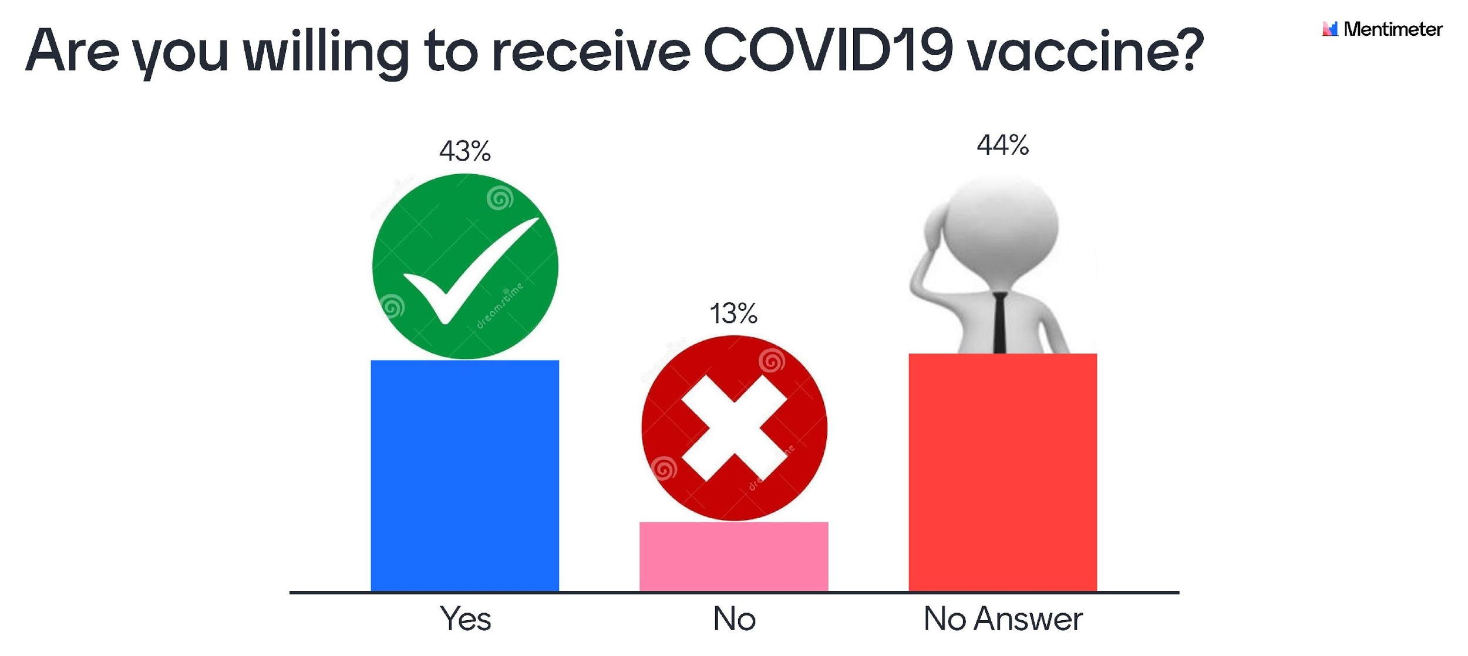
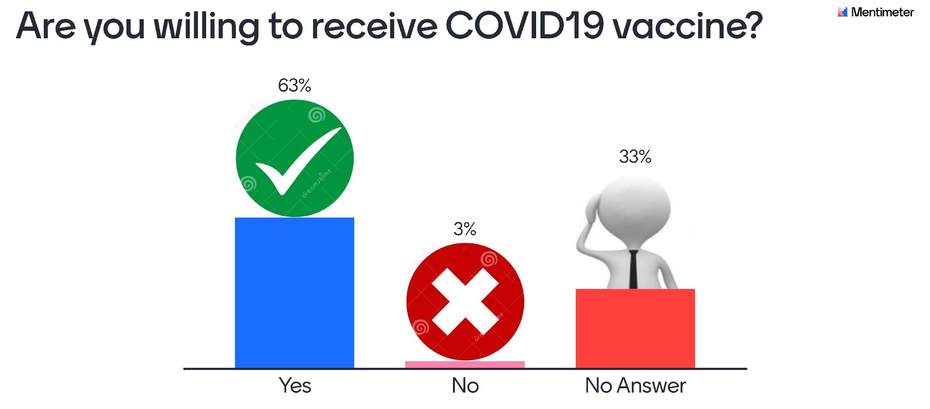
Example of Educational Outcome
Willingness Before Webinar
Willingness After Webinar
Mean trust towards the new vaccines for Covid19 increased from 3.1/5 to 3.8/5, while trust towards vaccines in general was higher (4.6/5) both before and after the webinar.
Willingness to receive a vaccine increased from 42.94% to 63.44% and negativity towards receiving a vaccine decreased from 12.94% to 3.08%.
Proper mask and protective gear use increased from 54.26% to 63.89%, while makeshift protective gear solutions were discouraged.

Slide 12
Aris Dermitzakis
Arisderm@gmail.com
Hellenic Society of Biomedical Technology (ELEVIT), Greece

