Slide 1
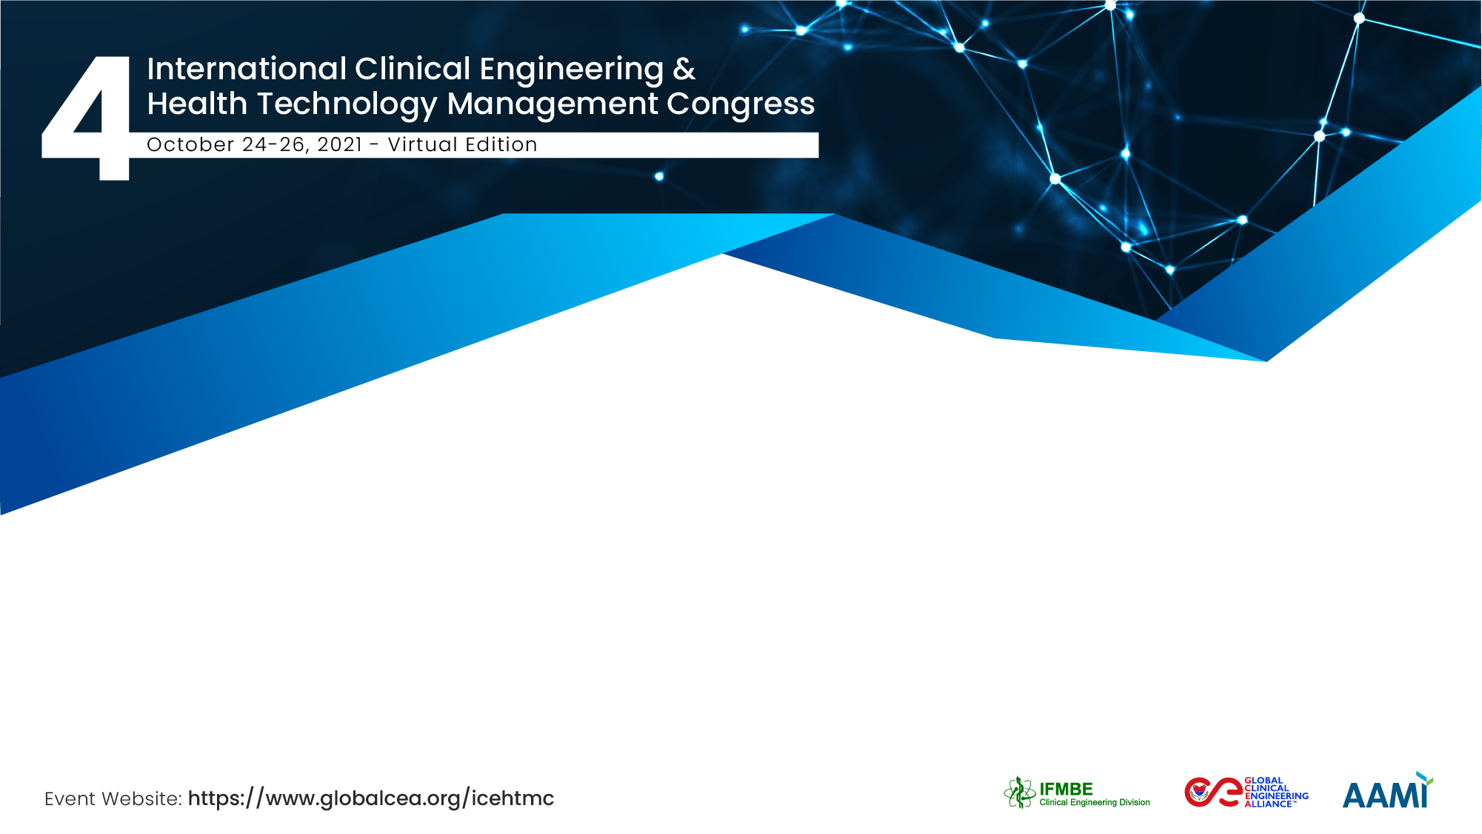
Innovating through a Pandemic
The central role of the clinical engineer in leveraging academia and industry to collaborate in addressing unmet clinical and service needs in a crisis
Frank Kirrane
Department of Medical Physics and Clinical Engineering, Galway University Hospital, Ireland
National University of Ireland, Galway

Slide 2


The Team / Workgroup
Frank Kirrane, Head of Clinical Engineering
Brendan Tuohy, Head of Department of Medical Physics and Clinical Engineering,
National University of Ireland, Galway
Clinical Research Facility, Galway University Hospital

Slide 3
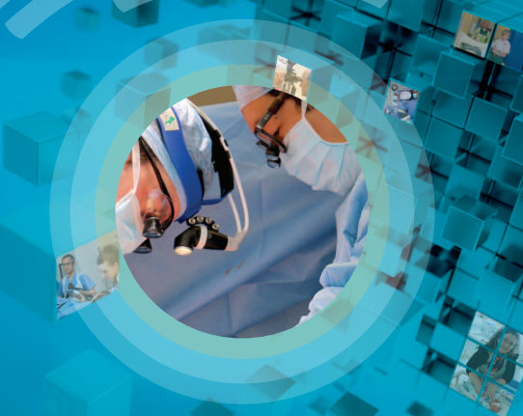
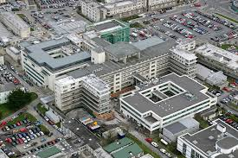

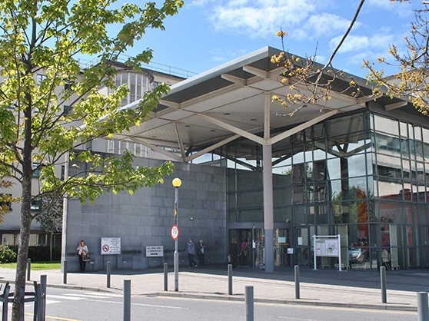
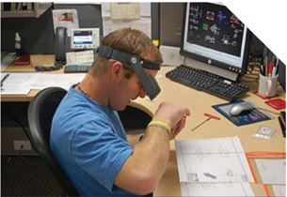
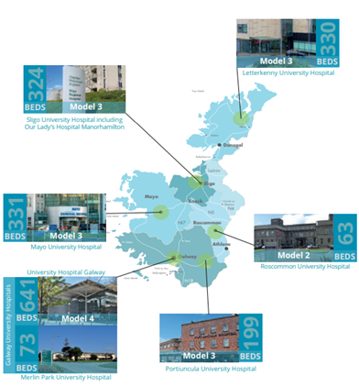
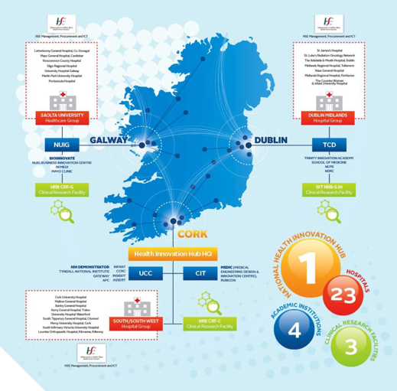
Who we are

Slide 4
Goals of the project
Demonstrate the unique role of the Clinical Engineering contributes to Research & Innovation (R&I)
How we ‘fit’ into the wider R&I “ecosystem”
How do we now learn from this experience to grow and sustain a Research & Innovation footprint

Slide 5
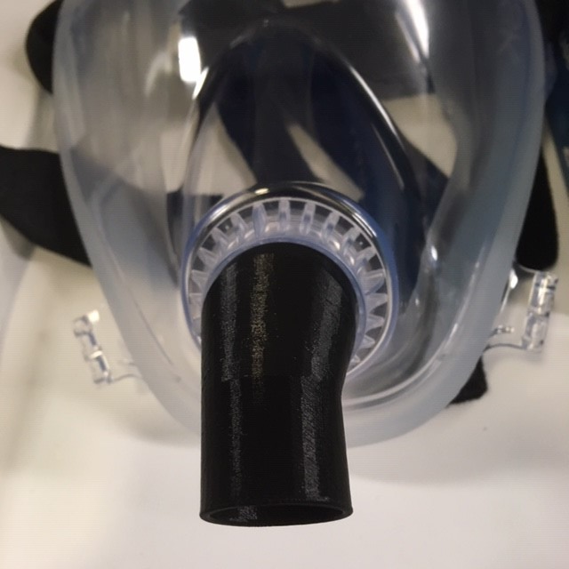
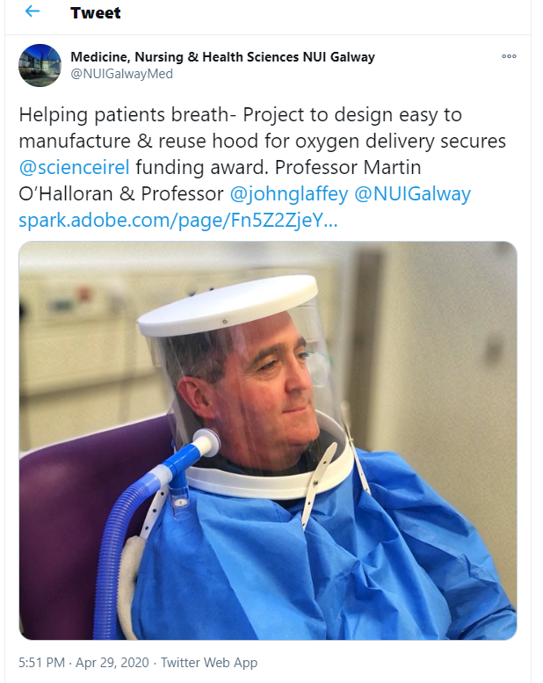
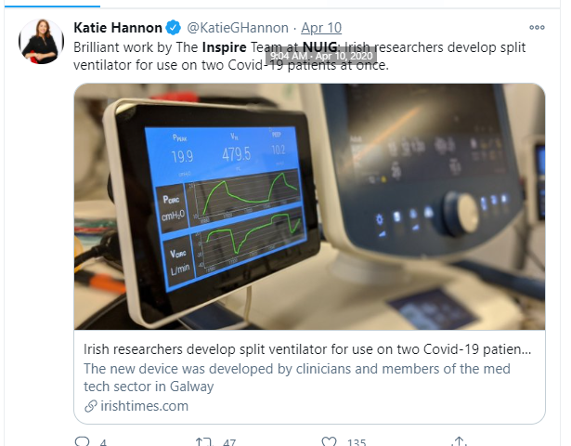
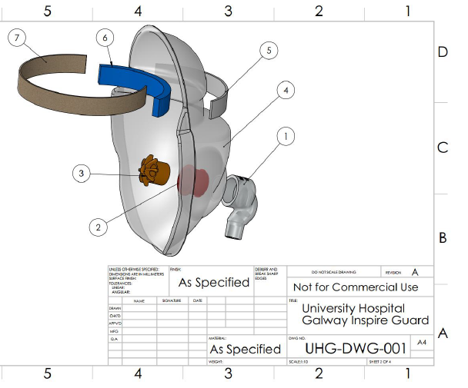
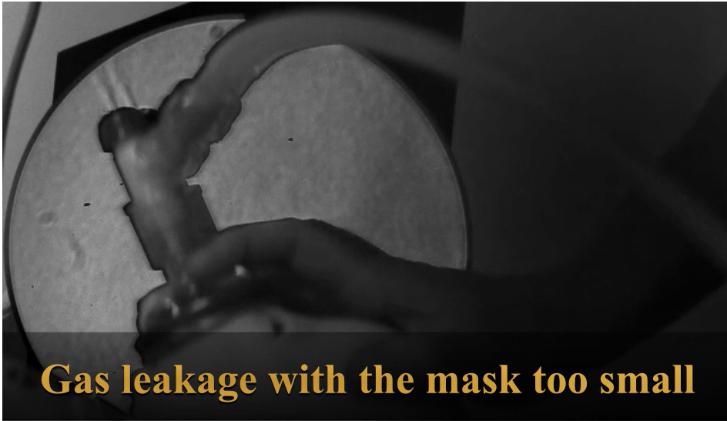
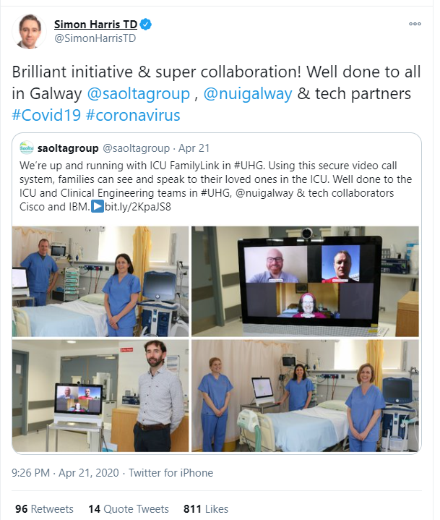
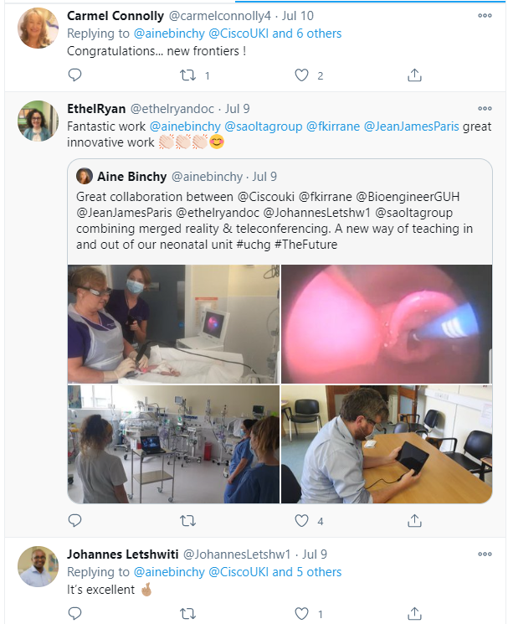
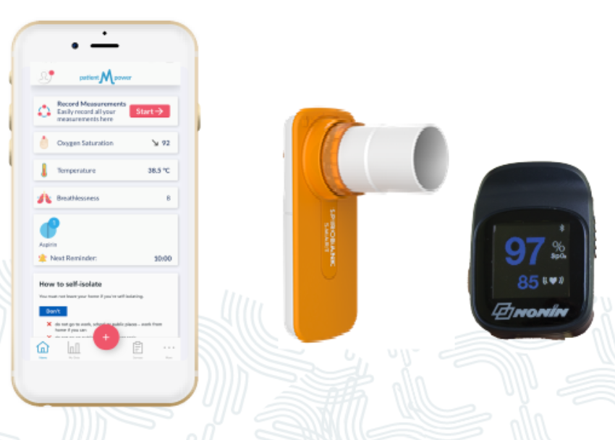
Case examples
Supply chain disruption
  3-d printed accessories
  NIV Hood
  VentShare
Occupational Safety/PPE
  Inspire Guard
  Scherelin imaging
Social Distancing
  ICU-Family-Link
  Telepresence
  Cystic Fibrosis Telehealth
Needs assessments, functional and safety requirements, prototype evaluation, testing, clinical simulation, Clinical risk assessments, Implementation, project management

Slide 6
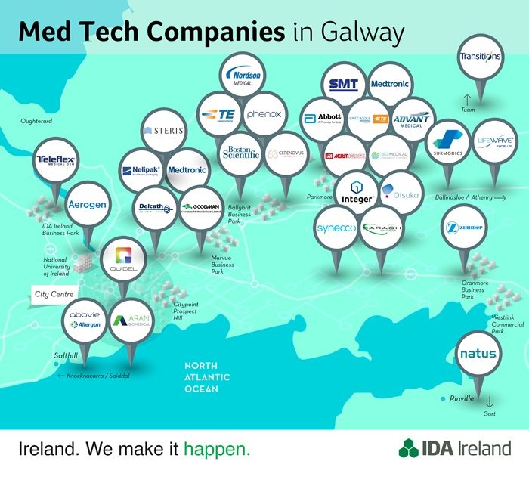
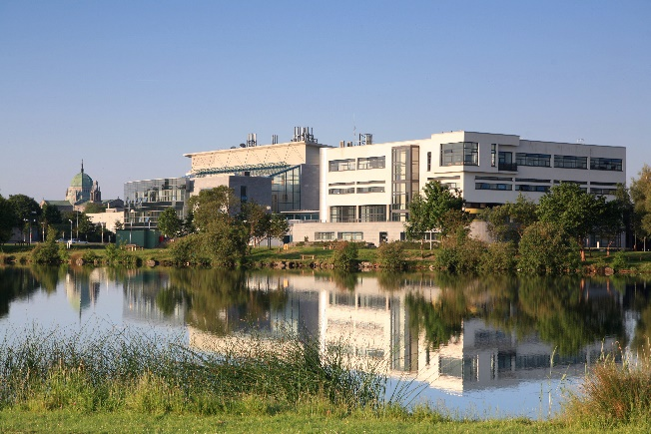
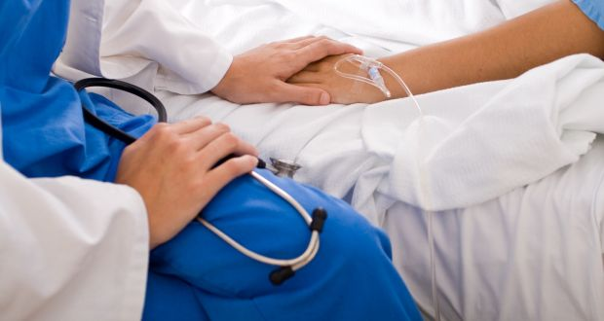
Our place in the R&I “ecosystem”
Needs Assessments, Functional and safety requirements, Prototype evaluation, Human Factors, clinical simulation, Clinical risk assessments, Implementation management
Industry
Academia
Clinical Engineer
hospital
Patient

Slide 7
Clinical Engineering Research & Innovation Maturity Model
Purpose (motivation)
Processes (actions)
Product (outcomes)
Level 5
Strategic
R&I integral to department profile, Joint Research appointments, Principal Investigator level, R&I budget, IP rights
Level 4
Proactive
Funded Research positions
Part-time secondments, Research grants
Level 3
Defined
Published strategy on R&I collaboration, Research publications
Level 2
Exploratory/Reactive
Ad-hoc, reacts to requests for input
Level 1
Unaware
R&I not a consideration

Slide 8
Frank Kirrane
frank.kirrane@hse.ie
Department of Medical Physics and Clinical Engineering
Galway University Hospital, IRELAND

