Slide 1
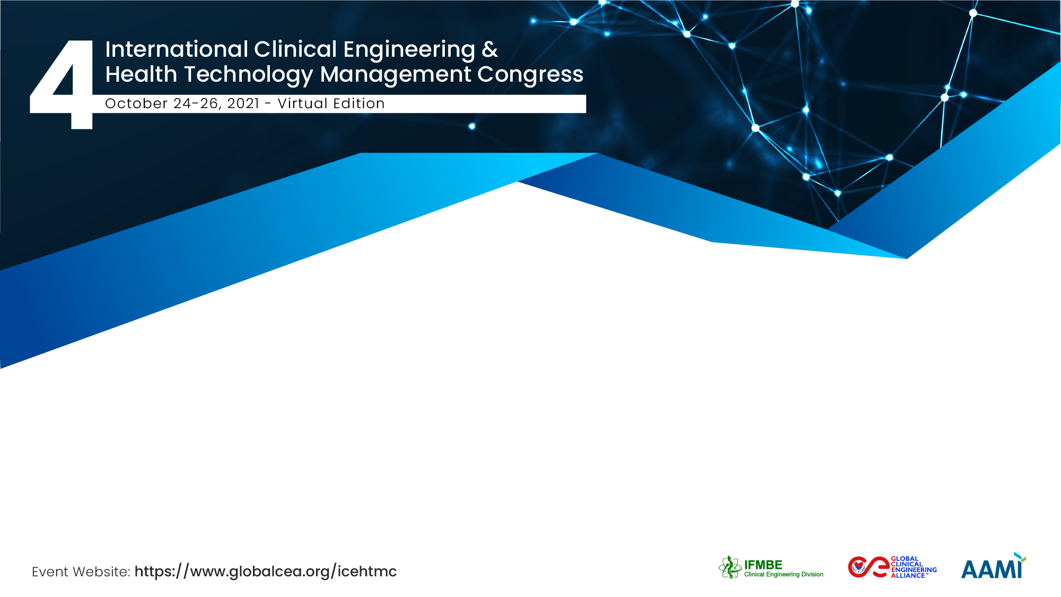


Inspiring the Activities of Clinical Engineering Association- Bangladesh (CEAB): Controls of Quality HTM Outcome
Mohiuddin Ahmad & Md. Anwar Hossain
Dept. of EEE, KUET, Bangladesh & NEMEMW & TC, MoH & FW, Bangladesh
Founder: President of CEAB & Secretary of, CEAB
Affiliated with CED, IFMBE

Slide 2
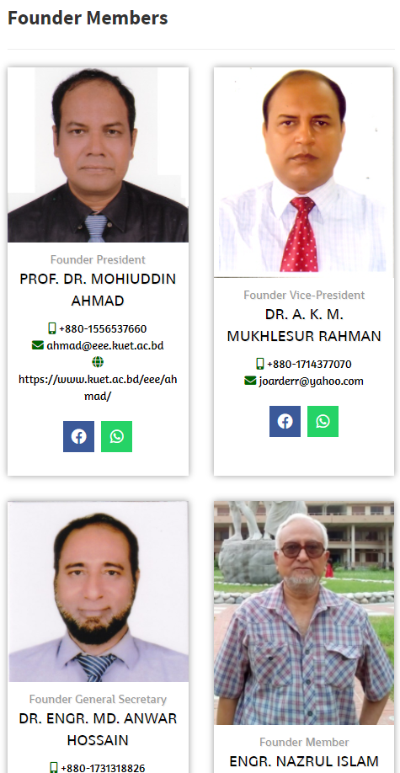
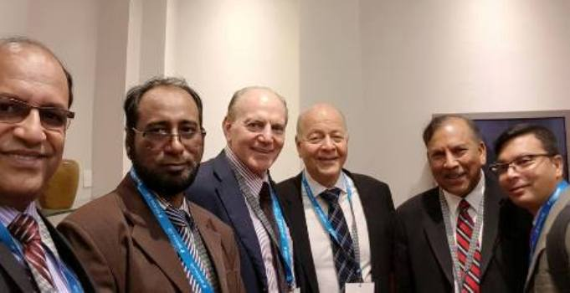
The Team / Workgroup
Founder President, Vice-President, and General Secretary
This project was developed in 2015 by Mohiuddin Ahmad, Md. Anwar Hossain, AKM Rahman, Azman bin Hamid, and Yadin David
    Leaders in National and International Clinical Engineering Program
Country: Bangladesh, Malaysia & USA
National Country Office Contact:
    Md. Anwar Hossain & Mohiuddin Ahmad, Bangladesh
    Office: +88-02-222298529, +88-041-769471333
    Cell: +880-1731318826, +880-1887066066
    email: anwar.bme@gmail.com, ahmad@kuet.ac.bd
    Web: www.ceab.org.bd
    Facebook: https://www.facebook.com/ceab.bd/
International Adviser:
  Yadin David, USA & Azman Bin Hamid, Malaysia

Slide 3
Description
This project takes a comprehensive view to improve the present activities of CEAB for the appropriate deployment of HTM practice in Bangladesh and justification strategies through an international health perspective.
  A comprehensive step is to be taken in order to obtain the patient outcome by applying appropriate HTM in economically fluctuating developing countries like Bangladesh
Three years of use error data from a large hospital system containing more than 25 hospitals with a wide range of complexity as well as standard data definitions within its computerized maintenance management system (CMMS) was utilized in this study to determine top trends in use errors. CEAB will perform -
  Error related to the medical device and its impact on patient care,
  Data collection, analysis, and finding results, development module to minimize the error by applying safety and calibration

Slide 4
Description
A descriptive analysis was performed on the secondary data to determine the top three trends for the unpleasant deployment of HTM practice and offer solutions to improve patient safety for all users.
  Hospitals: specialized hospitals, medical college hospitals, and district hospitals
  Medical Device: ICU ventilator with high flow nasal cannula, Oxygen therapy, PCR Lab/CT scan)
This data was also evaluated to determine the potential impact on access to care based upon the average time to repair the equipment.
  The study evaluated undesired costs related to the use of errors based on earnings (less income) and repair costs.

Slide 5
Description
International health forces including models for development, science, technology and innovation, resources, and human rights will be considered in the development of the overall understanding of medical device errors (risks related to medical device and users errors) and their impact on international health and access.
Using this international health technology model as a framework to investigate the issues and suggested mitigation strategies, as well as an enhanced post-market regulatory surveillance system, would provide specific insight to the key stakeholders within the healthcare industry, and regulatory bodies in Bangladesh.
We need a complete assessment tool that covers all aspects of medical equipment maintenance management in modern hospitals and clinics.
Using the model as framework
Identify/Investigate the problem (Medical device related to healthcare)
Output (Post-market regulatory surveillance system)
Mitigate the issues

Slide 6
Goals of the project and final users that will benefit
Goals:
  Perform a quantitative analysis identifying the top 3-5 parameters (equipment selection, maintenance and safety, safe discard) of HTM trends in CMSD and ten modern hospital in Bangladesh.
  Through an international HTM lens, determine the inter-disciplinary forces at play and suggest the next steps for research.
  Develop a Comprehensive Proposal for mitigating unpleasant HTM practice that has been conducting unskilled staffs
  Determine Potential Next Steps for Research in the International Health Stadium
Users that will Benefit:
  Exchange the technology related to medical equipment that brings excellent impacts. As examples: National skilled resource development, fewer purchase costs, safe use of the equipment, patient satisfaction, and cost-effective

Slide 7
Results
Awareness will possibly develop among health care providers that are yet not known
Directorate General of Clinical engineering services will establish under the Government of Bangladesh
Medical devices regulatory body regulates the patient safety.
Safe outcomes of medical devices ensure patient safety.
Specific areas where resources and technology are used to improve healthcare are highlighted by trends.

Slide 8
Mohiuddin Ahmad
ahmad@eee.kuet.ac.bd
Founder President, CEAB & Director, IICT, KUET, Bangladesh

