Slide 1


Interdistrict Hospital Evita
Bioengineering Service
Maintenance Department
Formosa - Argentina

Slide 2

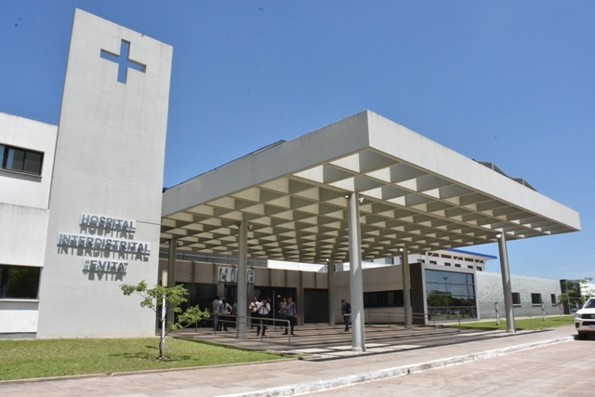
HISTORY
A story of resilience and constant Overcoming

Slide 3
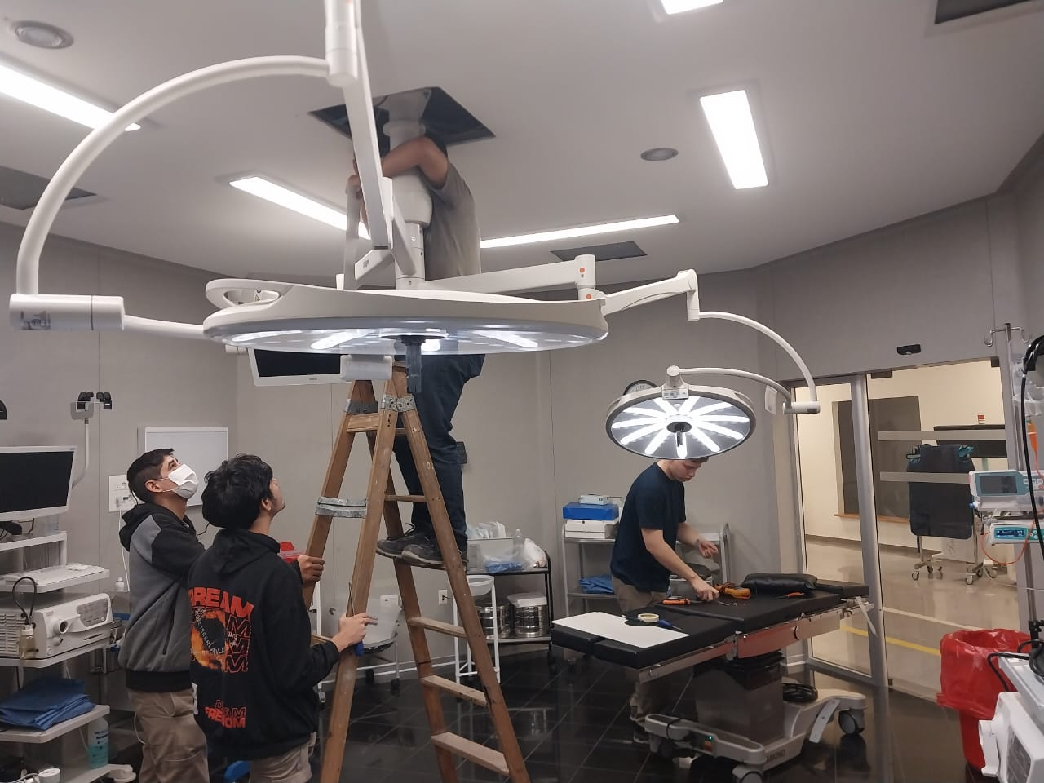
Beginnings
"The Province of Formosa is located in the northeast of the Argentine Republic, and is part of the Chaco Region along with the provinces of Chaco, northern Santa Fe, eastern Salta, and Santiago del Estero. It is an extensive plain that emerged with the formation of the Andes mountain range, and is traversed by gallery forests, wetlands, savannas, grasslands, palm groves, rivers, and streams, where a great variety of plant and animal species inhabit."
It is in this place where the Interdistrict Hospital Evita is located, in the center of the health hub of the province, a strategic location to provide quality healthcare to the entire region.

Slide 4
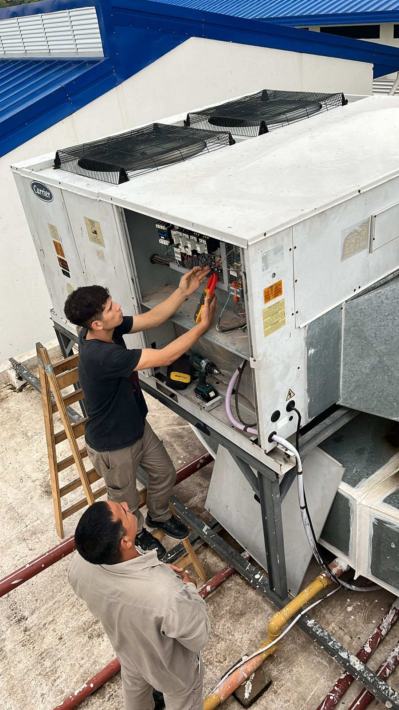
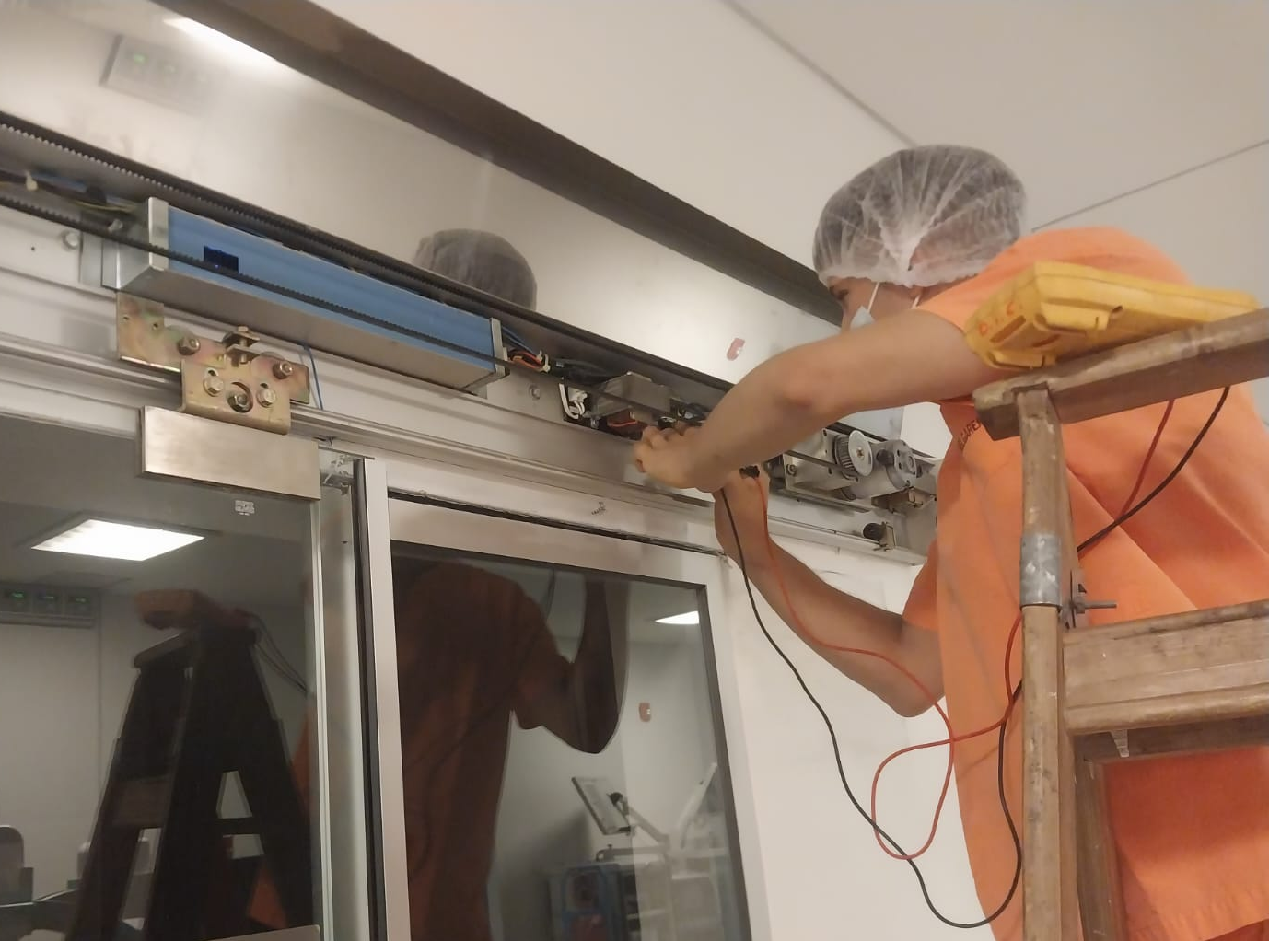
Refurbishment
Its beginnings were in the midst of the H1N1 COVID-19 pandemic, where it started operating as a single-purpose hospital exclusively dedicated to treating patients with this disease. For this purpose, all facilities had to be refurbished to include more intensive care beds as well as thermomechanical installations for this pathology. After the pandemic, the entire hospital had to be reconfigured again to become a multipurpose hospital and a provincial reference.

Slide 5
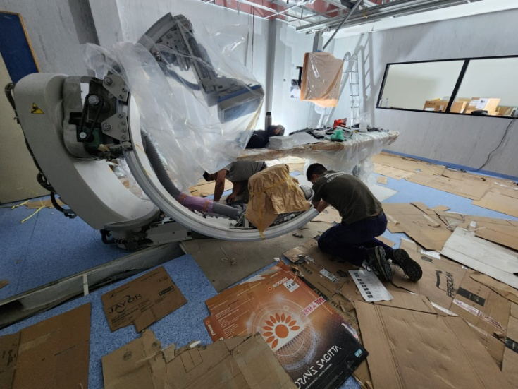
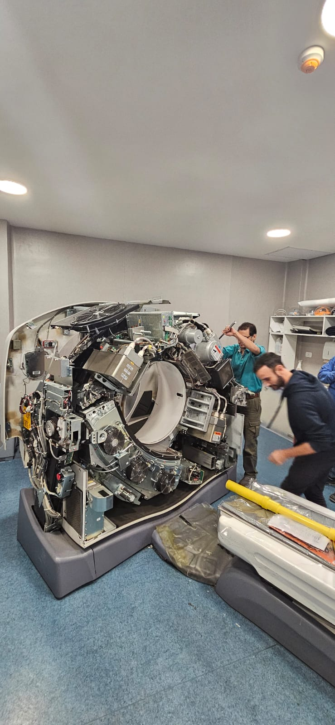
Implementation and updating of New Technologies
The installation of a state-of-the-art angiograph was carried out, as well as maintenance and repairs to the computed tomography system.

Slide 6
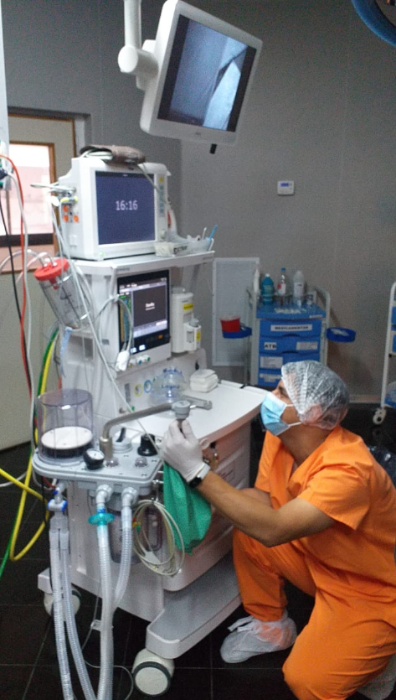
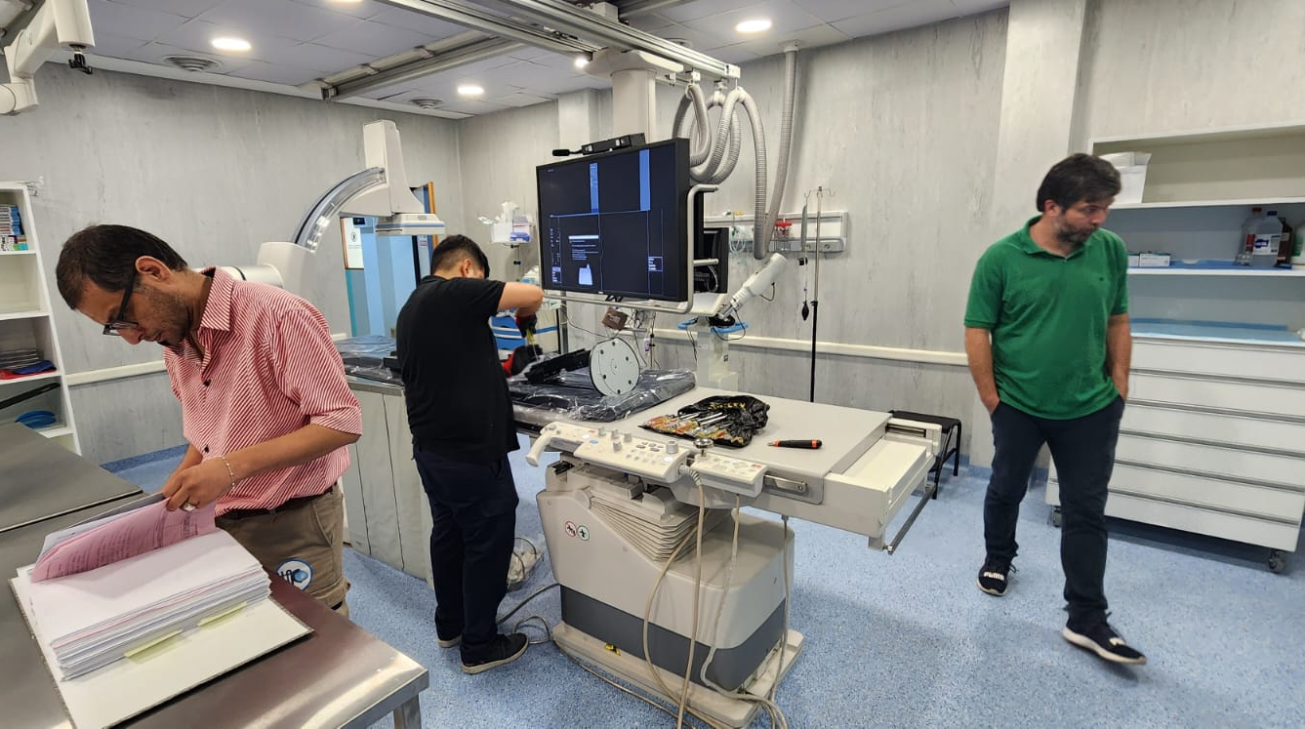
Implementation and updating of New Technologies
"The hospital has a capacity of 193 beds, including Coronary Unit, Intensive Care Unit, Emergency, Inpatient, Burn Unit, Triage, among other services. During the pandemic, all inpatient positions were arranged as Intensive Care Units with their corresponding facilities and medical equipment."
"After the pandemic, all beds and consultation rooms were reconfigured to provide all the services that a polyvalent hospital should offer. All the work was carried out by the team of technical professionals, including engineers and technicians, all of whom belong to the hospital."

Slide 7
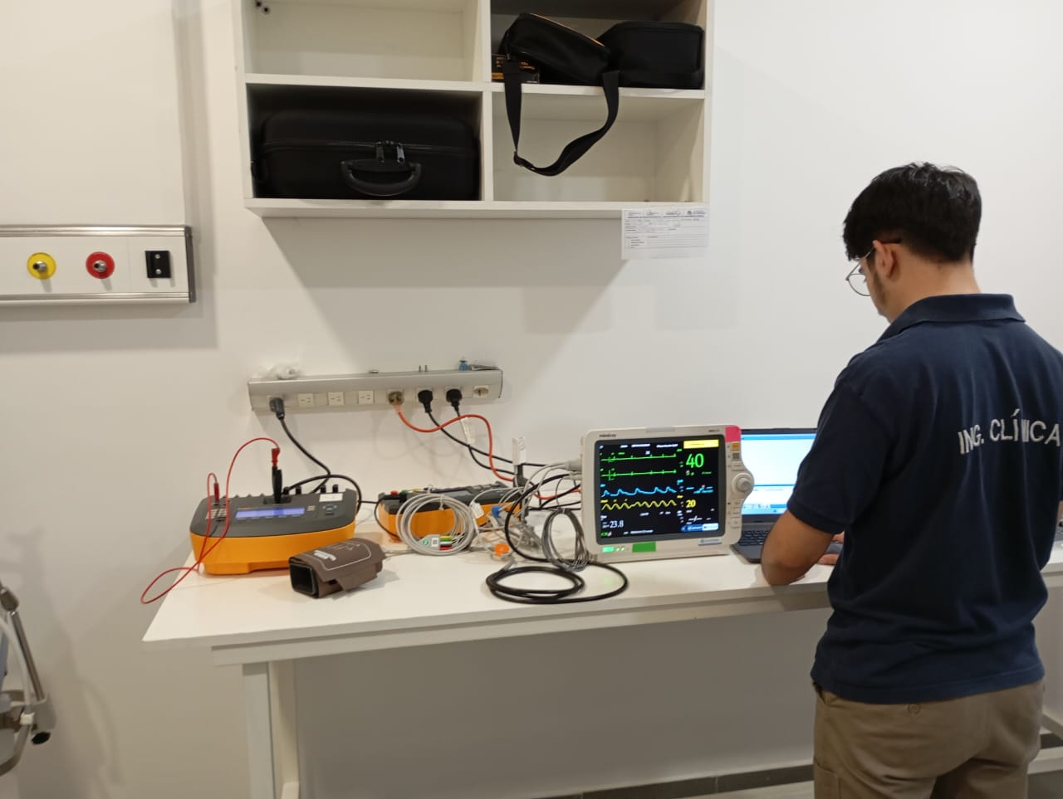
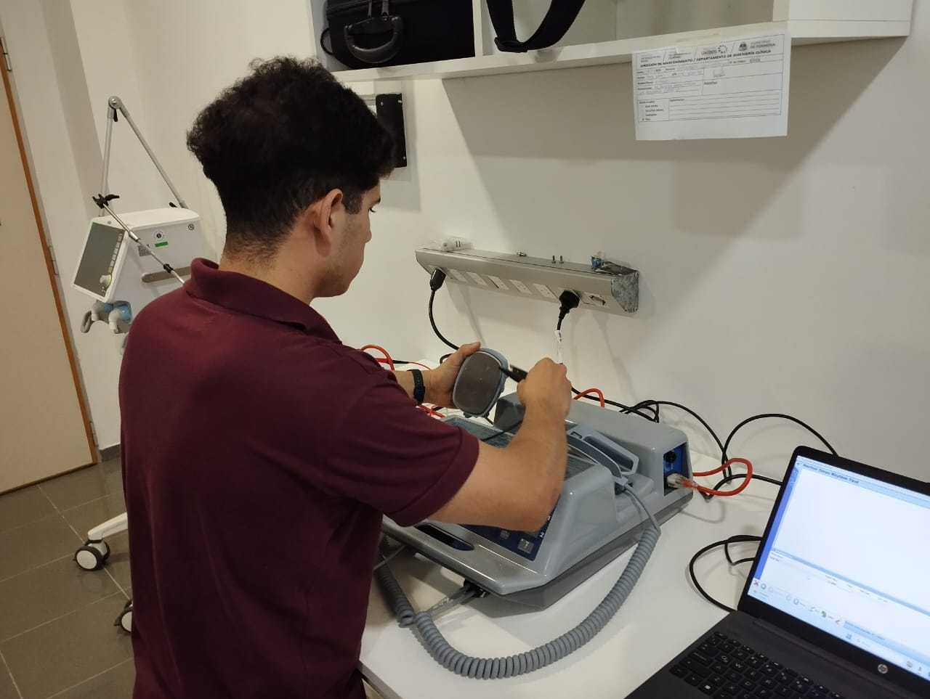
Implementation of a Metrology and Quality Control Laboratory
Project Objective:
Ensure the proper functioning and accuracy of medical equipment through regular checks and timely repairs.
Key Benefits:
Quality and Safety: Ensure all medical equipment operates within specified parameters, enhancing patient safety.
Reduction of Failures: Early identification of potential issues, reducing equipment downtime.
Operational Efficiency: Preventive and corrective maintenance that optimizes equipment performance.
Regulatory Compliance: Ensure all equipment meets international standards and regulations.

Slide 8
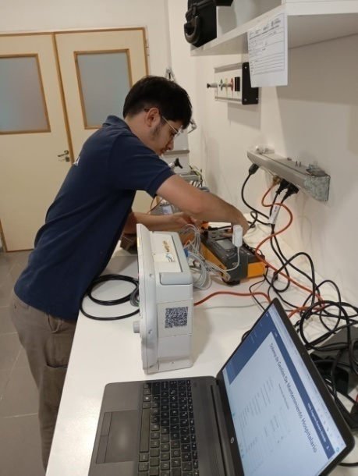
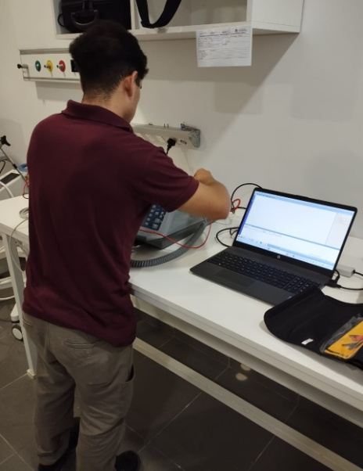
Implementation of a Metrology and Quality Control Laboratory
Equipment and Technology:
High-Precision Measuring Instruments: To calibrate and verify the functioning of medical equipment.
Maintenance Management Software: To schedule and record all maintenance and calibration activities.
Staff Training: Continuous training for the operation and maintenance of metrology equipment.
Future of the Project:
Expansion: Enlargement of the laboratory to include new measurement technologies.
Collaboration: Establishment of partnerships with other hospitals and research centers for knowledge exchange.
Research and Development: Continuation of research projects to keep innovating in the field of medical metrology.

Slide 9
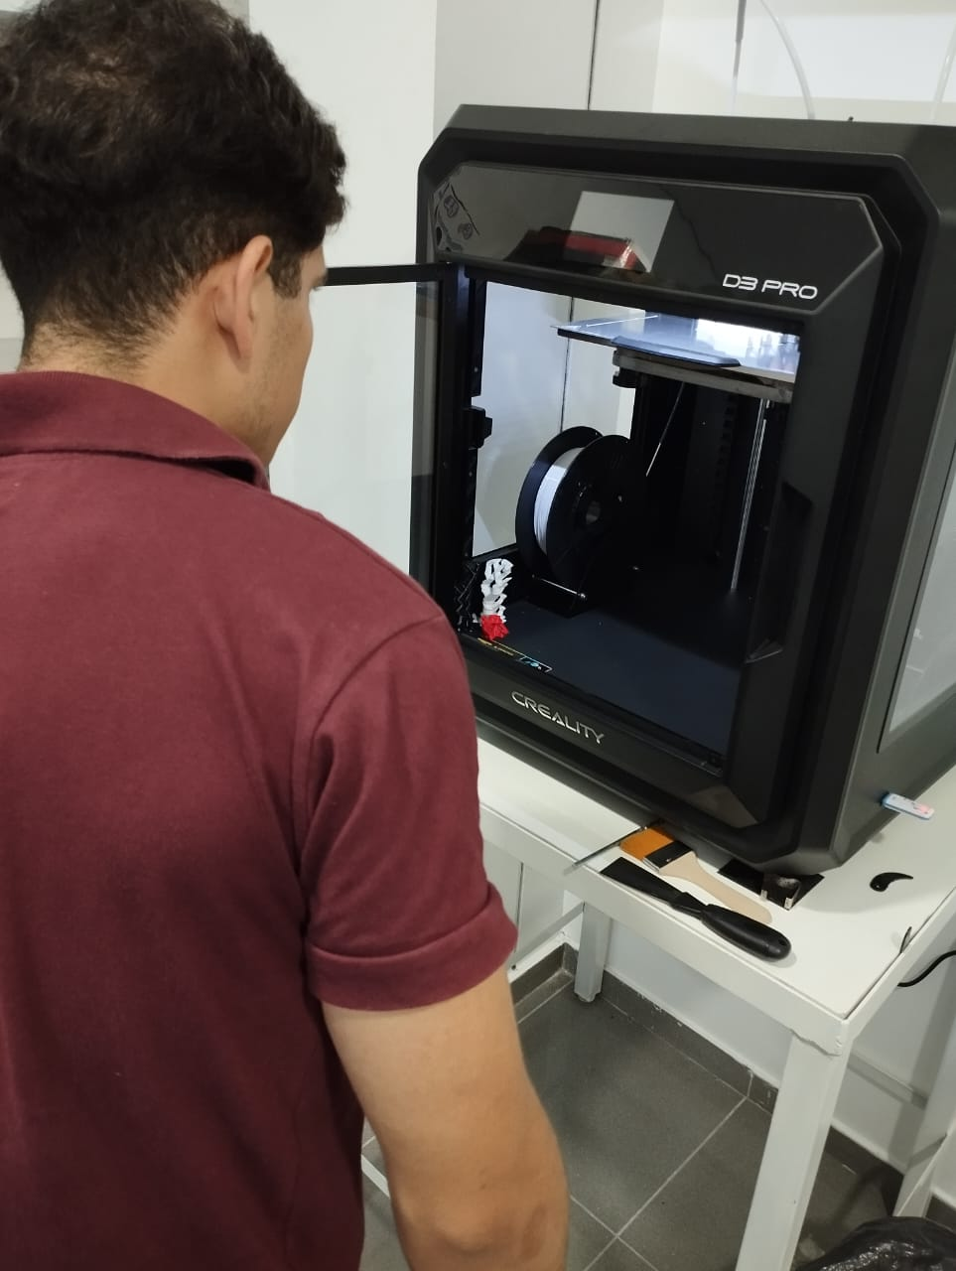
Implementation of a 3D Printing Lab
Project Objective:
Enhance the responsiveness and customization in the manufacturing and repair of medical devices, and explore the possibility of implementing locally manufactured prosthetics.
Key Benefits:
Cost Reduction: In-house production of devices and spare parts at a lower cost.
Customization: Creation of prosthetics and devices tailored to the specific needs of each patient.
Speed: Reduction in the waiting time for obtaining medical devices.
Innovation: Promotion of research and development in advanced medical technologies.

Slide 10
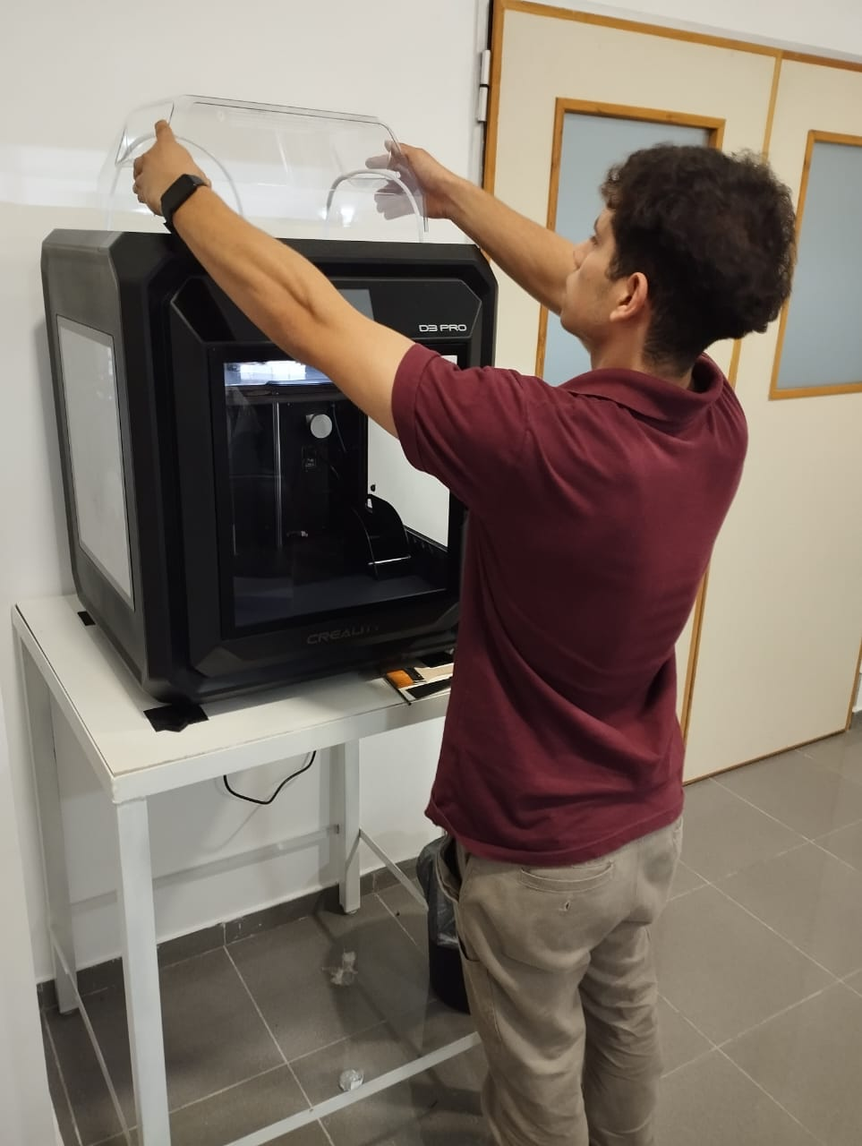
Implementation of a 3D Printing Lab
Future of the Project:
Expansion: Enlargement of the laboratory to include new technologies and materials.
Collaboration: Establishment of partnerships with other institutions for knowledge and resource exchange.
Research and Development: Continuation of research projects to keep innovating in the field of medical 3D printing

Slide 11
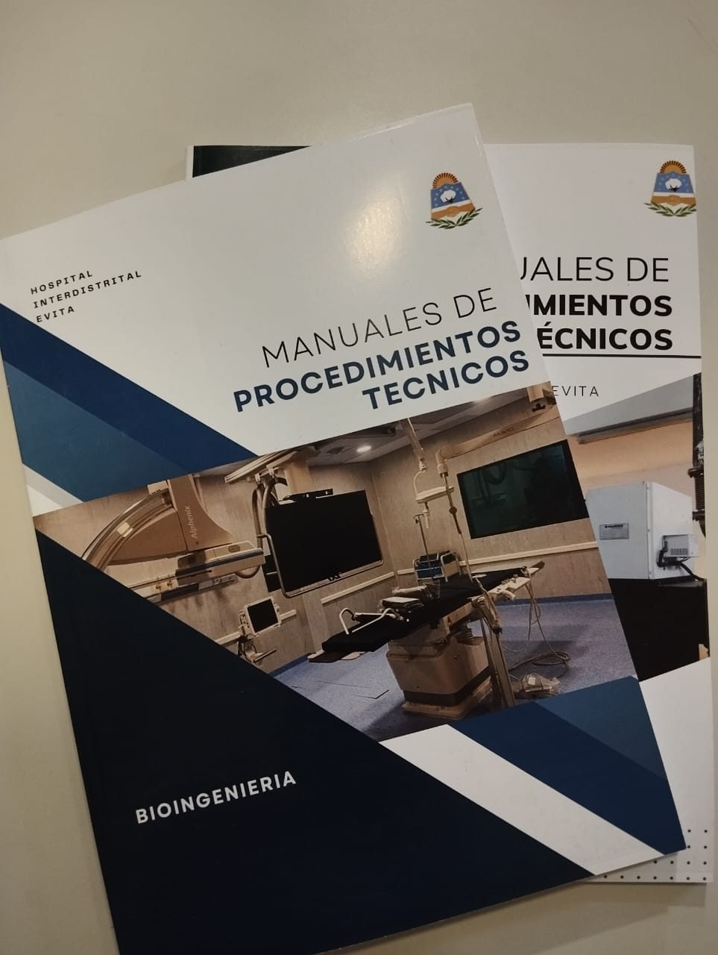
Implementation of Technical Procedure Manuals
Project Objective:
Standardize and optimize the control and maintenance procedures for medical equipment.
Key Benefits:
Consistency and Quality: Ensure all procedures are carried out uniformly and to high-quality standards.
Patient Safety: Minimize risks by ensuring medical equipment functions correctly and safely.
Operational Efficiency: Reduce downtime and improve the efficiency of the maintenance service.
Regulatory Compliance: Ensure all activities comply with international standards and regulations.

Slide 12
Implementation of Technical Procedure Manuals
Manual Contents:
Control Procedures: Detailed instructions for the verification and calibration of medical equipment.
Maintenance Procedures: Step-by-step guides for preventive and corrective maintenance.
Safety Protocols: Recommended measures and practices to ensure the safety of staff and patients.
Implementation and Training:
Continuous Training: Training programs to ensure staff are familiar with the procedures and specifications.
Impact and Results:
Service Quality Improvement: Increase in the accuracy and reliability of medical equipment.
Failure Reduction: Decrease in incidents and repair times.

Slide 13
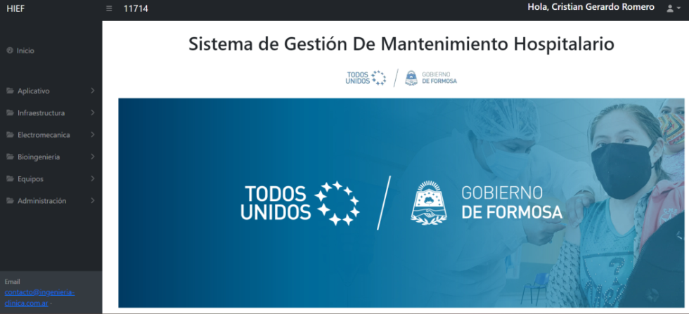
Creation and Implementation of Maintenance Management Software
Project Objective
Optimize the management of inventories and the maintenance of medical equipment to improve service efficiency and quality.
Key Benefits
Management Efficiency: Automation of inventory and maintenance processes, reducing errors and saving time.
Real-Time Visibility: Real-time monitoring of equipment status and inventory, facilitating decision-making.
Preventive Maintenance: Automatic scheduling of preventive maintenance to avoid failures and extend equipment lifespan.
Maintenance History: Detailed record of all maintenance activities performed, improving traceability and regulatory compliance.

Slide 14
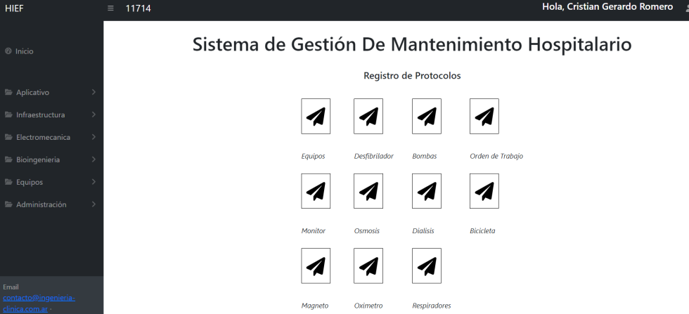
Creation and Implementation of Maintenance Management Software
Software Features
Intuitive Interface: Easy to use, with quick access to critical information.
Alerts and Notifications: Alert system to remind scheduled maintenance and notify about low inventory levels.
Customized Reports: Generation of detailed reports on equipment status and maintenance activities.
Integration: Capability to integrate with other hospital systems for more comprehensive management.
Results Achieved
Cost Reduction: Decrease in operational costs due to better inventory and maintenance management.
Improved Equipment Availability: Increase in the availability and reliability of medical equipment.

Slide 15
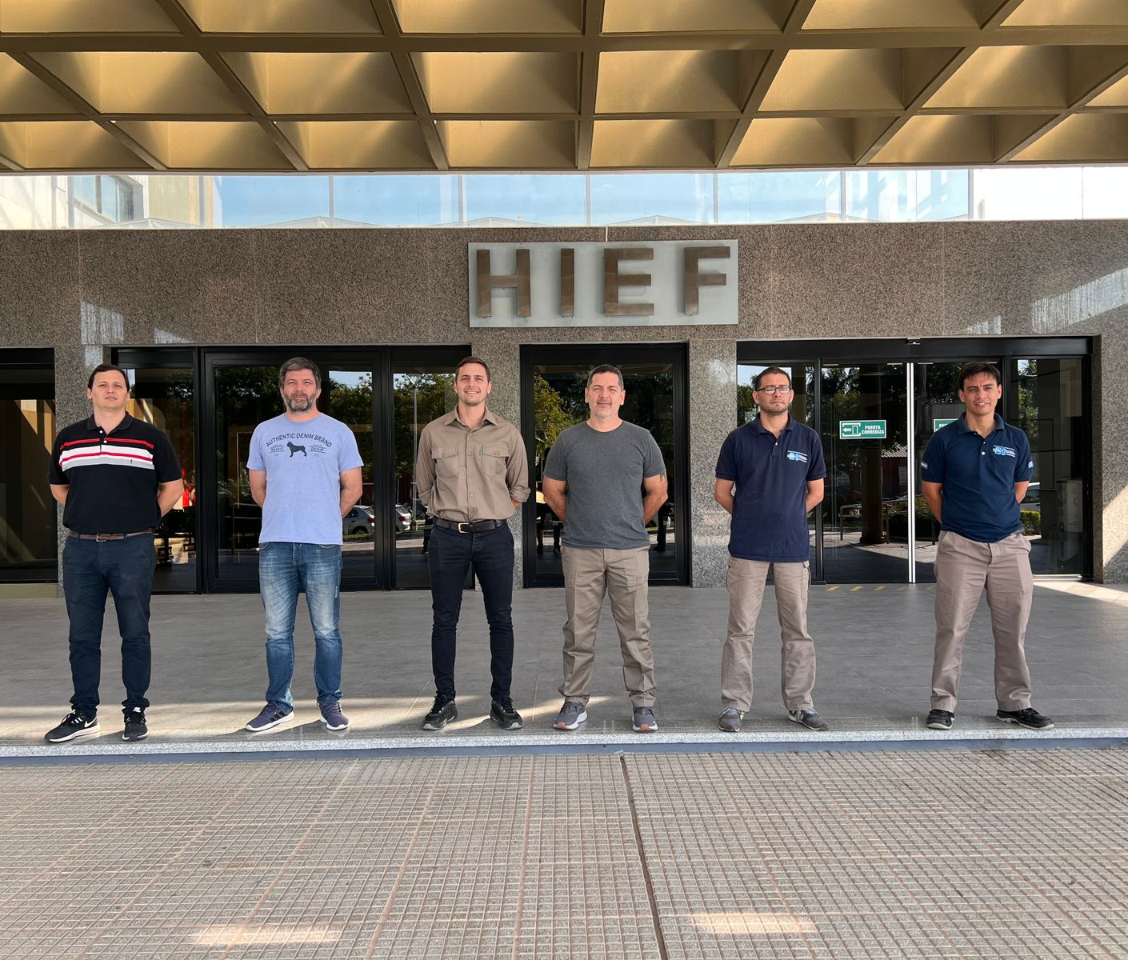
"Engineering Team"
Ing. Jojot, Santiago
Ing. Nuñez, Lucas
Ing. Campbell, Carlos Javier
Ing. Canalis Guido Andrés
Ing. Melacki, Johan
Ing. Romero, Cristian Gerardo
contact: www.ingenieria-clinica.com.ar contacto@ingenieria-clinica.com.ar

