Slide 1

MOSY
“My Oxygen System”
Leslie Yessenia Cieza Huané
Pontificia Universidad Católica del Perú
PERU

Slide 2




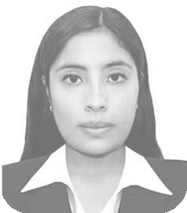
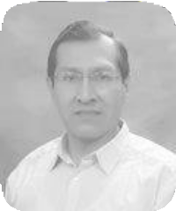
Our Team
Leslie Cieza
Julissa Venancio
Luis Vilcahuamán
Project Advisor
Bach. Electronic Engineering MSc.(c). Biomedical Engineering. Master in Business Administration Research and development of medical equipment.
Bach. Mechatronics Engineering MSc.(c). Biomedical Engineering Health technology assessment and clinical validations
Phd. Electric Engineering MSc. Biomedical Engineering Principal professor of PUCP
Member of Engineering for Medicine and Biology Society EMBS-IEEE. APBIO - CORAL Member.
ACCE IFMBE Member

Slide 3

Description

Slide 4

Description
300
millions
People have
Respiratory
diseases

Slide 5

Description
Oxygen
Therapy

Slide 6

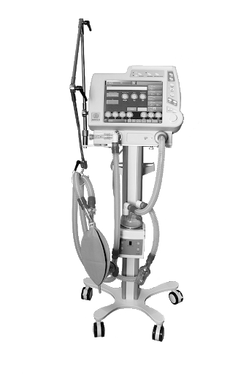
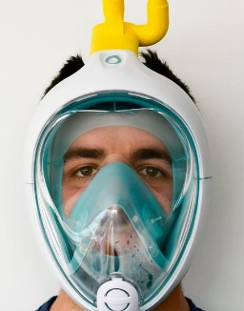
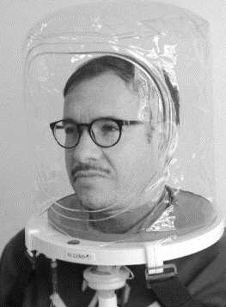
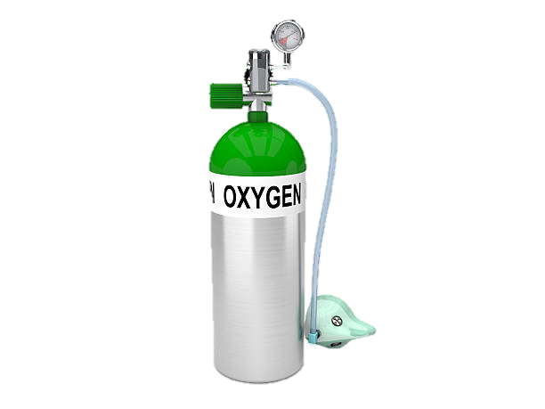
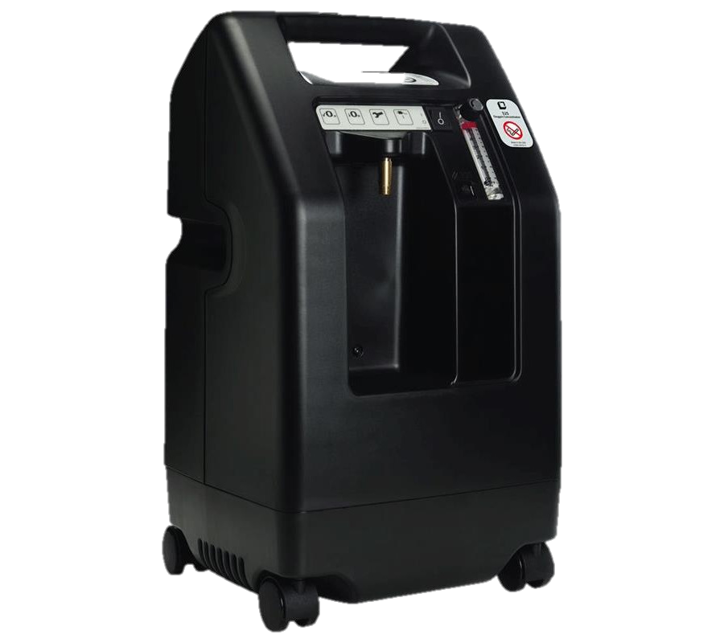
Description
Critical
Care
Intermediate
care
Oxygen
Therapy
Hospitalization
Emergency
Snorkel
System
Compressed
Oxygen
Oxygen
Concentrator
Helmet
System
Medical
Ventilator

Slide 7
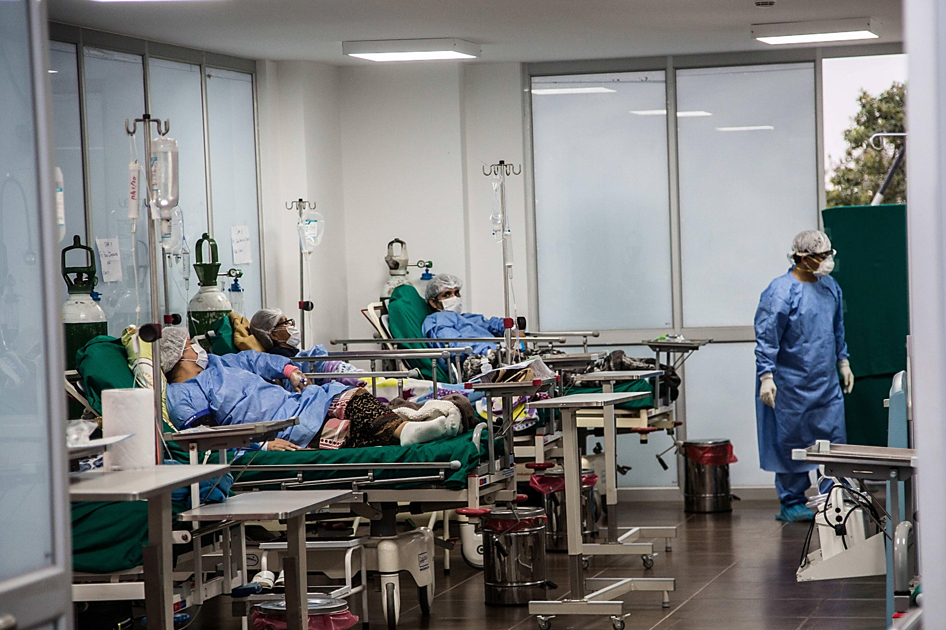
Description
MANUAL
Pandemic
Repeatedly adjusting the oxygen
Hospitals
WIHOUT Attention capacity

Slide 8
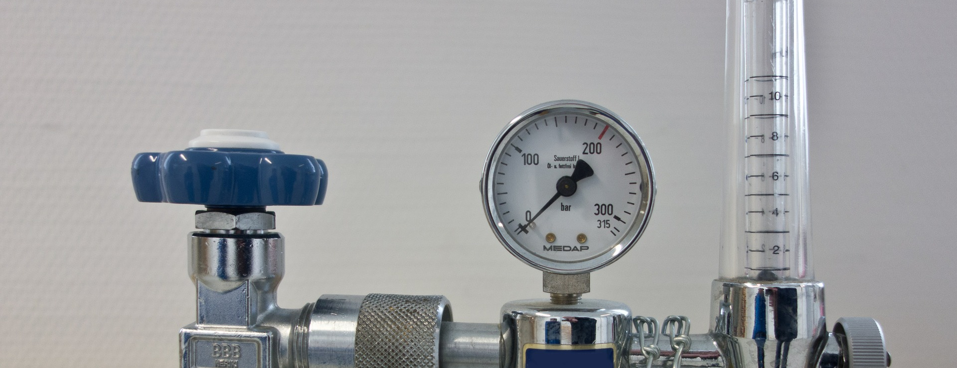
Description
How oxygen therapy
is provided nowadays?

Slide 9
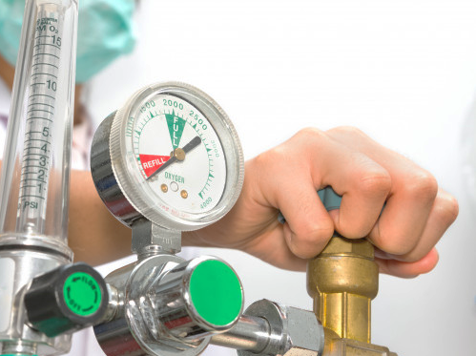
Description
MANUAL
Repeatedly adjusting the oxygen

Slide 10

Description
MANUAL
Repeatedly adjusting the oxygen
Risky
Capacity
limited
of attention
Without
control
oxygen

Slide 11
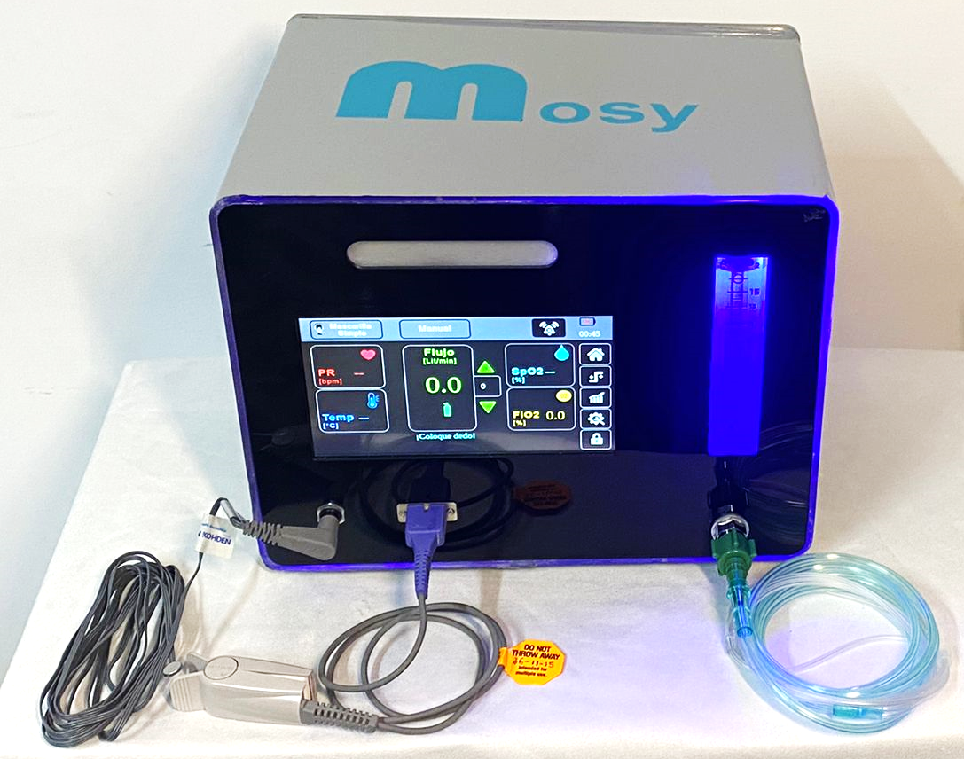

Description
Medical device that automates
oxygen therapy.

Slide 12
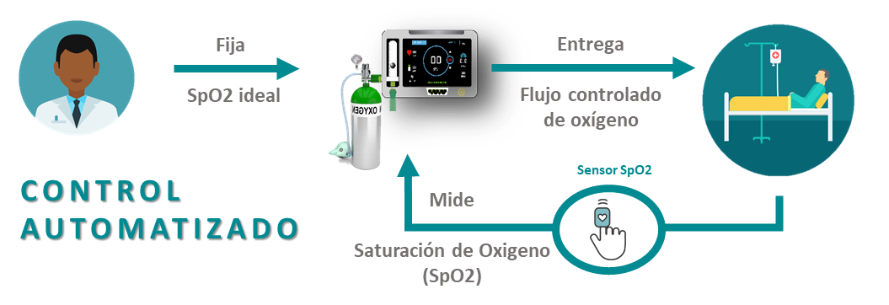
Description
1
SpO2 ideal
Indicated
by the doctor
3
Controlled flow
of oxygen
AUTOMATED
CONTROL
2
SpO2
Measured by the
sensor

Slide 13
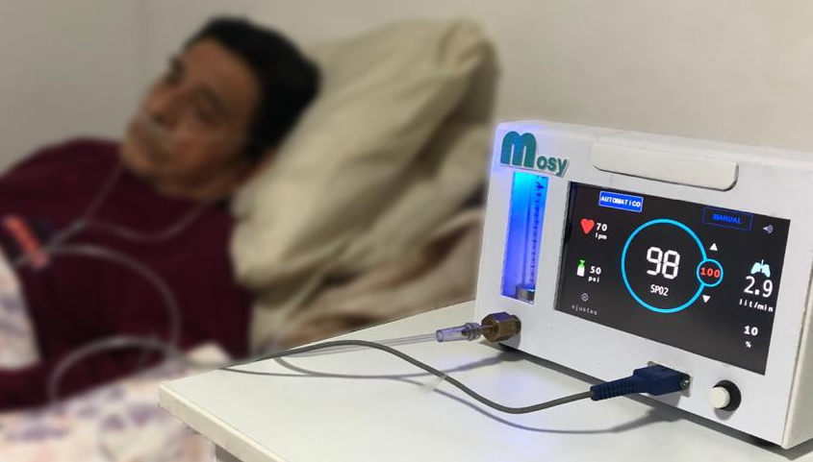
Goals of the project and final users that will benefit
with MOSY
Personalized
therapy

Slide 14


Goals of the project and final users that will benefit
Oxygen treatment
reliable, efficient and controlled
+ lifes
- cost
Adjust
automatically
the flow rate
Reduce
the time
of hospitalization
30%[2]
Avoid
Constant
contact
INCREASED CAPACITY
OF ATTENTION
[2] https://www.ncbi.nlm.nih.gov/pmc/articles/PMC5003517/pdf/copd-11-1983.pdf

Slide 15
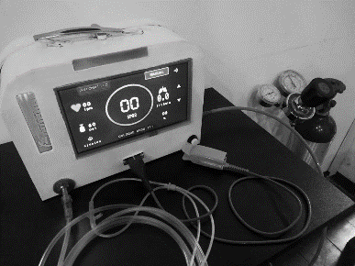
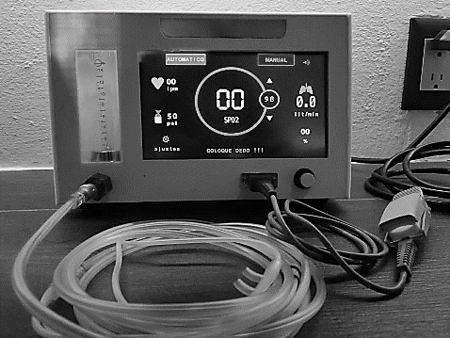
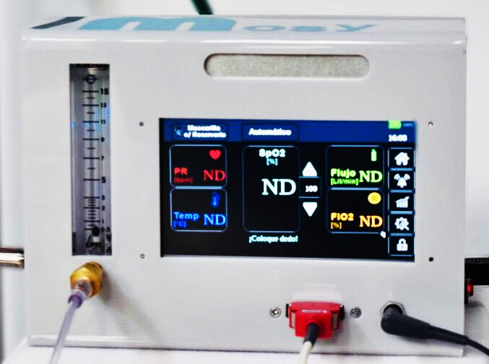
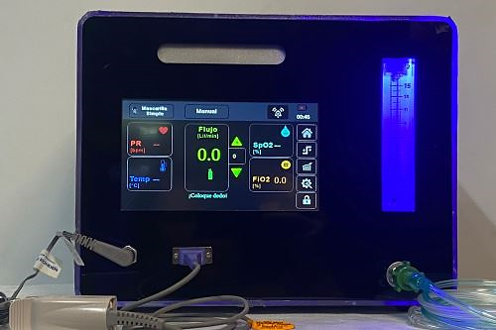






MOSY over the time…
Goals of the project and final users that will benefit
2020
2019
2018
2021
MEDICAL
grade
prototype
pulmonologists
Directors
of hospitals
Patients
Distributors

Slide 16








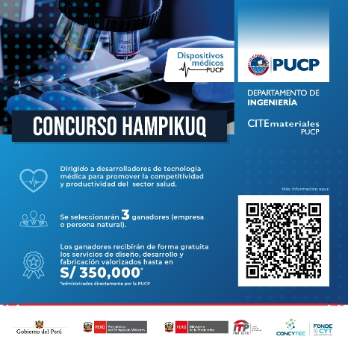


Goals of the project and final users that will benefit
2019
2020
2021
WISE 3G
1st PLACE
The best innovation in Latin America
(CLAIB 2019)
1st Place
Innovation
& Business Plan
3rd Place
Startup
Weekend Peru
Finalists
1st Place
PUCP & ITP
3rd Place

Slide 17
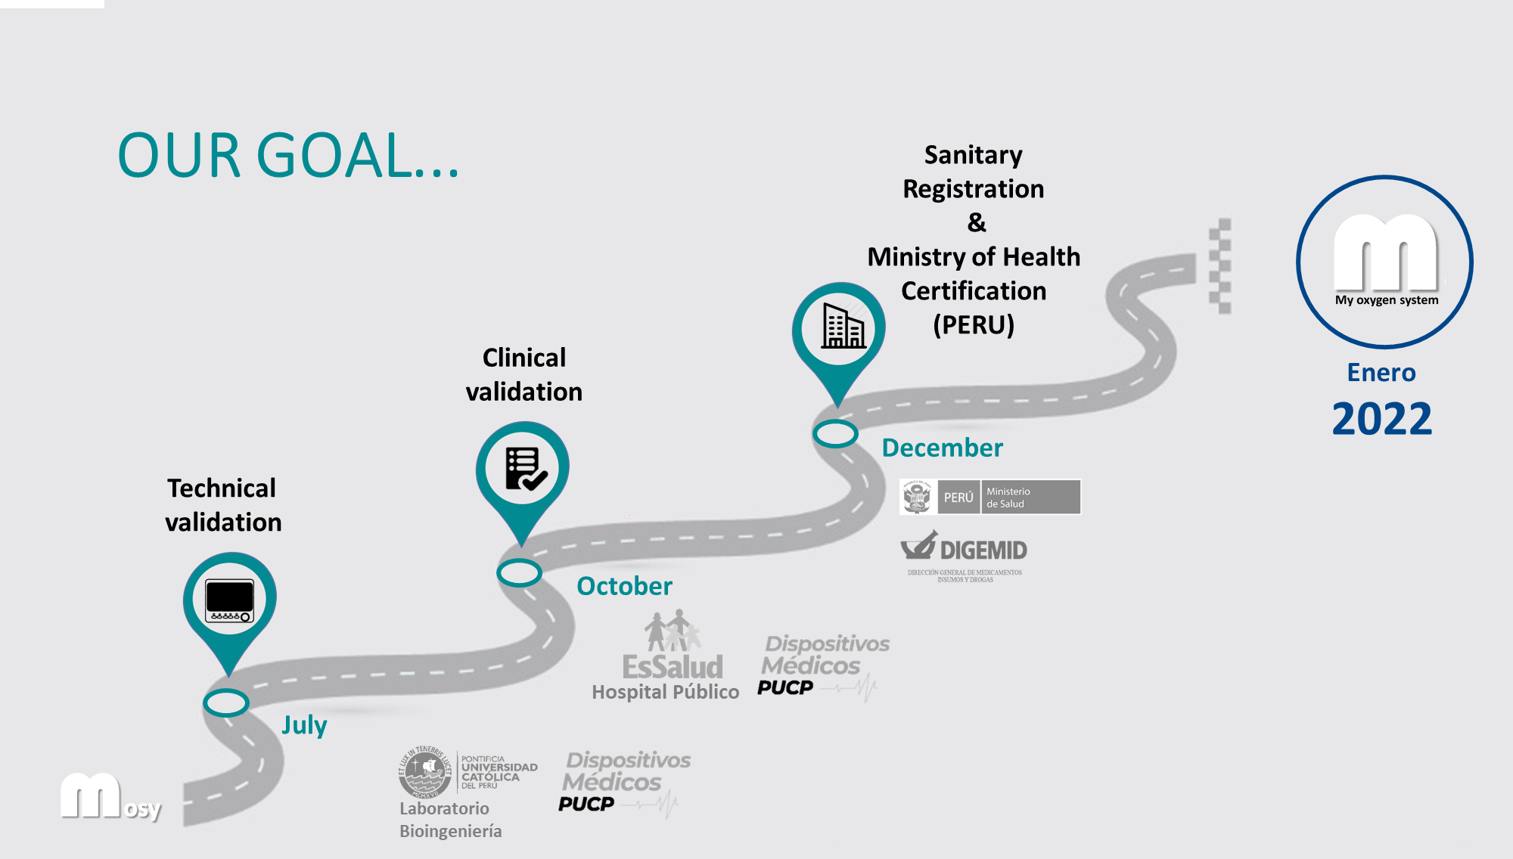
Goals of the project and final users that will benefit
OUR GOAL...

Slide 18


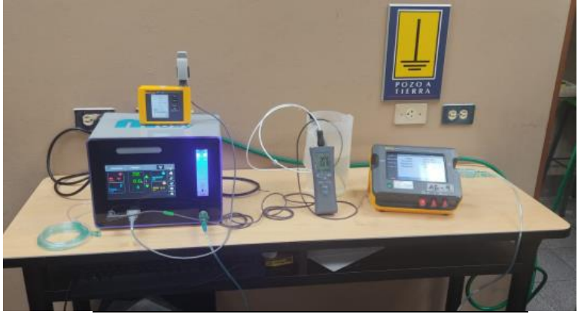

Results
METROLOGICAL VERIFICATION OF AUTOMATED AUTOMATED NON-INVASIVE OXYGEN THERAPY DEVICE
Completed technical tests of parameters:
  Physiological (Oxygen Saturation, Heart Rate, Temperature)
  Operativity (Inspiratory oxygen flow, oxygen inlet pressure, ambient conditions).
  TOOLS:
  - FLUKE Spot Light Pulse Oximetry Simulation
  - FLUKE VT650 Gas Flow Analyzer
  - Digital thermometer with RTD Pt100

Slide 19
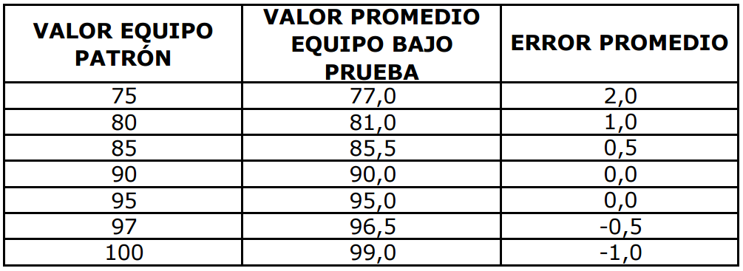
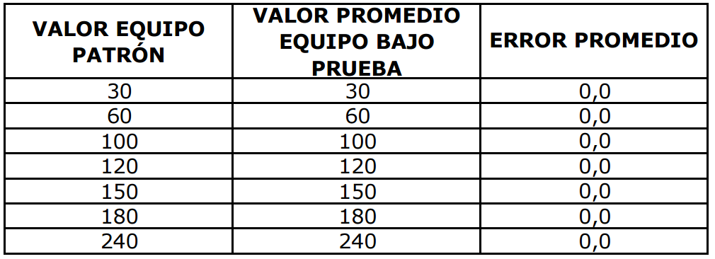

Results
Oxygen Saturation
Heart Rate
Standard
Equipment
Value
Average value of equipment under test
Average
error
Standard
Equipment
Value
Average value of equipment under test
Average
error
Error: 3%
Error: 0%

Slide 20
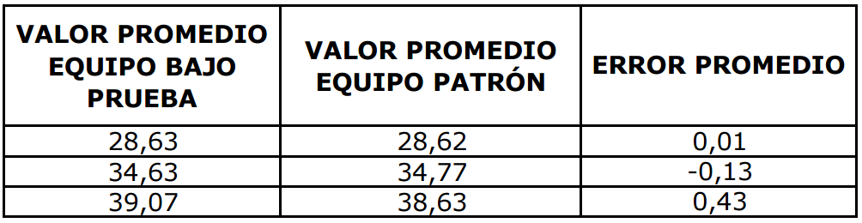
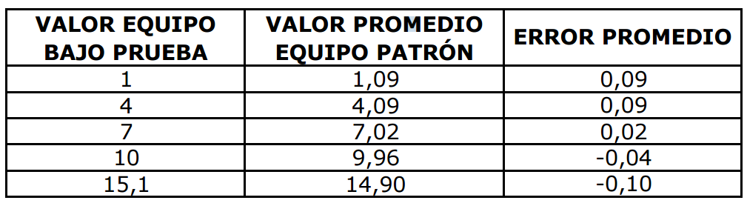
Results
Temperature
Flow
Average value of equipment under test
Standard
Equipment
Value
Average value of equipment under test
Standard
Equipment
Value
Average
error
Average
error
Error: 2%
Error: 1%
50PSI
21,5°C
72,1%hr

Slide 21
Leslie Yessenia Cieza Huané
ycieza@pucp.edu.pe
Pontificia Universidad Católica del Perú, PERU

