Slide 1

Management of Covid-19 within an Acute Healthcare Setting in the Irish Health Service – a Hospital Manager and Clinical Engineers approach
Brian Kearney
Professional Development Officer, BEAI (Ireland)
Portfolio Lead / Clinical Engineer, Irish Health Service

Slide 2
The Team / Workgroup
Kearney, Brian
Portfolio Lead / Past Acute Hospital Chief Operations Officer / Clinical Engineer, Irish Health Service
Professional Development Officer / Past Chairperson, BEAI (National Society for Clinical Engineering)
Grainger, Peter
Head of Department, Medical Physics and Clinical Engineering Dept, Irish Acute Hospital

Slide 3
Biomedical & Clinical Engineering in Ireland
Healthcare
Industry
Academia
Patient

Slide 4
Healthcare
‘Two headed monster’
Core medical and ‘non-medical’ professionals working alongside
Delivering patient care in an ever evolving and changing environment.
Highly qualified
  Clinicians very knowledgeable in the biomedical and treatment aspects of patient care.
  Healthcare Management Teams educated in managing the various functions of an organisation that delivers patient care.

Slide 5
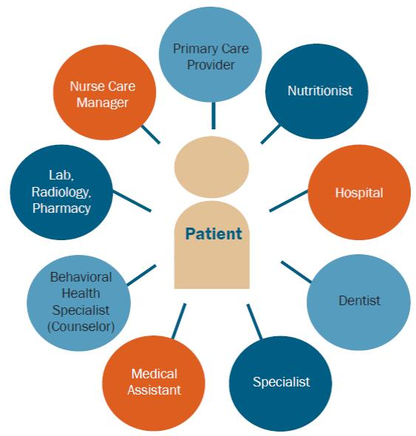

Healthcare Challenges
Increasing and aging population
Mismatch between supply and demand of the workforce
Technological Advancements
Bringing healthcare to the home/service user
Increasing Regulation
Budgetary constraints
And all this while aiming to maintain a high quality and safe service!
Covid-19

Slide 6
Clinical Engineers
“A Clinical Engineer is a professional who supports and advances patient care by applying
engineering and managerial skills
to healthcare technology.”
ACCE definition, 1992.
The Profession of Clinical Engineers:
Know and respect the Clinical Environment.
Understand the clinical aspects of healthcare and its terminology, demands and importance.
Engineering practice and methodology as standard.
Specialise in the role of applying and implementing medical technology to optimise healthcare delivery, through the application of specialist engineering, physics and scientific principles.

Slide 7
Organisational
Importance of Clinical Engineers during and post Covid-19
Role as Chair of Covid-19 Oversight Group for acute hospital response.
Bring people together – translate between clinical and technical language.
Central to informed decision making in a methodical manner:
  Analysing business cases and providing advice on service decisions, based on facts and figures, in a scientific way.
Inform and promote health technology management to non-HTM people.
Improvement on Quality, Risk and Patient Safety.
Clinical user liaison – assessing what may work in a non-ideal environment.
Key to Project & Change Management.

Slide 8
Technical
Importance of Clinical Engineers during and post Covid-19
Management of Medical Device stock.
Adapting to new technologies in a short timeframe – new devices coming on stream with limited/no training or manufacturer support:
  Need for a central repository of information/training material.
‘Pop-up Acute Beds’ for bringing on-stream in a short timeframe.
Community / home device support – or lack of!
Integration with IT systems for monitoring patient wellbeing. Not just a medical device – healthcare technology focused:
  Changing practice or aligning to some existing practices to use the technology.
  Connecting with our ICT colleagues.
Management of medical oxygen and other gases.
Facilities support – air handling, filtration and air changes.

Slide 9
Lessons Learned
Clinical Engineers being involved at the top table – great expertise to be tapped into. Not just medical device related!
  Being at the table, influencing, making the best of what we have is better than sitting on the sideline.
Not being perfect is ok!
  Being 90% ok and allowing technology to support patient care may be better than waiting for the 100% mark – depends on risk assessment and clinician input.
Fatigue post pandemic – ability to change, adapt, cope with ongoing healthcare challenges.
  E.g. Cyber-attack in Ireland (May 2021)

Slide 10
Brian Kearney
Brian.kearney@hse.ie or bkearney141@gmail.com
Biomedical / Clinical Engineering Association of Ireland (BEAI)
Ireland

