Slide 1
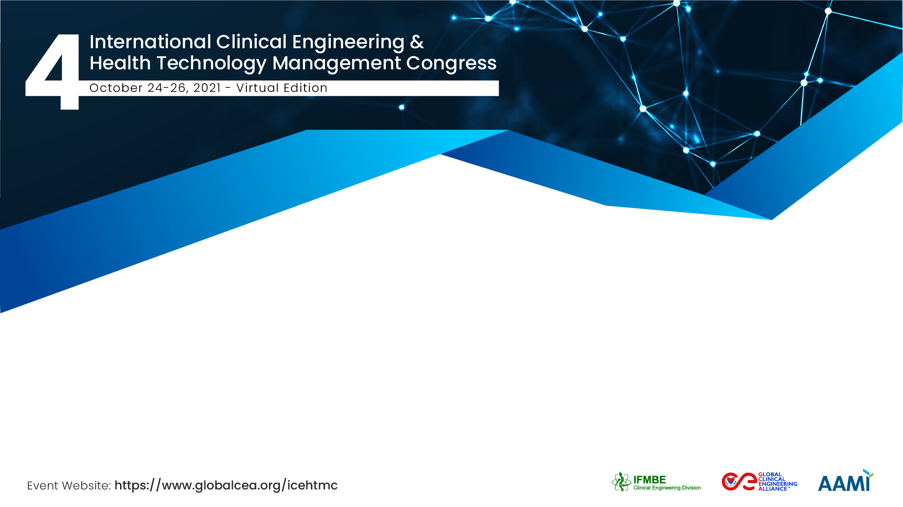
Managing Successful Medical device Warranty Period Maintenance
Demereu Yeshitla (BSc, MA),
Personal

Slide 2
The Team / Workgroup
Author
Demeru Yeshitla Desta, Chief Biomedical Engineer, working @ Jhpiego Ethiopia
Co-authors/ Reviwers
Sharon Kibwana, previously a project manager @ Jhpiego Ethiopia
Tegbar Yigzaw, Chief of party @ Jhpiego Ethiopia
Mihreteab Teshome, Previously Team leader and Immediate supervisor for me

Slide 3
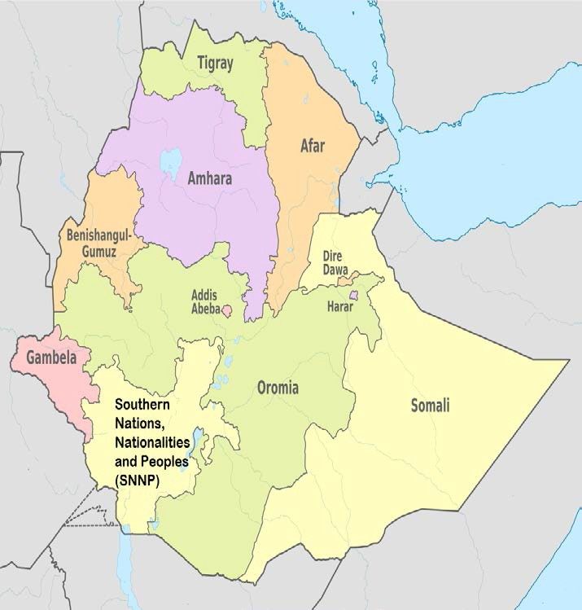
Ethiopia
110 million population
80⁺ ethnic group
11 regions + 2 city admin.
Background
HP teaching HEIs
Around 57 public
  RHSC+ University
Jhpiego HRH Project
National 5 years
4 result area

Slide 4
Background
A significant number of medical devices used in Ethiopian health facilities are imported.
The health sector faces challenges in ensuring that the devices are adequately maintained and serviced during the warranty period, affecting utility of the equipment and therefore service provision
Jhpiego-Ethiopia, under the USAID funded HRH Project procured 14 anesthesia machines from Gradian Health System, which were then donated to public hospitals in Ethiopia to deliver anesthesia services as well as for teaching purpose at anesthesia training schools

Slide 5
Description
Through collaboration of Jhpiego, the supplier and the health facilities, a total of 55 biomedical engineers/technicians and anesthesia preceptors were trained.
Maintenance visits for each machine was conducted twice a year and 2 batches of spare parts were supplied by the Gradian Health System for maintenance purpose.

Slide 6
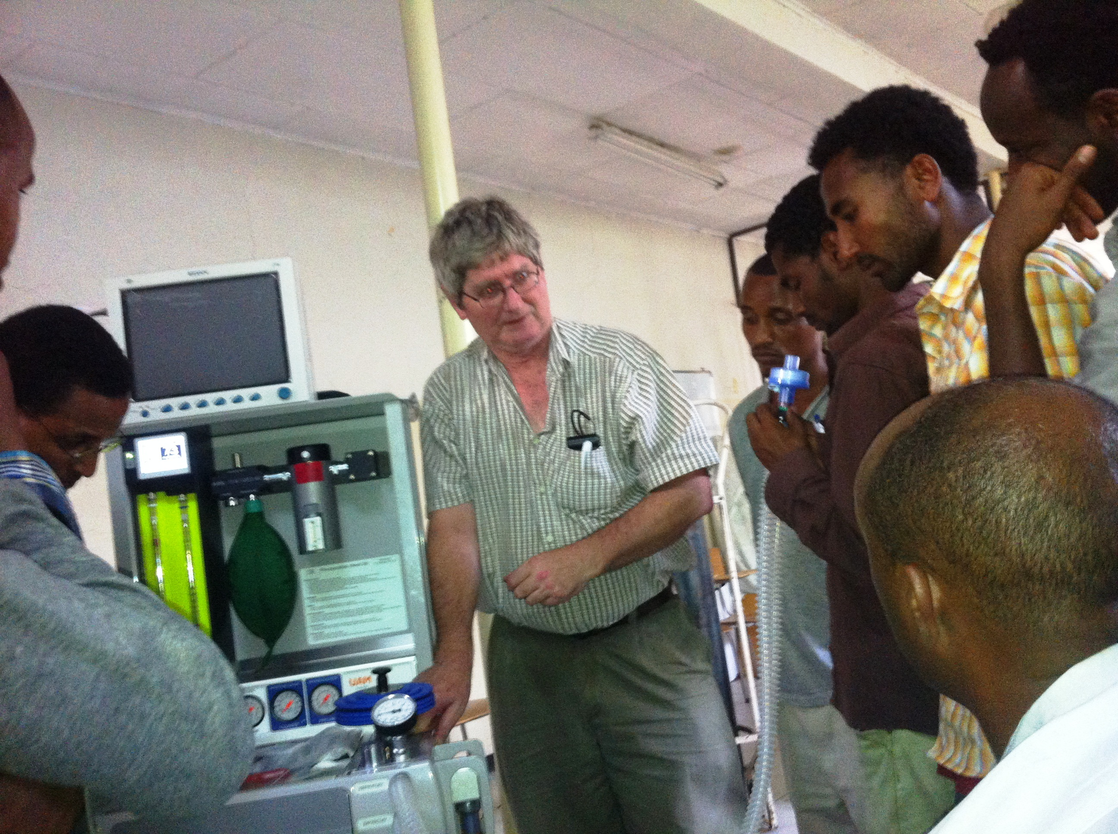

Slide 7
Goals of the project and final users that will benefit
The aim of this abstract is to share the program learning experience in management of medical devices warranty period maintenance.
The final users are University teaching hospitals, Regional and referral Hospitals

Slide 8
Results
The effective collaboration ensured continuous functionality of all the 14 anesthesia machines.
The average running time of the machines was 501 hrs. about 501 patients got surgical service.
A total of 1,003 anesthesia students received hands on training.
Although providing periodic maintenance support incurred extra cost and effort to Jhpiego, we have demonstrated the warranty period support for medical devices should not be the sole responsibility of the supplier.
It is possible to achieve better result through collaboration of all stakeholders.

Slide 9
Demereu Yeshitla desta
demex2008@gmail.com
Jhpiego, Ethiopia

