Slide 1
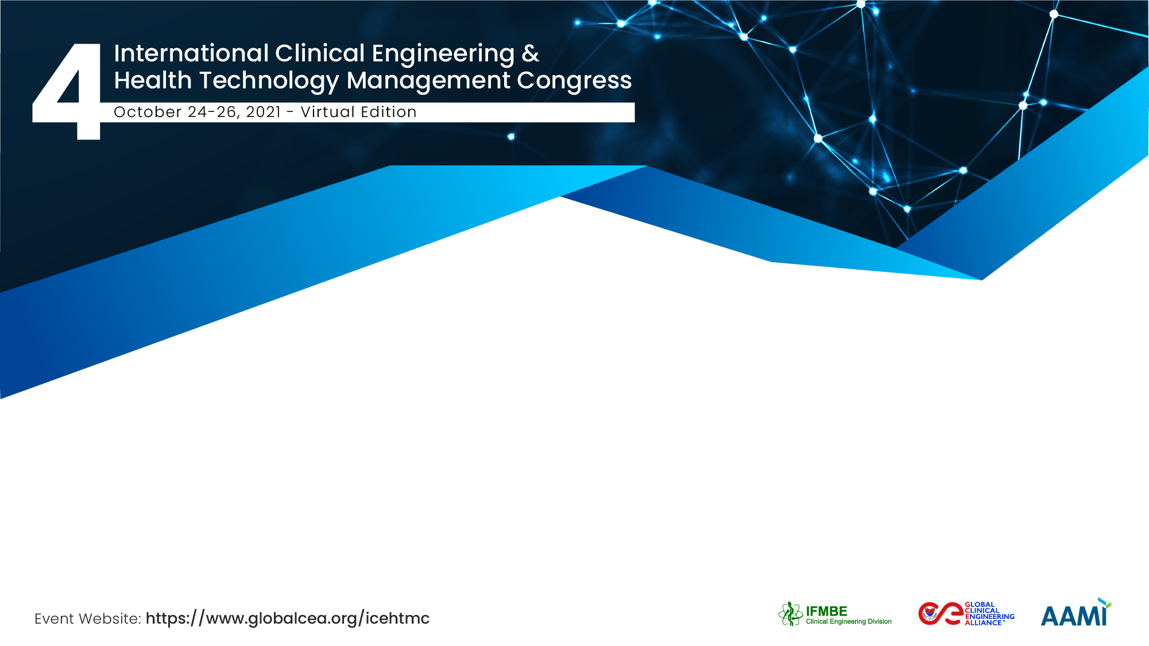


Medical Device Education (Good Management Practice) for Tanzania
Moonsoo Yoon, Collaborator CED/IFMBE, South Korea
Michael Cheng, PhD, PEng, Collaborator, CED/IFMBE , Canada
Bertha Francis Kavishe, Muhimbili National Hospital (Mloganzila), Tanzania

Slide 2
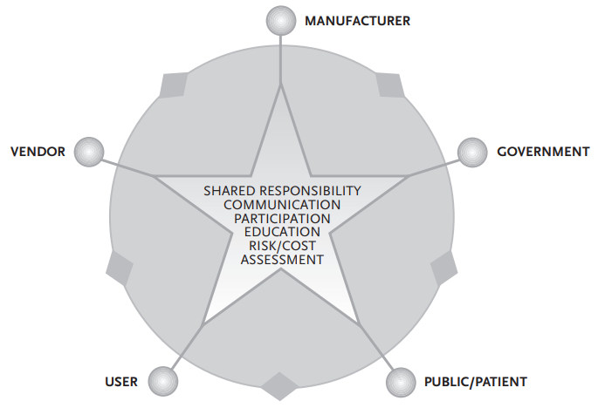
1. Introduction
Access to good quality, affordable, and appropriate health products is indispensable to advance Universal Health Coverage(UHC), address health emergencies, and promote healthier populations. It appears that there are about 2 million different kinds of medical devices on the world market, categorized into over 7,000 generic devices groups.*
The safety and performance of medical devices require shared responsibility by all stakeholders. The diamond handshake symbolizes cooperation and two-way communication(2-way arrow), and the star highlights how the fundamental elements for cooperation function best when all stakeholders communicate with each other.**
* https://www.who.int/health-topics/medical-devices#tab=tab_1 (accessed on 9 October 2021)
** WHO, Medical device regulations : global overview and guiding principles, 2003.

Slide 3
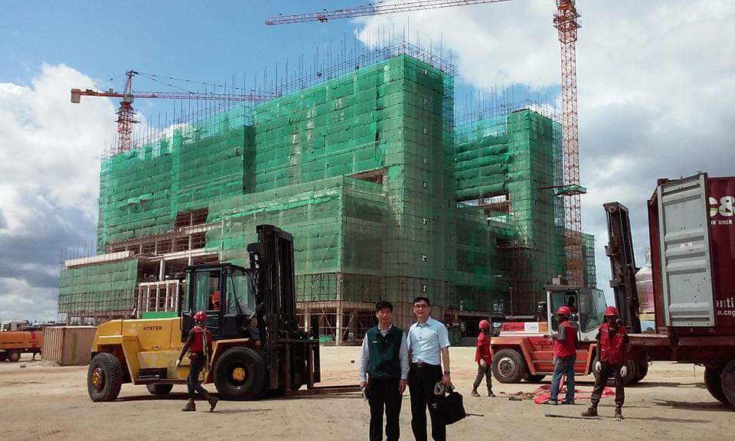
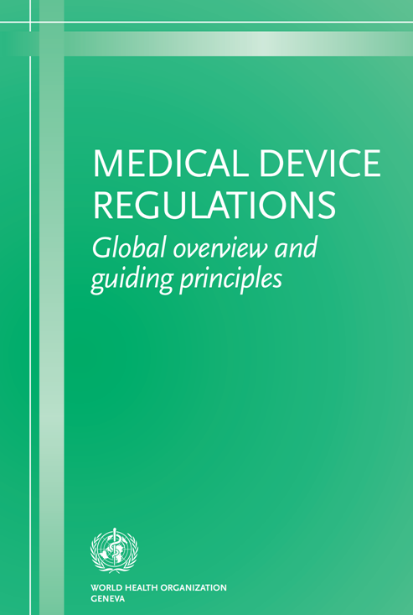
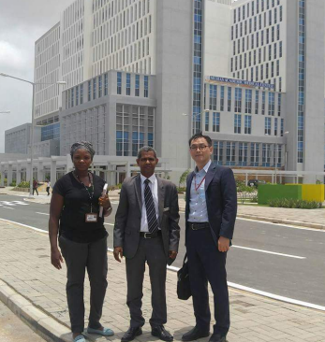
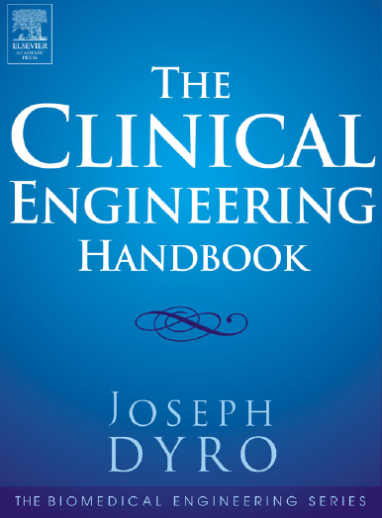
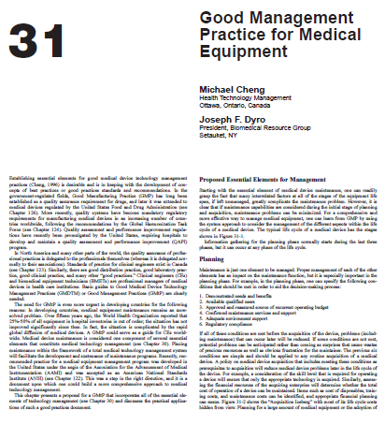
*A National Hospital, TANZANIA
2. Research background
2015(preparation)
2017(opening)
2017-2018(operation)
MS Yoon
(the principal authorship Dr. Michael Cheng)
B. F. Kavishe & MS Yoon

Slide 4
3. Research probelm
In drugs “Good Manufacturing Practices (GMP)” is the key tool mandatory by regulators for manufacturers to ensure the safety, efficacy and quality of producing drugs; similarly, for medical device GMP now incorporated in a comprehensive quality management system (QMS) is mandatory by regulators.
Unlike drugs which is metabolized by the body after being taken, the majority of medical devices are durable items that required management for repeated use.
The question arises that “since QMS is mandatory for manufacturers, and the outcomes of medical devices rely critically on how the device is managed and used, why QMS providing Good Management Practices(GMtP) is not mandatory for users of medical devices?
This presentation describes a 10 essential management elements based on the ISO9000 QMS concepts as a generic scheme that can universally apply to a one-person clinical engineering workshop or an entire regional shared clinical engineering services.
The qualitative study has been conducted at the A National Hospital that applied the GMtP principles(2017-2018) in Tanzania.

Slide 5
4. Research purpose and Method
Purpose :
To bring quality management practices to medical devices in parallel with mandatory QMS requirement for manufactures ; to compose a generic scheme based on the ISO9000 QMS concepts to guide “Good Management Practices(GMtP)” for medical devices
To understand what kinds of medical device education provided to the A National Hospital?; and what kinds of experiences the A National Hospital officials obtained?; what is the meaning of the stakeholder’s experiences?
Method: Qualitative study
Case: “the GMtP program that provided for the A National Hospital ”
Interview, survey analysis and workshop & consulting issues’ analysis were conducted
Stakeholders & Beneficiaries are clinical engineering communities and Healthcare services that use medical devices

Slide 6
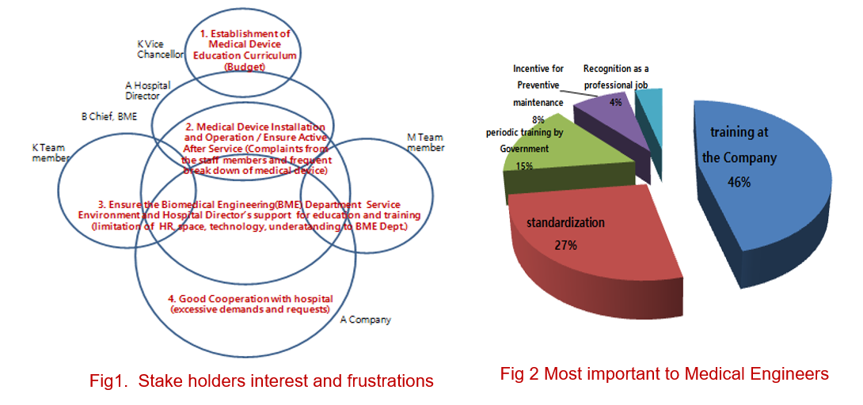
5. Research results: Findings from a survey of stakeholders on medical devices*
*MS Yoon et all, A Qualitative Study on Medical Device Education Provided to the Official Development Assistance(ODA) Hospital in Tanzania, Korean Society of Global Health Conference Poster Presentation, 2018.

Slide 7
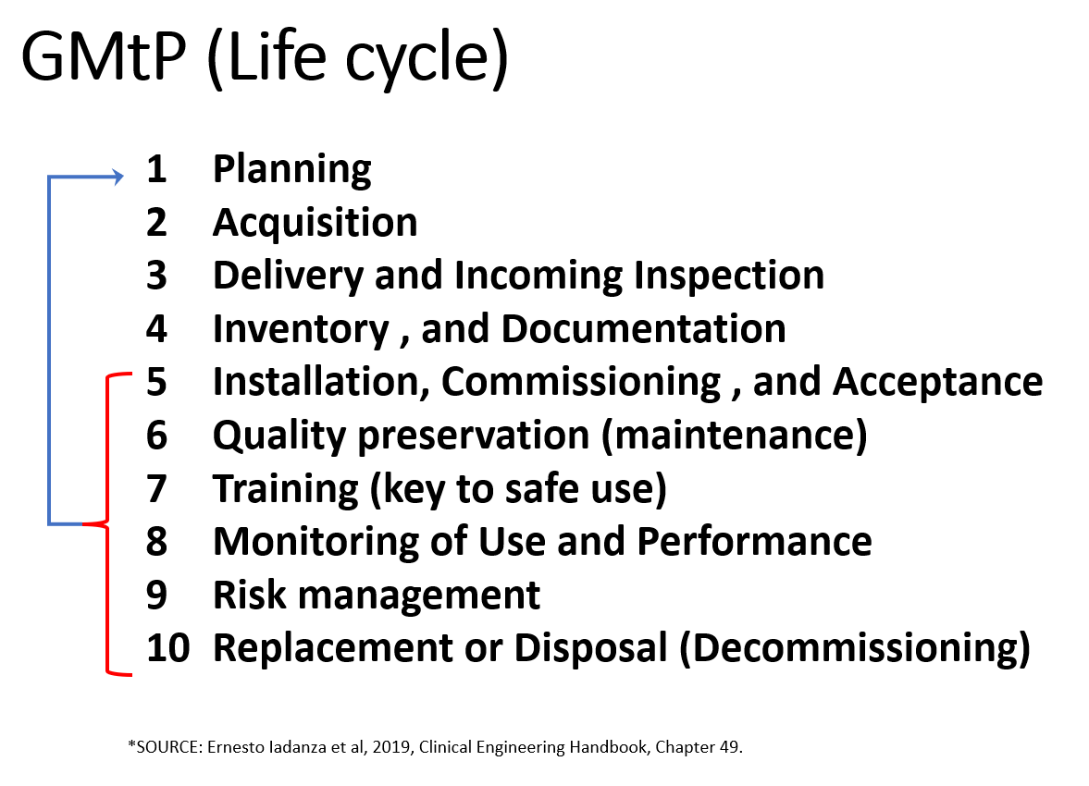
5. Research results
The earlier versions of this scheme was used by Cheng in the policy and procedure manual at the Ottawa General Hospital (Canada) in 1980’s. Subsequently, recommended in a WHO/WPRO mission to Mongolia in 1996; adopted as national medical equipment policy Vanuatu (1998) and Laos (2000).
Recently, the progressively updated scheme (see diagram right) has been used by Moonsoo Yoon in South Korea and in outreach assistance programs in Tanzania, Ethiopia, Vietnam, Uzbekistan and other countries in the education and establishment of medical device managements departments.
The GMtP concept has been reflected in the Standard Operating Procedure(SOP) of the Department of BioMedical Engineering , “A Tanzania National Hospital”.
* Joseph Dyro et al, Clinical Engineering Handbook, Elsevier, 2004.

Slide 8
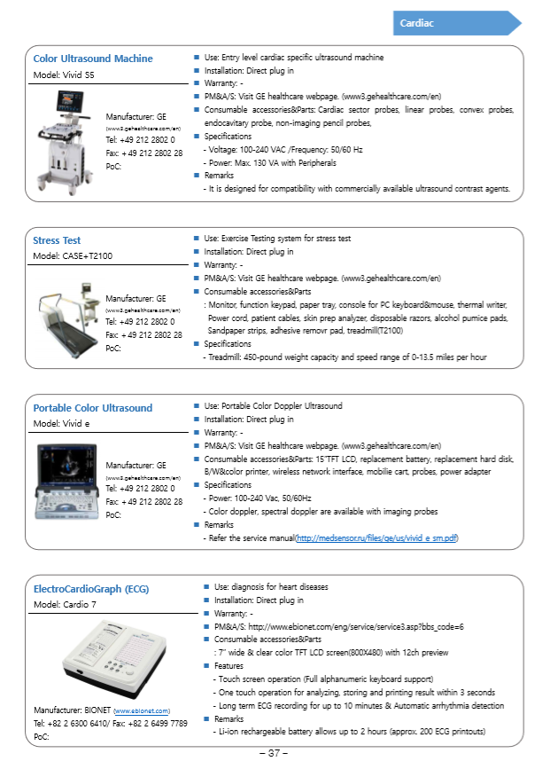
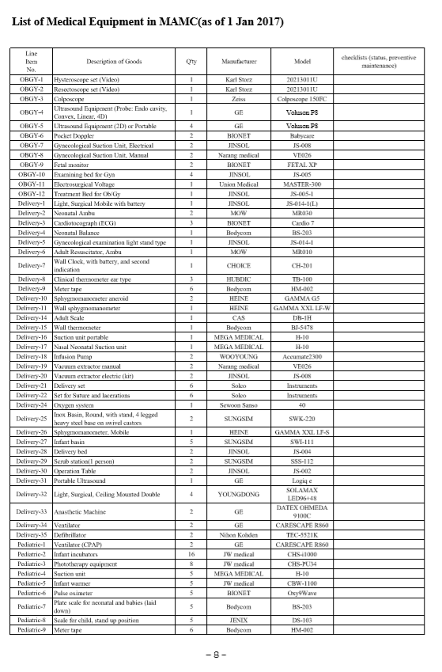
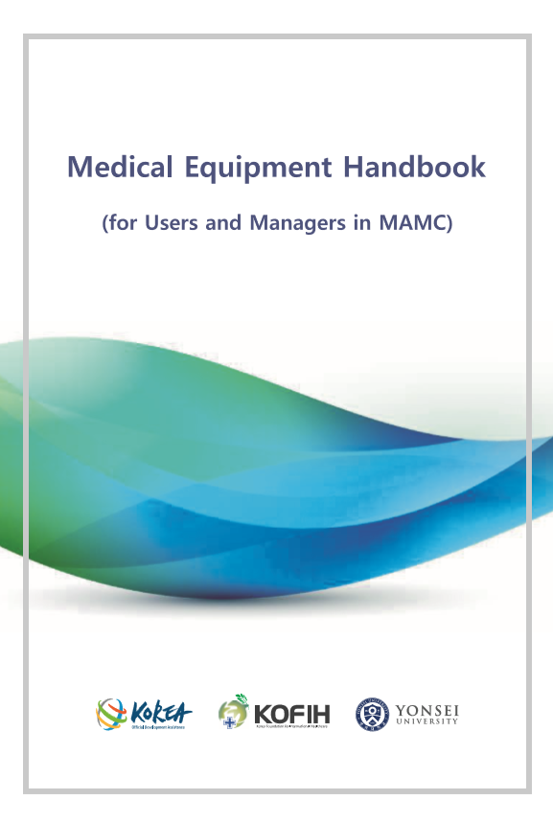
5. Research results

Slide 9
5. Research results(summary)
The medical device education program(MDEP) has contributed to the capacity building for the Biomedical Engineering(BME) team of A National Hospital. The number of the BME team technicians in A National Hospital were increased from 3 to 8 as of 1 Dec. 2017 due to the medical device education program.
The MDEP caused BME team members to understand the Good Management Practice(GMtP) and to let them realize the importance of Life Cycle medical device management program.
A National Hospital has become a platform of the medical device education program, so that the Tanzania Ministry of Health used A National Hospital (830 items in 33 departments) as the venue of training for 30 Biomedical Engineers from all of Tanzania in 2017.
The BME team members of A National Hospital opened their mind and had the awareness about maintenance program after warranty period which they had not known before.
The heads of departments participated in the MDEP realized the hidden costs of medical devices and requested that the GMP education.
The participants of the Biomedical Engineer workshop suggested the necessity of the medical device standardization, the training by the Vendor and the implementation of the license and certificate system for the qualified Biomedical Engineers.
The GMtP principles has been used and adopted during the MDEP in A National Hospital in Tanzania.

Slide 10
Moonsoo Yoon
msyoon1962@yuhs.ac
Institute of Tropical Medicine, College of Medicine, Yonsei University
Republic of Korea

