Slide 1

Medical Device Litigation in the US: a Tool for Patient Safety Improvement
Frank R. Painter, MS, CCE
University of Connecticut

Slide 2

Frank R. Painter, MS, CCE, FACCE
over forty years of clinical engineering and biomedical equipment service management experience.
directed in-house programs at three large metropolitan teaching hospitals and managed two successful regional independent medical equipment service organizations.
faculty member and past Clinical Engineering Program Director in the Biomedical Engineering Graduate Program at the University of Connecticut.
actively involved in the American College of Clinical Engineering and the New England Society of Clinical Engineering.

Slide 3
Improving Patient Safety
Individual Hospital’s local Commitment
Regulatory Requirements
Financial Incentives
Public Pressure
Legal System
Notes:
Let’s do the right thing
Report sentinel events and do an RCA
If the patient gets an infection in the hospital, we won’t pay for it
They have a better scanner, why don’t you
Let’s hire a lawyer.

Slide 4
Improving Patient Safety
Individual Hospital’s “Mission to Improve”
If administration is committed to Patient Safety, then progress can be made & the culture changed.
If hospitals learn of a problem, they may take steps to fix it.
Most HC systems quietly make changes without much publicity.
These well-intentioned changes just have a positive effect locally.
Systemic changes are needed to make a real difference.
Notes:
A TJC Nat Pat Safety Goal is getting leadership buy-in on Patient Safety, because so many say “Yes, Patient Safety, but no resources, no campaign, no support.
Taking steps to fix it – change the policy on “Time Out” before a surgical procedure.

Slide 5
Improving Patient Safety
Regulatory Requirements
Laws are enacted by governments
  FDA - Med Dev Reporting (MDR), Qual Syst Regs (QSR), Recalls
  Center for Medicare and Medicaid Services (CMS)
Accrediting agencies - changes in standards (TJC, JCI, DNV)
IEC & NFPA codes are adopted by an “Authority Having Jurisdiction” (CMS, TJC, local states)
Notes:
TJC NPSG
NFPA 99 – Healthcare Facilities
NFPA 99 - Electrical safety testing

Slide 6
Improving Patient Safety
Financial Incentives
Technology improvements – by manufacturers
Administrative changes – because of financial incentives
Improvements cost money – money helps
To avoid future court costs
Notes:
Safer, Faster, Better – buy this new technology
Electronic medical records – Fed Govt paid hospital to switch

Slide 7
Improving Patient Safety
Public pressure
Patient Safety Organizations (state based, profession based)
VA’s National Center for Patient Safety (NCPS)
Agency for Healthcare Research and Quality (AHRQ)
Publicity – power of a vigilant press
Notes:
Penn, Mass, Texas, Ohio / Anesthesia PS Foundation
VA
Federally funded
All promote Patient Safety, not the same but just as effective is the press

Slide 8

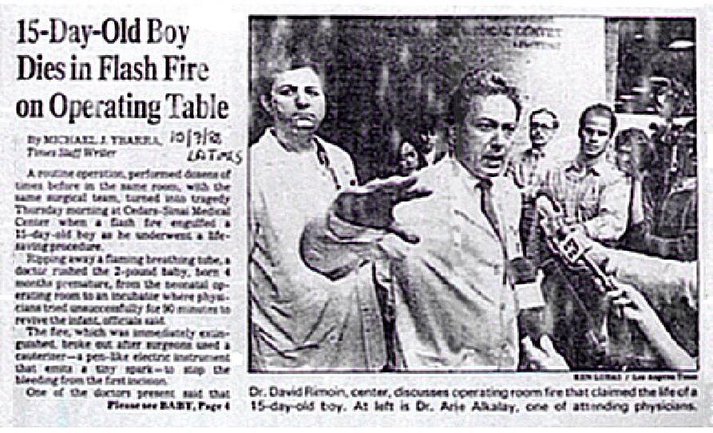

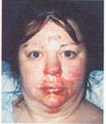
L.A. Times October 7, 1988
August 18-25, 2003
If the issue is interesting, the press can be a powerful mouthpiece.
Notes:
If the issue is interesting, the press can be a powerful mouthpiece.

Slide 9
Improving Patient Safety
The Legal System
Culls out the poorly performing physicians
  Too many lawsuits increases malpractice insurance
  Malpractice suits sometimes result in lose of license
Manufacturers are exposed
  Product liability suits expose poorly designed products or ill-intentioned manufacturers
Notes:
So far all this information is mostly well known
Now we will get to the main point of the presentation
Lawyers have a bad reputation
But Seriously, most lawyers are very good and very helpful.
The legal system is a means to get compensation when you are injured.
It generally provides a valuable and needed service.
INCLUDING INCREASING PATIENT SAFETY
OB Physicians
This happens often for repeat offenders
Manufacturers fear the legal system. They don’t mind paying compensation but losing a case and damaging their reputation is what they really fear.

Slide 10
The Legal System
Most cases are settled (so little information is available).
Some cases go to court & get a verdict.
The trial exposes the truth to the public, customers & regulators.
Class action lawsuits are very high profile and usually result in problem awareness on a national scale.
Sometimes healthcare system changes result.

Slide 11
The Legal System
The cost of making changes once a product is in the marketplace is very expensive, so manufacturer’s resist unless forced.
However, the court system is a powerful tool in the US
  based on large financial settlements
  based on the ‘culture of blame’ and ‘exposing the truth’
Going to court makes the private issue a more public issue.
If the manufacturer loses the legal case, it’s expensive, embarrassing and tarnishes their image.
Sometimes manufacturer changes are the result.

Slide 12

Frank R. Painter, MS, CCE
frpainter@gmail.com
University of Connecticut, United States
Presentation #10947

