Slide 1
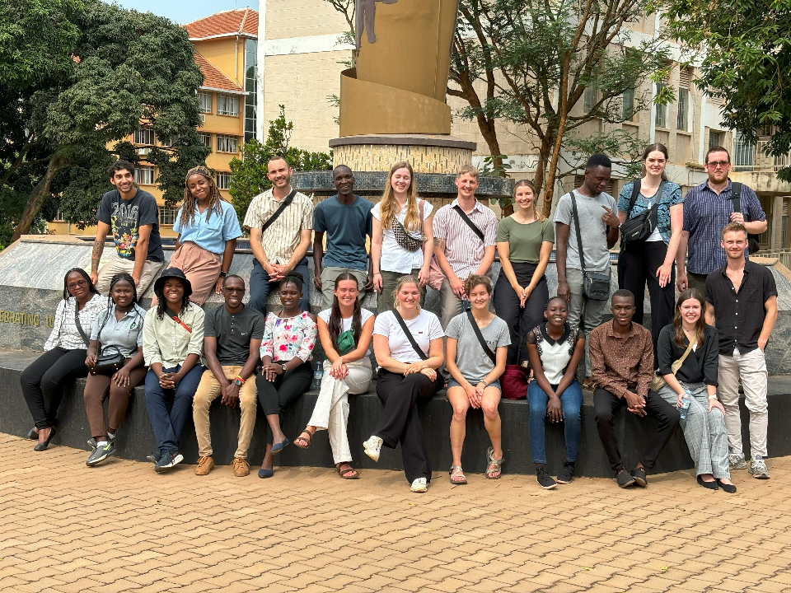



ENHANCING HEALTHCARE: MAKERERE BIOMEDICAL ENGINEERING- ENGINEERING WORLD HEALTH (MAKBME- EWH) IN UGANDA.
Authors: Nakuya Elizabeth, Elizabeth Shirley Mbabazi, Benedict Mulidwa, Brian Matovu, Dr. Robert Ssekitoleko - Uganda

Slide 2
MEET THE TEAM
Dr. Robert Ssekitoleko , Ewh Local Lead/ Lecturer/ Head, Biomedical Engineering, College Of Health Sciences, Makerere University, And the entire Makerere Biomedical Engineering(MAKBME) Team.

Slide 3
Engineering world health Impact in Uganda.
Makerere Biomedical engineering - engineering world health chapter- 2015 to date.
Engineering world health summer and winter institute in Uganda – 2017 to date namely :- June – august summer Institute
- December – January Institute
More than 30 facilities visited over the years. For instance, In 2024, 23 facilities were visited where repair, maintenance, installation, user training and calibration of medical equipment was done.

Slide 4
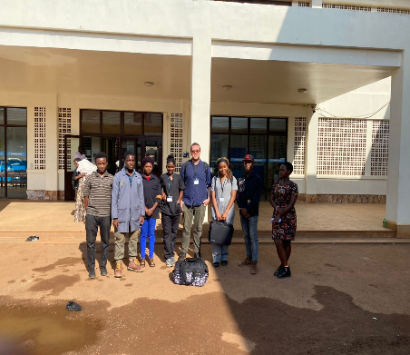

These institutes are carried out for 2 consecutive months
Engineering World Health Summer and winter Institutes
In month one
Fellows receive training on how different medical equipment work and how to troubleshoot. These include lecture and practical sessions that take place at Makerere University.
Clinical visits are then done in different facilities around Kampala city.
Over 200 medical Equipment were fixed in a 2 or 3 day clinical visit over the years.
Patients are receiving better healthcare services at these clinical sites – MakBME EWH Fellows

Slide 5
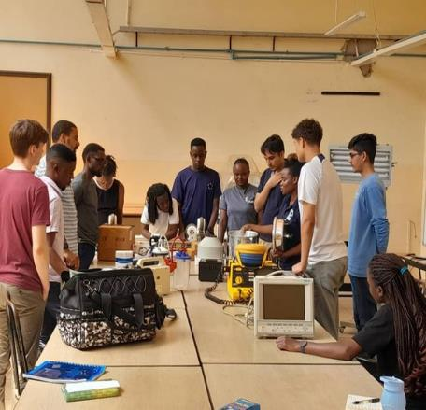
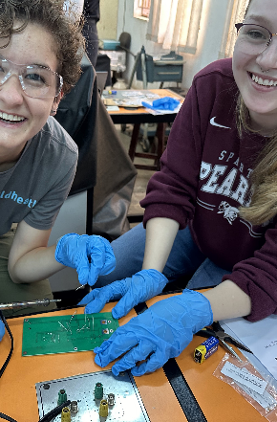
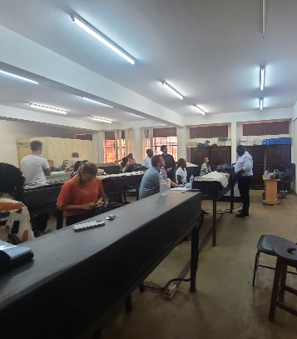
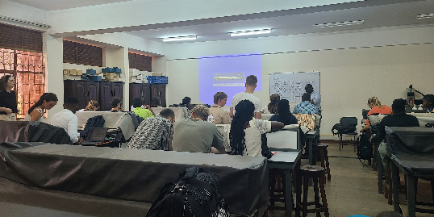
Training Sessions

Slide 6
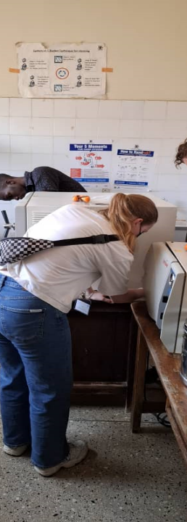
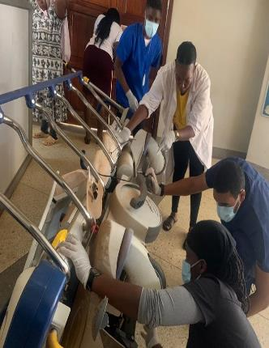
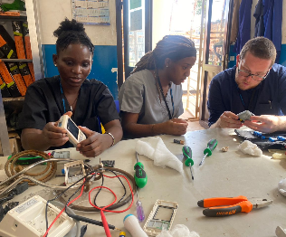
Hospital Visits

Slide 7
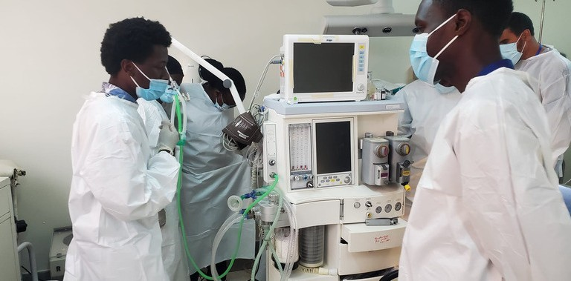
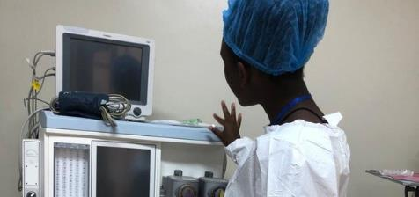
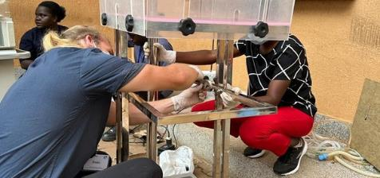

Slide 8
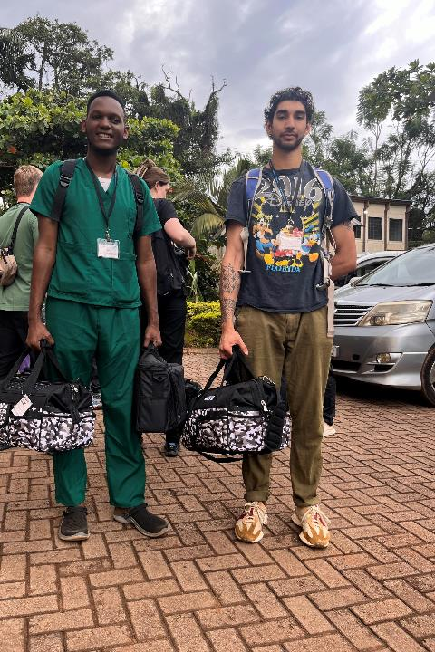
2nd month
In month two , students are placed sat different facilities in groups of 2 to 4 to put all the attained skills in month one into practice.
Approx. 1000 medical equipment fixed in 4 weeks across all the hospitals over the years
One or Secondary projects are developed @ each of the placement.

Slide 9
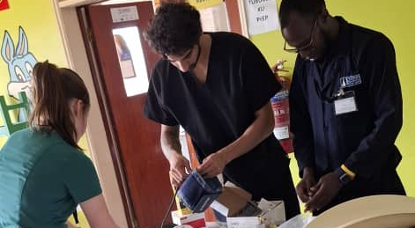
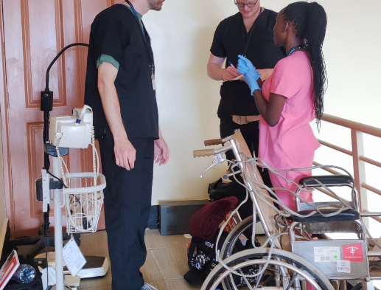
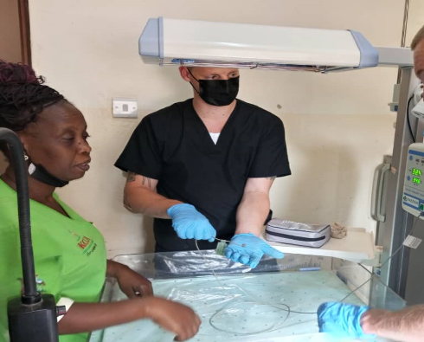
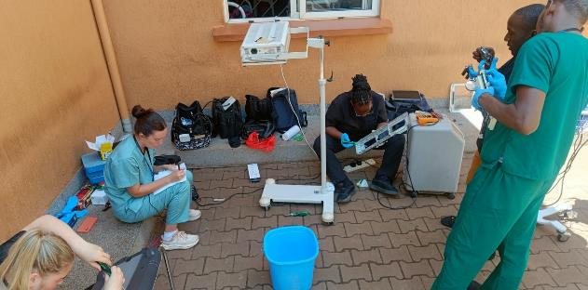

Slide 10
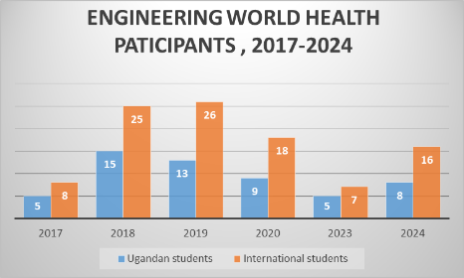
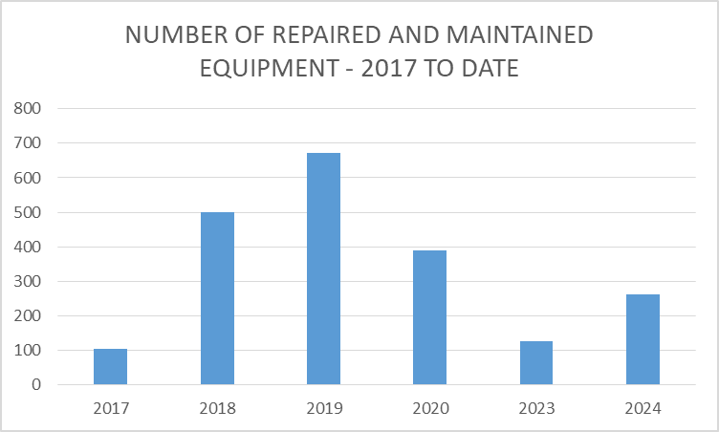
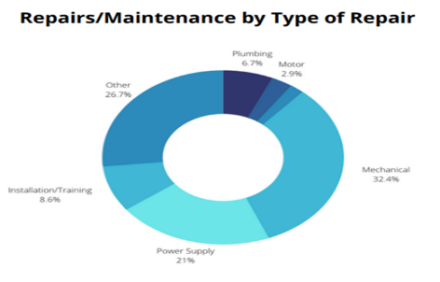
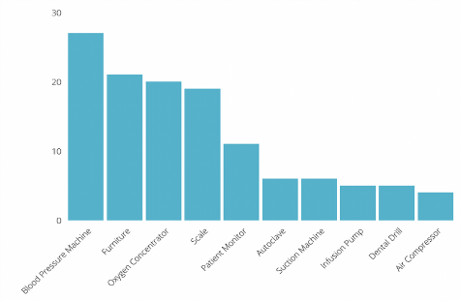
EWH Summer And Winter Institute
Examples of equipment worked on over the years (2023 SI)

Slide 11
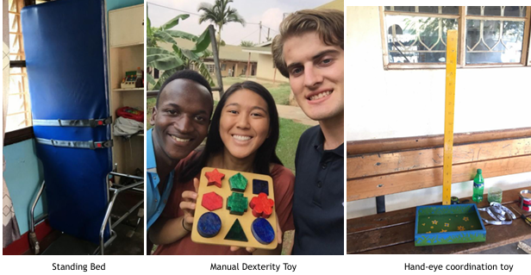
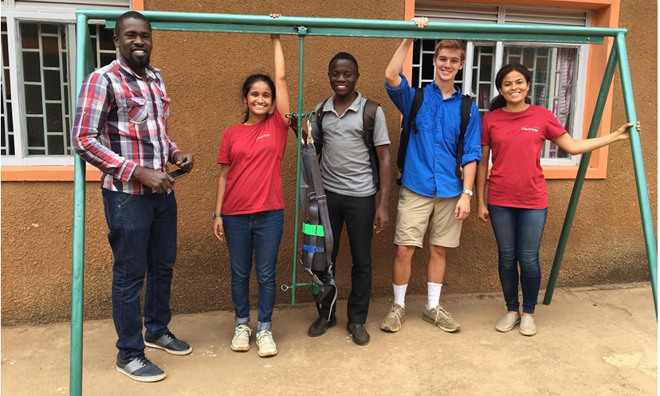
Design and Secondary Projects
Over 50 projects in health facilities across Uganda
Designs done at katalemwa rehabilitation center (2017 SI)
A prototype for a device that assists children with pelvic and lower limb disabilities to walk and stand at katalemwa rehabilitation center (2018 SI)

Slide 12
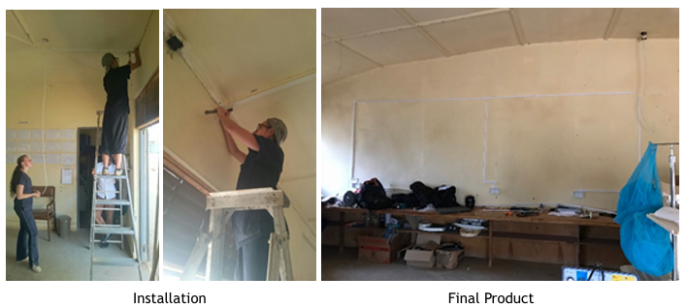
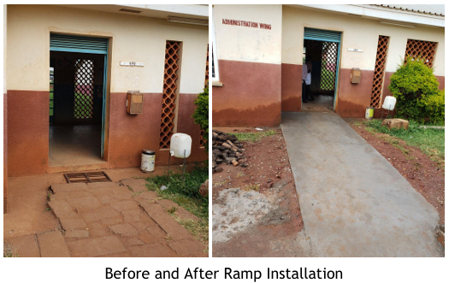
Design and Secondary projects
Electrical wiring of the new workshop at Masaka Regional Referral Hospital (2018 JI)
A renovated ramp connecting the entrance of the outpatient department (OPD) for improved disability access at Kamuli General Hospital (2019 SI)

Slide 13
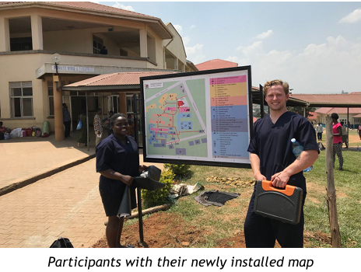
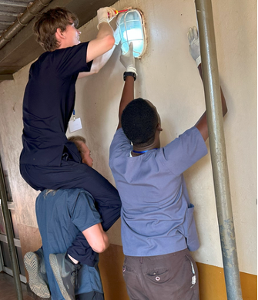
Design and secondary projects
A navigation system for both patients and staff at Mbarara Regional Referral Hospital (2020 JI)
Replacing 100 outside light bulbs around Mukono general hospital (2023 SI)

Slide 14
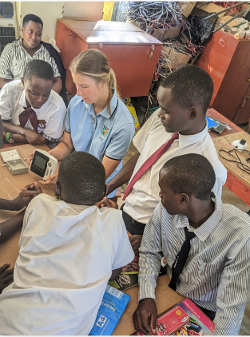
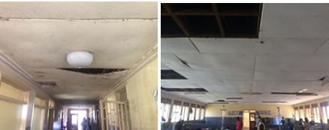
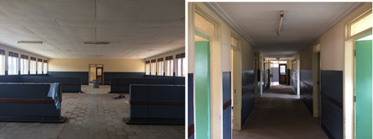
Design and secondary projects
Soldering and Repair Workshop at Nakaseke Christian Secondary School (2024 SI)
Renovation of the female ward at Iganga general hospital (2019 JI)
BEFORE
AFTER

Slide 15
MAKBME- EWH CHAPTER
Makerere University's Biomedical Engineering Freshman's Challenge
The Makerere University Biomedical Engineering Students’ Association (MUBESA) and the Makerere EWH Chapter in Uganda jointly host the Freshman's Challenge each year.
This event is designed to welcome new students of the Biomedical Engineering program. The challenge encourages first-year students to collaborate, explore a specific healthcare issue, and develop innovative solutions to address it.

Slide 16
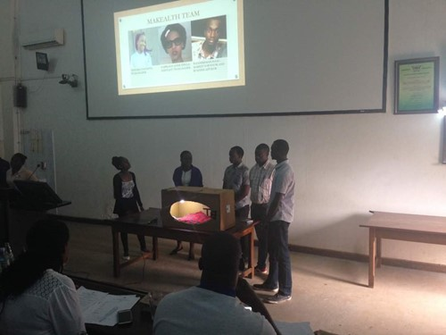
FRESHMAN’S CHALLENGE
2017 Annual Freshman’s Challenge which focused on the theme, “innovative health technologies to impact maternal and infant health.”
Incubox Team Presenting Their Design

Slide 17
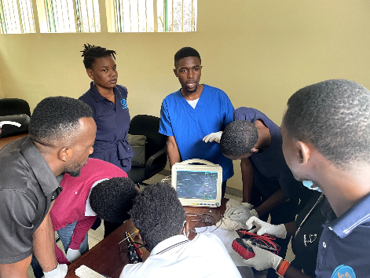
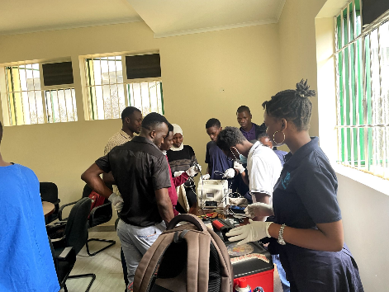
Makerere University EWH Chapter out reaches
Makerere University EWH Chapter Reaches Out to Hospitals in Uganda

Slide 18
Conclusion
Engineering World Health aims not only to improve hospital services but also to shape volunteers into skilled engineers and responsible global citizens. Through hands-on experience, innovative projects, and outreach, the Makerere University EWH Chapter has positively impacted healthcare in Uganda, with patients receiving better care due to improved medical equipment maintenance and functionality.

Slide 19
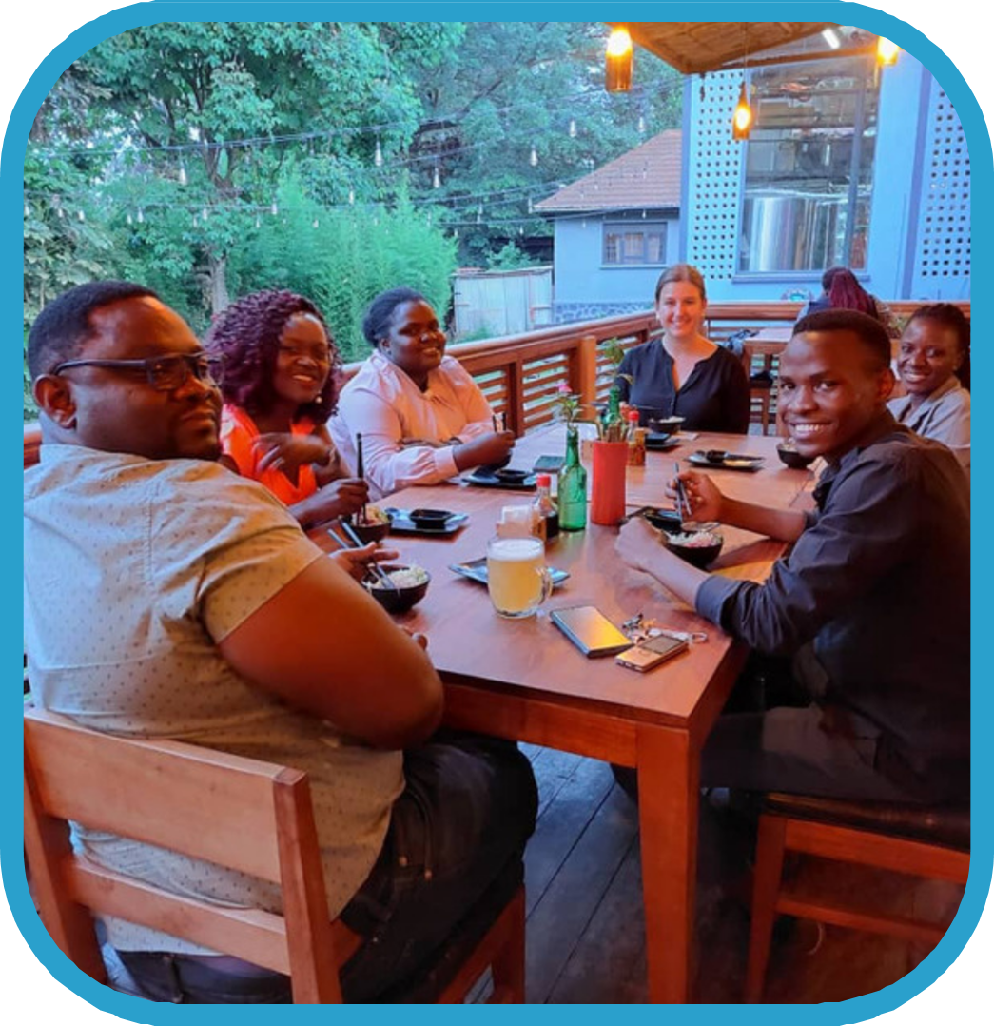
APPRECIATION
Gratitude to Dr. Robert T. Ssekitoleko for leadership in EWH Summer and Winter Institutes.
Acknowledgment of MAK BME volunteers and staff for ensuring smooth program execution.
Special thanks to on-the-ground coordinators like Megan Lavery, Will Lewin, Catherine Namayega, and Claire Atim for their key logistical roles.
Over 2,000 medical equipment repairs across Uganda since 2017 by dedicated international volunteers.
Recognition of Ugandan hospital staff for their cooperation, enabling successful equipment repair and healthcare improvements.
Appreciation for program partners: Duke University, University of New South Wales, and EWH leadership for technical and international support.

Slide 20



