Slide 1

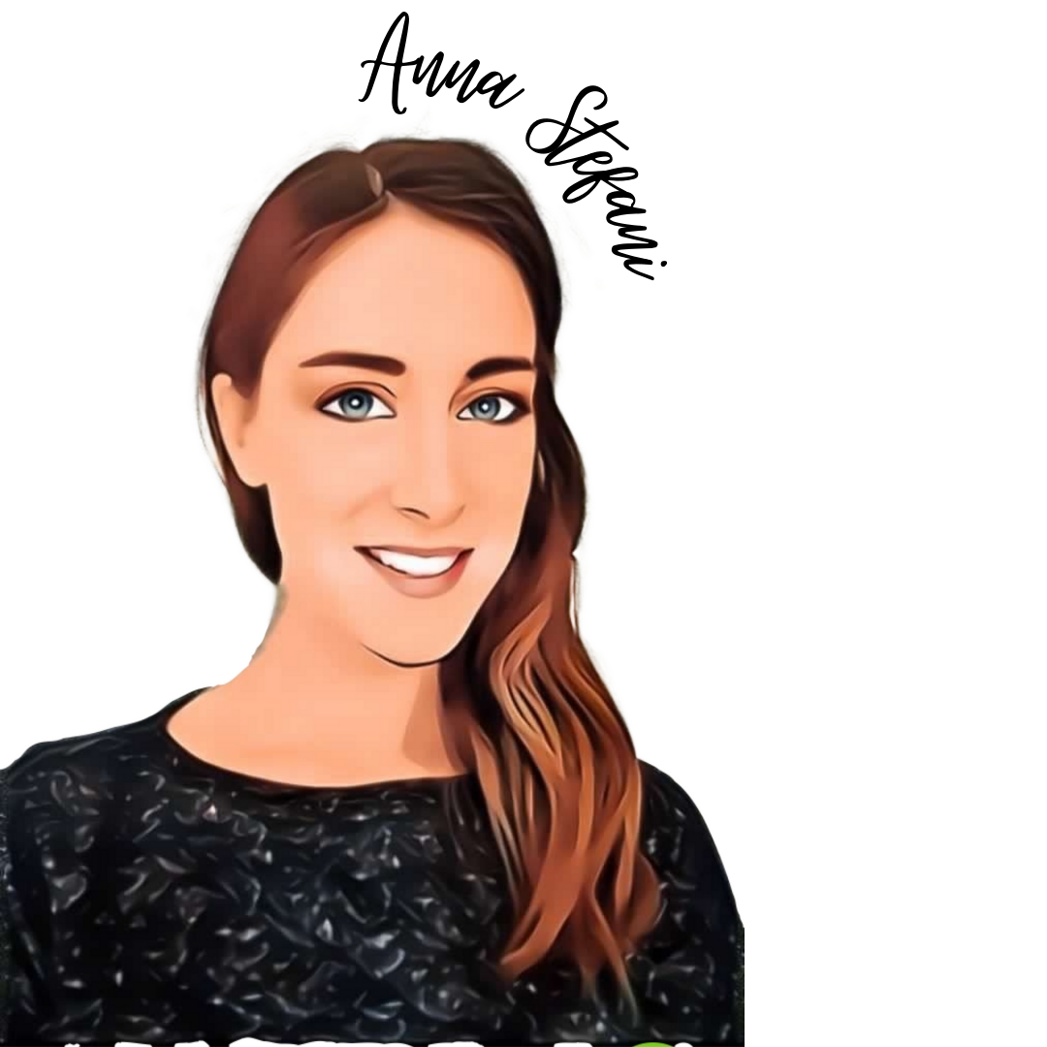

National survey and digital communication instruments to foster the role of the biomedical engineer in Italy
Manuela Appendino & Anna Stefani
WWE – Wewomengineers
Italy

Slide 2




The Team
2021 - WWE is an association!
WeWomEngineers (WWE) is a team composed of 20 Italian Biomedical & Clinical Engineers (BE & CE), mostly women, both students and workers, including PhD students, researchers and professionals in the field of medical devices.
WWE’s aims concentrate on three specific goals:
  promoting the role of the Biomedical & Clinical Engineer,
  sustaining gender equity and equality,
  encouraging and supporting the study of STEM in schools
Since 4 years Role Models for InspirinGirls of ValoreD,
WWE cofounded the WIE IEEE Italy Chapter supporting STEM in respect of “WIESteer2toSTEMchart”,
WWE is a not profit and self-sustaining community specialized in digital communication
Notes:
Da 4 anni siamo Role Model per InspirinGirls di ValoreD portiamo nelle scuole la nostra giornata tipo e discutiamo con ragazzi e insegnanti della nostra professione
Da 4 anni abbiamo co-fondato il gruppo WIE IEEE Italy chapter e supportiamo il team attraverso iniziative STEM nel rispetto della
“WIESteer2toSTEMchart”
Ci siamo specializzate in digital COMMUNICATION per avvicinare un target di giovani ingegneri/e e futuri ingegneri/e attraverso La condivisone delle nostre tappe operative e digital editing per fornire nuovi spunti di discussione ed essere continuamente aperte verso le idee innovative nel settore Biomedicale o generarne di nuove

Slide 3

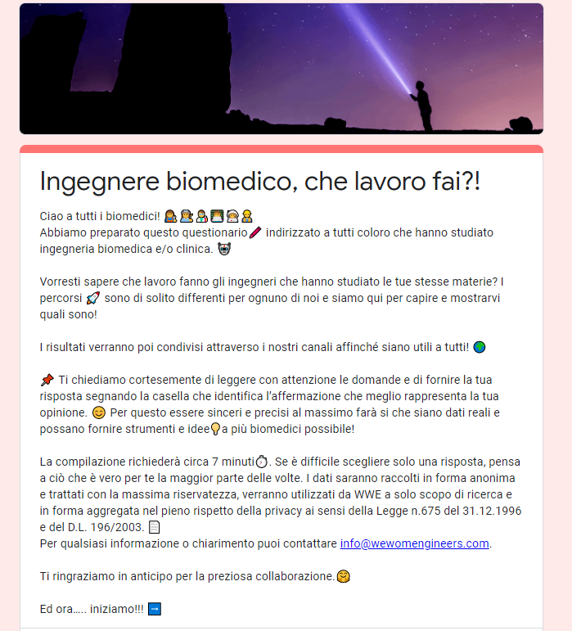
Description
The first National Survey was launched by WWE in May 2020,
asking 46 direct questions to Italian BE & CE, divided in four sections:
(13 questions)
(15 questions)
UNIVERSITY
JOB
SATISFACTION
EVALUATION
of the career path
BE & CE ROLE
GOVERNANCE
?
(12 questions)
(6 questions)

Slide 4




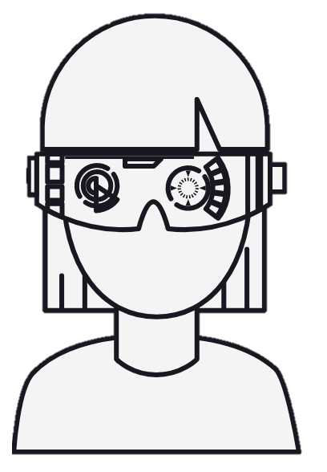
Goals and final users
i
IGITAL SOLUTIONS
Foster practical digital solution
to fill the gap enlightened and
give recognition to BE & CE role.
o
d
NTERACTION
Creation of a direct dialogue
with BE & CE through Survey and digital instruments
RIENTATION
Elaborate the
Italian map of BE & CE jobs
Healthcare stakeholders
(Job agencies, companies, sectorial orders & associations, research & organizational institutions)
New graduated
engineers
Internal
WWE members
Targeted
followers

Slide 5


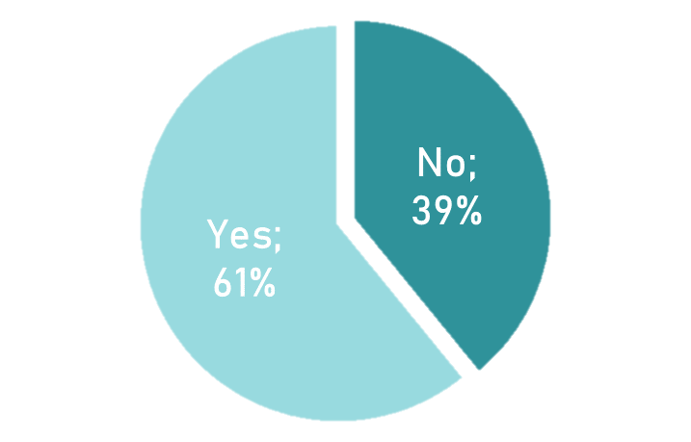
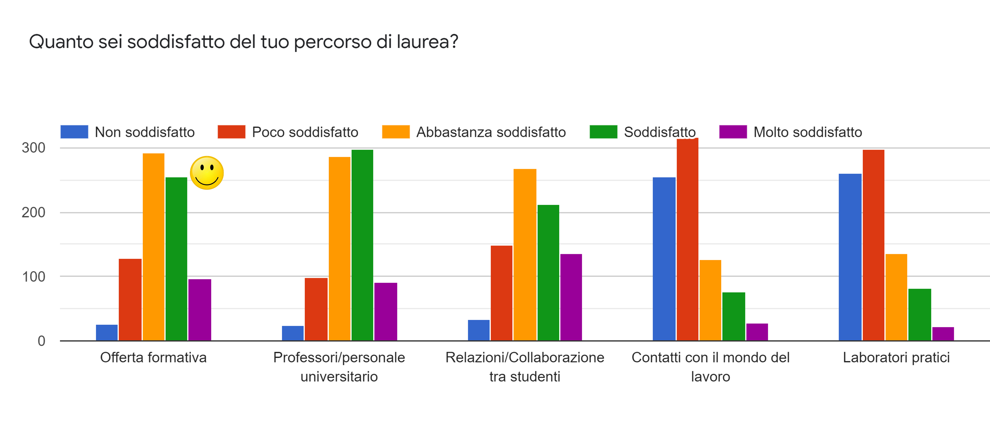

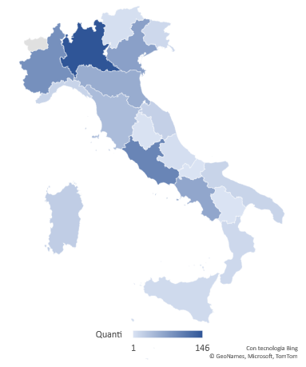
Ongoing Results
updated 27.09.2021
854
Why BE/CE?
Help others
Bring innovation in engineering
21%
responses
13%
75% workers
12% students
6% work and live abroad
UNIVERSITY
JOB
14%
SATISFACTION
EVALUATION
of the career path
Do you work in biomedical sector?
82% OF THEM would like to
work in biomedical field
EDUCATION PRACTICAL
PROVIDED LABORATORIES
REGIONAL RESPONSES
NOT SATISFIED ------------ SATISFIED

Slide 6
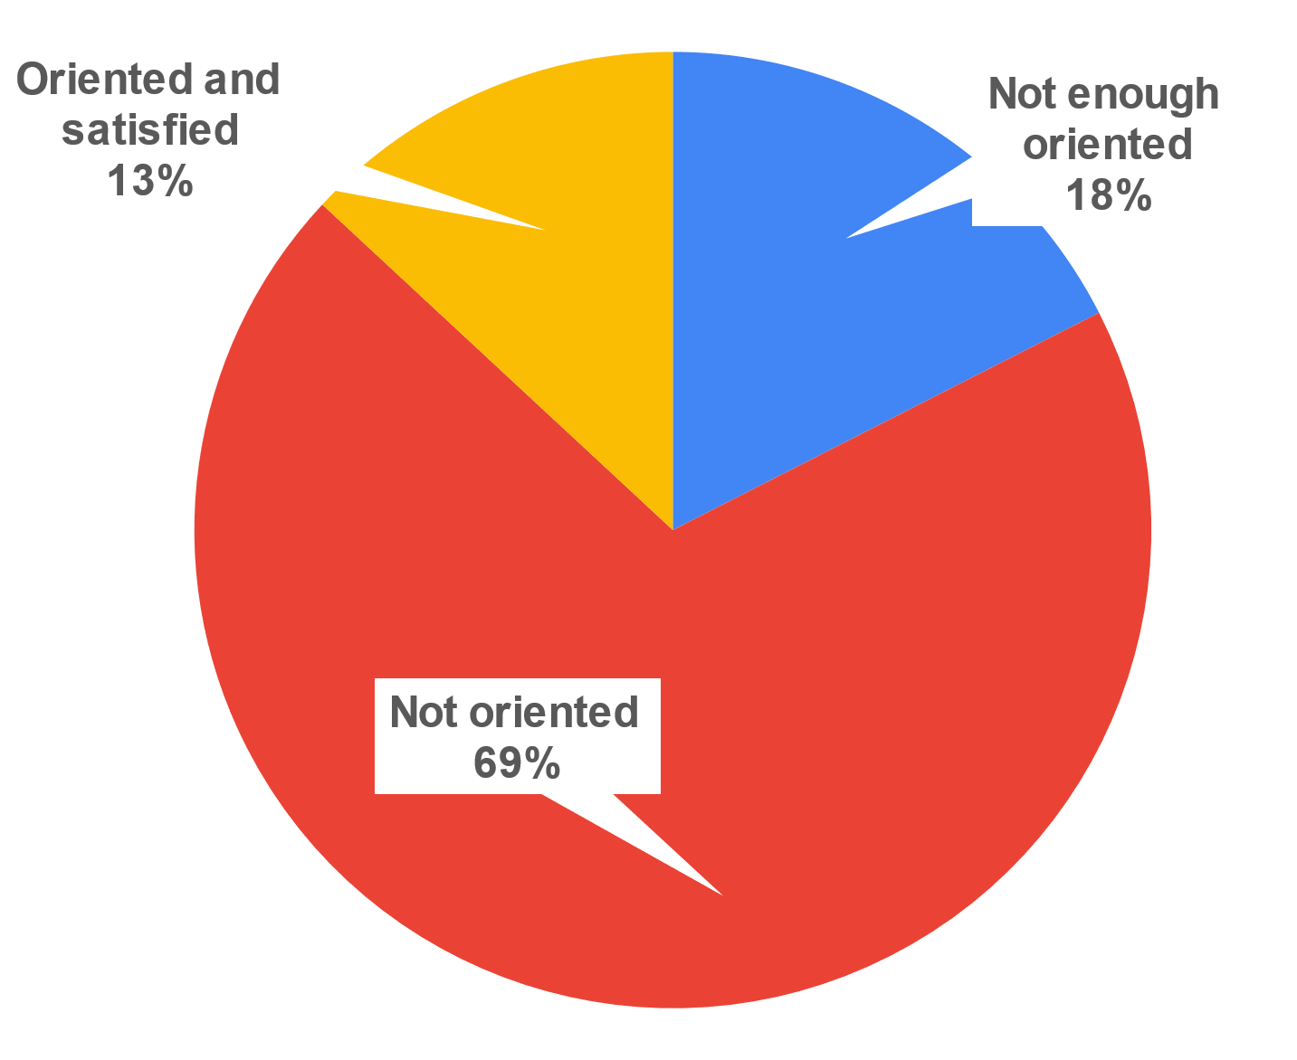



Summary Results
87%
PRACTICAL LAB LACK in universities
LACK OF CONSUELING SERIVICE and industry contact
LACK OF CLARITY in the role covered by biomedical engineers
SALES ROLE is the most representative, is it really coherent?
ITALY R&D GAP: Few biomedical companies have an R&D department in Italy
PROFESSIONAL BODIES are non biomedical-aware and give poor concrete support
BE & CE ROLE
GOVERNANCE
  More than 85% declared the need
  of a fundamental improvement
  of the recognition of the role of BE & CE in Italy.
Notes:
UNIVERSITIES provides few practical laboratories to apply the knowledge developed and have few contacts with industries
LACK OF CONSUELING SERIVICE gap between graduation and the world of work
MIX of ROLES need to understand the roles covered by biomedical engineers and provide maps to guide job search
SALES ROLE of the biomedical engineer (most representative), has been declined in a mix of activities / responsibilities
GAP R&D: Few Italian companies have an R&D DEPARTMENT Non-specific biomedical
PROFESSIONAL ORDERS are non biomedical-aware and give poor concrete support
How is the Biomedic Engineer in Italy:
DYNAMIC likes travelling and having mixed activities
PASSIONATE about technology and medicine
NOT BIO 40% not covering biomedical roles
TRANSVERSAL (pros and cons to manage)
FEMALE is the most (60%) represented gender
EXPERT mainly in medical devices and IT
DIGITAL mostly interact and find job online
NOT RECOGNISED have no respresentatives into industry, healthcare institutions and even professional orders in Italy

Slide 7
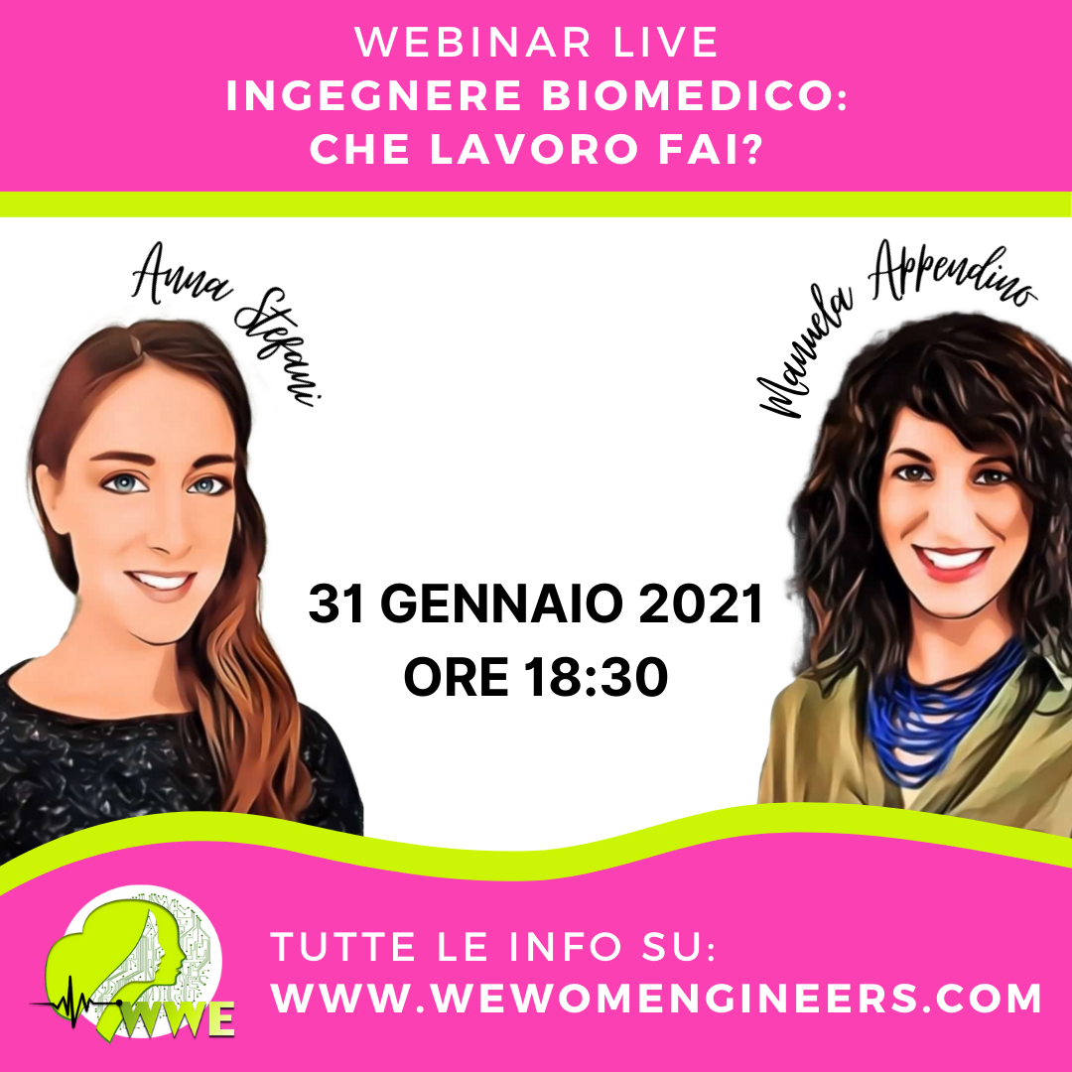
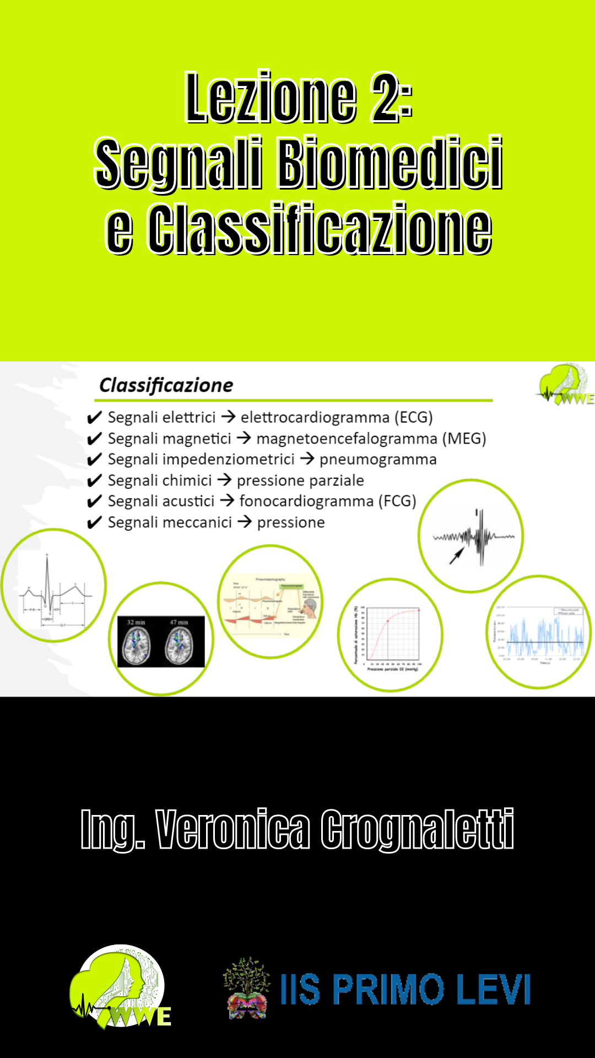



Outcomes
The 2021 digital communication plan developed by WWE per to create culture
around the work and the figure of the BE & CE involving:
Webinars and IG directs (January, March, June 2021)
Hidden healthcare innovation articles for specialistic journal
(ISDN – Innovazione e Salute – to be published in September 2021)
One book (Il Cappello di Paglia – published in July 2021)
Online Lessons for high school students on biomedical engineer job
Video pills on biomedical world arguments
2021
WWE became an association!
Where we want to go next…
Focal point for BE & CE graduates and workers to provide job orientation
Referral for market updated professional training
Dialogue with institutions
Industrial & Healthcare sector presence
Driving investments to foster biomedical R&D in Italy

Slide 8
Anna Stefani Manuela Appendino ing.anna.stefani@gmail.com appendino.manuela@gmail.com
Thank you
www.wewomengineers.com
info@wewomengineers.com
Wewomengineers, Italy
Thanks to Anna Stefani, Elisa Panero, Serena Bertoldi, Maria Agnese Pirozzi, Giusi Di Salvio, Francesca Albano, Veronica Moi, Luca Radice, Alice Bellini, Veronica Crognaletti, Manuela Appendino

