Slide 1
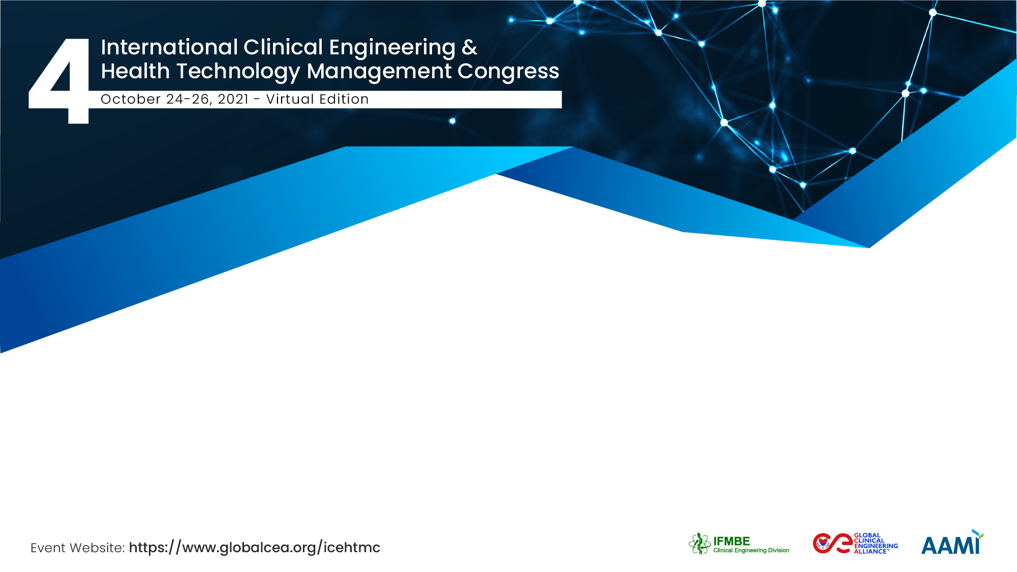
Nationwide Medical Equipment Inventory & Maintenance Practices in Nepal
Barun Kumar Raniyar
M4H-TTM-MEH Consultants

Slide 2
Team Members of Maintenance Project
Josef Riha, Tanzania
Stefano Ferrari, Germany
Shyam Sundar Sharma, Nepal
Emma Flor De Guzman, Philippines
Bhawi Prasad Gurung, Nepal
Barun Kumar Rauniyar, Nepal
Junu Hada, Nepal
Anupama Limbu, Nepal
Jitendra Yadav, Nepal
Shailendra Yadav, Nepal
Ashok Thapa, Nepal
Mukunda Khatiwada, Nepal
Sonu Shrestha, Nepal
Padhma Mishra, Nepal
Sanjita Sharma, Nepal
Rupesh Mishra, Nepal
Sujata Bhattarai, Nepal
Usha Poudel, Nepal

Slide 3
Description
Pilot phase(2011-2014):
New approach to maintenance of medical devices in Nepal started in 2011
Supported by KFW, the German Development Bank
56 health facilities in two regions were selected for piloting
more sophisticated equipment of district & regional health facilities were covered
Project phases:
  Planning and contract preparation phase
  Data collection(Inventory)/Mobilization phase
  Execution/implementation phase
PLAMAHS-Database management system to manage overall project/contract

Slide 4
Description cont………….
Nationwide maintenance outsourcing project(2015-2020):
5000 Equipment in 178 health facilities were covered
Database system PLAMAHS used in the pilot phase upgraded to online version
Three suitable contractors were hired who had to set up workshops & logistics, recruit and train service engineers
Ministry of health conducted sensitization of all health facilities & stakeholders, before maintenance of equipment under contract started in 2017
In 2019, overall management was handed over to the biomedical engineers of the PAM Unit
Major challenges were:
  bureaucratic bottlenecks in the Ministry, including slow recruitment of technical personnel to manage the contracts
  poor initial performance of database (PLAMAHS)
  unreliable electricity supply and
  the extreme topology of Nepal with poor roads and harsh weather conditions.

Slide 5
Goals of the project and final users/beneficiary
Goals of project were to increase utilization of health care technology by ensuring safety and high availability of medical equipment of public health facilities:
  By inventory management to analyse status of equipment
  Through planned preventive & corrective maintenance.
  By performing calibration
  By strengthening in-house maintenance capacity and user competency
    Through user & technician training
    By skill transfer from international experts to national Biomedical & service engineers
Beneficiary: poor public who can not afford high health service cost of private health facilities & end users.

Slide 6
Results
4% medical equipment remains un-commissioned & unpacked for more than 3 years.
during rapid inventory
judged out-of-order (O/O)
or UNSERVICEABLE
Result: Improvement in Equipment Status
MW & FW 2011 – 2014
Pilot Phase: 64% equipment under contract was functional before maintenance interventions which increased to 88% within six months & more than 99% at end of project in 2014 with significant increase in availability.
contract BoQ was on average about 1,150 items
94 %
operational
97 %
operational
> 99 %
operational
88 %
1/3 of O/O items judged by MC as SERVICEABLE during mobilization phase
64 %
all data extracted from the PLAMAHS database
2/3 of O/O items REPAIRED by MC during mobilization phase
mob. ph.
3 years of PPM, CM & training
Jan 2011
June 2011
June 2012
June 2013
June 2014
Rapid Inventory Assessment 2010

Slide 7
Thank You
Barun Kumar Rauniyar
ajayrauniyar@hotmail.com
MEH Consultants Pvt. Ltd., Nepal
Collaborator, IFMBE-CED
Consultant, WHO-SEARO

