Slide 1
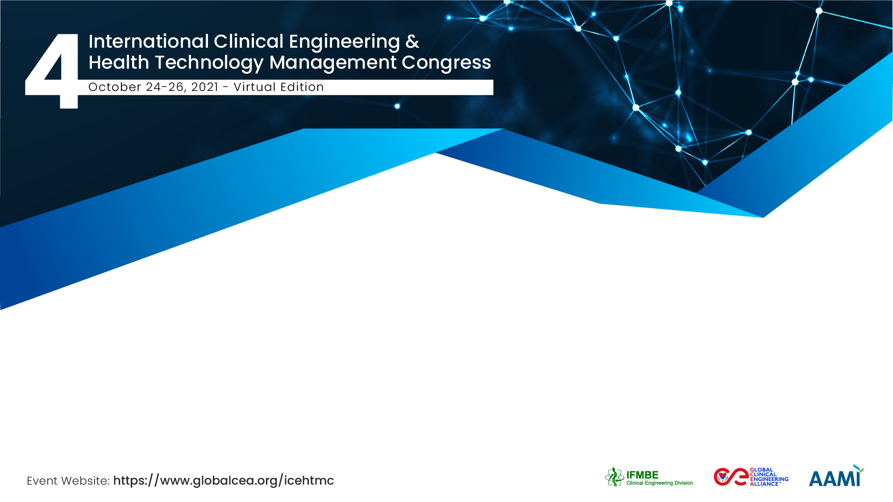
Optimization of the COVID19 Molecular Analysis Production Process
Anna Squara
Operations Management Team - Asst dei Settelaghi - Italy

Slide 2
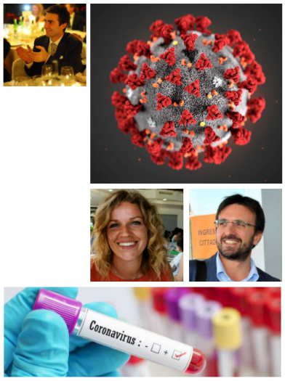
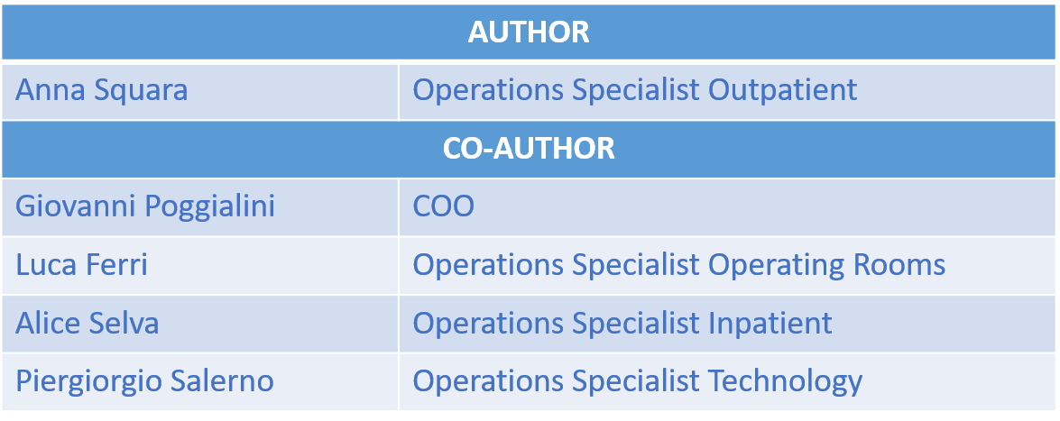


The Team / Workgroup

Slide 3

Description
Problem
ASST dei Sette Laghi has optimized the production process by both reducing TAT and expanding the number of swabs processed in 24H thanks to a deep analisys of the process and through the ridesign lab layout.
During Covid epidemic emergency, the number of swabs have grown exponentially. We have exceeding 2000 swabs/day.
We needed a TAT process as fast as possible in order avoid problems in inpatient and outpatient logistics.
Solving
We have analyzed the whole process: we have created an improvement plan to maximize our production capacity according to time, laboratory equipments and staff availability. This challenge allowed us to progress from 600 samples to more than 2000 in less than 7 days.

Slide 4

Goals of the project and final users that will benefit
Production x 4
TAT reduction
Micriobiology Lab opened H24 became benchmark for the 7 hospitals of ASST dei Sette Laghi
Optimization of admission and dimission process (in/outpatient)
Optimization of the Operating Room process

Slide 5

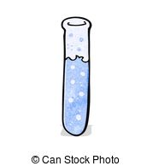
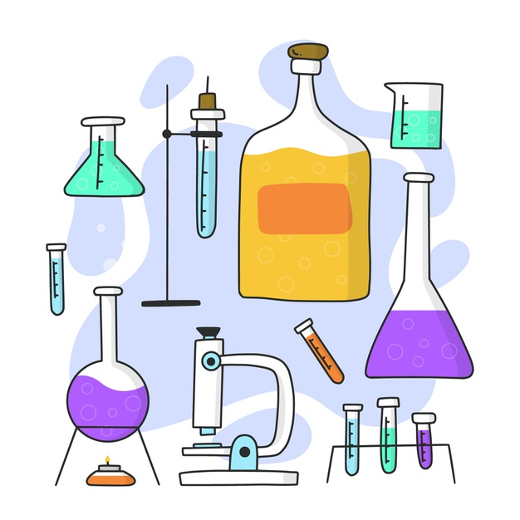

Results
12H
6H
24H
-83%
-70%
Average execution time
(TAT)
Average execution time - Fast Track (TAT)
Working TIME
2000
+90%
+233%
Automatization of reporting and signature processes
New Laboratory
Layout
Swabs processated

Slide 6
Anna Squara – Operations Managment Office
anna.squara@asst-settelaghi.it
ASST dei Sette Laghi, Italy

