Slide 1
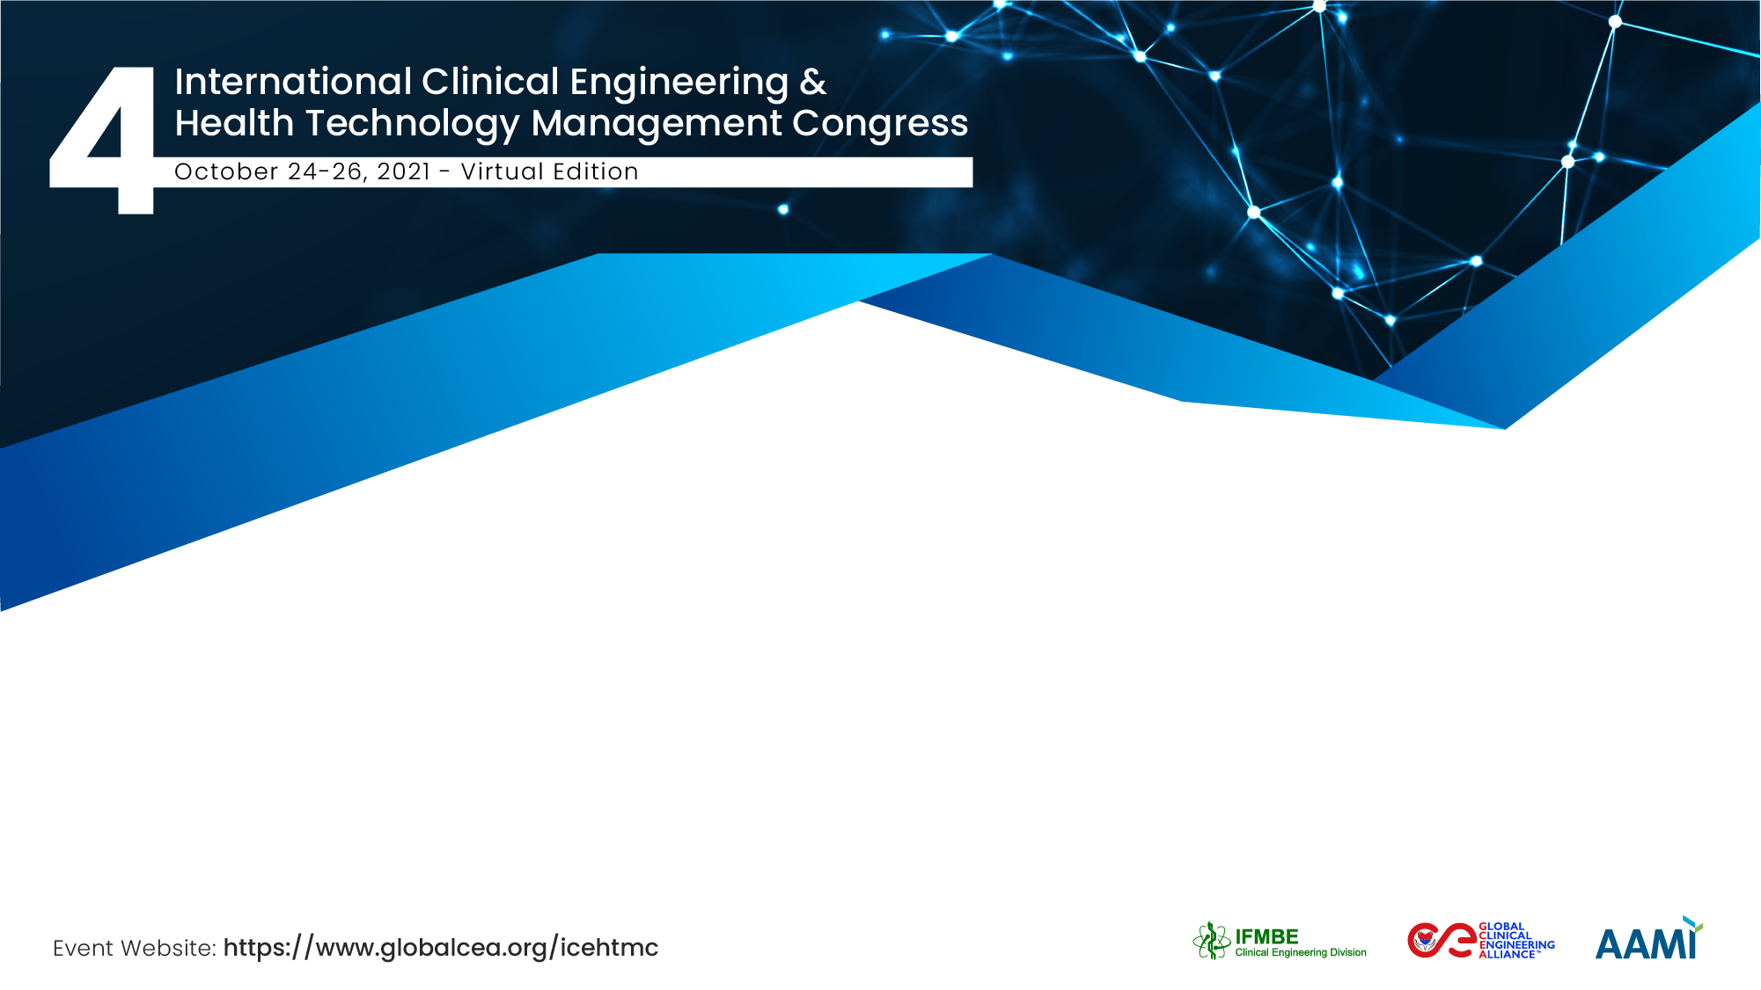
Promoting Equality & Inclusion
Global Clinical Engineering Alliance
Shauna Mullally (Canada)
GCEA Founders Council & Goverment of the Northwest Territories

Slide 2
Who are we?
Equality & Inclusion Leads
Dan Clark (UK)
Shauna Mullally (Canada)
GCEA Founders Council
Keiko Fukuta (Japan)
Elliot Sloane (US)
James Wear (US)
Li Bin (China)
Mladen Poluta (South Africa)
Nicolas Pallikarakis (Greece)
Saide Calil (Brazil)
Stefano Bergamasco (Italy)
Tom Judd (US)
Wayne Morse (US)
Yadin David (US)

Slide 3

What is the goal of the alliance?
Our goal is to educate and advocate through global CE alliances by serving as one voice, for one field, for all patients and healthcare staff everywhere…
to improve patient experience, patient outcomes and community wellness.
We can’t be one voice without being an inclusive voice. We as an alliance commit to promoting inclusion and equality in our profession globally.

Slide 4

What does promoting equality and inclusion mean?
Inclusion
Equality
Diversity
Equity
Representation

Slide 5
Why is it one of our founding values?
Our profession should reflect the people we serve.
We as an engineering profession haven’t always gotten it right.
Small changes can mean big things for people who haven’t always felt included.
It isn’t just the right thing to do. It’s the smart thing to do.
It will make our profession stronger.

Slide 6
Who are we focusing on?
Everyone should feel like they belong in our profession.
Women in our profession
People from all regions of the world, in particular low- and middle-income countries
People of all races, in particular indigenous communities and peoples of colour
People with diverse sexual orientations and gender identities
People with disabilities
People with diverse cultures and belief systems, religious and otherwise
People with diverse clinical engineering qualifications

Slide 7
How are we doing this?
We are developing our strategic plan for equality and inclusion now.
It includes:
  Reviewing all the work we do through an equality & inclusion lens (reflecting)
  Seeking to partner with organizations that promote equality & inclusion (partnering)
Two 2022 activities are:
  Hosting a webinar on equality and inclusion in our profession (learning)
  Doing a survey with our GCEA members and non-members in our profession to guide our future work in this area (listening)

Slide 8
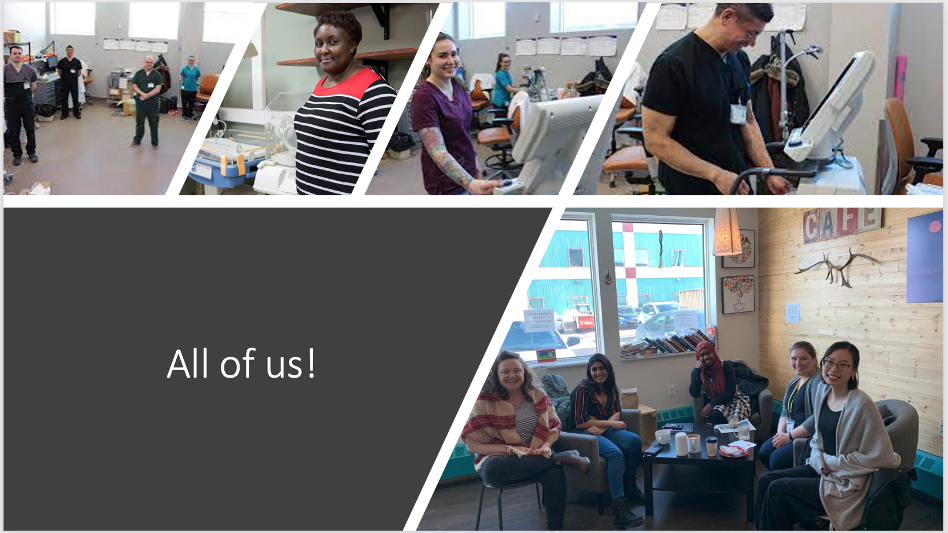
Shauna Mullally
shaunamullally [at] gmail.com
GCEA Founders Council, Government of the Northwest Territories

