Slide 1

RECALLS,Q&A PLATFORM FOR BME AND CLINICIANS FOR KENYAN HEALTHCARE
Kevin Koech
Nyeri National Polytechnic
AMEK- Member

Slide 2
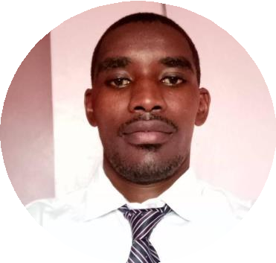
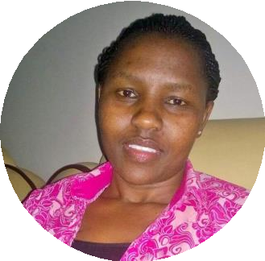
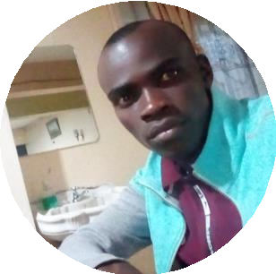
The Team / Workgroup
Kevin Koech
Biomedical Engineer
Trainer
Salome
Team
Calet
Team

Slide 3
Description
The current trend of Medical Technology is the disruptive use of ICT as an enabler specifically 5G Wireless and wire Network for the implementation of IoT, AI, BC and ML. The use of collaborative and predictive platforms by Medics has enhanced the Telemedicine and improved service delivery in Healthcare especially UHC a Big 4 agenda pillar. The purpose of this abstract is to introduce a Platform for BME and HealthCare professionals, interns, attachees and any Medical Device user which is a collaborative Q & A.I was inspired by Quora and StackOverflow way and saw a need to segment completely to have a sole platform for BME in Kenya.Also a Dashboard for real-time remotely centralized in HQ Medical equipment management.
The current way for which BME ask questions from a fellow expert is through Whatsapp4 Groups, Telegram5 , SMS6 or Phone calls which are easy and very much available channels however, these channels some are one-one way, others chat rooms/groups but do not store the history of all users who ask questions for help while maintaining, servicing, troubleshooting or installing medical equipment. https://bit.ly/3mFTltT
Is a platform which allows users to ask questions and BME experts answers them and the best voted or answer which worked is green ticked/selected by the system. The person who ask the question select the answer which worked.
In addition, the platform is a cloud based hosted and real-time retrieval /access it also awards points when you vote for an
answer, answering and asking questions.

Slide 4

Video Demo
Recorded with Screen Recorder App

Slide 5
Goals of the project and final users that will benefit
-To appreciate use of ICT as an enabler for BME in UHC in Kenya.
-To store and re-use expert knowledge for future generation
-A dashboard to have realtime status of medical Equipment In Kenyan Hospitals.
-Medical Staff(Nurses and BMEs) will benefit.
-HQ Ministry of health will have updated and reatime info on BMEs and status of Medical Equipment(services,repair,installations etc.)

Slide 6
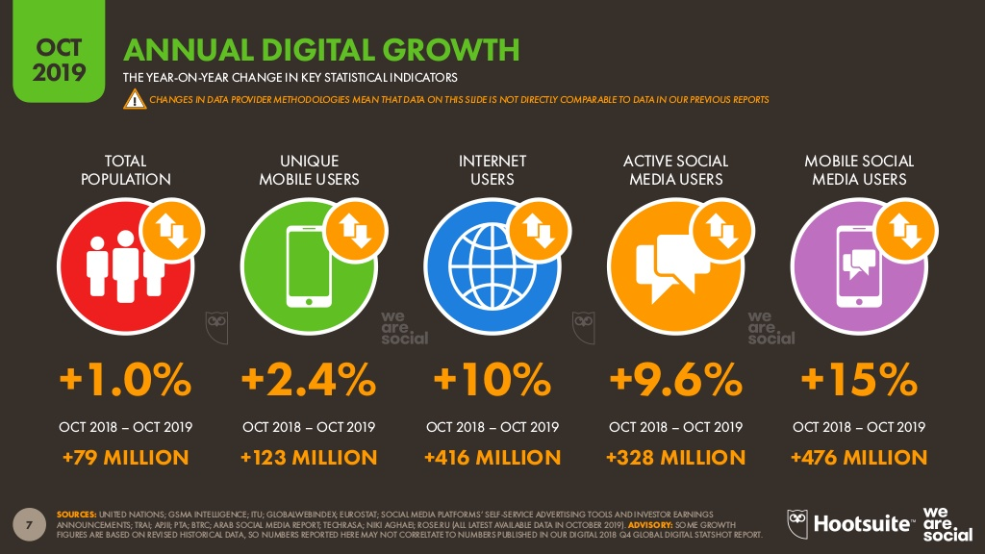

Slide 7
Results A
-We started the project 2018 and the Platform was well appreciated during the AMEK Conference in Mombasa in 2019.
-20 Experience field Engineers answered questions asked by new Engineers.
-Currently due to web hosting and Domain renewal annually we had not renewed the initial site https://theant.co.ke.
-The Dashboard in in progress for Medical Equipment Management.

Slide 8
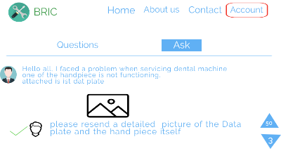
Results B

Slide 9
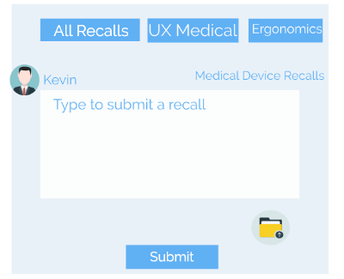
PROPOSED SOLUTION

Slide 10



STRENGTH OF THE PROPOSED SOLUTION

Slide 11
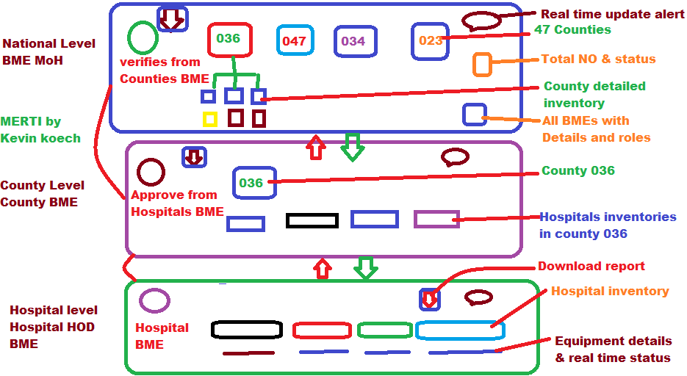
Big Picture

Slide 12
Kevin Koech
kevkokip@gmail.com
The Nyeri National Polytechnic,Kenya

