Slide 1
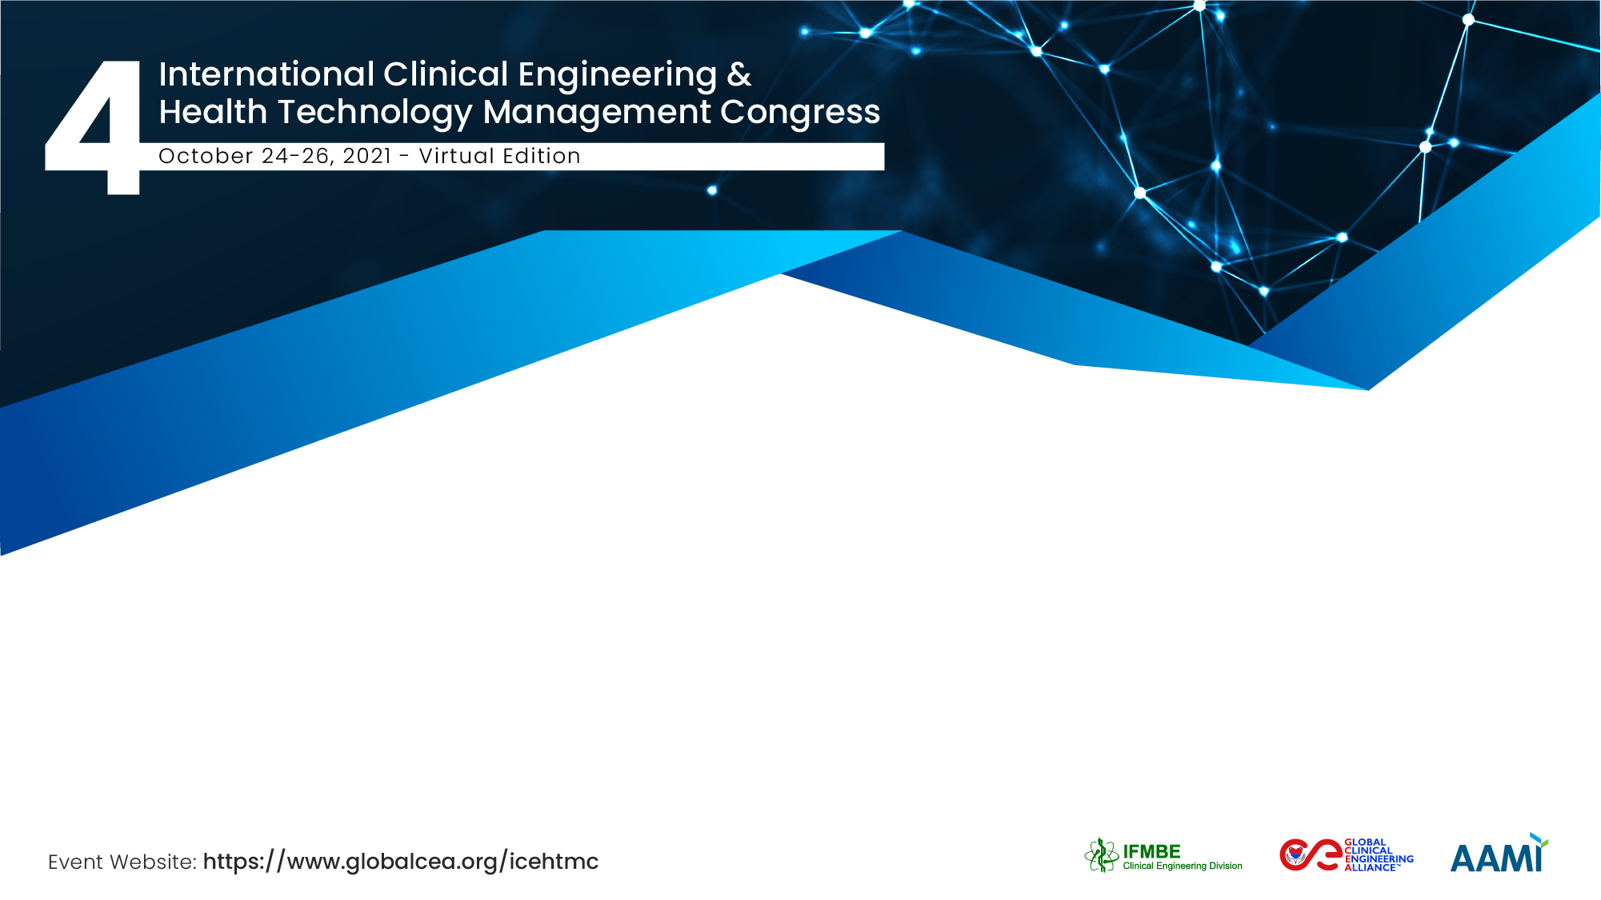
Reaching Out to Russian-speaking HTM Professionals with CE/HTM Leadership Competency Webinars
Andrei Issakov, M.D., M.P.H., Ph.D.
Former WHO Head of Health Services Provision, Facilities and Technology Planning & Management,
IFMBE Honorary Life Member, IFMBE CED Collaborator,
Director Health Systems & Technology Consulting, Geneva

Slide 2
The Team / Workgroup
Andrei Issakov, Switzerland/Russia
Tom Judd, USA

Slide 3
Description
Following the 2019 Global CE Summit, IFMBE CED has developed CE Leadership Competency Webinar series demonstrating global best practices and leadership qualities needed to achieve excellence in a complex and demanding field of HTM and CE .
During 2020 and 2021, more than 20 CE Leadership Competency Webinars as well as webinars focused on different country experiences and CE experiences in addressing COVID-19 pandemic challenges have been conducted that attracted a world-wide audience and proved to be an indispensable educational and training resource for building and improving HTM & CE capacities globally.
While most of these webinars were held in English, some were also done in French and Spanish expanding the webinar reach to Francophone and Spanish-speaking countries.

Slide 4
Description (continued)
Another widely spoken international language is Russian. It is used in official capacity or in public life in all ex-USSR countries. Large numbers of Russian speakers can also be found in other countries such as US, Israel, Germany, countries of the former Eastern block, and other countries. There are some 260 million Russian speakers worldwide. It is one of the official WHO languages, and one of the working languages of the WHO European Office.
However, HTM community particularly in ex-USSR countries remains largely isolated from the mainstream of international professional exchanges in the area of CE and HTM.
This particularly refers to the Commonwealth of Independent States (CIS), a diverse grouping of all countries of the former Soviet Union, except Baltic States that being EU members are in a completely different situation as they have to make sure that their HTM approaches and capacity are adequate to meet European quality standards.

Slide 5
Description (continued)
Analyzing the reasons for that is not the subject of this presentation, but it may be attributed to:
  The language barrier as English remains not that widely spoken in CIS, particularly outside big cities,
  Lack of proactive approach on the part of local engineers and technicians in searching for external sources of information and professional contacts,
  Lack of support from authorities and lack of incentives for learning best practices and innovative approaches in HTM that remain largely unknown to a wider HTM community in these countries.
However, throughout the years, there were a range of international efforts to share international knowledge and best practices with colleagues from Russia and other countries of CIS:
  ACEWs (1993 – Boston, 1999 – Moscow, 2000 – Chicago) and ACEW-type Workshops by WHO in partnership with ACCE and SCIH (1999 – Nizhny Novgorod, 2000 – Penza)
  Various HTM-related projects by WHO, GIZ, SCIH, AIHA, M4H …. in Ukraine, Kyrgyzstan, Uzbekistan, Tajikistan…..
  Publications in Russian language

Slide 6
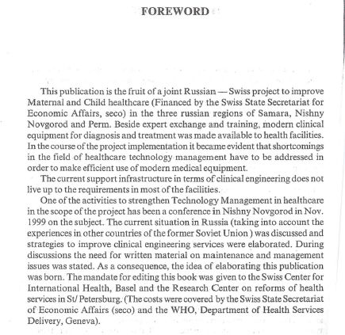
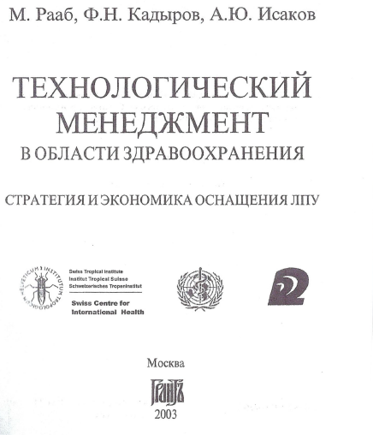
Description (continued)

Slide 7
Description (continued)
In spite of these efforts, CE/HTM as it is understood internationally remain largely unknown in CIS countries. Most of the available written “HTM” materials (in Russian) are about maintenance and repair only.
At the same time, some HTM-related elements are rather well developed in Russia and some other CIS counties:
  Regulatory mechanisms are quite comprehensive and are strictly followed as far as technology market access is concerned.
  Biomedical engineering education (both under- and post-graduate) is rather good and sophisticated.
  HTA is also being developed in recent years but still has a long way to go to become an integral part of decision-making.
However in general, HTM is not viewed as a logical sequence of integrated events. Various parts of the HTM cycle are separated and being dealt with by different actors separately without any interaction.
Needs assessment and selection are ad hoq and opportunistic.
There are practically no in-house CE departments, and this function is outsourced to private or state-run companies. In Russia, the inventory in most of facilities outside Moscow and St Petersburg is obsolete and large part of it (around 40 %) is not used due to various reasons. In other CIS countries, for example, in Central Asia, situation is even worse.
The book demonstrated in the previous slide is being read and referred to in various journal articles but concepts and practices described there are not widely implemented.

Slide 8
Goals of the project and final users that will benefit
Unfortunately, working contacts with Russian-speaking HTM professionals are sporadic, and there are currently very few mechanisms for involving them in regular productive exchanges.
Responding to this situation, IFMBE CED has decided to offer CE/HTM Leadership Competency Webinars in Russian language starting in 2022 on selected subjects identified as global priorities:
  HTM: Assessing and managing health technologies (HT)
  Cost: Containing HT-related costs and increasing ROI
  Quality & Safety (Q&S): Improving HT-related patient & staff safety and quality
  Partner with Clinicians: Supporting clinical caregivers using HT
  Innovation: Innovating new care processes using HT
  Digital Health: Using digital health care to improve patient access and care
  Regulation: Addressing HT regulation challenges
  Policy & Legislation: Developing appropriate HT-related policy and legislation
  Partner with Health Leaders: Develop reporting/communication relationships with healthcare decision makers
  Partner with Allied Health: Optimizing partnerships and communications with allied health professionals

Slide 9
Goals of the project and final users that will benefit
The target audience that IFMBE CED is planning to reach and who will benefit from this project are CE and HTM professionals in Russian-speaking countries, primarily Russia and countries of CIS.
We expect that our audience would be those affiliated with MoHs and other health authorities at regional and municipal levels, hospitals and other health care provider organizations, healthcare equipment service state-run and private companies, and biomedical engineering programs at universities and other educational establishments.
The pure technical engineering knowledge and skills are more than sufficient in this group of countries. What is lacking is the appreciation of modern HTM concepts and awareness of HTM best practices, and hence their application to the routine operation of health sector and health care services.
Therefore, our key target groups, particularly those affiliated with authorities and hospital leadership as well as with universities, by learning HTM state-of-the-art, best practices and innovative approaches are expected to optimize country HTM organization and practices, and add HTM focus to biomedical engineering educational programs.

Slide 10
Results
IFMBE CED is currently busy with identifying Russian-speaking lecturers, particularly in USA, Germany, Israel as well as colleagues from ex-USSR countries with international experience, to conduct these webinars.
In parallel, we are working on identifying contact persons at MoHs, key healthcare provider organizations, professional societies, if such exist, and universities in CIS countries with two main purposes, i.e. to mobilize with their help as broad audience as possible, and to adapt the themes and content of webinars to needs and priorities of this group of countries.
Both processes are quite advanced, and there are already a number of names on the list.
Then, a series of online meetings will be organized with lecturers and focal points jointly to go through the list of webinars already held and to finalize the webinars program targeting the key HTM issues specific to CIS countries.
By no means, the content of webinars would be a mechanical translation of their already developed English versions. Identified Russian-speaking lecturers would pick up webinar themes according to their personal expertise, and adapt the existing content bringing in their personal experience as well as adding, if necessary, responses to country-specific questions posed by HTM focal points.
It is planned to complete this preparatory work and start the program of Russian language CE/HTM Leadership Competency Webinars by mid-2022.

Slide 11
THANK YOU !!!
Andrei Issakov
andrei.issakov@hst-consulting.ch
Health Systems & Technology International Consulting (HS&T), Geneva, Switzerland

