Slide 1
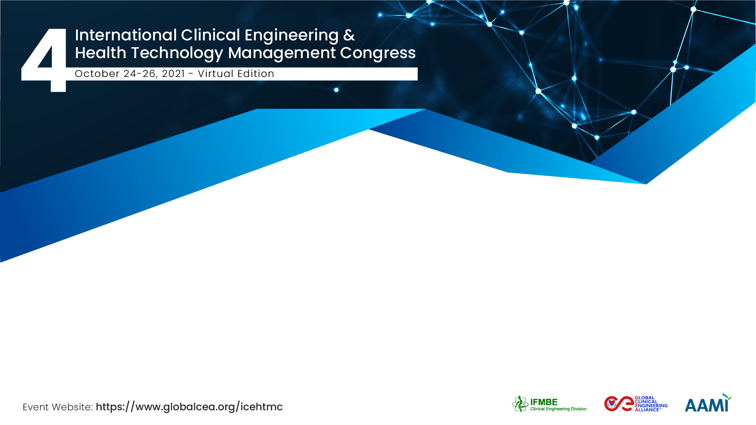
Remote clinical engineering professional training when in-person courses are not feasible
Stefano Bergamasco
MedTech Projects Srl, CED IFMBE, AIIC, GCEA

Slide 2

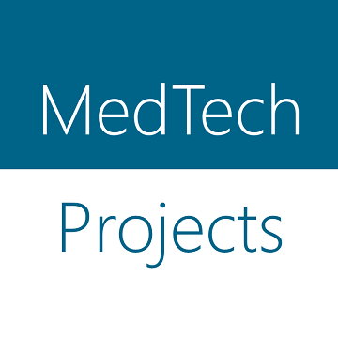

The Team / Workgroup
Stefano Bergamasco – AIIC, MedTech Projects Srl
Roberto Belliato – AIIC, MedTech Projects Srl
Antonella Pianosi – AIIC, ASUR Marche
Ilaria Sirotich – AIIC, MedTech Projects Srl

Slide 3
Description
Training and continuous education are key elements for the professional advancement of clinical engineers. This is increasingly important as new areas of activity emerge and new technologies are available in an evolving regulatory scenario.
One of the most relevant topics in Europe is the new medical device regulation (MDR), that has introduced many relevant changes both for manufacturers and for the final users and managers of technologies inside hospitals. Many workshops and courses have taken place since the first introduction of the MDR in 2017; unfortunately, the Covid-19 outbreak introduced severe limitations to travels and meetings, and many events had to be cancelled or postponed. On the other hand, the pandemic gave the opportunity to learn new online collaborative tools, and the concept of “smart working” is now a reality that proved efficient and cost effective.
This work presents the experience of ASUR Marche, a regional health institution in Italy covering a wide territory with several hospitals and care units, that planned a training course on the new MDR for the network of clinical engineers of the region.

Slide 4
Goals of the project and final users that will benefit
ASUR Marche contacted MedTech Projects, a company specialized in regulatory consultancy, clinical engineering and training, and designed an online course that could achieve the training goals despite the limitations of the current situation.
The 24-hours course spanned over six sessions, delivered every Wednesday morning through Zoom online meetings. The 19 registered participants attended the course from their remote locations in each hospital, and the expert teachers could deliver their lectures from the company offices.

Slide 5
Results
The 24-hours course spanned over six sessions, delivered every Wednesday morning through Zoom online meetings. A dedicated Moodle e-learning platform was setup to provide the training material, additional documentation, the recordings of the online sessions and the learning tests for each session.

Slide 6
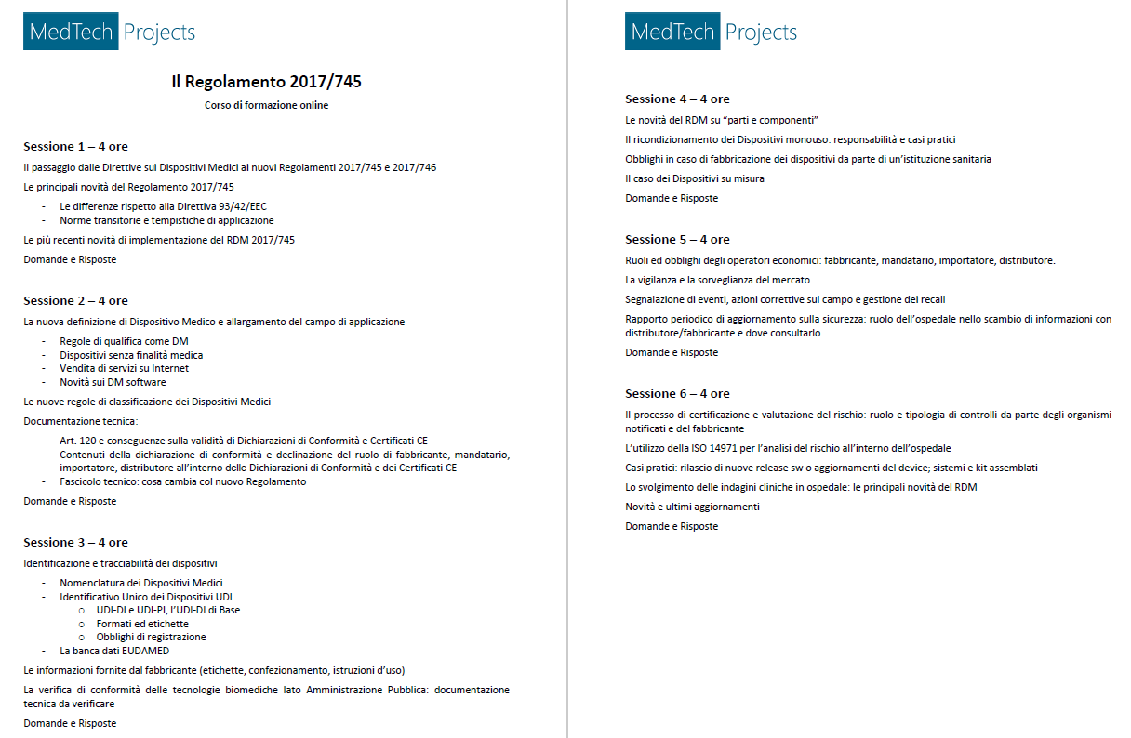
Results
Course program:
6 sessions
One 4 hours session per week (every Wednesday morning)
Time allotted for questions and answers
  At the beginning of each session (on topics of the previous session)
  At the end of each session

Slide 7
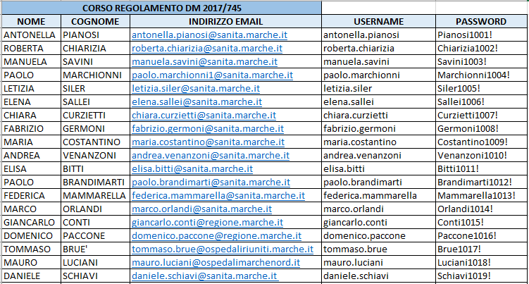
Results
Registered participants:
19 participants
Each participant would connect from his own office
Live streaming of the online sessions (zoom platform)
Dedicated username and password to access the online e-learning platform

Slide 8
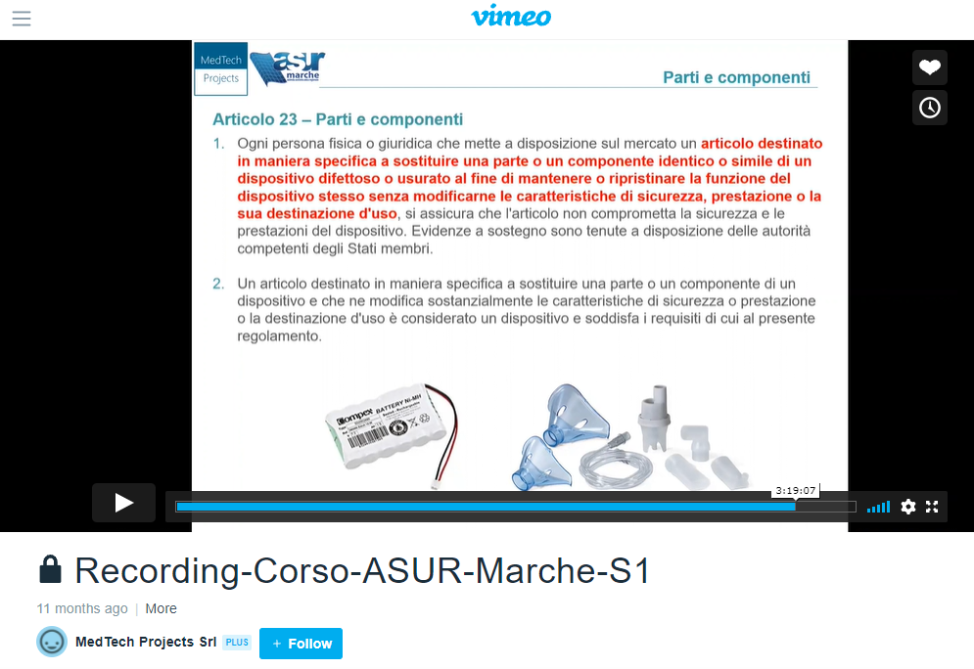
Results
Live sessions are also recorded and stored in a password protected Vimeo account for future review

Slide 9
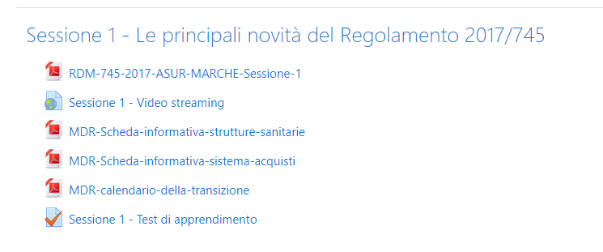
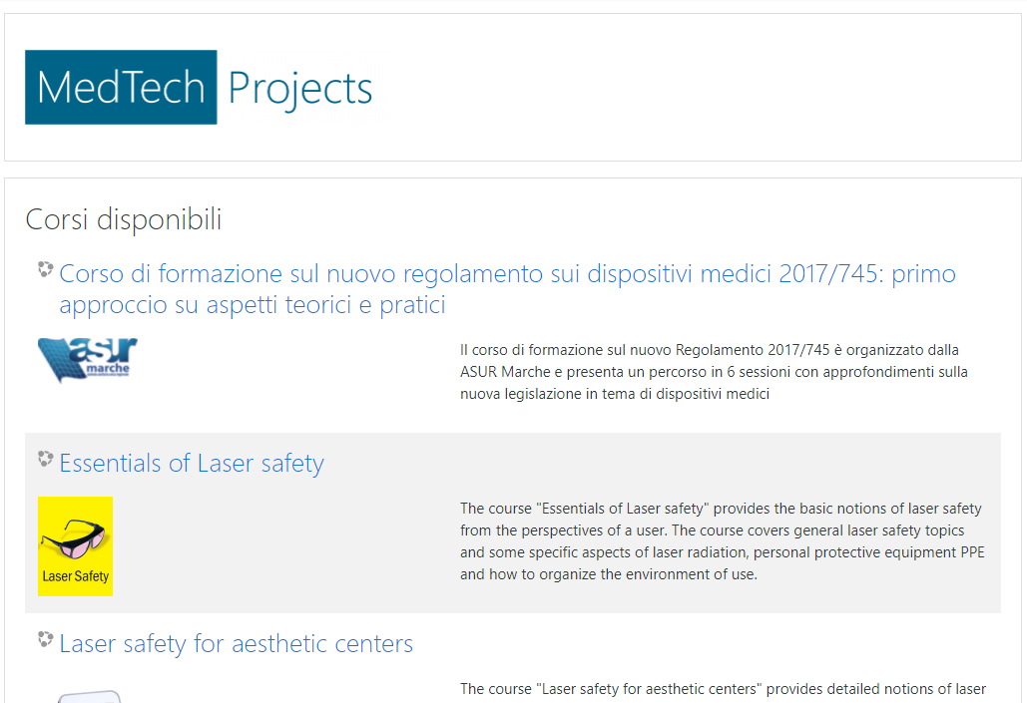
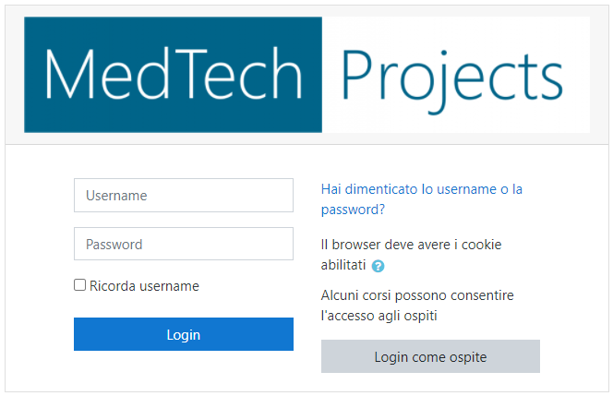
Results
For each session the e-learning platform presents:
Slides of the course
Link to the video recording of the session
Additional learning material
Final test

Slide 10
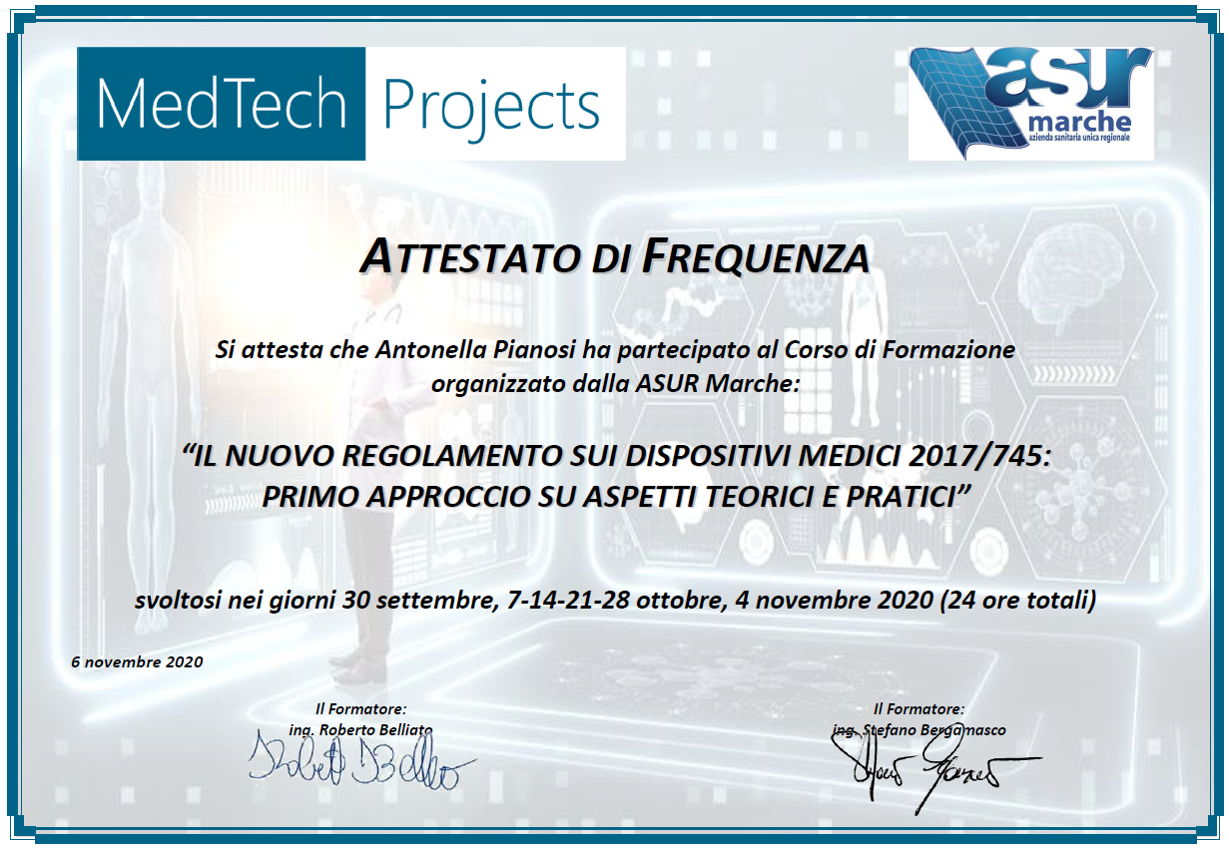
Results
Certificates of attendance delivered to each participant after completion of the final online test

Slide 11
Results
The course proved very effective; all participants could follow the online sessions with minimal disruption to their working routine and no travel and accommodation costs and logistics had to be wasted. The recordings could be listened to again after each session and the e-learning platform has been widely used to download the additional documentation provided and updated as the sessions proceeded. A final questionnaire was submitted to the participants and the questions regarding the quality of the course and the online organization scored 5/5 and 4.9/5 respectively.

Slide 12
Stefano Bergamasco
stefano.bergamasco@medtechprojects.com
MedTech Projects Srl – Italy

