Slide 1
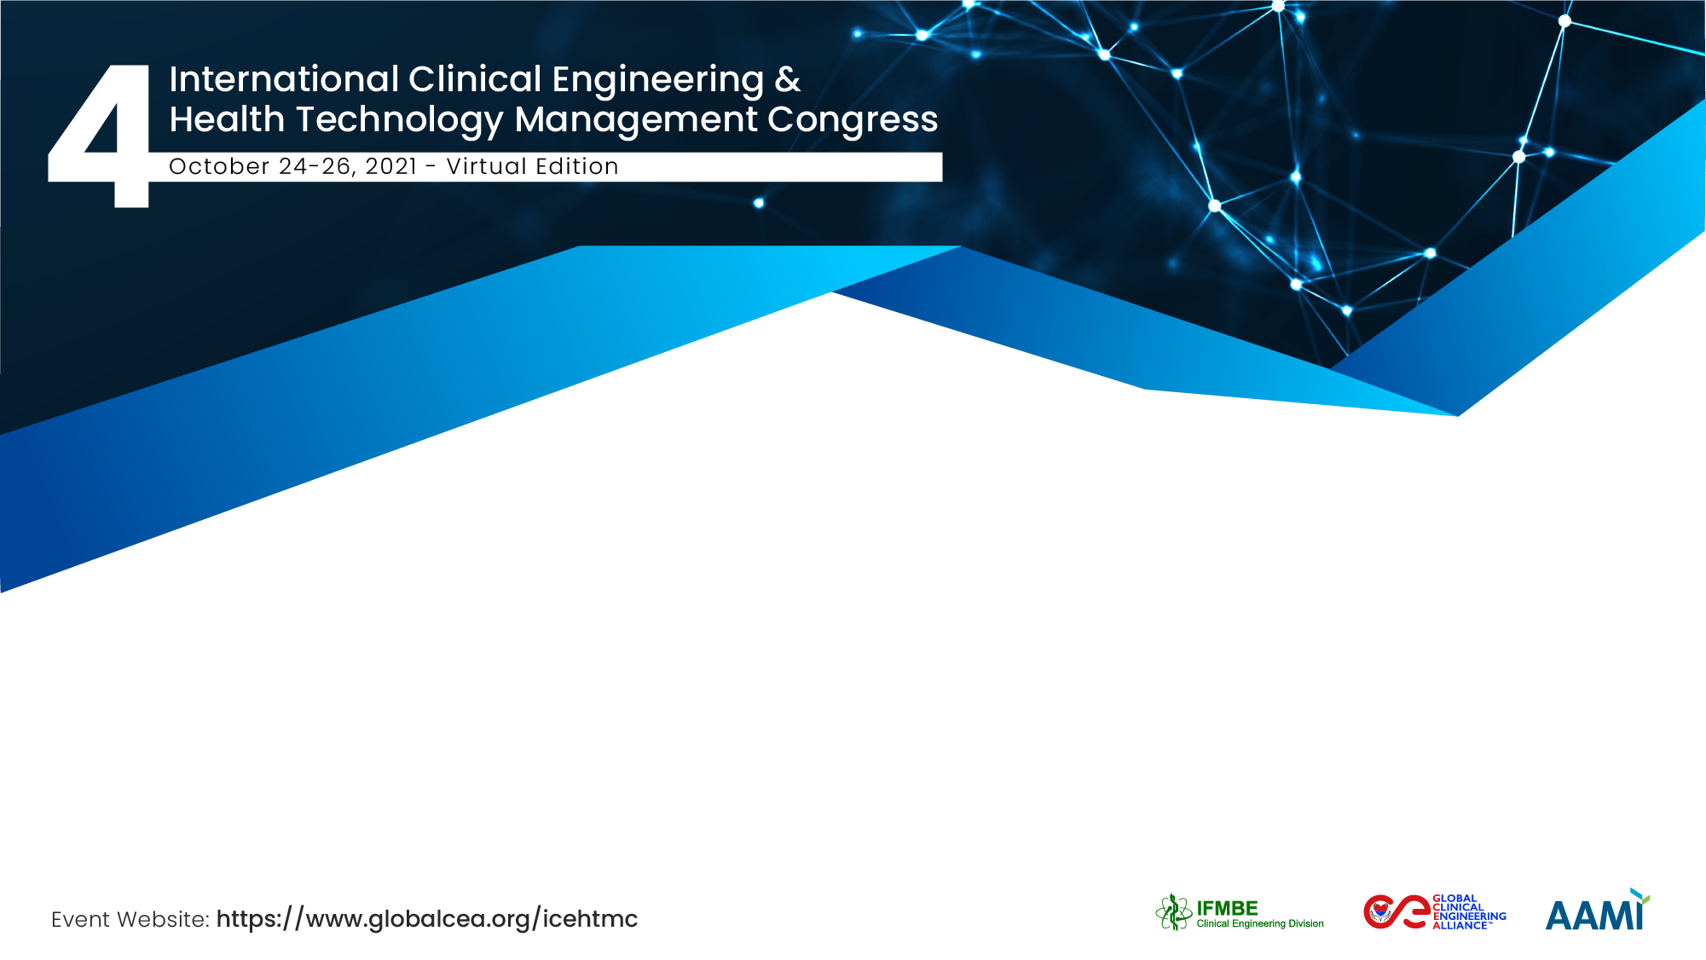
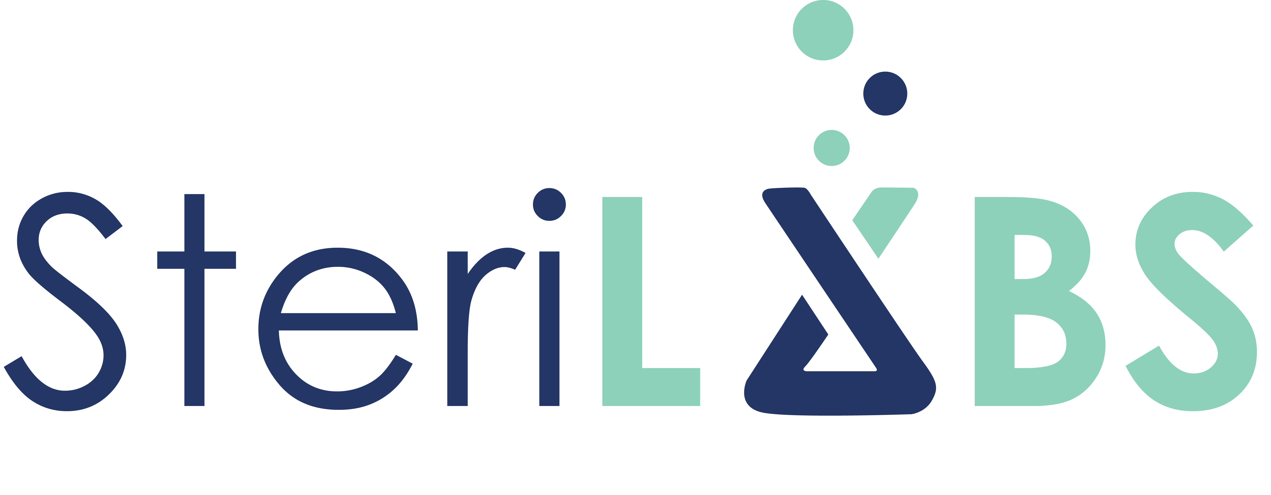

Reprocessing of N95 Respirators in Healthcare Facilities
Dr. Anas Aljabo, PhD
SteriLabs/SteriPro Canada

Slide 2

The Team / Workgroup
Anas Aljabo – SteriLabs/SteriPro
Eva Mueller – McMaster University
Dabeer Abdul-Azeez –McMaster University
Todd Hoare – McMaster University
Arun Jain – SteriLabs/SteriPro
Aljabo A, Mueller E, Abdul-Azeez D, Hoare T, Jain A. Gravity steam reprocessing in healthcare facilities for the reuse of N95 respirators. J Hosp Infect. 2020 Dec;106(4):698-708. doi: 10.1016/j.jhin.2020.09.032. Epub 2020 Oct 2. PMID: 33017616; PMCID: PMC7530561.

Slide 3
Background
The shortage of N95 respirators in hospitals around the world due to COVID19
Respirators are not designed to be used more than once
Due to shortages of N95 respirators their reuse is now being promoted by WHO and CDC
Reprocessing of medical devices is based on the use of validated processes
  to remove soil and contaminants by cleaning
  to inactivate microorganisms by disinfection or sterilization

Slide 4
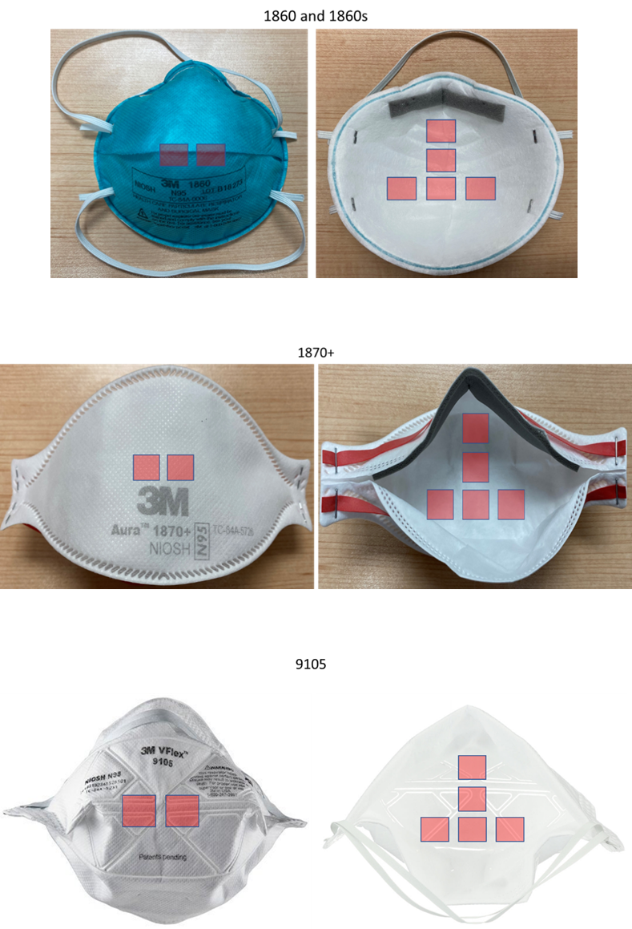
Regulatory requirements for the Reprocessing of N95 respirators
Effective cleaning of masks is not feasible due to their intrinsic filtering fabric structure
Given the pandemic stress on respirator supplies, reprocessing without cleaning is now being accepted as an alternative as long as respirators are returned to their original user
Regulations place reprocessing companies under the same regulations as manufacturers
  Disclosure of material compatibility, filtration performance, respirator fit, and contamination presence
Reduce pathogenic burden with bacterial sporicidal testing ; SAL of 10^-6

Slide 5
N95 respirators reprocessing experiments
Many recent publications do not adhere to standardized testing protocols
In comparing the results from N95 reprocessing experiments ensure testing beyond simple viricidal abilities
Results collected using unregulated laboratory testing standards are useful for rapidly advancing of knowledge
But cannot be promoted or supported by health organizations for clinically proven safety
Experimental reprocessing methods include
  Ultraviolet Irradiation
  Vaporized and Liquid Hydrogen Peroxide
  Dry and Moist Heat

Slide 6
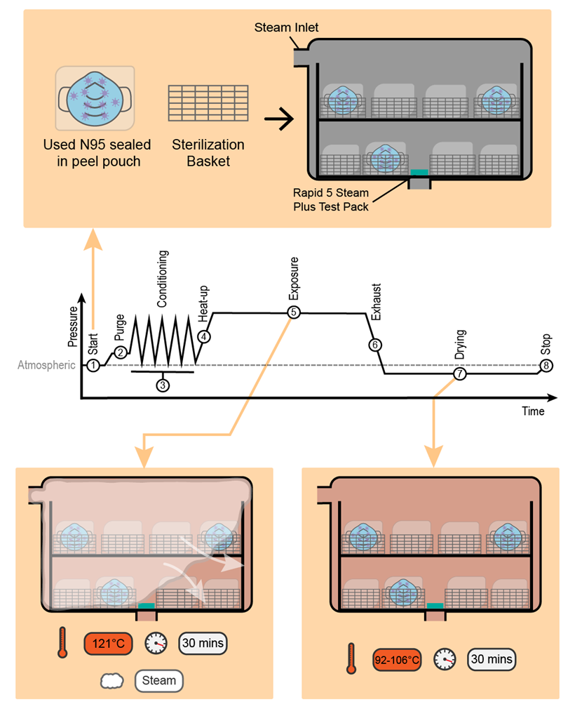
Study design and benefits
3M™ N95 respirators models tested; 1860, 1860s, 1870+, 9105
Packaged surgical instruments used to simulate full reprocessing load
Non-toxic commonly used gravity steam reprocessing method that can be implemented easily in hospitals
121 °C for 30 minutes followed by 30 minutes of drying
The reprocessing cycle was executed at a reduced level of treatment to assess the efficacy of the cycle at half of the exposure time
Geobacillus Stearothermophilus spore suspension demonstrates high resistance to moist heat and represents worst-case scenario
Aljabo A, Mueller E, Abdul-Azeez D, Hoare T, Jain A. Gravity steam reprocessing in healthcare facilities for the reuse of N95 respirators. J Hosp Infect. 2020 Dec;106(4):698-708. doi: 10.1016/j.jhin.2020.09.032.

Slide 7
Microbial inactivation and functionality testing
Process chart for microbiology testing on used N95 respirators
Process chart for functionality testing using used N95 respirators
Aljabo A, Mueller E, Abdul-Azeez D, Hoare T, Jain A. Gravity steam reprocessing in healthcare facilities for the reuse of N95 respirators. J Hosp Infect. 2020 Dec;106(4):698-708. doi: 10.1016/j.jhin.2020.09.032.

Slide 8

Microbial Inactivation
The treated 1860, 1860s and 1870+ respirator models did not show any bacterial growth
9105 respirator model showed bacterial growth in samples #3 and #9
Aljabo A, Mueller E, Abdul-Azeez D, Hoare T, Jain A. Gravity steam reprocessing in healthcare facilities for the reuse of N95 respirators. J Hosp Infect. 2020 Dec;106(4):698-708. doi: 10.1016/j.jhin.2020.09.032.

Slide 9
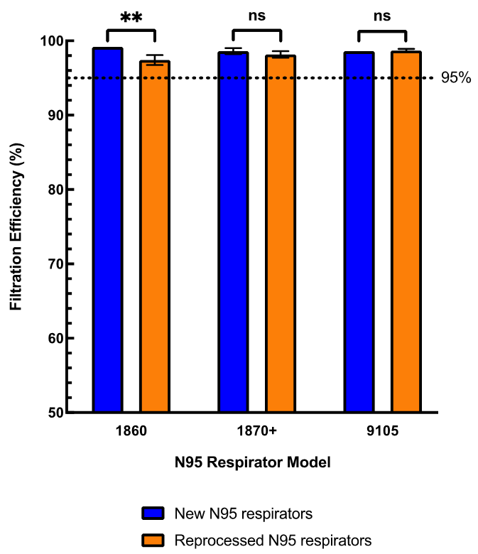
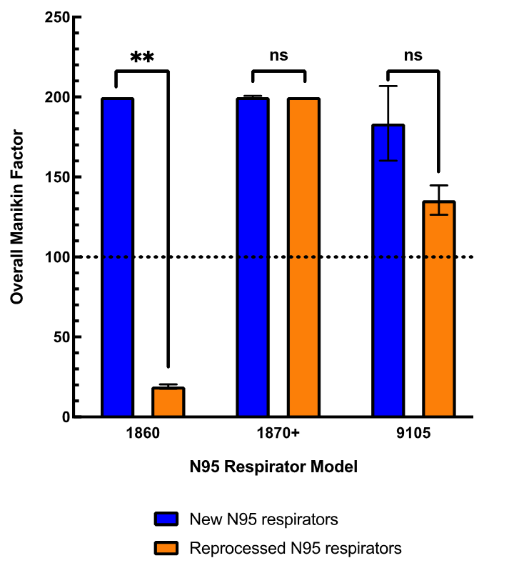
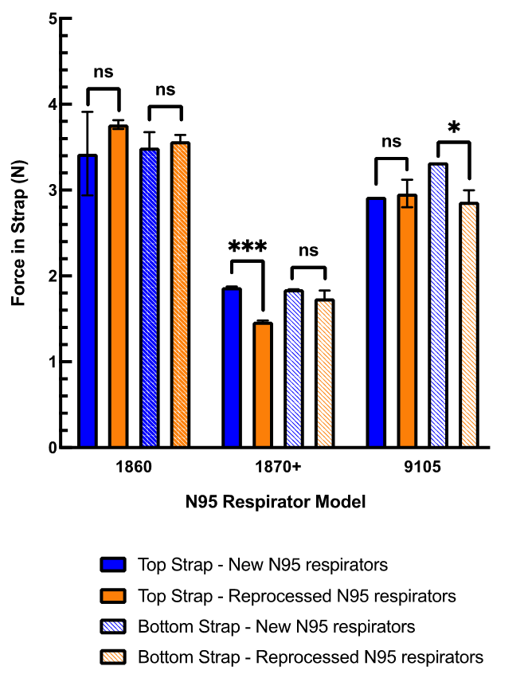
Functionality Testing
95% filtration efficiency
All models → PASS
Fit evaluation
1870+ and 9105 →PASS
1860 → FAIL
Strap Integrity Evaluation
All models → PASS
Aljabo A, Mueller E, Abdul-Azeez D, Hoare T, Jain A. Gravity steam reprocessing in healthcare facilities for the reuse of N95 respirators. J Hosp Infect. 2020 Dec;106(4):698-708. doi: 10.1016/j.jhin.2020.09.032.

Slide 10
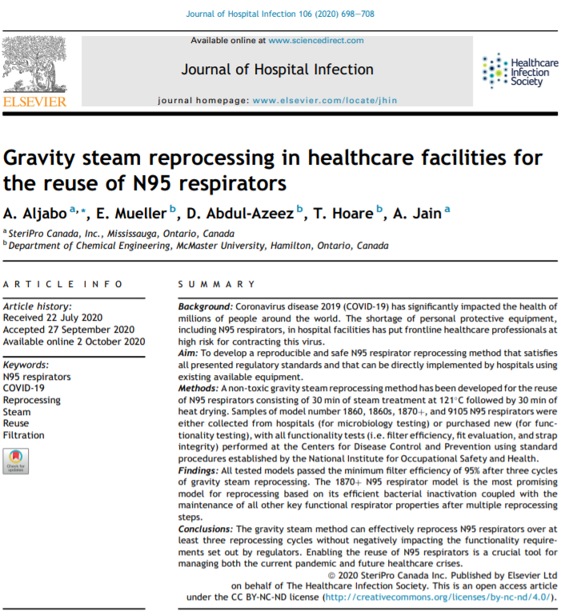
Takeaway Messages
Validation of reprocessing must be performed based on established standards
  AAMI TIR 30 and AAMI TIR 12
Functionality testing is a critical component in the validation of the reprocessing process
Proposed reprocessing processes must be practical utilizing commonly used methods
Reuse of some N95 respirators models (e.g. 1870+) in case of emergency is possible
Aljabo A, Mueller E, Abdul-Azeez D, Hoare T, Jain A. Gravity steam reprocessing in healthcare facilities for the reuse of N95 respirators. J Hosp Infect. 2020 Dec;106(4):698-708. doi: 10.1016/j.jhin.2020.09.032.

Slide 11
Dr. Anas Aljabo, PhD
anas.aljabo@steriprocanada.com
SteriLabs, Canada

