Slide 1
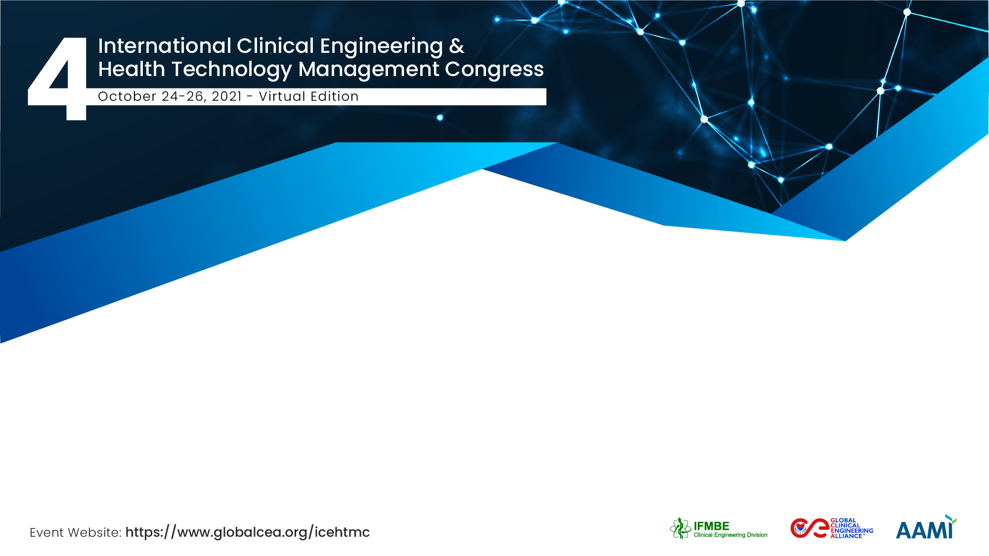
Singapore-Myanmar Partnership
Tan Peck Ha
Biomedical Engineering Society (Singapore)

Slide 2
The Team:
Members of Biomedical Engineering Society (Singapore)
Chua Tji Leng, Capability Group Lead, School of Engineering, Ngee Ann Polytechnic
Kannathal Natarajan, Senior Lecturer, School of Engineering, Ngee Ann Polytechnic
Tan Peck Ha, Senior Lecturer, School of Engineering, Ngee Ann Polytechnic

Slide 3
Myanmar Biomedical Engineering Training
Biomedical Engineering Society (Singapore) partnered with Myanmar’s Ministry of Health in a sustainable, capacity-building programme with the following key features:
hands-on training on hospital-grade equipment
partnership with local engineering experts
validation of practical proficiency by industry practitioners

Slide 4
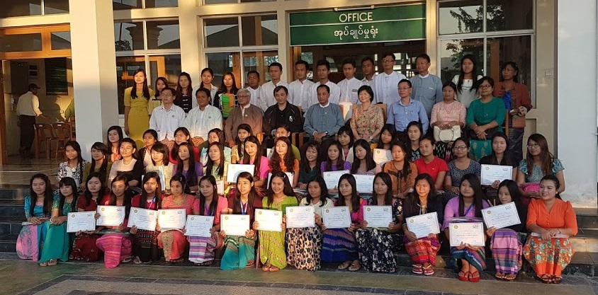
The goal of this partnership was to train a team of engineers to provide guidance on the set-up, equipment requisition and management of future BME departments. Myanmar’s MOH’s plan is that each of the country’s regions and states will have its own team of hospital engineers, of which at least one will be a biomedical engineer.
Myanmar BME Training, Nay Pyi Taw, Myanmar, 19th to 30th December 2016
Notes:
Myanmar has 7 states and 7 regions, with over 1000 hospitals. Ideal team of hospital engineers should consist of 1 BME, 1 civil engineer and 1 maintenance engineer.
2. This picture was taken on 30th December 2016 at the completion of the training of 53 new engineers working with the Myanmar Ministry of Health under the education grant provided by Sea Lion Company Limited, a company incorporated in Myanmar to provide healthcare solutions since 1997. Out of the 53 trainees, 47 were young female engineers. I had the privilege and permission to interview some of them and promised to share their common story. I will return to their story later in this session.

Slide 5
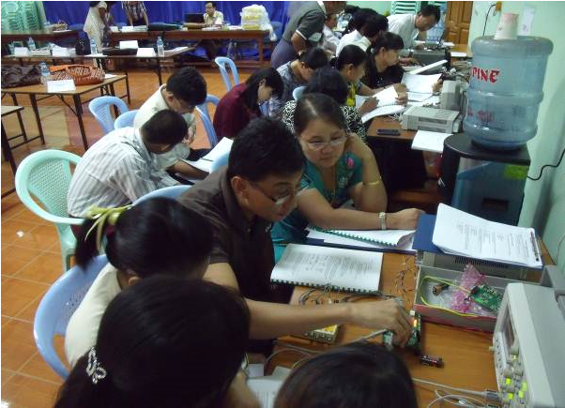
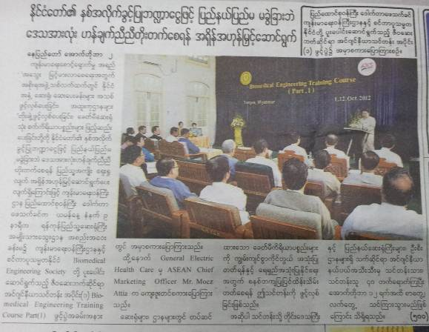
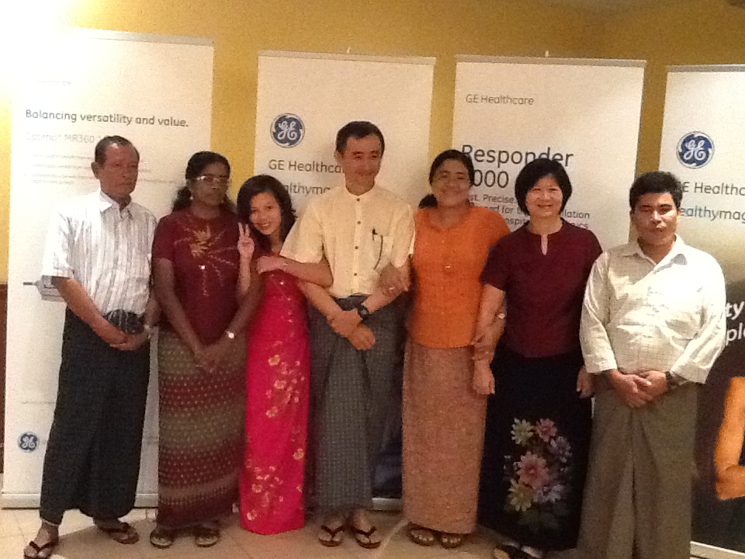
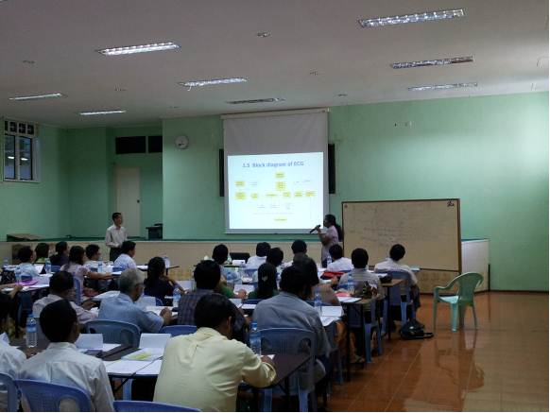
The Training Phases:
1st Training: 1st to 12th October 2012, National Blood Center, Yangon, Myanmar
Trainees: 40 Engineers and Clinicians working with the Myanmar Ministry of Health
Sponsorship: Education grant by GE Healthcare; local hospitality by Sea Lion Co. Ltd.
Format: Lectures on Biomedical & Clinical Engineering concepts; practical sessions on the use, maintenance and safety testing of selected medical equipment.
Notes:
Opening ceremony reported in national newspaper; GOH - National Minister of Health, Dr. Phe Thet Khin
Classroom lecture
Practical sessions
End of training ceremony in national dress

Slide 6
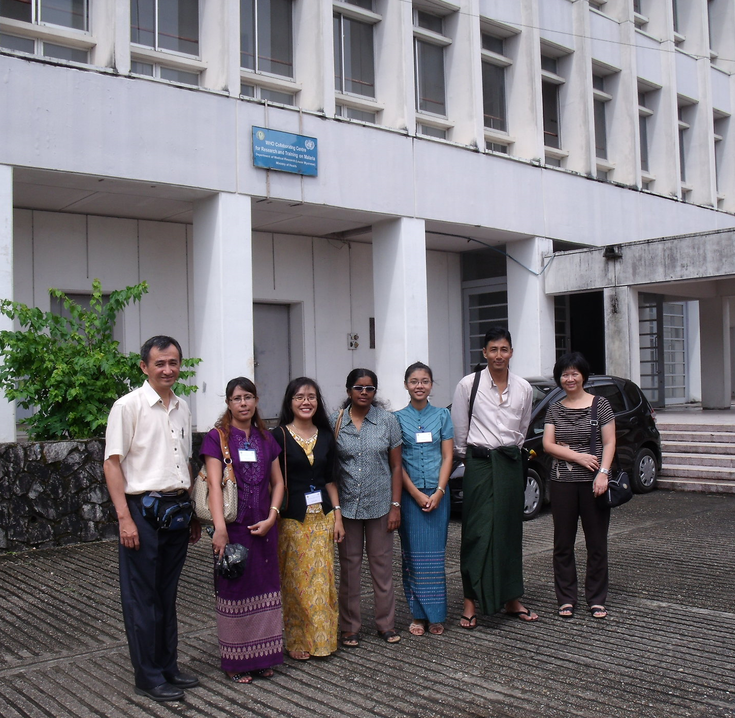
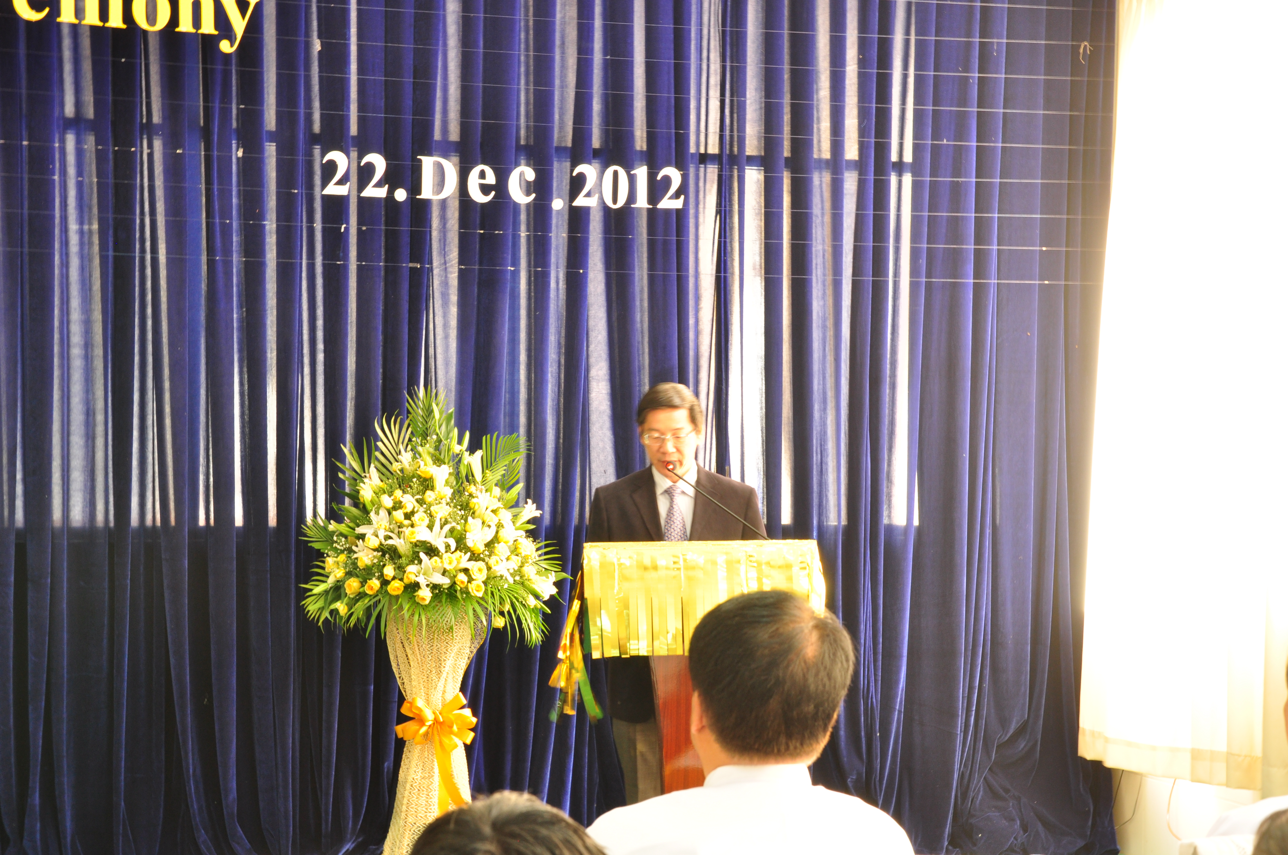
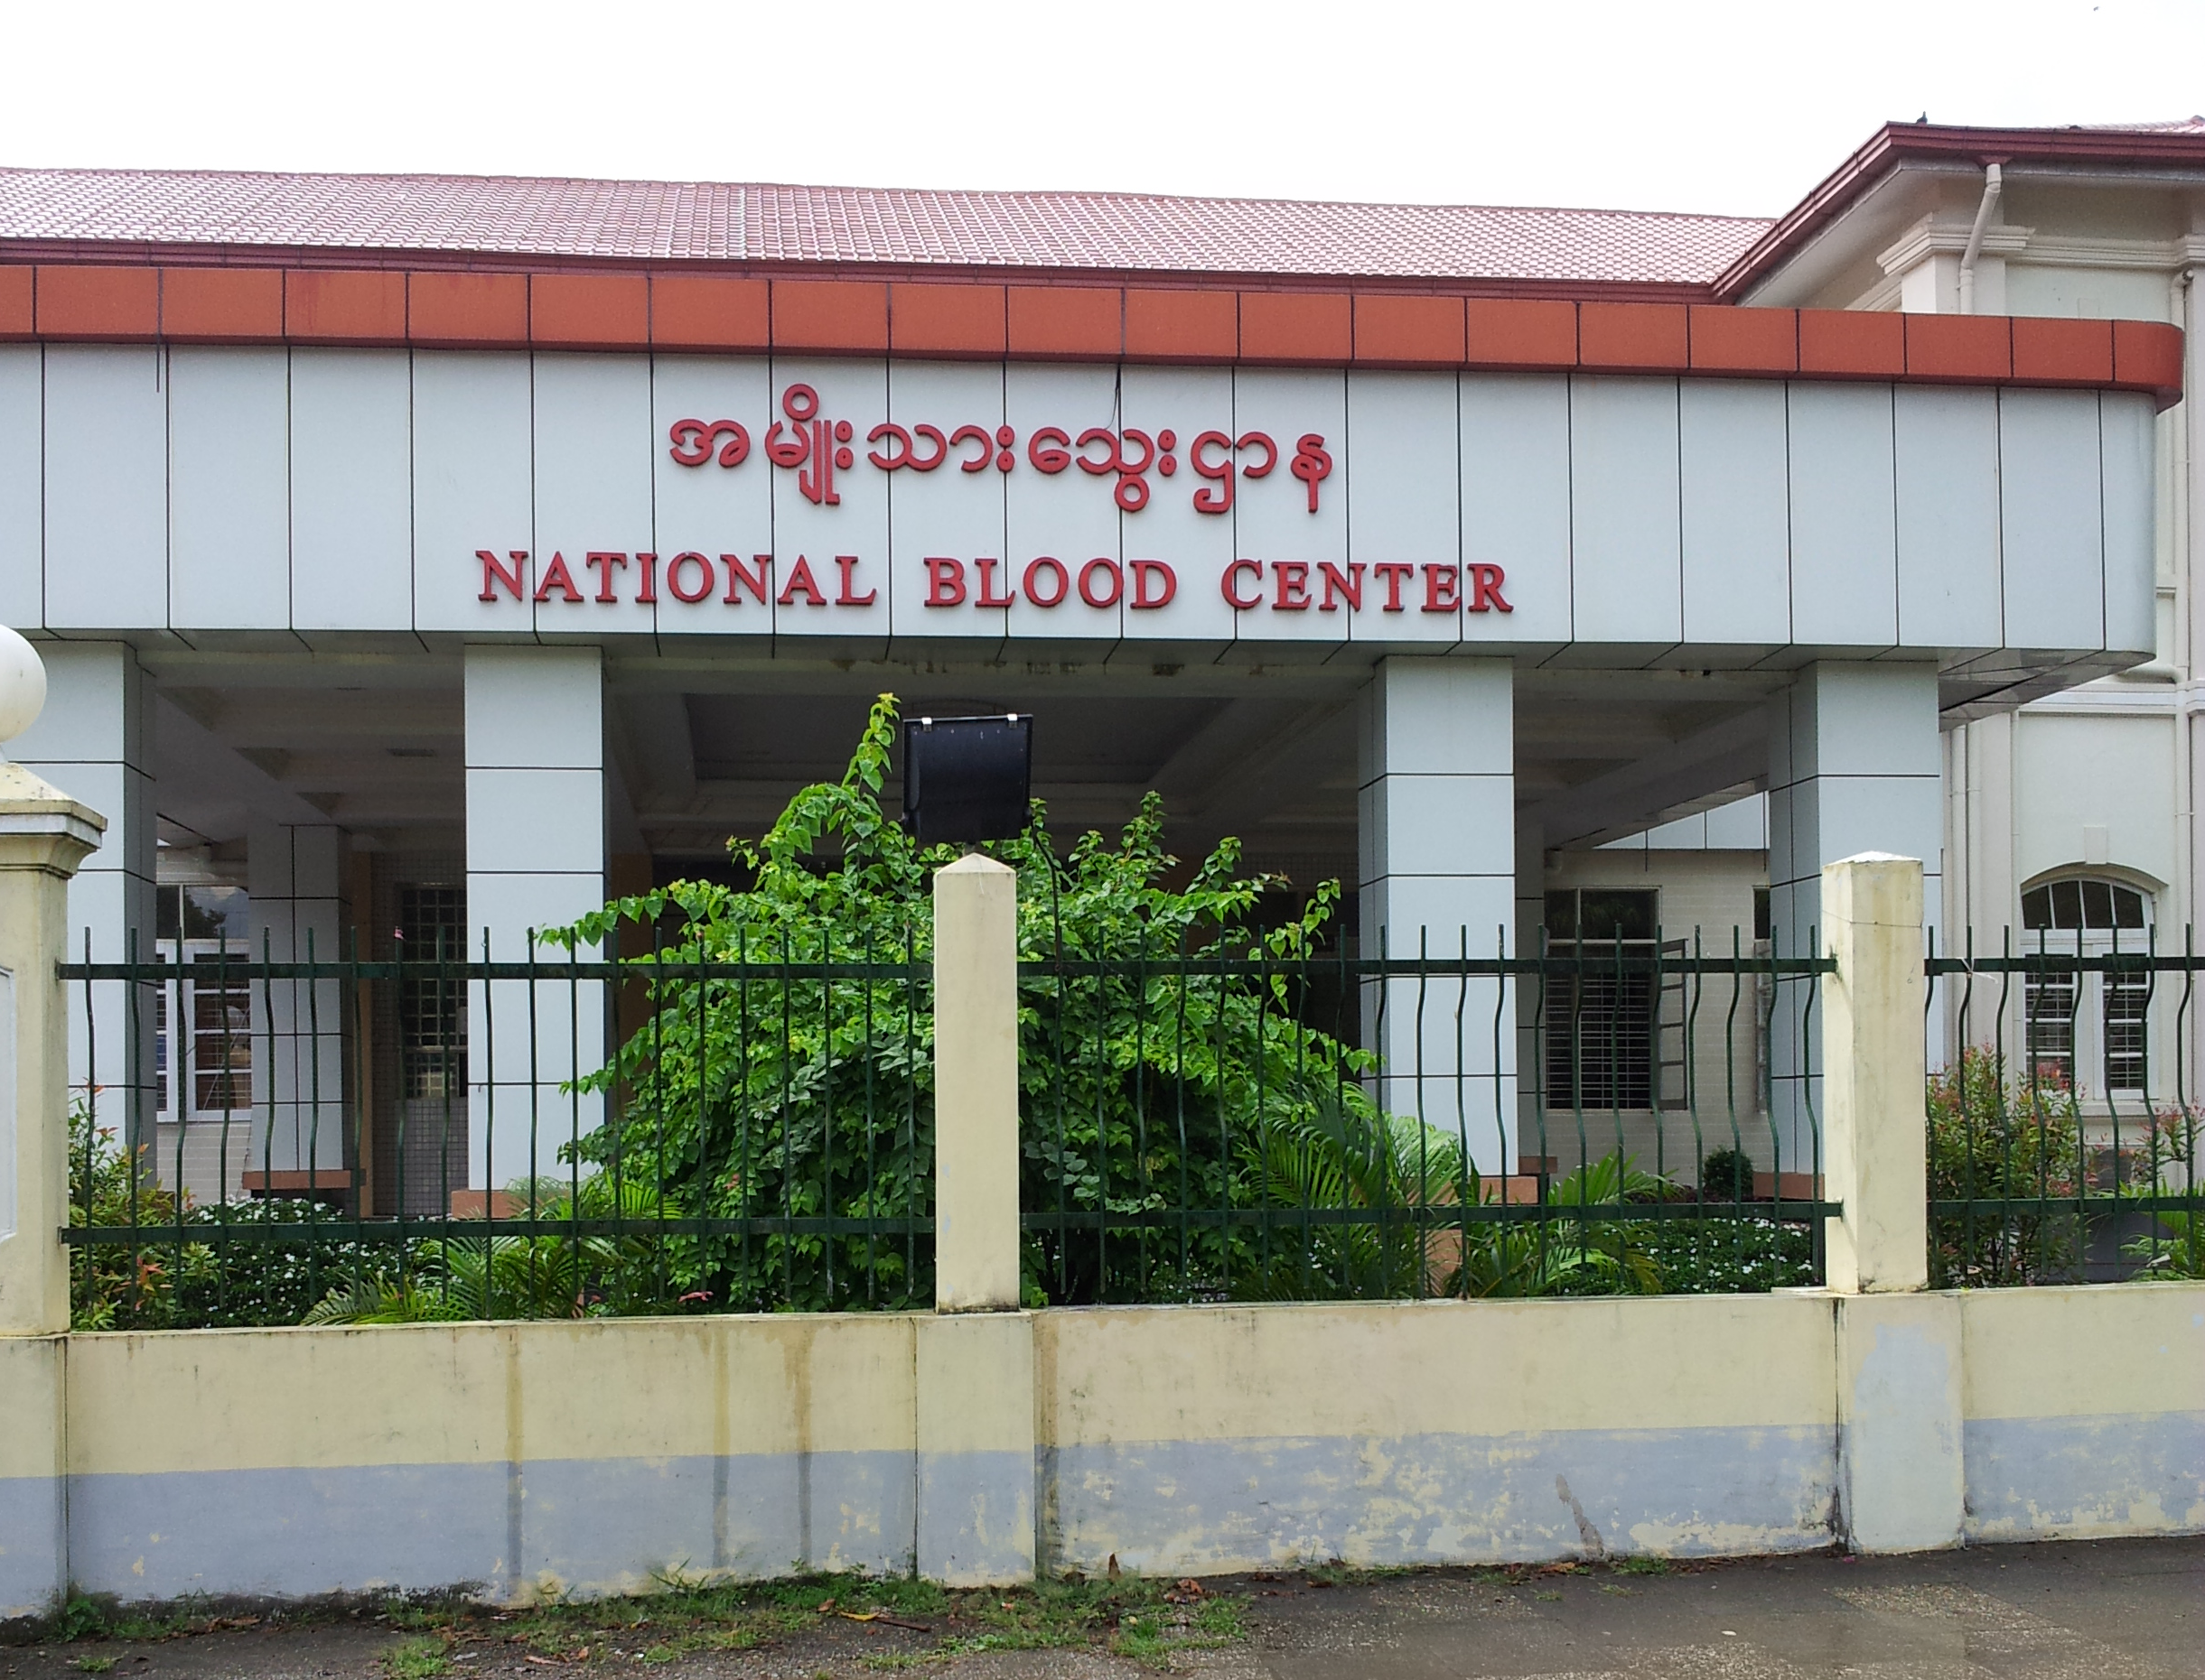
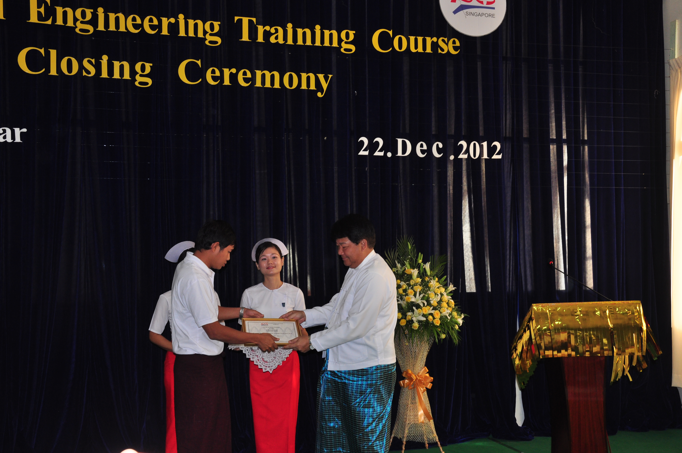
The Training Phases:
2nd Training: 17th to 21st December 2012, National Blood Center, Yangon, Myanmar
Trainees: 40 Engineers and Clinicians working with the Myanmar Ministry of Health (same participants as 1st Training)
Sponsorship: Education grant by GE Healthcare; local hospitality by Sea Lion Co. Ltd.
Format: Lectures on advanced Biomedical & Clinical Engineering concepts; practical sessions include the design of equipment management plans and facility visits to identify areas of good practice and/or improvement.
Notes:
Closing Ceremony – certificates awarded by the National Minister of Health, Dr. Phe Thet Khin
Closing Ceremony – Prof Toh Siew Lok spoke on behalf BES(S)
Training Centre for both 1st and 2nd training sessions.
Facility visits included a trip to the WHO Collaborating Centre for Research and Training on Malaria in Yangon

Slide 7
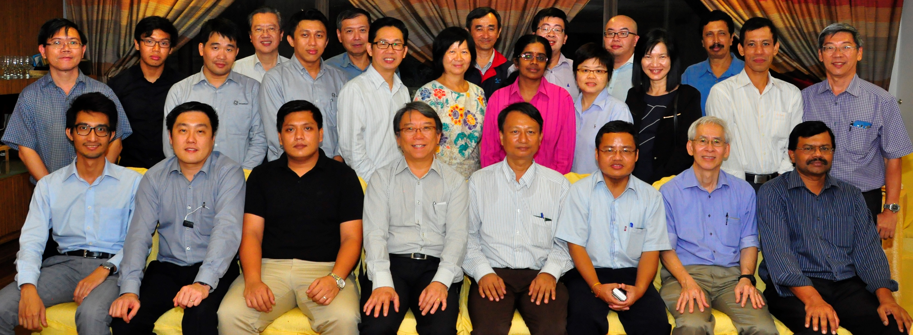
The Training Phases:
3rd Training: 1st to 30th September 2014, Singapore
Trainees: 3 Engineers working with the Myanmar MOH (participants from the 2012)
Sponsorship: Education grant by GE Healthcare; local hospitality by Sea Lion (Singapore office) & BES(S).
Format:
Each trainee was attached to a different Singapore hospital to learn through observation and immersion in the hospital’s environment.
Trainees were rotated through functional units and participating hospitals.
BES’s members facilitated and monitored their progress.
Notes:
Dinner meeting with BES members, participating hospital trainers, and Sea Lion’s Singapore director.

Slide 8
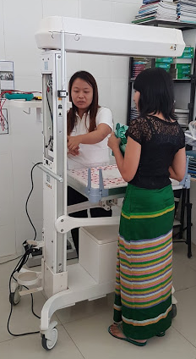
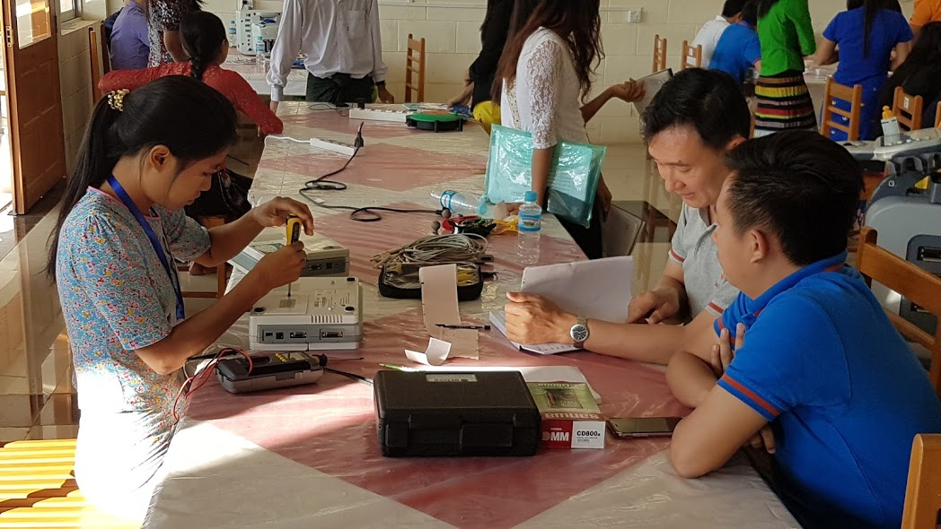
The Training Phases:
4th Training: 19th to 30th December 2016, Retired Service Personnel's Hospital, Nay Pyi Taw, Myanmar
Trainees: 53 newly recruited engineers working with the Myanmar Ministry of Health
Sponsorship: Education grant by Sea Lion Co. Ltd.
Format: Lectures on Biomedical & Clinical Engineering concepts; practical sessions in the use, maintenance and safety testing of selected medical equipment; facility visits; individual oral, written and practical assessments.
Notes:
1. Practical assessment
2. Practice on actual hospital equipment
3. Remember their common story? These 47 lovely ladies studied engineering because the engineering education was technically free. Technical education was almost purely theoretical – we had to teach them the use of very basic equipment including screwdrivers and pliers. Families sent sons to private colleges/universities as these offered much better training and employment prospects. But not the girls. These young ladies were expected to travel all over the country to service medical equipment, often requiring long overnight bus rides from Yangon or Nay Pyi Taw to difficult to access village hospitals and clinics.

Slide 9
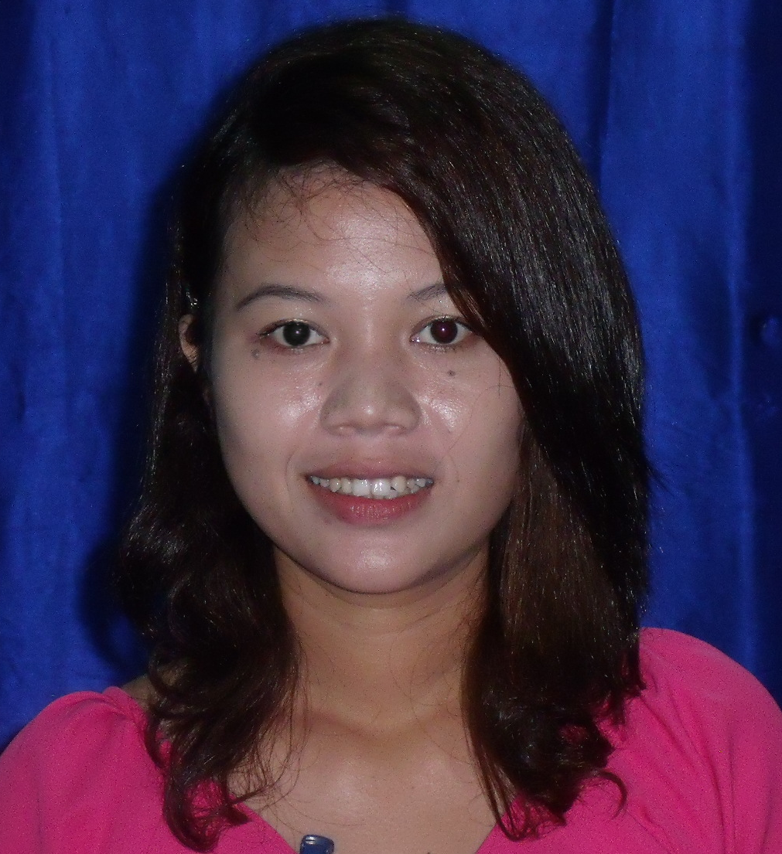
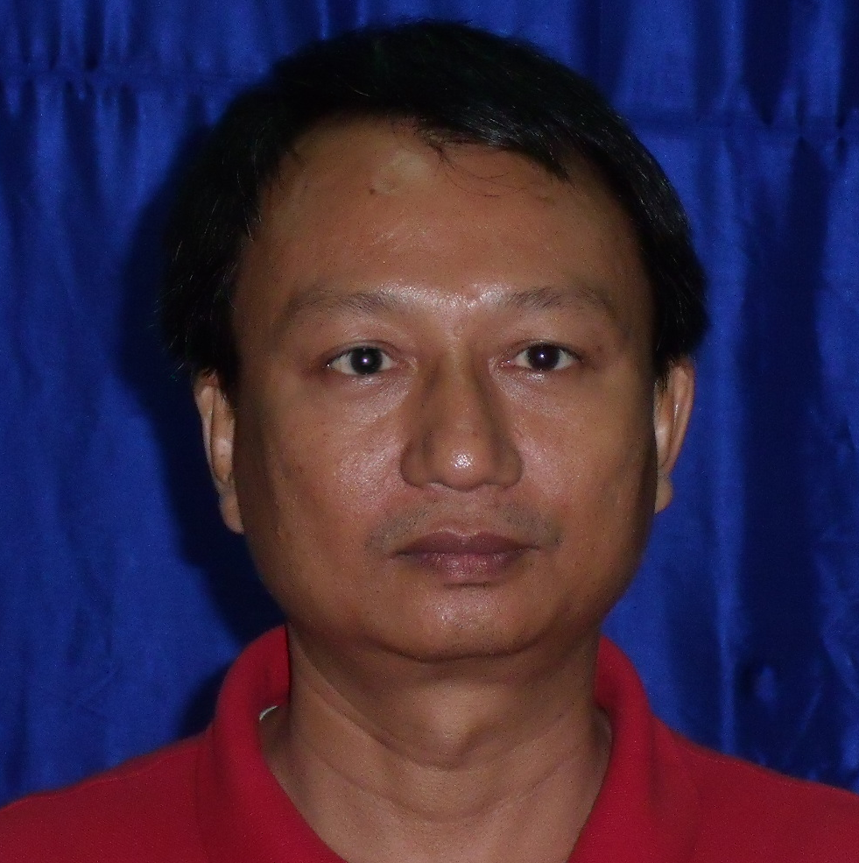
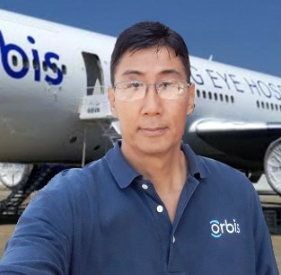
Success Stories:
Setting Up of BME Training Centre & Workshop in Nay Pyi Taw
This took place in September 2016 after a study visit by BES members to plan the December 2016 Training. The main engineer in charge of this project was a female participant from the 2012 training.
Co-Trainer for the December 2016 Training
As the 53 new engineers were from diverse engineering backgrounds, one of the participants from the 2012 & 2014 trainings undertook the task of training these recruits in basic physiology one week prior to the start of the BME/CE training by BES(S). This local volunteer also conducted extra classes (in Burmese) in the evenings to help the trainees cope with the BME/CE crash course.
International Opportunity
A participant from the 2012 training was offered the job of managing the medical equipment on board Orbis’ Flying Eye Hospital shortly after completing the 2012 training. His career is on a new trajectory.
Notes:
We are so pleased with the recognition of women in BME in Myanmar!
This engineer was heading the BME department in a Yangon Hospital by 2016. However, he took part in the demonstration against military coup this year and had since lost his MOH job.
I can still remember vetting through his initial equipment management plan proposal for the FEH. He will soon be appearing in a BBC article through IFMBE’s initiative.

Slide 10
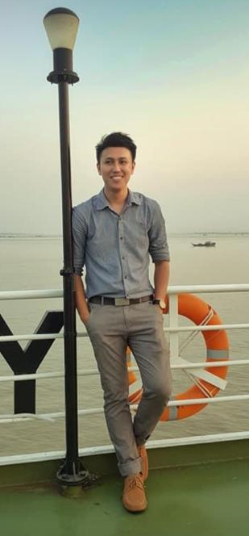
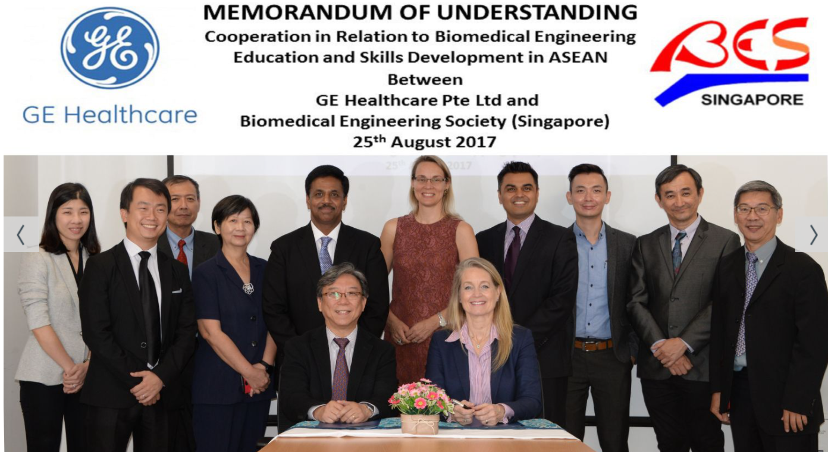
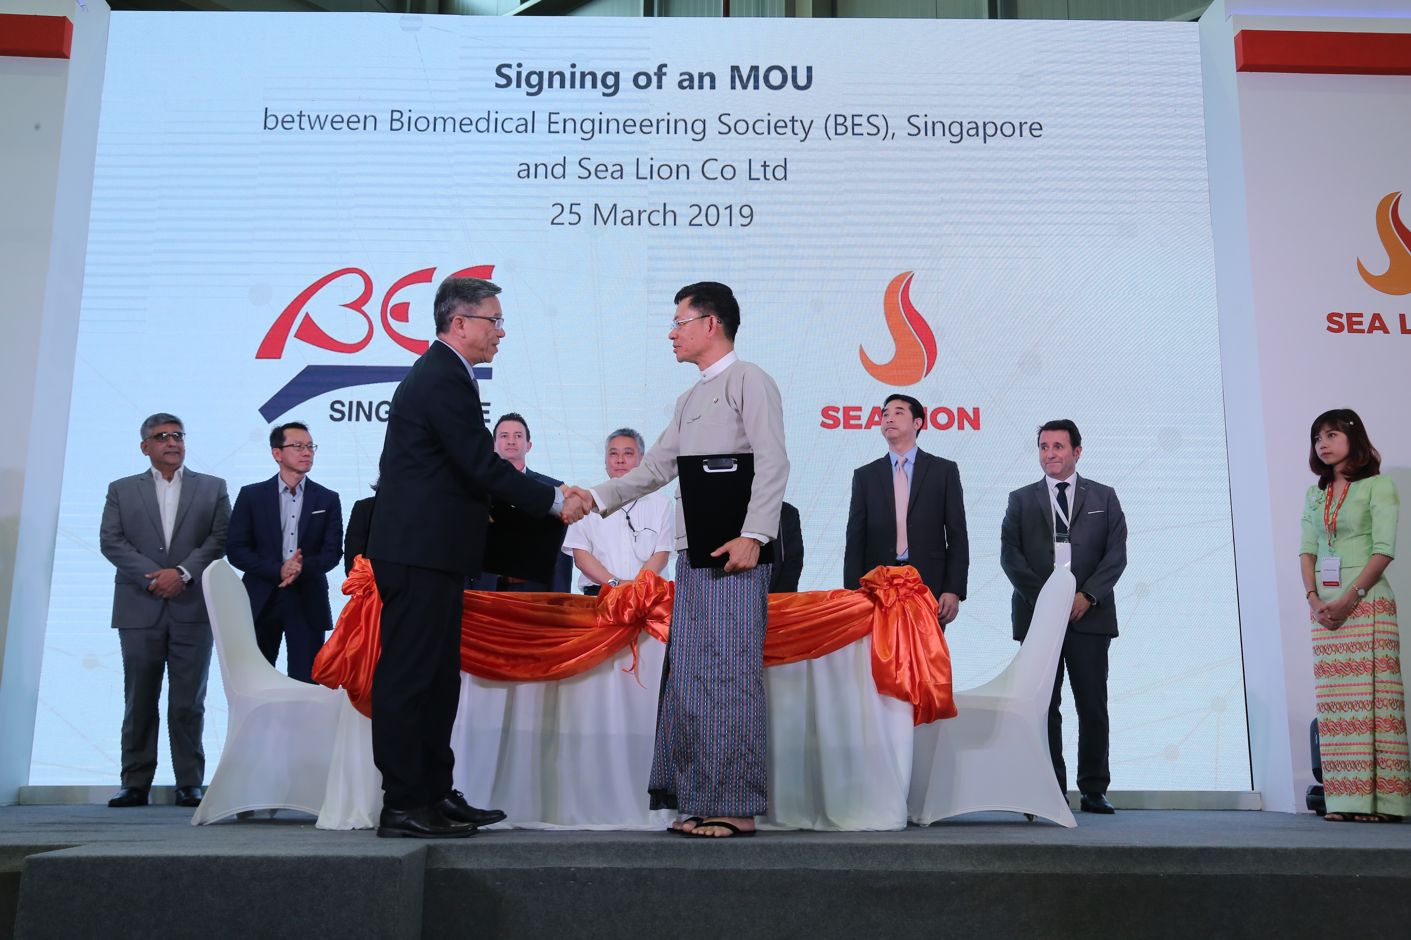
Acknowledgements:
GE Healthcare for introducing BES(S) as a training partner for Myanmar’s MOH.
Sea Lion Co. Ltd. for facilitating and supporting the training programmes since 2012. In March 2019, BES signed an MOU with Sea Lion Co. Ltd to continue this successful partnership in training and technology transfer.
Engineers of Sea Lion Co. Ltd who were instrumental to the successful training and assessment of the MOH engineers.

Slide 11
Tan Peck Ha
TAN_Peck_Ha@np.edu.sg
Biomedical Engineering Society (S), Singapore
Ngee Ann Polytechnic, Singapore
Notes:
This is my contact should you want to find out more about the details of the different phases of training.

Slide 12
