Slide 1

Supplying genuine devices in the context of the Covid-19 pandemic: fake certifications between scam and ignorance
Stefano Bergamasco
MedTech Projects Srl, CED IFMBE, AIIC, GCEA

Slide 2


The Team / Workgroup
Stefano Bergamasco – AIIC, MedTech Projects Srl
Roberto Belliato – AIIC, MedTech Projects Srl
Ilaria Sirotich – AIIC, MedTech Projects Srl

Slide 3
Description
The global health emergency determined by the Covid-19 pandemic put huge pressure on healthcare providers worldwide. The demand for some key medical technologies (oxygen equipment, intensive care ventilators, diagnostic tests, etc.) and personal protective equipment (face masks, face shields, gloves) has been huge. Due to several factors (peak of utilization, requests also from the general public, lack of local production in most western countries), the provision of these technologies has been very difficult and led to speculations and questionable quality levels of the items supplied.
This work highlights the evidence collected during the peak of the Covid-19 pandemic in 2020 regarding the questionable certifications and quality of medical technologies and personal protective equipment available across Europe.

Slide 4
Goals of the project and final users that will benefit
The documents collected (CE certificates, database registrations) have been analysed to check whether they were genuine or fake. We checked the NANDO database (New Approach Notified and Designated Organizations - Information System) to verify if the organization that issued a Certificate is registered to do so, and we used the online verification tools of the designated organizations to check the documents. We also scrutinized the contents of these certificates to identify the hints that they may be fake or incorrect (unusual titles, strange statements, wrong signatures, improper markings, etc.)
With this work we tried to highlight the situation and to provide evidence to the final users of these necessary devices to increase safety and quality of care and prevention.

Slide 5
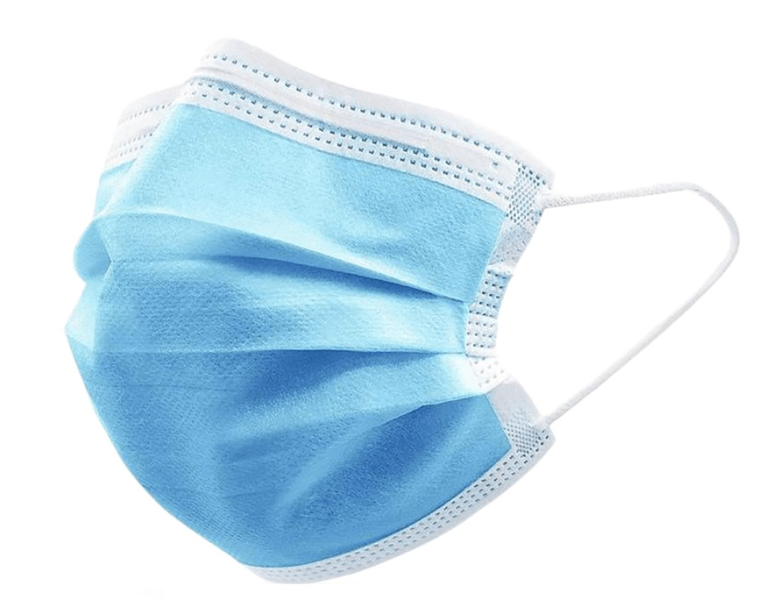
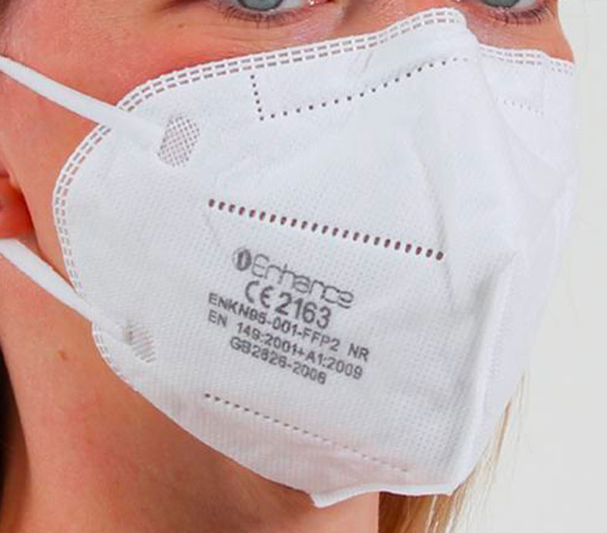
Results (quick notes on the European regulatory framework for face masks)
YES Declaration of Conformity (from the manufacturer)
NO EU Certificate (from Notified Body)
Class I
Medical Devices
Regulation (EU) 2017/745
YES Declaration of Conformity (from the manufacturer)
YES EU Certificate (from Notified Body)
Class IIa, IIb, III
YES Declaration of Conformity (from the manufacturer)
NO EU Certificate (from Notified Body)
Category I
Personal Protective Equipment
Regulation (EU) 2016/425
Category II, III
YES Declaration of Conformity (from the manufacturer)
YES EU Certificate (from Notified Body)

Slide 6
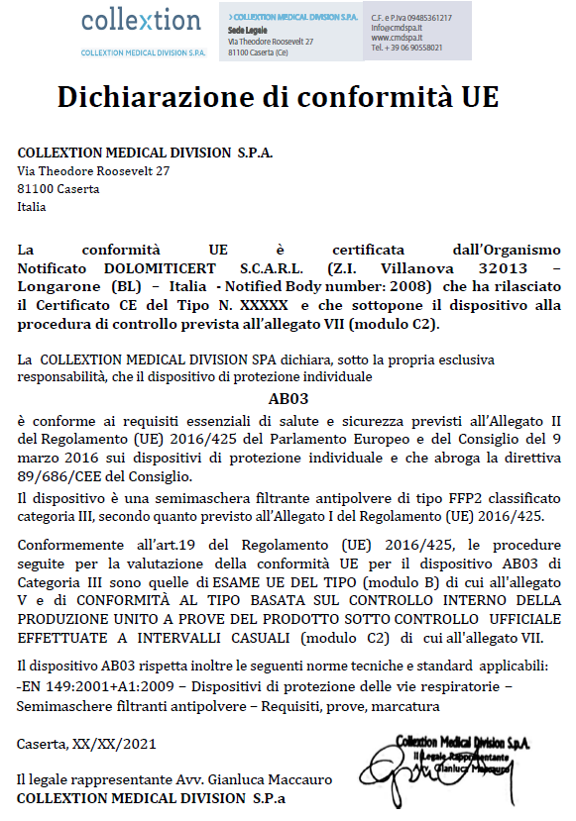
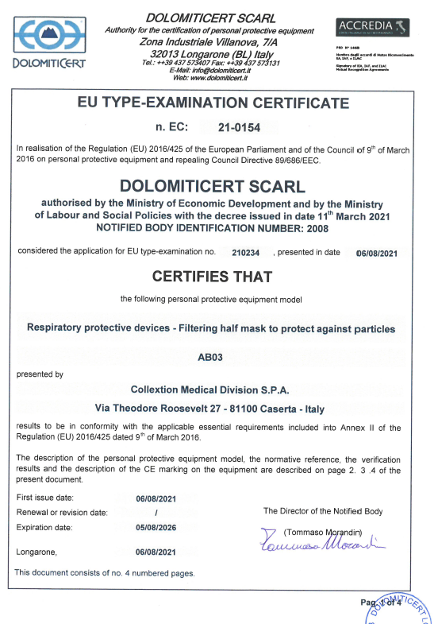
Results
Example of genuine documents for PPE Face Mask
Declaration of Conformity
Proper contents according to Reg. 2016/425
Signed by the manufacturer
EU Certificate
Signed by the Notified Body
Notified Body listed in NANDO and approved for PPE Face Masks

Slide 7
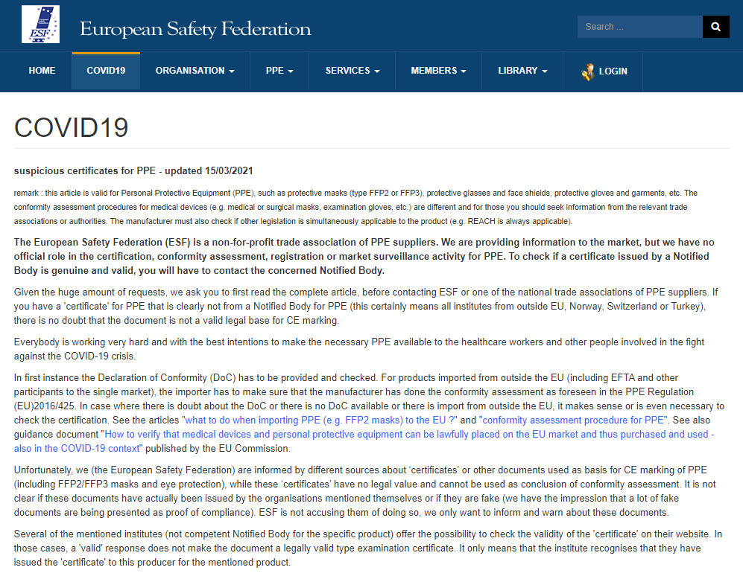
Results
Website of the European Safety Federation with a huge list of fake or suspicious certificates for PPE
https://www.eu-esf.org/covid-19/4513-covid-19-suspicious-certificates-for-ppe

Slide 8
Results
Different situations were detected:
certificates on letterhead (or using their logo and/or name) of institutes based in Europe that are not a notified body competent for PPE mentioned in the document or the documents are fake
falsified certificates using the name, logo and/or layout Notified Bodies for PPE. These are not issued by themselves, so they are a victim of fraude and can not be blamed for this abuse
certificates on letterhead (or using their logo and/or name) of institutes based outside Europe (India, Canada, China, …). In any case, a certificate issued by an institute outside Europe is not a legally valid type examination certificate as these can only be issued by a Notified Body with the type of PPE concerned in their scope. So the 'certificates' by such organisations are no legal basis for CE marking nor for placing the PPE on the EU market
We have the impression that manufacturers outside the EU (and probably even ‘newcomers’ and importers in the EU) are not entirely familiar with the EU Legislation on PPE and thus believe that by paying the ‘certificate’ from such an organisation, they are fully in compliance with the EU legislation. And most likely, also on the side of the customers (including health authorities), the knowledge about the exact requirements of the EU legislation is lacking and thus they judge those documents as accurate.

Slide 9
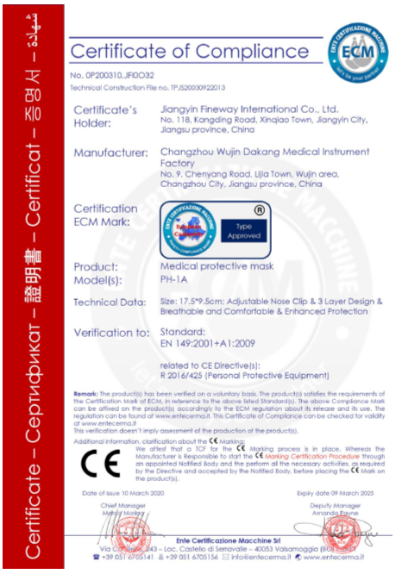
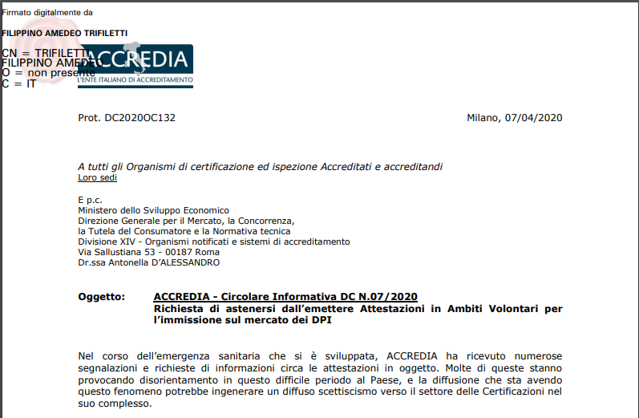
Results
Many incorrect documents we have detected were “certificates of compliance” that are not a Declaration of Conformity and are not a EU Certificate.
These documents are issued to manufacturers “on voluntary basis” by entities that are not a Notified Body for PPEs
They are not “fake” but are useless from the regulatory standpoint
Many manufacturers or importers paid a lot of money to get these useless “certificates” and believed they were sufficient for placing these PPEs on the European market
Accredia, the Italian national accreditation agency, published a letter to discourage certification bodies from releasing this kind of “certficates”

Slide 10
Results
A wide compendium of fake or wrong certificates has been collected and categorized. Evidence was clear that many economic operators entered this specialized market without proper knowledge of the field; in some cases they seemed to have knowingly forged the required certifications, but in some instances they appeared to have acted in good faith and were tricked by unscrupulous suppliers or consultants. This also resulted in huge shipments being seized by the local authorities and several legal litigations have emerged between suppliers and their customers.

Slide 11
Stefano Bergamasco
stefano.bergamasco@medtechprojects.com
MedTech Projects Srl – Italy

