Slide 1
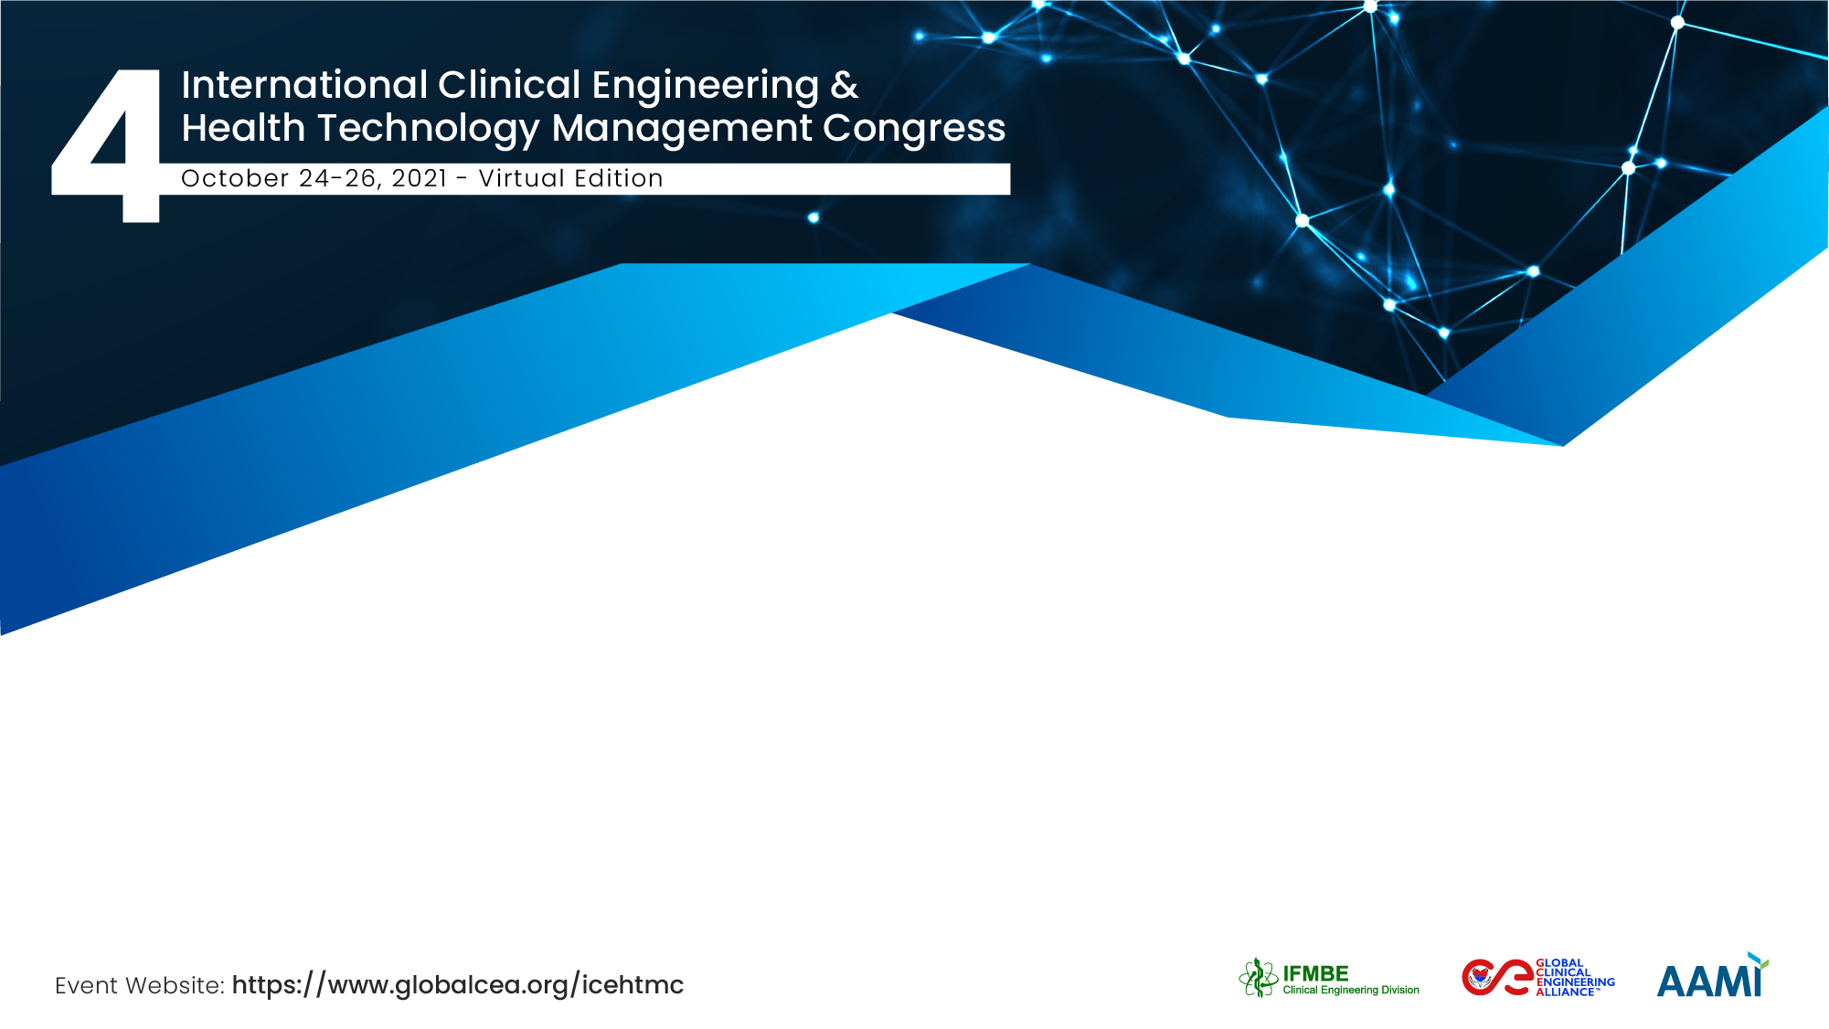

Technical support for medical device management in Vietnam during the COVID19 pandemic
Tatsunori Ogawa
Department of Clinical Engineering,
National Center for Global Health and Medicine, Japan
Notes:
Hello everyone. I am Tatsunori Ogawa. I am a clinical engineer from the National Center for Global Health and Medicine (NCGM) in Tokyo, Japan. The main duties of clinical engineers in Japan are to operate life support systems as well as maintain and manage medical devices.
Today, I would like to report on our efforts to provide technical support for medical device management to Vietnam during the COVID 19 pandemic.

Slide 2
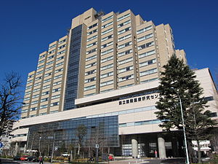
The Team / Workgroup
National Center for Global Health and Medicine, Tokyo
Department of Clinical Engineering
Risa Narita, Kumi Inaba, Ayano Yokota, Yuiko Kawakami, Kent Torita, Takashi Fukaya, Shigeru Hosaka
Bureau of International Health Cooperation
Masahiko Doi, Chieko Matsubara, Noriko Fujita
Department of Medical Engineering, Teikyo University Hospital, Tokyo
Yoshitaka Kawasaki, Satoshi Watanabe, Koji Miyasaka
(Cooperative partners)
NIHON STERY Co., Ltd., a subsidiary of H.U. Group Holdings, Inc., Tokyo Hideaki Nakauchi
NIHON KOHDEN CORPORATION, Tokyo Hironori Iwaizumi, Hiroaki Motokawa
TAISHO BIOMED INSTRUMENTS Co., Ltd., Osaka Naoya Kato
Dräger Medical Japan Ltd., Tokyo Kanako Takeuchi
Notes:
We worked together with the Department of Clinical Engineering and the Bureau of International Health Cooperation of the National Center for Global Health and Medicine, as well as the Department of Medical Engineering at Teikyo University Hospital.
The Team consisted of a total of 14 people including not only clinical engineers, but also a wide variety of experts such as doctors and nurses.
There were also four companies who supported our work.

Slide 3
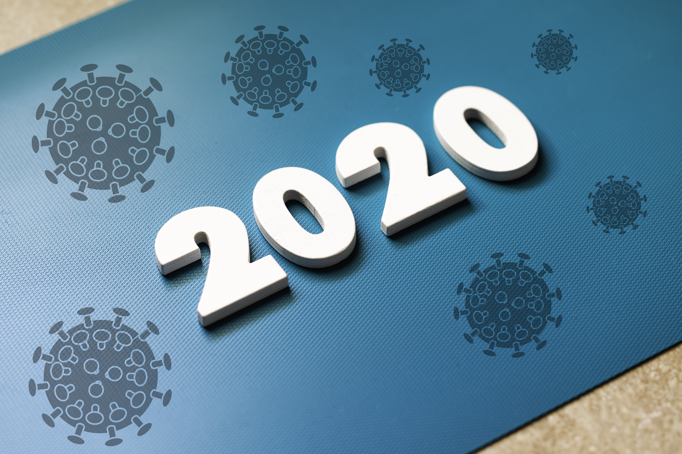


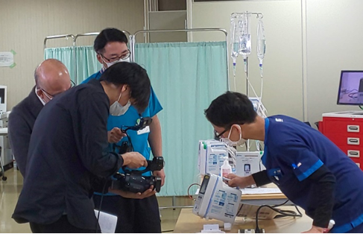
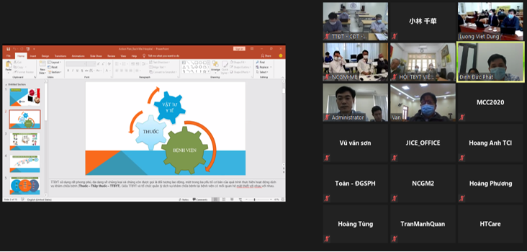

Description
Our Department of Clinical Engineering has been providing technical support for medical device management at Bach Mai Hospital, a national hospital in Hanoi, Vietnam, since 2017.
We planned online training as an effective support method in the COVID 19 pandemic where we cannot come and go.
We conducted meetings, video distribution and e-learning online, and were able to obtain good results.
YOUTUBE LIVE
Notes:
Originally, there were no laws and regulations regarding medical device management in Vietnam. Medical device management was conducted by each facility’s standards.
Therefore, since 2017, our Department of Clinical Engineering has been providing technical support for medical device management at Bach Mai Hospital, a national hospital in Hanoi, Vietnam.
This technical support mainly consists of sending Japanese experts such as clinical engineers, doctors, and nurses to local sites and conducting personnel exchanges that bring Vietnamese biomedical engineers and doctors to Japan for training.
However, there have been restrictions on overseas travel due to the COVID 19 pandemic since the beginning of 2020, so we planned to provide our support online, which has included conducting meetings, video distribution, and e-learning.
Consequently, we were able to obtain good results.
The activity funds for these projects have been contributed by the “Project for global growth of medical technologies, systems, and services” of the Japanese Ministry of Health, Labour, and Welfare.

Slide 4
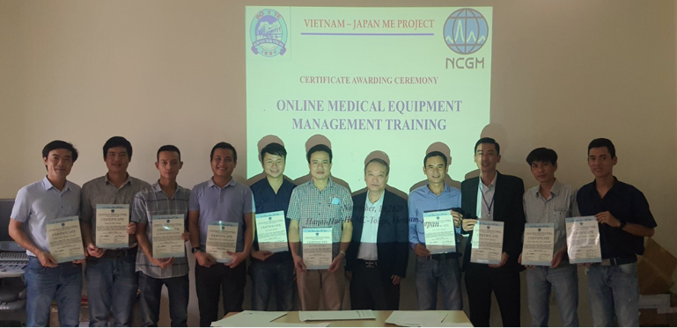
Goals of the project and final users that will benefit
Goals Noted in the Abstract Submission
Being able to provide effective technical support online.
Those who are likely to benefit from this work
Biomedical engineers (BMEs), clinical engineers (CEs), and educators involved in medical device management and educational guidance.
As a result,
It helps to provide better medical care to Vietnamese people.
Notes:
The goals of the project were set as being able to provide effective technical support online because personnel exchanges cannot take place.
The targets of this online technical support are biomedical engineers (BMEs), clinical engineers (CEs), educators, and government officials.
BMEs and CEs play a role in inspecting and repairing the medical devices in a hospital. Educators are responsible for training BMEs and CEs. Government officials are in charge of creating and implementing rules for medical device management.
Originally, the targets were those involved with specific facilities, but we drew up the project to expand the range of targets to anyone involved throughout Vietnam by taking advantage of the online system where anyone can participate regardless of location.
As a result, we believe that supporting these people will lead to higher-quality medical care being provided to the Vietnamese people.

Slide 5



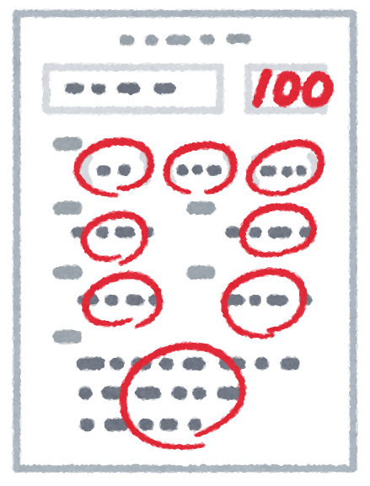


Methods
(1) Use the Zoom web conferencing service to draw up local needs and future plans.
(2) Based on the needs, create and share materials such as videos and
PDFs available on demand.
(3) Use YouTube to distribute LIVE videos for more detailed and practical training.
(4) Administer online tests using Google Forms to measure the effects of training.
Executed during the period from April 2020 to January 2021
Notes:
Now, I am going to show you the specific methods.
(1) Firstly, use the Zoom web conferencing service to draw up local needs and future plans.
(2) Based on the needs, create and share materials such as videos and PDFs available on demand.
(3) Use YouTube to distribute live videos for more detailed and practical training.
(4) Administer online tests using Google Forms to measure the effects of training.
These four methods were executed during the period from April 2020 to January 2021.

Slide 6
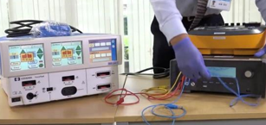
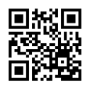
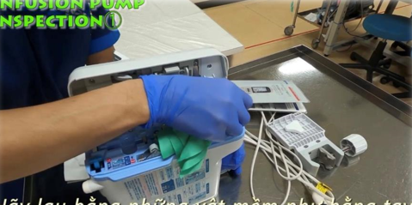
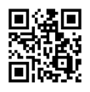
Results 1
The main themes of the web conferences, were as follows :
1) Maintaining and managing dialysis water treatment
2) Maintaining and managing mechanical ventilators
3) Maintaining and managing infusion pumps
4) Inspecting electrical safety
E.g.) Oct 8, 2020​ LIVE electrical safety inspection
Web conferences | 8 times
On-demand materials | 47 materials
On-demand videos | About 1,700 views for 25 videos
LIVE video distribution | 3 times
Level of understanding tests | 4 times in total : one test for each theme
Total participants | 468 people
Details of participants | 303 BMEs, 88 educators, and 33 researchers
Participating facilities | 41 facilities
https://youtu.be/qq0OuqyCfmA
E.g.) “Daily inspection of infusion pump”
https://youtu.be/lUgXhQXz6wU
Notes:
Here are the results.
Eight online meetings took place, and in accordance with the local needs, we set four main themes which were “Maintaining and managing dialysis water treatment”, “Maintaining and managing mechanical ventilators”, “Maintaining and managing infusion pumps”, and “Inspecting electrical safety”.
In addition, 25 newly created on-demand videos, including videos related to the themes, as well as videos created from materials used thus far, were viewed a total of 1,700 times.
A total of around 468 people from 41 facilities in various areas such as the northern, central, and southern parts of Vietnam participated in the training.
The picture on the right shows an example of the on-demand and live videos. You can access them by reading the QR code from a smartphone camera.

Slide 7
Results 2
40%
57.5%
%
Participants’ level of understanding exceeded 80% after every training session, and 95.7% of participants rated the training contents “good”.
There were points where the accuracy rate declined because the questions were inappropriate due to cultural differences. In addition, some questionnaire replies indicated that the training might be less valuable without access to equipment and inspection devices.
Notes:
Here are the level of understanding tests and questionnaires carried out after the training was provided.
For the level of understanding tests, participants answered 10 questions related to the training that were created with Google Forms.
As a result, the average level of understanding for each training session exceeded 80 percent.
Regarding the evaluation questionnaire, participants evaluated the training contents on a scale from 1 to 4, and 95.7 percent of the respondents evaluated them as “good”.
There were points where the accuracy rate declined because the questions were inappropriate due to cultural differences. In addition, some questionnaire replies indicated that the training might be less valuable without access to equipment and inspection devices.

Slide 8
Conclusions
As many facilities throughout Vietnam participated in these efforts, and the training evaluation was favorable, we consider this to be an adequate business plan.
Including this project, all of our efforts thus far have produced good outcomes. And in Vietnam in 2021, the Ministry of Health started distributing official notices regarding medical device management.
Because of this, we are hopeful that proper medical device management will become common, and that many Vietnamese people will be able to have access to high-quality medical care services. Furthermore, we will continue to flexibly work together in various ways as much as possible.
Notes:
As many facilities throughout Vietnam participated in these efforts, and the training evaluation was favorable, we consider this to be an adequate business plan.
Including this project, all of our efforts thus far have produced good outcomes. And in Vietnam in 2021, the Ministry of Health started distributing official notices regarding medical device management.
Because of this, we are hopeful that proper medical device management will become common, and that many Vietnamese people will be able to have access to high-quality medical care services. Furthermore, we will continue to flexibly work together in various ways as much as possible.

Slide 9
Tatsunori Ogawa
togawa@hosp.ncgm.go.jp
Department of Clinical Engineering,
National Center for Global Health and Medicine, Japan
Notes:
That is all for my presentation.
I would like to express my appreciation to all of you involved for giving me the opportunity to make this presentation.
Thank you so much.

