Slide 1

Technical validation process for emergency use, critical care ventilators in Mexico
ROBERTO AYALA
CE-HTM Consultant

Slide 2
The Team / Workgroup
Roberto Ayala, CE-HTM Consultant
Biomedical Engineer with clinical engineering specialty from Mexico.
30 years of experience in the field of medical equipment management and Clinical Engineering. Technology manager in one of the largest private hospitals companies in Mexico participating in the start up of more than 9 new hospitals. Responsible for the Biomedical Engineering area in an agency of the Ministry of Health of Mexico (CENETEC, a WHO/PAHO Collaborating Center), participating in the design of policies, guidelines, and recommendations for the management of medical equipment, with emphasis on public health care facilities. He has published articles in diverse scientific journals and is the co-author of a book on Clinical Engineering.
Collaborator with international bodies, such as the WHO, PAHO and the IFMBE-CED.

Slide 3
Description
Review of the validation process of technical specifications for locally manufactured ventilators in Mexico, in order to obtain a temporary sanitary authorization from the national health regulatory agency, for emergency use during the COVID-19 pandemic.

Slide 4
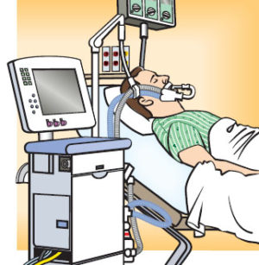
Background
Establishment of a regulatory framework and technical review process for locally manufactured critical care ventilators in Mexico
The health regulatory authority, COFEPRIS, led the process with help from the National Science and Technology Council, CONACYT

Slide 5
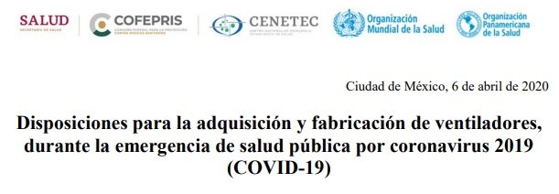
Technical validation process for emergency use critical care ventilators in Mexico – Route Map
Establishment of technical specifications based on recommendations by WHO, PAHO, AAMI, MHRA and CENETEC.
Guidelines for acquisition and local manufacturing by COFEPRIS
Process sequencing for validation of locally manufactured ventilators (3 phases)
Review group formed by Clinical Engineers from MoH, healthcare institutions and professional association
https://www.gob.mx/cofepris/es/articulos/disposiciones-para-la-adquisicion-y-fabricacion-de-ventiladores-durante-la-emergencia-de-salud-publica-por-coronavirus-2019-covid-19-239776?idiom=es

Slide 6
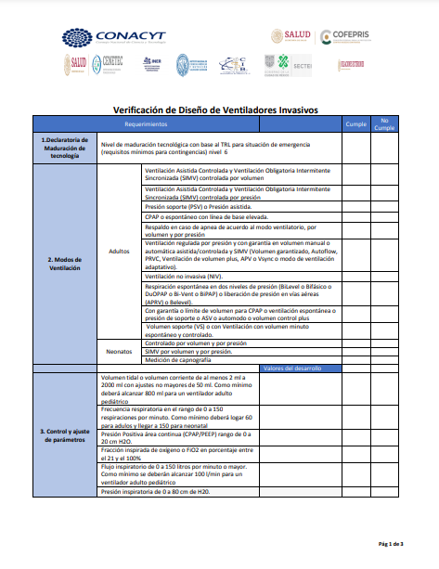
Technical validation process for emergency use critical care ventilators in Mexico – Phase 1 of 3 process
Phase 1: Validation of technical design of manufactured ventilators
  Review of technical documentation for compliance of minimal specs for safe and efficiency assurance (ventilation modes, parameters range, alarms, gas connection, electrical safety, biocompatibility, mechanical safety, etc.
https://www.gob.mx/cofepris/es/articulos/informacion-sobre-los-lineamientos-de-ventiladores-actualizacion-9-de-mayo?idiom=es

Slide 7
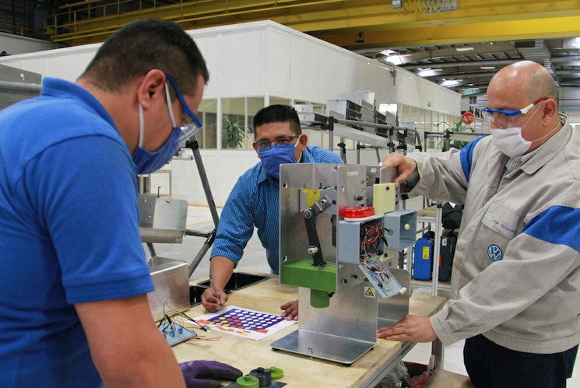
Results
36 reviewed proposals
  9 approved
    4 AMBU based and 5 other pneumatic mechanisms
  8 not approved
  7 not applicable
  12 pending
Clinical Engineering proved its value as experts in the field.

Slide 8
Roberto Ayala
rap6701@gmail.com
CE-HTM Consultant, Mexico

